Slide 1
ENTERPRISE SYSTEMS
Hadeel elgerbi

Slide 2
objectives
Logistics Fields
Production logistics
Manufacturing Logistics
Shortening Life Cycles

Slide 3
Logistics Fields
production logistics : which is the flow of materials inside a factory or business.
recovery logistics which is the return flow of returns from consumers and waste, and recycling logistics which is the flow of recyclable materials.
sales logistics that moves products from the producer to the consumer.
procurement logistics which is the flow of raw materials and parts.

Slide 4
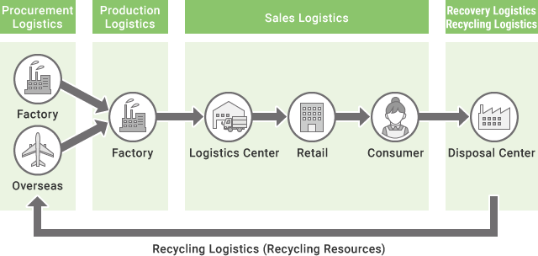

Slide 5
Production logistics
Production logistics is the flow of goods that includes the management of procured parts and materials, distribution inside a factory, product management, packaging, and shipping to warehouse.
Delivery management, warehouse dispatch management, and shipping management can be optimized and the state of delivery vehicles can be managed by smoothly linking procurement logistics and sales logistics.

Slide 6
Manufacturing Logistics
Manufacturing logistics refers to all planning, coordination and service functions required to carry out manufacturing activities.
The temporal scope of manufacturing logistics begins from the point where end-item customer demands are determined, and extends to the point where the demands are fulfilled.
In this process, the flow of material, information, and service may move across enterprise, industry and national boundaries

Slide 7
Manufacturing Logistics
manufacturing logistics includes the planning, scheduling and control of all activities resulting in the acquisition, processing, movement and storage of inventory.
These activities include order acceptance, production planning and scheduling, inventory control, inventory distribution, and the design of the corresponding decision processes and decision support systems.

Slide 8
Globalization
Globalization presents new opportunities to logistics operations, but it also poses serious threats and increases scope, instability and complexity (Cohen and Huchzermeier, 1999).
Multi-national logistics considerations include currency valuation, labor force capabilities, tax laws, international treaties and trade agreements, engineering practices and business conventions, environmental and union regulations.
globalization is fast emerging as the norm for all major corporations.

Slide 9
Product Proliferation and Shortening Life Cycles
companies are maximizing market leverage and penetrating new markets by developing new products in larger numbers, compressing product development times, and shortening product life cycles.
For example, electronics, computer products now have an average product life cycle shorter than 18 months.
These trends complicate manufacturing operations , New products are introduced and old products are phased out continually, so operational efficiency is a constant challenge.

Slide 10
Product Proliferation and Shortening Life Cycles
Product proliferation represents a significant change in the market place.
As product variety increases while volume decreases, setup time and setup cost both become a more significant issue, and planning efficient production become more difficult.
Process consolidation, design alternation, flexible layout configurations are among the steps currently being taken to address these problems.

