Slide 1
ENTERPRISE SYSTEMS
Hadeel elgerbi

Slide 2
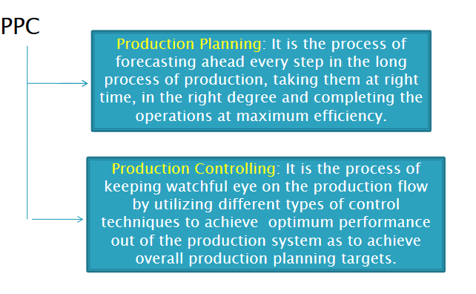
Production planning and control

Slide 3
Production planning and control
It is the nervous system of a production operation.
The primary concern of production ,planning and control is the delivery of products to customers or to inventory stocks according to some predetermined schedule

Slide 4
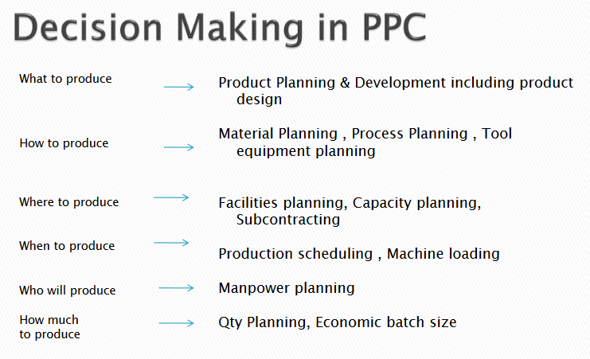

Slide 5
characteristics
Inputs like materials, men and machines are efficiently used.
Factors of productions are integrated to use them economically Division of work is undertaken carefully so that every available element is properly utilized.
Work is regulated from the first stage of raw material to the stage of finished goods.
Questions like what, when and how to be manufactured are decided.

Slide 6
Objectives of PPC
  Optimum utilization of organizational resources.
  Continuous Flow of Production.
  Deliver good quality product at minimum cost.
  Reduce production cycle time.
  Flexibility in production processes.
  Coordination between various departments.
  Optimum Inventory Levels.
  Plan for future requirements.
  Remove bottlenecks of production.
  Customer Satisfaction.
  Production and Employment Stabilization.

Slide 7
SCOPE of Production planning and control
Material
Method
Machine and equipment
Manpower
Estimation
Routing
Loading and Scheduling
Dispatching
Expediting
Inspection

Slide 8
Role of PPC
Taking orders from marketing division.
Analyzing the orders & feeling the requirements of customer.
Planning for production.
Cost analysis & lead time.

Slide 9
Benefits of PPC
Effective utilization of resources.
Minimizing the wastage.
Proper coordination.
Quality products produced.
Provide better environment.
Estimation of resources.
Smooth flow of production.
Increases labor productivity.

Slide 10
Disadvantages of PPC
Based on assumptions.
Rigid.
Time consuming.
Costly.
Difficult for small firms.
Dependence on external factors.

