Slide 1
Lecture8
Mobile Network Architecture

Slide 2
FREQUENCY REUSE
Each cell has a base transceiver.
The transmission power is carefully controlled, to allow communication within the cell.
The objective is to use the same frequency in other nearby cells.
Adjacent cells assigned different frequencies to avoid interference.
10 to 50 frequencies assigned to each cell .
The issue is to determine how many cells must intervene between two cells using the same frequency.

Slide 3
Fig1. Frequency Reuse Patterns

Slide 4
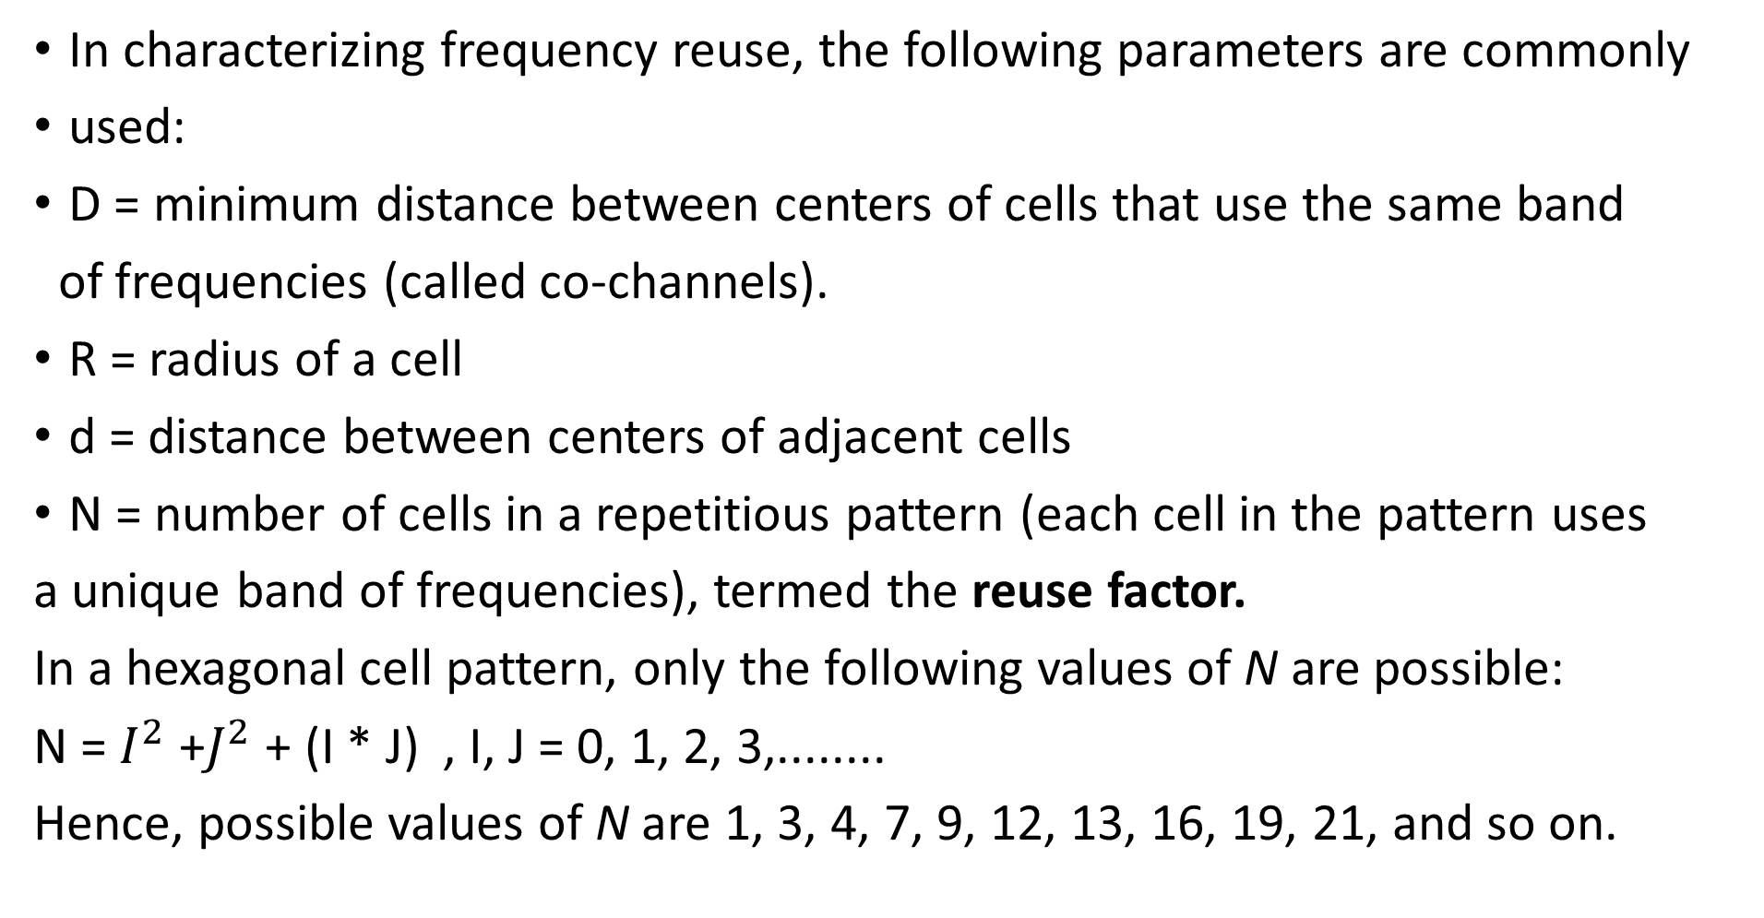
In characterizing frequency reuse, the following parameters are commonly
used:
D = minimum distance between centers of cells that use the same band
of frequencies (called co-channels).
R = radius of a cell
d = distance between centers of adjacent cells
N = number of cells in a repetitious pattern (each cell in the pattern uses
a unique band of frequencies), termed the reuse factor.
In a hexagonal cell pattern, only the following values of N are possible:
N = $I^{2}$+$J^{2}$+ (I * J) , I, J = 0, 1, 2, 3,........
Hence, possible values of N are 1, 3, 4, 7, 9, 12, 13, 16, 19, 21, and so on.

Slide 6

The following relationship holds:-
$\frac{D}{R}$=$\sqrt{3N}$
This can also be expressed as D/d =$\sqrt{N}$

Slide 7
Each cell can have K/N frequencies, where K is the total number of frequencies allotted to the system, for example K= 395 and N=7 this implies that there can be at most 57 frequencies per cell on average.
Problem
Assume a system of 32 cells with a cell radius of 1.6 km, a total of 32 cells, a total frequency bandwidth that supports 336 traffic channels, and a reuse factor of N=7 If there are 32 total cells, what geographic area is covered, how many channels are there per cell, and what is the total number of concurrent calls that can be handled?

Slide 8
Frequency Assignment
Aim: To increase the number of available channels without compromising the quality of service e.g.
1) Efficient Utilization of Spectrum.
2) Increase Capacity.
3) Minimize Interference.

Slide 9
Increasing Capacity
To provide more channels per unit coverage area:-
Adding new channels: typically, when a system is set up in region, not all of the channels are used, and growth and expansion can be in orderly fashion by adding new channels.
•Frequency borrowing:-frequencies are taken from adjacent cells by congested cells. The frequency can also be assigned to cells dynamically.
Cell splitting :-cells in areas of high usage can be split into smaller cells.
Generally, the original cells are about 6.5 to 13 km in size. The smaller cells can themselves be split; however, 1.5-km cells are close to the practical minimum size as a general solution.
This is usually done to make more voice channels available to accommodate traffic growth (too much blocking of calls) in the area covered by the original cell. The smaller cells can themselves be split;

Slide 10
If the radius of a cell is reduced from R to R/2, the area of the cell is reduced from Area to Area/4.
The power level used must be reduced.
As a mobile moves from cell to cell, which requires transferring of call from one base transceiver to another (Handoff) . Handoffs becomes much more frequent.

Slide 11
Fig2. Cell Splitting

Slide 12
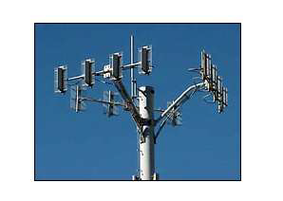
Cell sectoring:-
Cells are divided into a number of wedge-shaped sectors, each with their own set of channels Typically three or six sectors per cell. Each sector is assigned a separate subset of the cell’s channels. Direction antenna are used at the base station to focus on each sector.
Fig3. Cell sectoring

Slide 13
Microcells:
As cells become smaller, antennas move from the tops of tall buildings or hills, to the tops of small buildings or the sides of large buildings, and finally to lamp posts, where they form microcells.
Each decrease in cell size is accompanied by a reduction in the radiated power levels from the base stations and the mobile units. Microcells are useful in city streets in congested areas, along highways, and inside large public buildings.

Slide 14
Table 1 suggests typical parameters for traditional cells, called macrocells, and microcells with current technology. The average delay spread refers to multipath delay spread (i.e., the same signal follows different paths and there is a time delay between the earliest and latest arrival of the signal at the receiver). As indicated, the use of smaller cells enables the use of lower power and provides superior propagation conditions.

Slide 15
Operation of Cellular Systems:-
Mobile unit initialization
Mobile-originated call
Paging
Call accepted
Ongoing call
Handoff

Slide 16
Fig3.Overview of Cellular System.

Slide 17
Mobile unit initialization:
When mobile unit is turned on, it scans and selects the strongest setup control channel and monitors that channel.
The effect of this procedure is that the mobile unit has automatically selected the BS antenna of the cell within it will operate.
Then a handshake takes place between the mobile unit and the MTSO controlling this cell, through the BS in this cell. The handshake is used to identify the user and register its location.
As long the mobile unit is on, this procedure is repeated periodically to count for the motion of the unit.

Slide 18
Fig 4.Example of Mobile Cellular Call

Slide 19
Mobile-originated call:
A mobile unit originates a call by sending the number of the called unit on the preselected setup channel.
The receiver circuit at the mobile unit first checks that the setup channel is idle by examining information in forward (from BS) Channel.
When idle condition is detected, the mobile may transmit on the corresponding reverse (to BS) Channel.
The BS sends the request to the MTSO.

Slide 20
Paging:-
The MTSO then attempts to complete the connection to the called unit, sending a paging message to certain BSs depending on the called mobile unit number. Each BS transmits the paging signal on its own assigned setup channel.

Slide 21
Call accepted:
The called mobile unit recognizes its number on the setup channel being monitored and responds to that BS, which sends the response to the MTSO. The MTSO sets up a circuit between the calling and called BSs, and also selects an available traffic channel within each BS's cell and notifies each BS, which in turn notifies its mobile unit .

Slide 22
Ongoing call
While the connection is maintained, the two mobile units exchange voice or data signals, going through their respective BSs and the MTSO (Figure 4e).
Handoff:
If a mobile unit moves out of range of one cell and into the range of another during a connection, the traffic channel has to change to one assigned to the BS in the new cell (Figure 4f).The system makes this change without either interrupting the call or alerting the user.

Slide 23
Other functions performed by the system:
Call blocking: During the mobile-initiated call stage, if all the traffic channels assigned to the nearest BS are busy, then the mobile unit makes a preconfigured number of repeated attempts. After a certain number of failed tries, a busy tone is returned to the user.
Call termination: When one of the two users hangs up, the MTSO is informed and the traffic channels at the two BSs are released.
Call drop: During a connection, because of interference or weak signal spots in certain areas, if the BS cannot maintain the minimum required signal strength for a certain period of time, the traffic channel to the user is dropped and the MTSO is informed.

Slide 24
Calls to/from fixed and remote mobile subscriber: The MTSO connects to the public switched telephone network. Thus, the MTSO can set up a connection between a mobile user in its area and a fixed subscriber via the telephone network. Further, the MTSO can connect to a remote MTSO via the telephone network or via dedicated lines and set up a connection between a mobile user in its area and a remote mobile user.

Slide 25
Mobile Radio Propagation Effects
Mobile radio communication introduces complexities not found in wire communication or in fixed wireless communication. Two general areas of concern are signal strength and signal propagation effects.
Signal strength:
strength of the signal between base station and mobile unit must be:
strong enough to maintain signal quality at the receiver
–not be so strong as to create too much co-channel interference with channels in another cell using the same frequency band.
The signal strength varies As a function of distance from BS to a mobile within its cell.
dynamically as the mobile unit moves.

Slide 26
Fading
Signal propagation effects may disrupt the signal and cause errors.

