Slide 1
Lecture 7
Mobile Network Architecture

Slide 2
Wireless System Terminology
Mobile Station
A station in radio service intended for use while in motion at unspecified locations. They can be either hand-held personal units (portables) or installed on vehicles (mobiles).
Low-power transmitter/receiver for voice and data.
Communicating wirelessly through a collection of base stations.
Base stations
Stationary, ground-based sites linked to neighboring sites.
Connected to and controlled by MSCs.
Cell
Logical way of thinking about a coverage region (usually hexagonal).
Base station coverage areas.

Slide 3
SIM (Subscriber Identity Module)
The SIM is a physical card that is inserted into a mobile device.
It contains a unique identifier called the SIM number or ICCID (Integrated Circuit Card Identifier), which identifies the SIM card itself.
The SIM card stores the subscriber's authentication information, such as the IMSI.

Slide 4
Cont..
IMSI(International Mobile Subscriber Identity).
The IMSI is a 15-digit number that uniquely identifies a mobile subscriber within a cellular network. It is stored on the SIM (Subscriber Identity Module) card of the mobile device.
The IMSI is composed of three main parts:
Mobile Country Code (MCC) - 3 digits
Mobile Network Code (MNC) - 2 or 3 digits
Mobile Subscriber Identification Number (MSIN) - up to 10 digits

Slide 5
Purpose:
The IMSI is used to uniquely identify a subscriber and their associated subscription information.
It is used for various network operations, such as:
Authentication and authorization of the subscriber
Tracking the subscriber's location for efficient call routing
Providing subscriber-specific services and features.

Slide 6
MSISDN (Mobile Subscriber Integrated Services Digital Network Number):
The MSISDN is the full international phone number of the mobile subscriber, including the country code.
This is the unique identifier assigned to a mobile subscriber by the network operator.
It is a longer number that includes the country code, national destination code, and the subscriber number.
The MSISDN is used by the network to identify and route calls, SMS, and other services to the subscriber.
Example: +1 555 123 4567

Slide 7
Mobile Number
This is the actual phone number associated with the subscriber's mobile device.
It is the subscriber number component of the MSISDN, without the country and national destination codes.
The mobile number is the number that people use to directly call or send messages to the subscriber's mobile device.
Example: 123 4567

Slide 8
Subscriber
A user who pays subscription charges for using a mobile communication system.
Transceiver
A device capable of simultaneously transmitting and receiving radio signals.
Radio channel used for transmitting information from the base station to the mobile.
Control Channel
Radio channel used for transmission of call setup, call request, call initiation and other control purposes and maintaining calls with establishing a relationship between a mobile unit and nearest BS.
Two types of control channels available between mobile unit and BS
Forward Channel
Radio channel used for transmitting information from the base station to the mobile

Slide 9
2.Reverse Channel
Radio channel used for transmitting information from mobile to base station.
Traffic channels
carry voice or data connection between users.

Slide 10
Simplex Systems
Communication systems that provide only one-way of communication (TV broadcast Channels).
Half Duplex Systems
Communication Systems that allow two-way communications.
It uses the same radio channel for both transmission and reception.
At any given time, the user can either transmit or receive information.
Full Duplex Systems
Communication systems that allow simultaneous two-way communication.
Transmission and reception is typically on two different channels (FDD).
Handoff
While in connection the handoff is the process of transferring a mobile user from one
channel to another or base station to another.

Slide 12
Roaming:
It extends the connectivity service in a location that is different from the home location where the service was registered.
Roaming ensures that the wireless device is kept connected to the network
The connection to the network is only provide in place where the roaming service is purchased.
Cell Site:
The location where a wireless antenna and network communication equipment's are placed in order to provide wireless service in a geographic area.
Repeater
Devices that receive a radio signal, amplify it and re-transmit it in a new direction.
Used in wireless networks to extend the range of base station signals and to expand coverage.
Repeaters are typically used in buildings, tunnels, or difficult terrains.

Slide 13
Smart Antenna
A wireless antenna with technology that focuses its signal in a specific direction. Wireless networks use smart antennas to:-
Reduce the number of dropped calls.
Improve call quality, and Increase channel capacity.

Slide 14
Overview of Cellular system (GSM Network)
The Mobile Station:-
Is the mobile component of the GSM system and includes the Mobile Equipment (ME) and the Subscriber Identity Module (SIM).
Base Station Subsystem includes :-
- Base Transceiver Stations (BTS).
Base Switching Centers (BSC).
Base Station Subsystem interfaces with:
Mobile Station and manages the mobility of the Mobile Equipment across different Base Transceiver Stations.
Network Subsystem to connect to the external networks and other services.

Slide 15
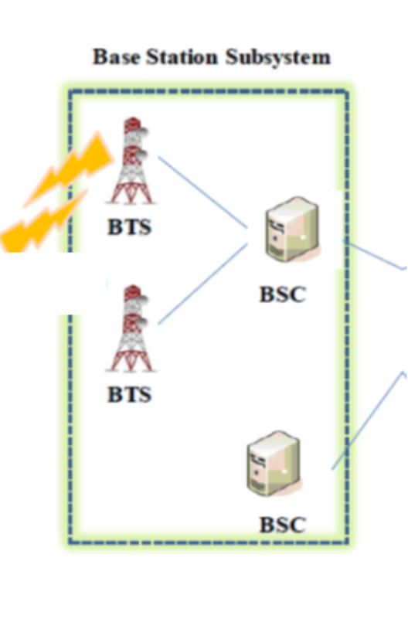
Network Subsystem is the core of the GSM system. provides functionalities such as:-
- call connections.
-management of subscribers.
mobility.
Base Station Subsystem (BSS)
-BSS consists of base station controller and one or more base transceiver stations (BTS).
-Includes radio antenna, radio transceiver and a link to a base station controller (BSC).
-BSC reserves radio frequencies, manages handoff of mobile unit from one cell to another within BSS, and controls paging. (Paging Systems are wireless communication systems that are designed to send brief messages to a user. It's a one-way messaging system in which Transmitters send messages to all users)

Slide 16
Network Subsystem:-
Interfaces with the other networks:
Public Switched Telephone Network (PSTN).
Internet and other data networks.
These functionalities are implemented through the core components.

Slide 17
Mobile switching centers (MSCs) (mobile telephone switching offices—MTSOs)
Establish call connections
The MSC is responsible for setting up and managing call connections for mobile subscribers, both for roaming and non-roaming users.
Coordinate all base stations
The MSC coordinates the activities of all the base stations (cell sites) within its serving area, including handling handovers and ensuring seamless service continuity(Handover Management,).
Provide links to the wired telephone network and the Internet
Keep calling and billing records.
The MSC maintains detailed records of all calls and transactions made by mobile subscribers within its serving area. This information is used for billing purposes and to support various network management and optimization functions.
The switching functions of the system and controls calls to and from other telephone and data systems.

Slide 18
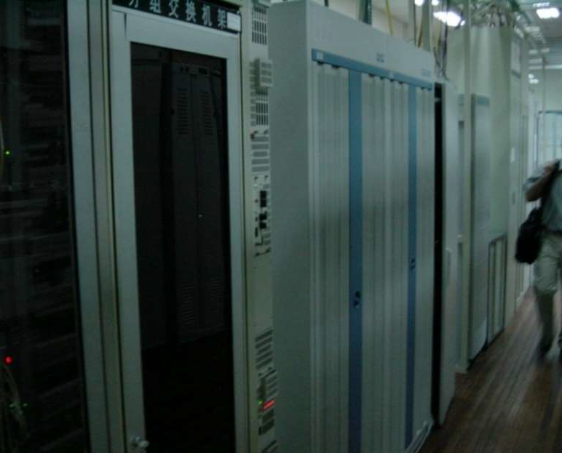
(cont..)Mobile Switching Center (MSC):
Deliver the short message to the specific mobile subscriber through the proper base station.
Provides functions such as registration, authentication,
Location updating, handovers and call routing to a roaming subscriber

Slide 19
Network Subsystem
Home Location Register (HLR)
The HLR is a central database that contains the master copy of all the subscriber information for a mobile network operator's subscribers.
Stores all permanent subscriber data.
The HLR contains all the administrative information including their phone number, account information, and service subscriptions and current location of each subscriber registered in the corresponding GSM network.
When a subscriber roams into a different network area, the VLR in that area communicates with the subscriber's HLR to obtain their profile and enable service(Activating the subscriber's subscribed services (e.g., voice calls, SMS, data services)

Slide 20
Visitor Location Record (VLR):-
The VLR is a temporary database used in mobile networks that stores information about mobile subscribers who have roamed into a specific geographic area covered by that VLR.
When a mobile subscriber roams into a new area, their mobile device registers with the local VLR. which then communicates with the subscriber's Home Location Register (HLR) to authenticate the subscriber and obtain their subscriber profile..
Subscription information needed for call control, for all mobiles in the area of the associated MSC.
This information is needed by the MSC to service visiting subscribers.

Slide 21
Authentication Center (AuC):
used in the security management Stores the secret key held in each user’s SIM card.
Equipment Identity Register (EIR):
EIR is a database that contains a list of all valid mobile equipment on the network.
HLR – database of all users + current location. One per network
VLR – database of users + roamers in some geographic area.
Caches the HLR
EIR – database of valid equipment.
AuC – Database of users’ secret keys.

Slide 22
Cellular Geometries: Design Considerations
Spectral Sharing
Time division (TD), Code Division (CD) or hybrid
Reuse Distance
Distance between cells using the same frequency, timeslot, or code
Smaller reuse distance packs more users into a given area, but also increases co-channel interference
Cell radius
Decreasing the cell size increases system capacity, but complicates routing and handoff

Slide 23
Common multiple access schemes used in cellular systems include CDMA (Code Division Multiple Access), OFDMA (Orthogonal Frequency Division Multiple Access), and TDMA (Time Division Multiple Access).

Slide 24
Cellular Geometries
The first design decision to make is the shape of cells to cover an area.
Use multiple low-power transmitters (100 W or less). Because the range of such a transmitter is small.
Areas divided into cells
served by its own antenna
Each Served by base station consisting of transmitter, receiver, and control unit
Band of frequencies allocated
Cells set up such that antennas of all neighbors are equidistant (hexagonal pattern)

Slide 25
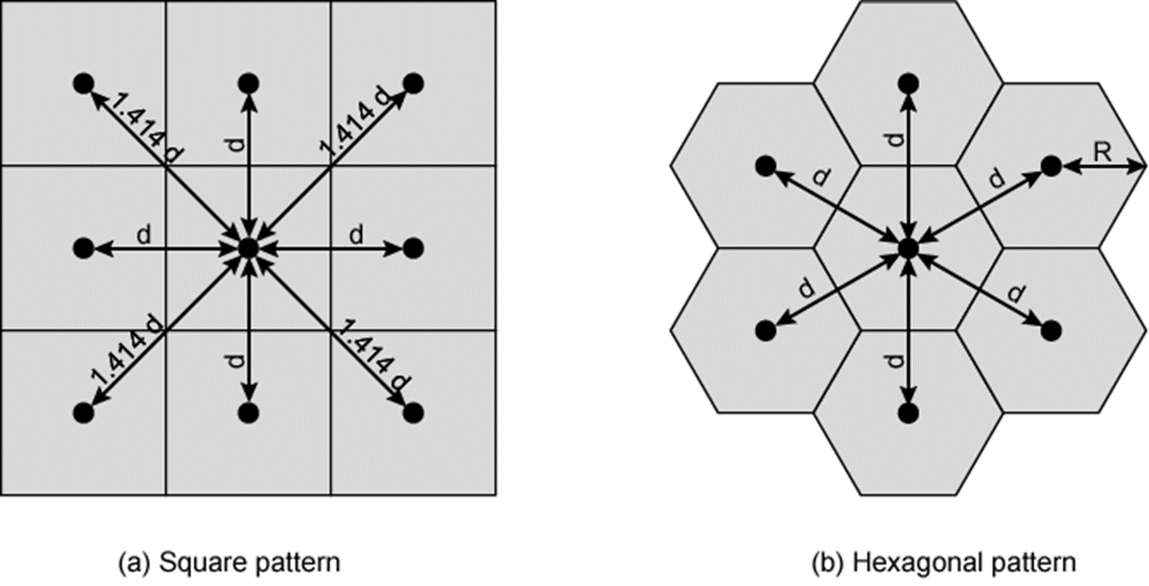

Slide 26
Adjacent Cells are assigned different frequencies to avoid interference or crosstalk.
Cells sufficiently distant from each other can use the same frequency band.
It is best if all of adjacent cells are equidistant

Slide 27
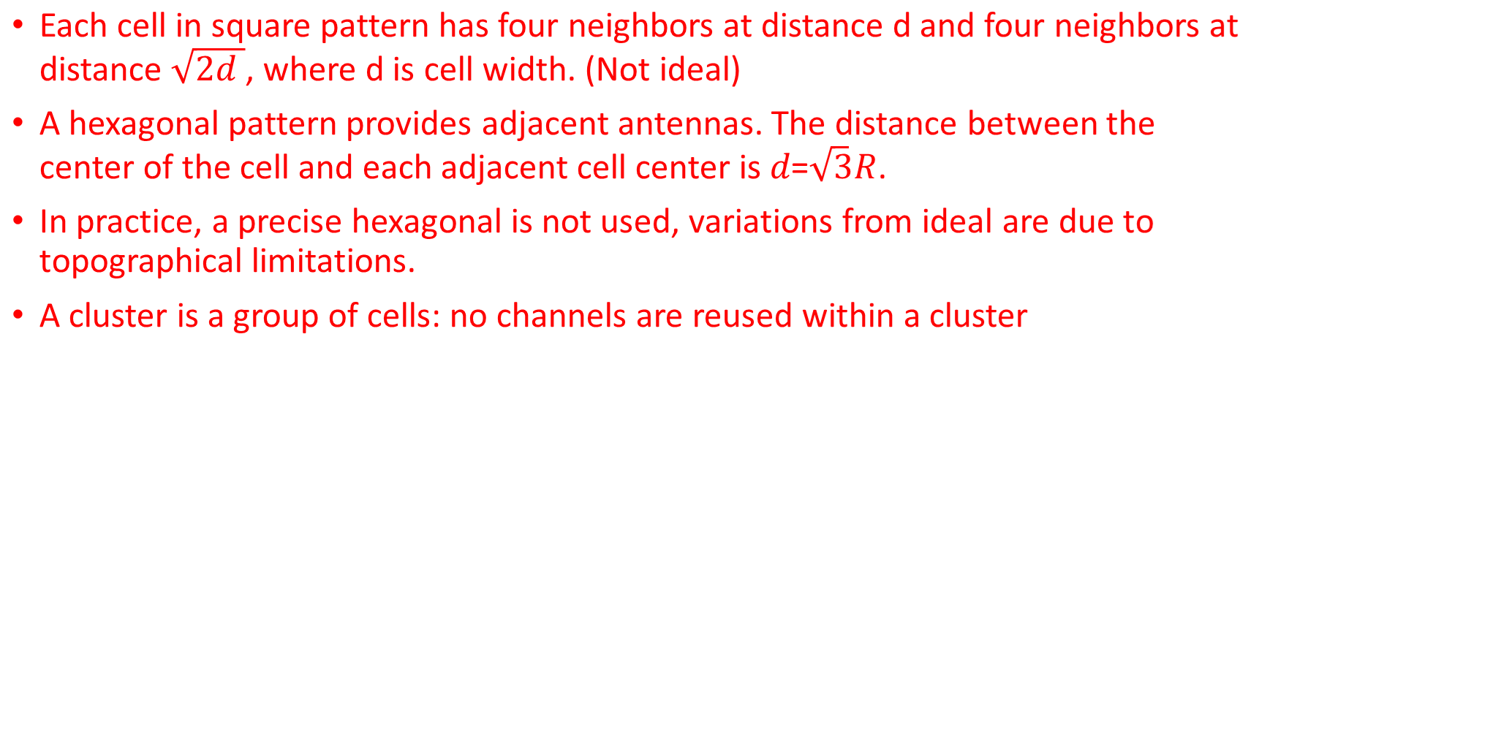

Slide 28
A seven Cell Cluster

