Slide 1
Lecture6
Introduction Of Wireless Lan Network

Slide 2
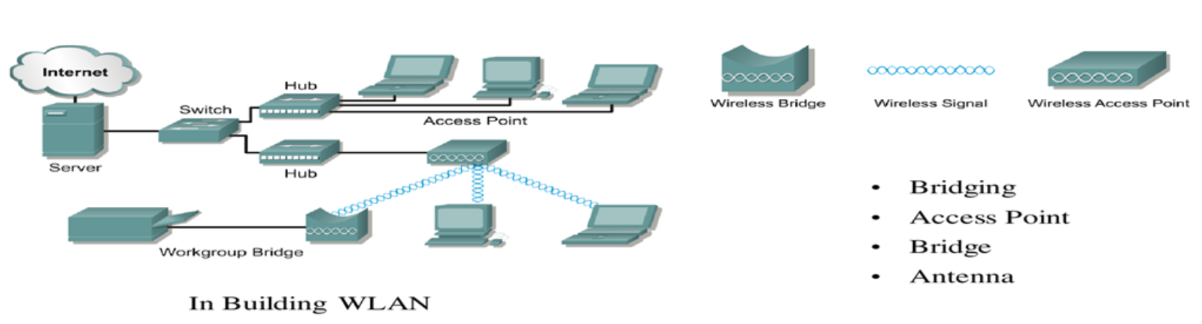
Introduction
A wireless LAN (WLAN) is a wireless computer network that links two or more devices using wireless communication to form a local area network (LAN) within a limited area.
Most modern WLANs are based on IEEE 802.11 standards and are marketed under the Wi-Fi brand name(Wi-Fi).
The Wi-Fi Alliance is a non-profit organization that owns the Wi-Fi trademark
IEEE 802.11 supports two modes of network topology: infrastructure and ad hoc, also called independent (IBSS) mode., In infrastructure mode all 802.11 transceivers are in the direct range of an access point.that handles all nodes within its range.
Fig 1 WLAN Architecture

Slide 3
Cont ..
In ad hoc mode, 802.11 transceivers can communicate directly with each other, without the need for an access point in range. Although most 802.11 transceivers support the ad hoc mode or Independent BSS (also referred to as IBSS), infrastructure mode is mostly used.
Every 802.11 transceiver is associated with one of the access points. Communication between nodes goes through the access points or directly over the radio medium. If nodes are in range of each other, they directly communicate with each other.
Otherwise, they communicate by sending their packets to the access point to which they are associated. Communication with outside networks always goes through the access point.

Slide 4
Physical Layer
The following table are describe the specifications that employ in 802.11 physical layer with data rate .
IEEE 802.11 standard | Year | Max data rate | Range | Operating Frequency Band
802.11b | 1999 | 11 Mbps | 30 m | 2.4 Ghz
802.11g | 2003 | 54 Mbps | 30m | 2.4 Ghz
802.11n (WiFi 4) | 2009 | 600Mbps | 70m | 2.4, 5 Ghz
802.11ac (WiFi 5) | 2013 | 3.47Gpbs | 70m | 5 Ghz
802.11ax (WiFi 6) | 2020 (exp.) | 14 Gbps | 70m | 2.4, 5 Ghz
802.11af | 2014 | 35 – 560 Mbps | 1 Km | unused TV bands (54-790 MHz)
802.11ah | 2017 | 347Mbps | 1 Km | 900 Mhz
all use CSMA/CA for multiple access, and have base-station and ad-hoc network versions

Slide 5
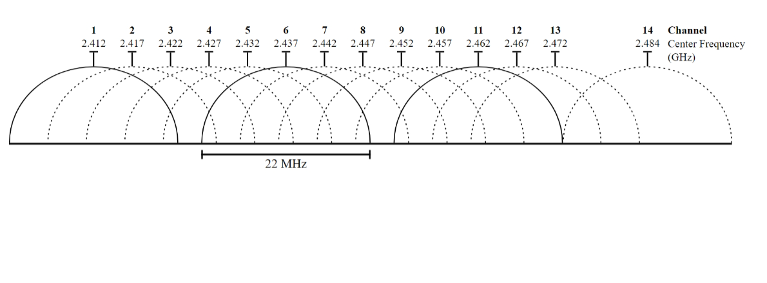
IEEE802.11b/g channels in 2.4 GHz band

Slide 6
Elements of a wireless LAN network
wireless hosts
laptop, PDA, IP phone
run applications
may be stationary (non-mobile) or mobile
  wireless does not always mean mobility
network
infrastructure
Fig2 Elements of a wireless LAN network

Slide 7
Cont..
base station
typically connected to wired network
AP are similar to bridges, but connect many wireless users devices (NICs) to one
network (e.g. Ethernet) and forward all frames received (no filtering).
It responsible for sending packets between wired network and wireless host(s) in its “area”
  e.g., cell towers, 802.11 access points
network
infrastructure
Fig3. Elements of a wireless LAN network

Slide 8
Cont..
wireless link
typically used to connect mobile(s) to base station
also used as backbone link
multiple access protocol coordinates link access
various data rates, transmission distance
network
infrastructure
Fig4 Elements of a wireless LAN network

Slide 9






Cont..
wireless host communicates with base station
  base station = access point (AP)
Basic Service Set (BSS) (aka “cell”) in infrastructure mode contains:
  wireless hosts
  access point (AP): base station
  ad hoc mode: hosts only
  Basic service area (BSA): This is the area that is bound by the reach of the AP’s signal.
Internet
switch
or router
BSS 1
BSS 2
Fig5 Elements of a wireless LAN network

Slide 10
IEEE802.11 - Architecture of an infrastructure network
Basic Service Set
IEEE 802.11 defines the basic service set (BSS) as the building block of a wireless LAN. A basic service set is made of stationary or mobile wireless stations and an optional central base station, known as the access point (AP). (i.e It is a group of stations (devices) that communicate with each other within a wireless network).
The BSS includes an Access Point (AP) and one or more stations that are associated with that AP. Each BSS has a unique identifier called the Basic Service Set Identifier (BSSID), which is typically the MAC address of the AP.)

Slide 11
Service set identifier (SSID): This is a human-readable, non-unique identifier used by the AP to advertise its wireless service.
A BSS without an AP is called an ad-hoc network ; a BSS with an AP is called an infrastructure network.
This consists of a single AP interconnecting all associated wireless clients.

Slide 12
Extended Service Set
An extended service set (ESS) is made up of two or more BSSs with APs. In this case, the BSSs are connected through a distribution system, which is usually a wired LAN. The distribution system connects the APs in the BSSs. IEEE 802.11 does not restrict the distribution system; it can be any IEEE LAN such as an Ethernet.
Each ESS is identified by its ESSID, and each BSS is identified by its BSSID.
Notice that the configuration of the APs to share the same SSID allows wireless clients to roam between BSAs.

Slide 13
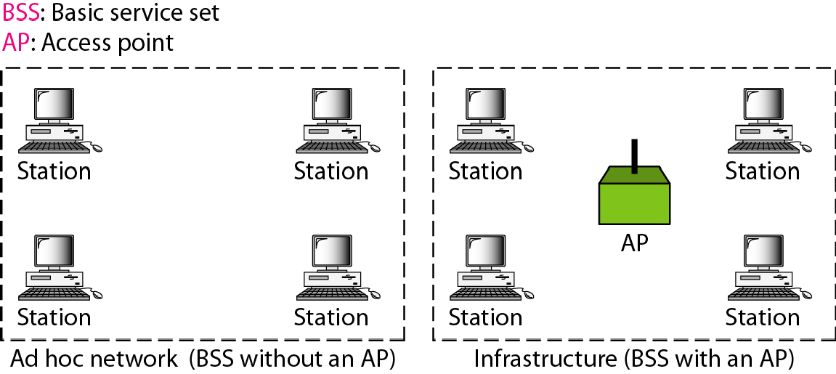
Fig6 Types of wireless LAN network

Slide 14
Distribution system
A distribution system (DS) connects access points in an extended service set. The concept of a DS can be used to increase network coverage through roaming between cells.
An AP with a wired connection to the DS is responsible for translating frames between 802.3 Ethernet and 802.11 wireless protocols.
DS can be wired or wireless. Current wireless distribution systems are mostly based on MESH protocols, ( i.e. such as IEEE 802.11s. These wireless DS solutions allow APs to communicate with each other wirelessly, eliminating the need for a wired backbone infrastructure).

Slide 15
IEEE802.11 - Architecture of an infrastructure network
Fig7 Elements of a wireless LAN network

Slide 16
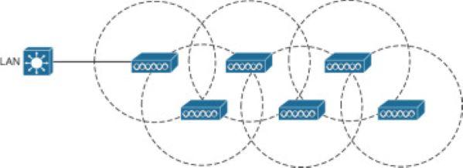
source https://www.ciscopress.com/articles/article.asp?p=2999384&seqNum=4(6-7-2024)
Fig8 Elements of a wireless LAN network

Slide 17
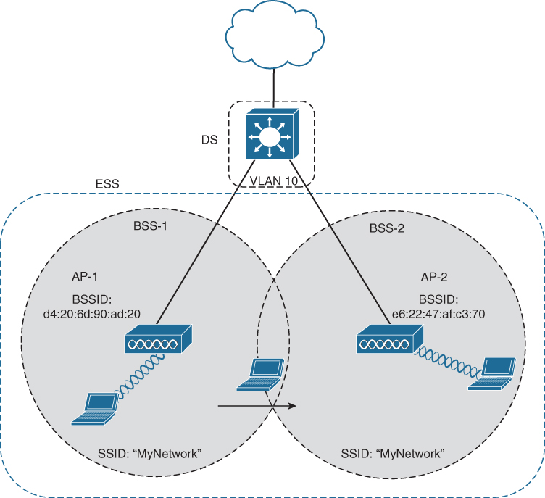
Fig9 SSID , BSSID and BSS in wireless LAN network

Slide 18


IEEE standard 802.11
fixed terminal
mobile terminal
infrastructure network
access point
application
application
TCP
TCP
IP
IP
LLC
LLC
LLC
802.11 MAC
802.11 MAC
802.3 MAC
802.3 MAC
802.11 PHY
802.11 PHY
802.3 PHY
802.3 PHY
Fig10TCP/IP layer of a wireless LAN network

Slide 19
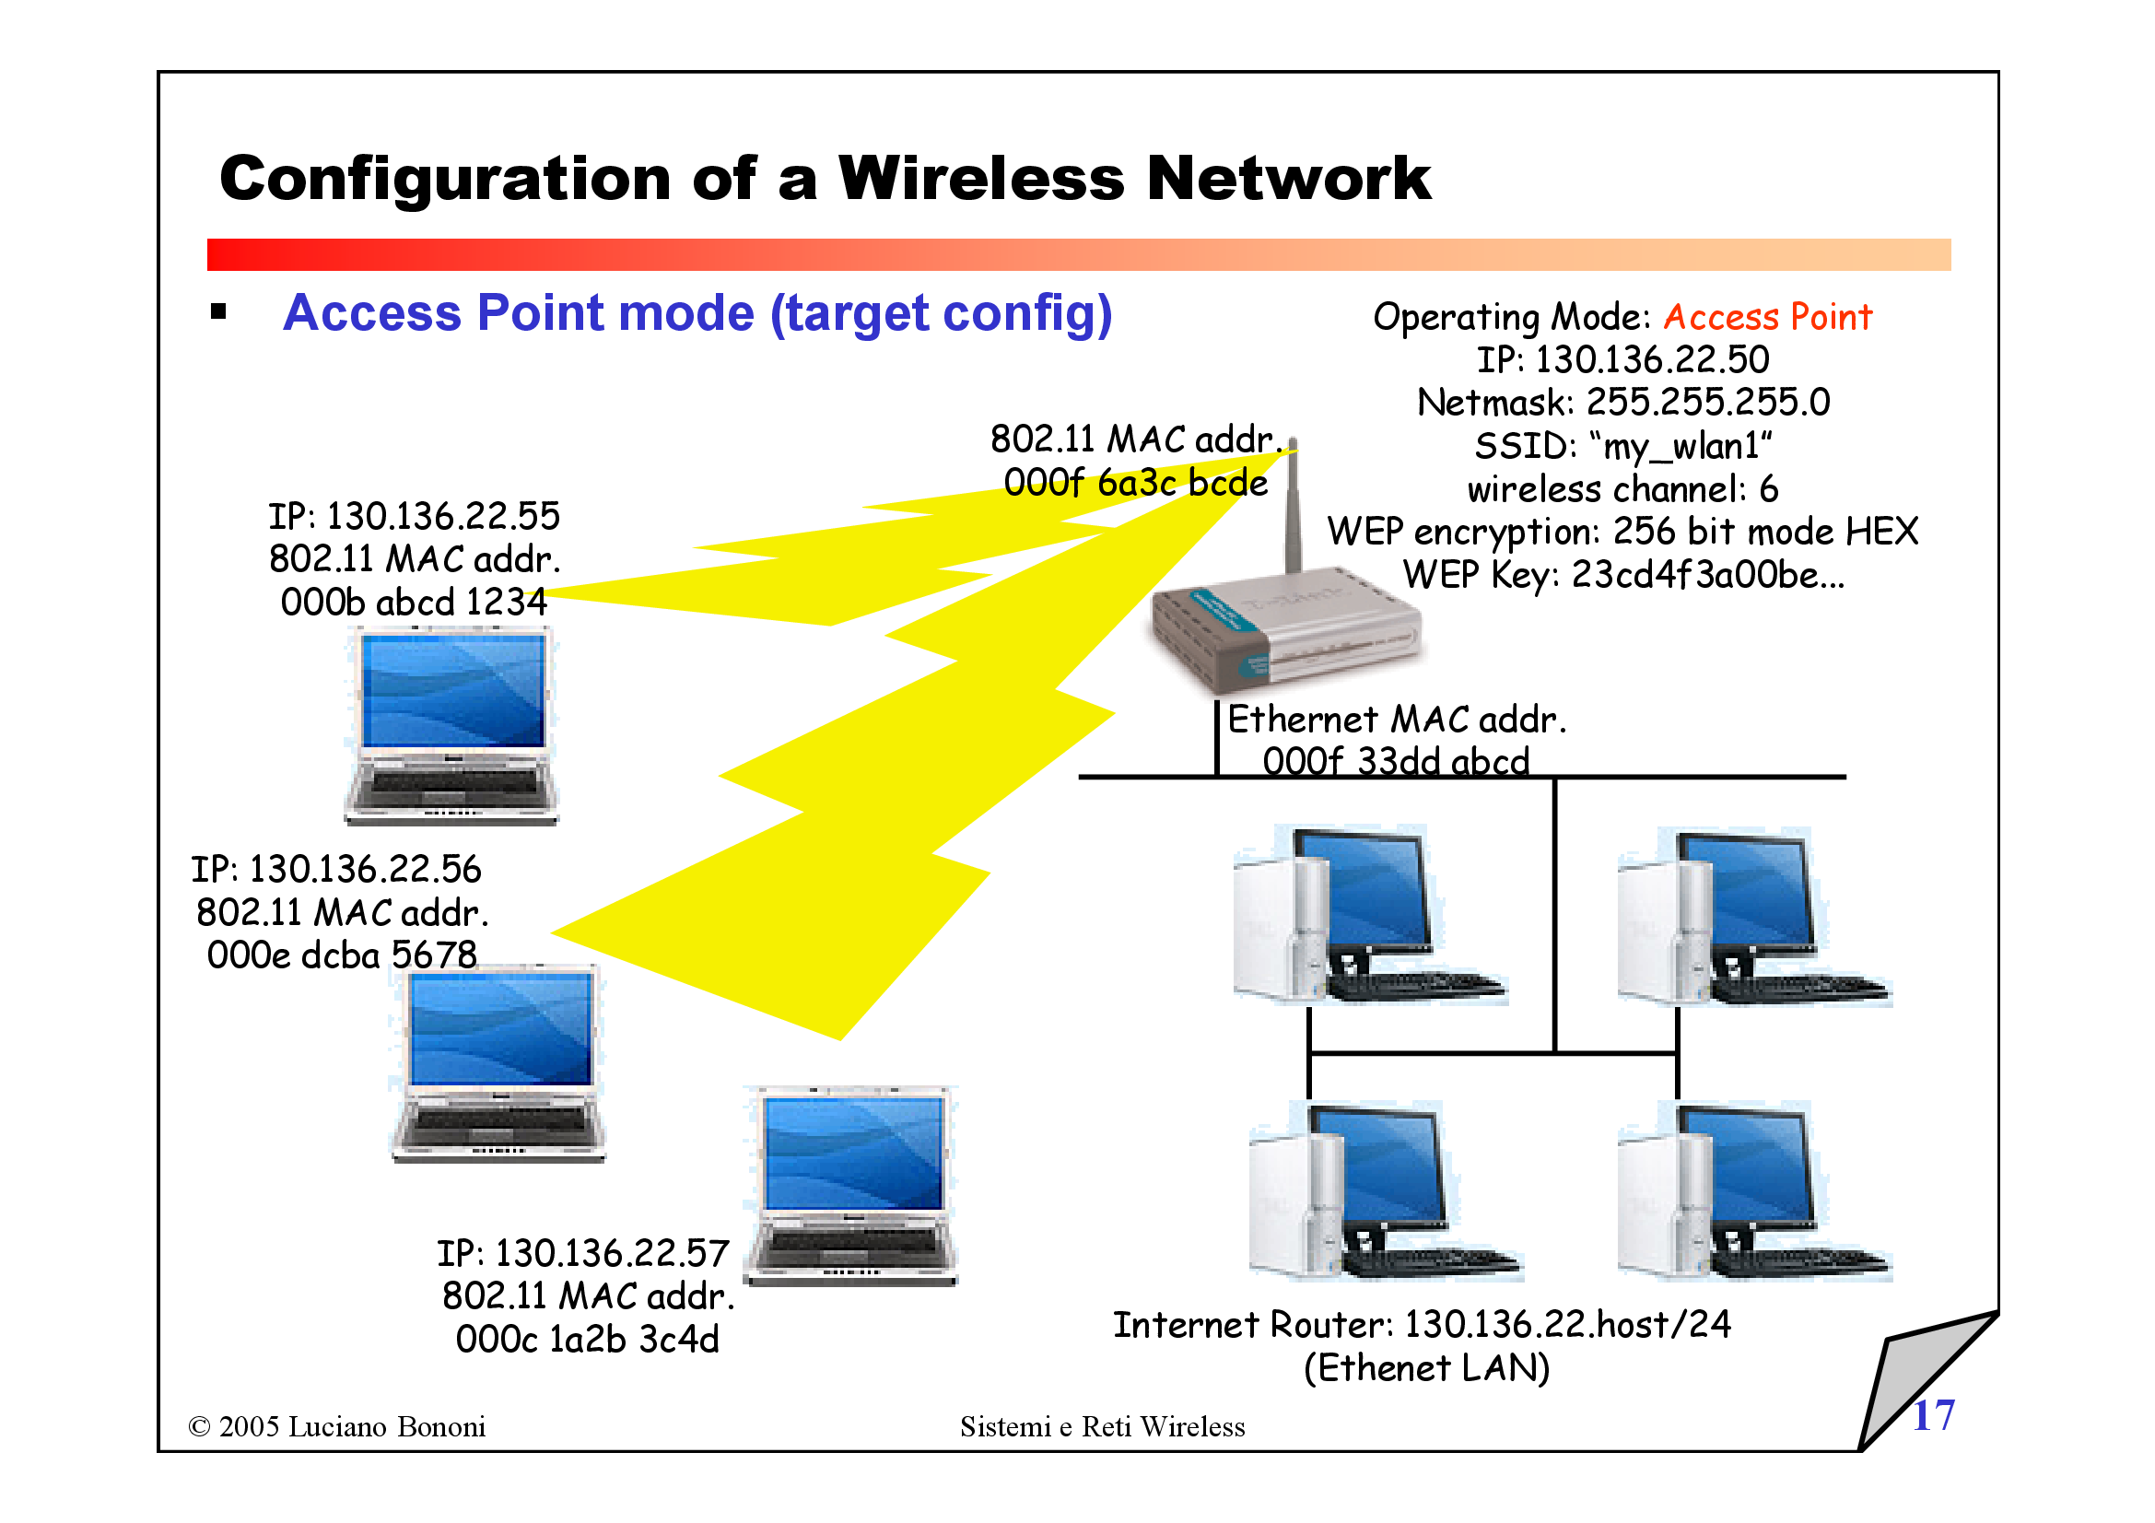
Fig11 Elements of a wireless LAN network

Slide 20
Station Types
Station with no-transition mobility is either stationary (not moving) or moving only inside a BSS.
Station with BSS-transition mobility can move from one BSS to another, but the movement is confined inside one ESS.
A station with ESS-transition mobility can move from one ESS to another.
IEEE 802.11 does not guarantee that communication is continuous
during the move.

Slide 21
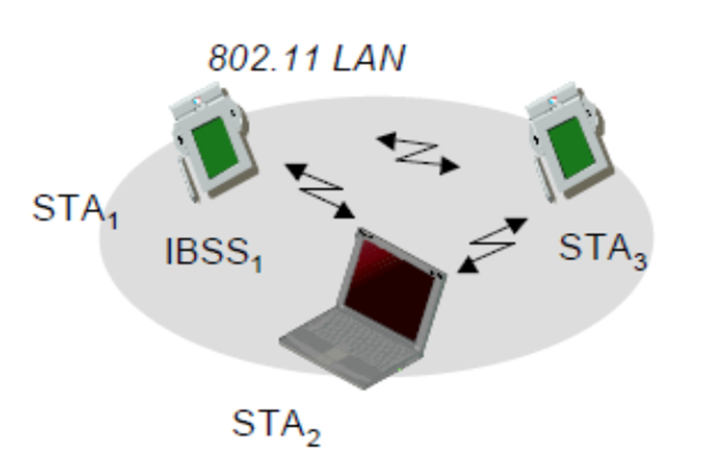
IEEE802.11 - Architecture of an ad-hoc network
Direct communication within a limited range
Station (STA):
Terminal with access mechanisms to the wireless medium.
Independent Basic Service Set(IBSS).
Group of stations using the same radio frequency.
Fig12 Ad-hoc mode in a wireless LAN network

Slide 22
Logical Link Control (LLC)
The functions of Logical Link Control (LLC) are:-
Flow control
Error control

Slide 23
MAC Sub-layer
IEEE 802.11 defines two MAC sub layers:
Distributed coordination function(DCF).
Point coordination function (PCF).

Slide 24
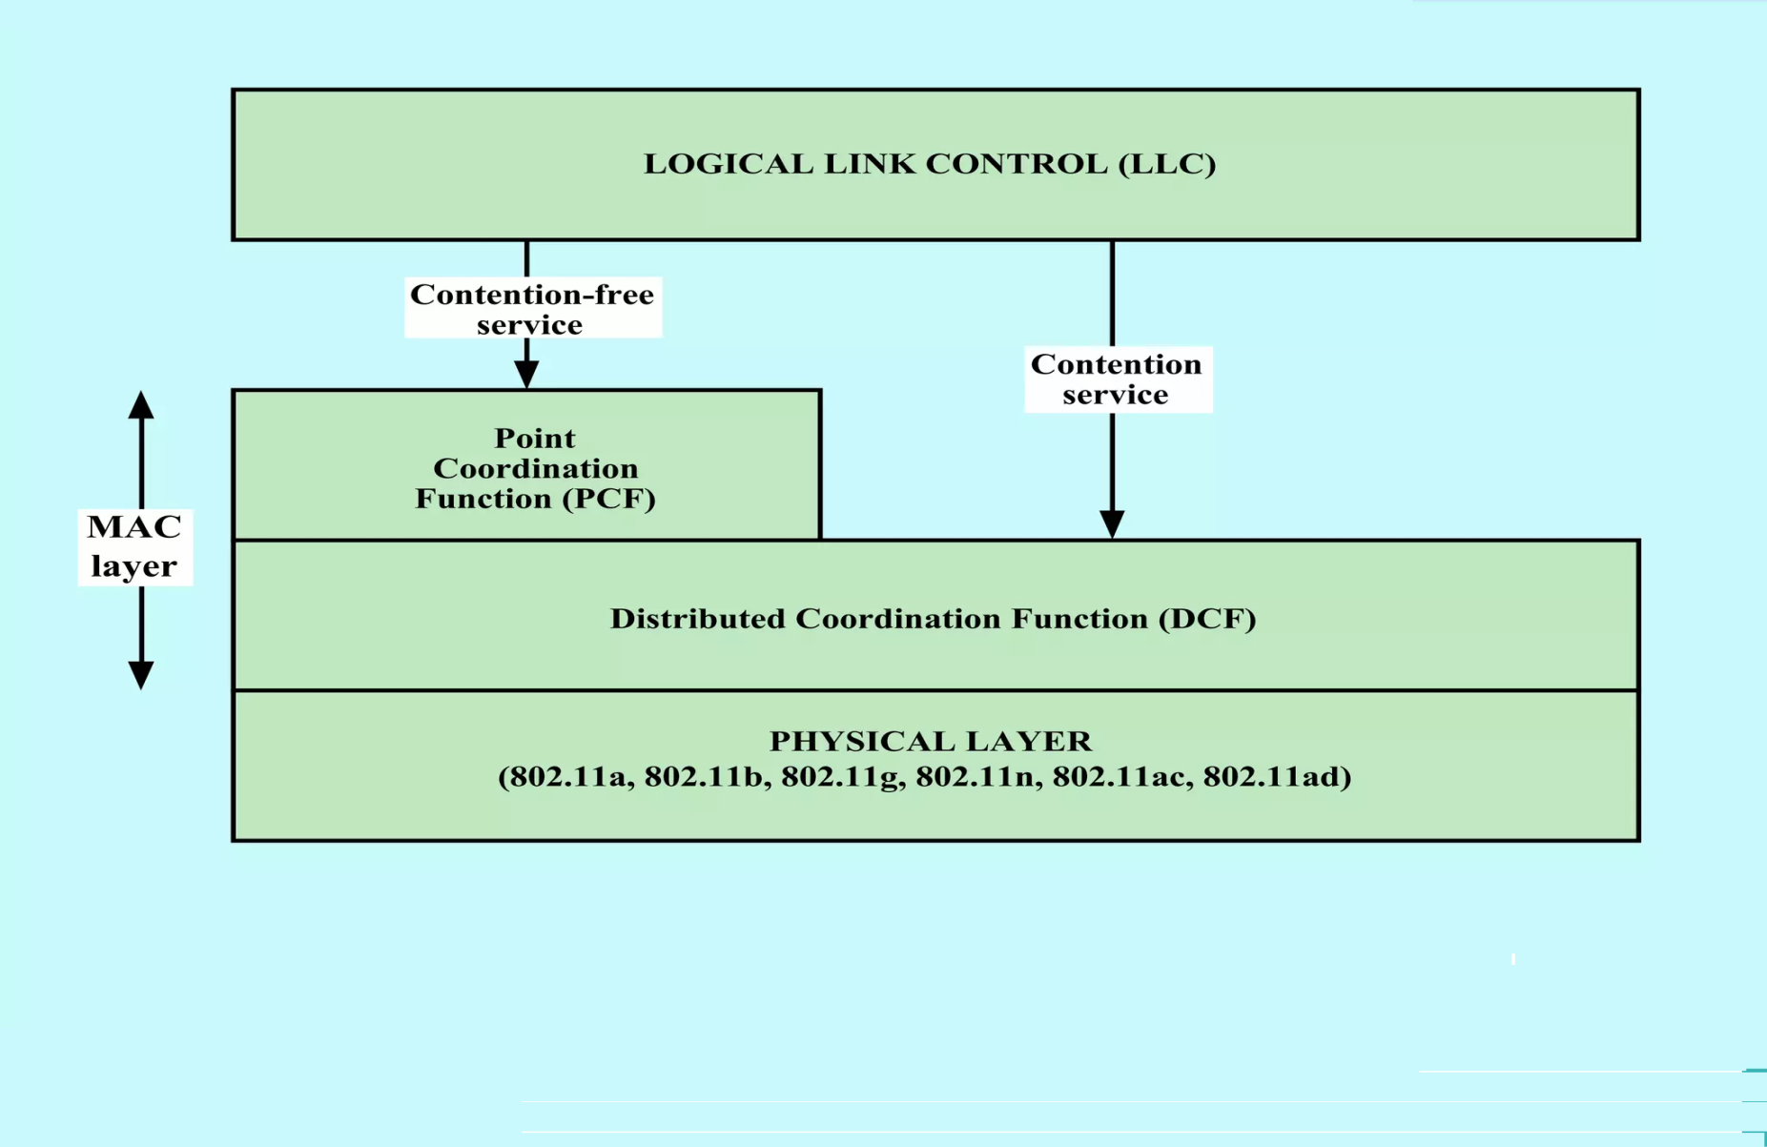
Fig13 IEEE802.11 Protocol Architecture

Slide 25
Distributed Coordination Function(DCF)
IEEE 802.11: multiple access
DCF uses CSMA/CA as the access method, the following step will describe it:
Before sending a frame, the source station senses the medium by checking the energy level at the carrier frequency.
a. The station uses a persistence strategy with back off until the channel is idle.
b. After the station is found to be idle, the station waits for a period of time called the distributed interframe space (DIFS); then the station sends a control frame called the request to send (RTS).

Slide 26
2-After receiving the RTS and waiting a period of time called the short interframe space (SIFS), the destination station sends a control frame, called the clear to send (CTS), to the source station. This control frame indicates that the destination station is ready to receive data.
3-The source station sends data after waiting an amount of time equal to SIFS.
4-The destination station, after waiting an amount of time equal to SIFS, sends an acknowledgment to show that the frame has been received. Acknowledgment is needed in this protocol because the station does not have any means to check for the successful arrival of its data at the destination.

Slide 27
Network Allocation Vector
How do other stations defer sending their data if one station acquires access?
The key is a feature called NAV.
When a station sends an RTS frame, it includes the duration of time that it needs to occupy the channel. The stations that are affected by this transmission create a timer called a network allocation vector (NAV) that shows how much time must pass before these stations are allowed to check the channel for idleness.
Each time a station accesses the system and sends an RTS frame, other stations start their NAV. In other words, each station, before sensing the physical medium to see if it is idle, first checks, its NAV to see if it has expired. Figure 14 shows the idea of NAV.

Slide 28
Fig14 CSMA/CA and NAV

Slide 29
Point Coordination Function (PCF)
The point coordination function (PCF) is an optional access method that can be implemented in an infrastructure network (not in an ad hoc network).
This mode is optional, and only very few APs or Wi-Fi adapters actually implement it.
It is implemented on top of the DCF and is used mostly for time-sensitive transmission.
PCF has a centralized, contention-free polling access method.
APs send "beacon" frames at regular intervals (usually every 0.1 second).
The AP sends Contention Free-Poll (CF-Poll) packets to each station, one at a time, to give them the right to send a packet. The AP is the coordinator.
To give priority to PCF over DCF, another interframe space, PIFS, has been defined.

Slide 30
PIFS (PCF IFS) is shorter than DIFS. This means that if, at the same time, a station wants to use only DCF and an AP wants to use PCF, Due to the priority of PCF over DCF, stations that only use DCF may not gain access to the medium.
To prevent this, a repetition interval has been designed to cover
both contention-free PCF and contention-based DCF traffic.
The repetition interval, which is repeated continuously, starts with a special control frame, called a beacon frame.
When the stations hear the beacon frame, they start their NAV for the duration of the contention-free period of the repetition interval.

Slide 31
During the repetition interval, the PC (point controller or Access point) can send a poll frame, receive data, send an ACK, receive an ACK, or do any combination of these (802.11 uses piggybacking).
At the end of the contention-free period, the PC sends a CF end (contention-free end) frame to allow the contention-based stations to use the medium.

Slide 32
Fig15 MAC protocols in WLAN

Slide 33
Hidden and Exposed Station Problems
Multiple wireless senders and receivers create additional problems (beyond multiple access):
A
B
C
C
A’s signal
strength
C’s signal
strength
B
A
Hidden terminal problem
B, A hear each other
B, C hear each other
A, C can not hear each other
means A, C unaware of their interference at B
space
Signal attenuation:
B, A hear each other
B, C hear each other
A, C can not hear each other interfering at B

Slide 34
Hidden-Station Problem
The solution to the hidden station problem is the use of the handshake frames (RTS and CTS). Figure 16 also shows that the RTS message from B reaches A, but not C. However, because both B and C are within the range of A, the CTS message, which contains the duration of data transmission from B to A, reaches C. Station C knows that some hidden station is using the channel and refrains from transmitting until that duration is over.

Slide 35
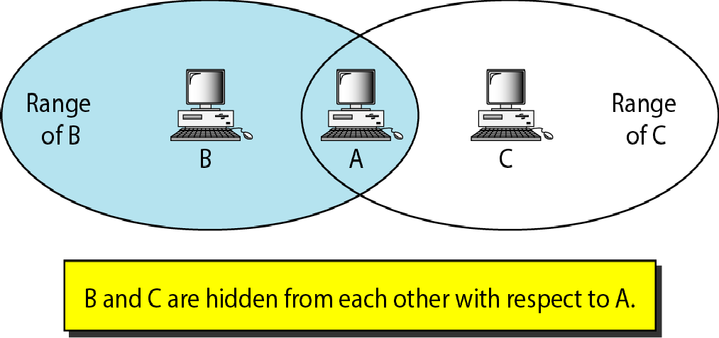
Hidden station problem
Fig16 Hidden station problem

Slide 36
Exposed station problem
Station A is transmitting to station B.
Station C has some data to send to station D, which can be sent without interfering with the transmission from A to B.
However, station C is exposed to transmission from A; it hears what A is sending and thus refrains from sending.
In other words, C is too conservative and wastes the capacity of the channel.

Slide 37
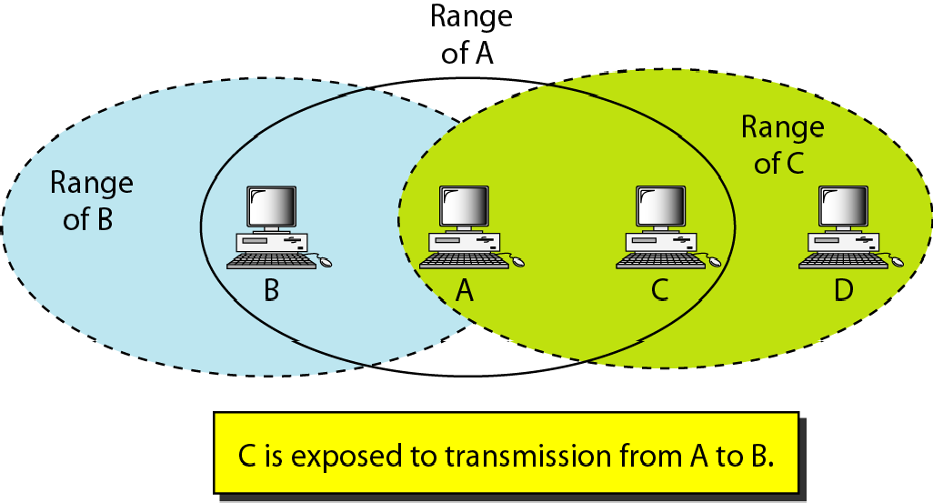
Exposed station problem
Fig17 Exposed station problem

Slide 38
Fragmentation
The wireless environment is very noisy; a corrupt frame has to be retransmitted. The protocol, therefore, recommends fragmentation.
It is division of a large frame into smaller ones. It is more efficient to resend a small frame than a large one.

Slide 39
802.11 frame: addressing
2
2
6
6
6
2
6
0 - 2312
4
frame
control
duration
address
1
address
2
address
3
seq
control
address
4
payload
CRC
Address 1: MAC address of wireless host or AP to receive this frame
Address 4: used only in ad hoc mode
Address 3: MAC address of router interface to which AP is attached
Address 2: MAC address
of wireless host or AP
transmitting this frame
Fig18 802.11 frame addressing

Slide 40


802.11 frame: addressing
Internet
H1
R1
802.3 Ethernet frame
R1 MAC addr
H2 MAC addr
MAC dest addr
MAC source addr
AP MAC addr
H1 MAC addr
R1 MAC addr
address 1
address 2
address 3
802.11 WiFi frame
Fig19 802.11 frame addressing

Slide 41
802.11 frame: addressing
duration of reserved
transmission time (RTS/CTS)
frame sequence # (for reliable data transfer)
2
2
6
6
6
2
6
0 - 2312
4
frame
control
duration
address
1
address
2
address
3
seq
control
address
4
payload
CRC
2
2
4
1
1
1
1
1
1
1
1
protocol
version
type
subtype
to
AP
from
AP
more
frag
retry
power
mgt
more
data
WEP
rsvd
frame type (RTS, CTS, ACK, data)
Fig20 802.11 frame addressing

Slide 42
802.11: Channels, association
spectrum divided into channels at different frequencies
  AP admin chooses frequency for AP
  interference possible: channel can be same as that chosen by neighboring AP!
arriving host: must associate with an AP
  scans channels, listening for beacon frames containing AP’s name (SSID) and MAC address
  selects AP to associate with it.
  then may perform authentication then typically run DHCP to get IP address in AP’s subnet
BSS
Fig21 802.11: Channels, association

Slide 43










802.11: mobility within same subnet
H1 remains in same IP subnet: IP address can remain same
switch: which AP is associated with H1?
BSS 1
H1
BSS 2
Fig22 802.11: mobility within same subnet

Slide 44
Association
In 802.11, each wireless station needs to associate with an AP before it can send or receive network layer data.
Associating means the wireless device creates a virtual wire between itself and the AP.
The 802.11 standard does not specify an algorithm for selecting which of the available APs to associate with it.
The 802.11 standard requires that an AP periodically send beacon frames, each of which includes the AP’s SSID and MAC address.

Slide 45
The device chooses the AP whose beacon frame is received with the highest signal strength.
The process of scanning channels and listening for beacon frames is known as passive scanning.
A wireless device can also perform active scanning, by broadcasting a probe frame that will be received by all APs within the wireless device’s range.
APs respond to the probe request frame with a probe response frame. The wireless device can then choose the AP with which to associate from among the responding APs.

Slide 46
After selecting the AP with which to associate, the wireless device sends an association request frame to the AP, and the AP responds with an association response frame.
Note that this second request/response handshake is needed with active scanning, since an AP responding to the initial probe request frame doesn’t know which of the (possibly many) responding APs the device will choose to associate with.

Slide 47
802.11: passive/active scanning
BBS 1
BBS 2
BBS 1
BBS 2
1
1
AP 2
AP 1
1
AP 2
2
2
2
AP 1
3
3
4
H1
H1
passive scanning:
beacon frames sent from APs
association Request frame sent: H1 to selected AP
association Response frame sent from selected AP to H1
active scanning:
Probe Request frame broadcast from H1
Probe Response frames sent from APs
Association Request frame sent: H1 to selected AP
Association Response frame sent from selected AP to H1
Fig 23802.11: passive/active scanning

Slide 48
Power Management
A node is able to explicitly alternate between sleep and wake states.
A node indicates to the access point that it will be going to sleep by setting the power-management bit in the header of an 802.11 frame to 1.
A timer in the node is then set to wake up the node just before the AP is scheduled to send its beacon frame.(recall that an AP typically sends a beacon frame every 100 msec).
Since the AP knows from the set power-transmission bit that the node is going to sleep, it (the AP) knows that it should not send any frames to that node, and will buffer any frames destined for the sleeping host for later transmission.

Slide 49
A node will wake up (a wakeup time is 250 microseconds) just before the AP sends a beacon frame, and quickly enter the fully active state.
The beacon frames sent out by the AP contain a list of nodes whose frames have been buffered at the AP.
If There are no buffered frames for the node, it can go back to sleep. Otherwise, the node can explicitly request that the buffered frames be sent by sending a polling message to the AP.
A node that has no frames to send or receive can be asleep 99% of the time, resulting in a significant energy savings.

Slide 50
802.11: advanced capabilities
Rate adaptation
base station, mobile dynamically change transmission rate (physical layer modulation technique) as mobile moves, SNR varies
10⁻¹
10⁻²
10⁻³
BER
10⁻⁴
10⁻⁵
10⁻⁶
1. SNR decreases, BER increase as node moves away from base station
10⁻⁷
10
20
30
40
SNR(dB)
2. When BER becomes too high, switch to lower transmission rate but with lower BER
QAM256 (8 Mbps)
QAM16 (4 Mbps)
BPSK (1 Mbps)
operating point
Fig 24 802.11: Rate adaptation

