Slide 1
ENTERPRISE SYSTEMS
Hadeel elgerbi

Slide 2
objectives
work engagement
work efficiency
developing the principles of scientific management
Job Redesign

Slide 3
work engagement
Employees’ psychological connection with their work has gained critical importance in the information/service economy of the twenty-first century.
In the contemporary world of work, to compete effectively, companies not only must recruit the top talent, but must also inspire and enable employees.
to apply their full capabilities to their work. Contemporary organizations need employees who are psychologically connected to their work

Slide 4
work efficiency
this principle specifies that maximum work efficiency will be achieved if jobs are simplified and specialized to the greatest extent possible:
The notion is that the employees will function most efficiently if they perform the same specialized functions repeatedly instead of spreading their attention and energies across several more complex tasks.
the clearest example of how the division-of-labor principle was applied to the design of work.

Slide 5
developing the principles of scientific management
The theorist responsible for developing the principles of scientific
management underlying the industrial engineering approach:
The work to be done should be studied scientifically to determine, in quantitative terms, how the work should be divided among workers
Employees selected for the job should be matched according to the skills demanded by the job.
Employees should be trained by management on how to perform the task as specified exactly by the scientific analysis of the work.
To motivate employees, incentive systems should be developed by
management that reward employees for the completion of each day’s production that meets the standards set by management.

Slide 6
Job Redesign
Job design is the deliberate purposeful planning of the job, including all its structural and social aspects and their effect on the employee.
Job design is a broad concept that can refer to any part or combination of parts of the job.
For example, industrial engineering and job enrichment
are both job-design approaches.
It highlights their overlapping nature.

Slide 7
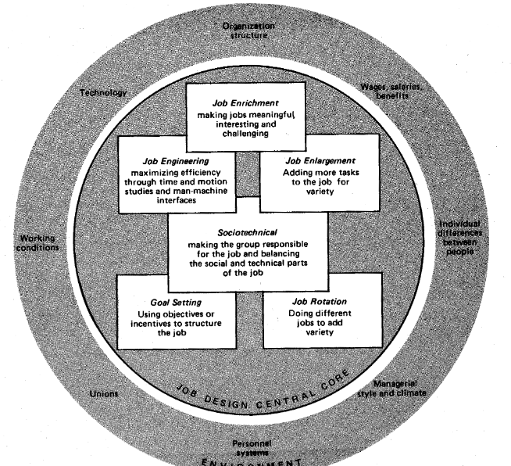

Slide 8
job is meaningful
the job should allow a worker to feel personally responsible for a meaningful portion of his or her work.
A job is meaningful to an individual when he or she feels personally responsible for the job’s success or failure. The key to this is autonomy.
the job should involve doing something intrinsically meaningful or otherwise experienced as worthwhile to the individual.

Slide 9
several ways in which jobs can be made more meaningful
task identity: Individual jobs can focus on an entire unit as opposed to just a portion of it. For example, a bank teller may be responsible for satisfying all the bank needs of a customer, including transactions involving checking, savings, utility payments, loan payments rather than specializing only in savings account
deposits and withdrawals.
Task variety: The task may require an individual to develop and use a variety of skills and abilities in the performance of the task. In the case of a general superintendent of a manufacturing plan, the technical knowledge of the firm’s machinery

Slide 10
several ways in which jobs can be made more meaningful
Task significance: Jobs should have a substantial impact on the welfare of the organization. By recruiting high caliber students and faculty the dean of a college not only satisfies society’s needs for well educated men and women, but provides jobs for others at the colleges as well. A high degree of task significance is attached to this job.

Slide 11
JOB feedback
the job should provide feedback about what is accomplished. Knowledge of one’s task performance is a requirement for higher order needs satisfaction.
If an employee is working on a task that is meaningful, satisfaction of higher order needs will not he obtained unless some form of task feedback is provided.
Feedback can originate from either doing the task itself, or from others, such as supervisors, co-workers, or customers.

