Slide 1
ENTERPRISE SYSTEMS
Hadeel elgerbi

Slide 2
objectives
enterprise system introduction.
Supply chain.
Benefits of Implementing an Enterprise System.

Slide 3
What is an enterprise system?
Enterprise systems are large scale software packages that are able to track and control all of the complex operations of a business.
These are used as central command hub to help automate the business and make reporting and decision making easier.

Slide 4
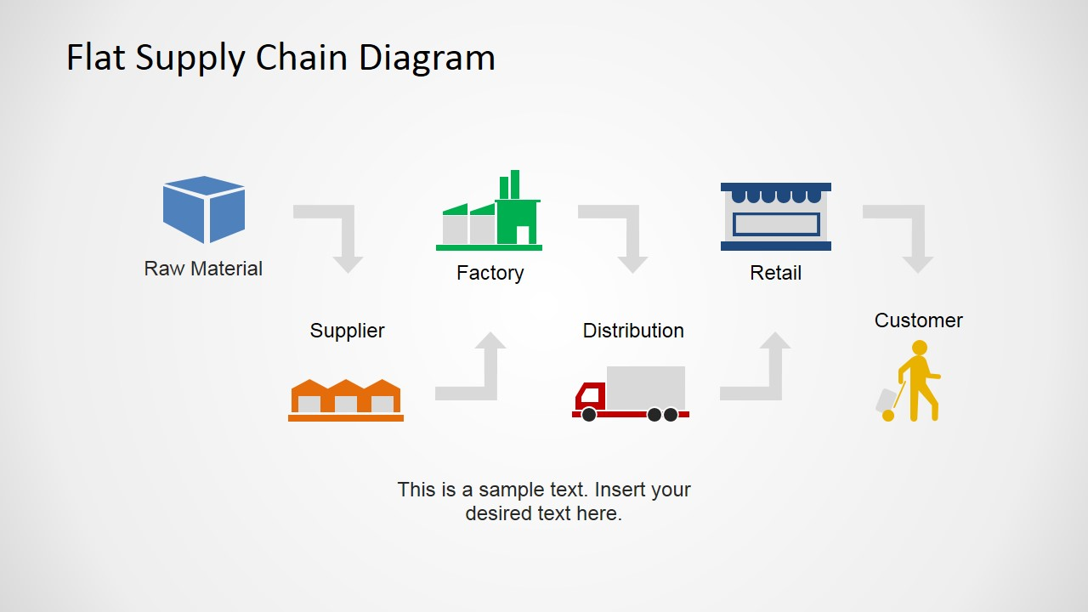
المورد
الموزع
العملاء
مواد خام
المصنع
الأسواق
er

Slide 5
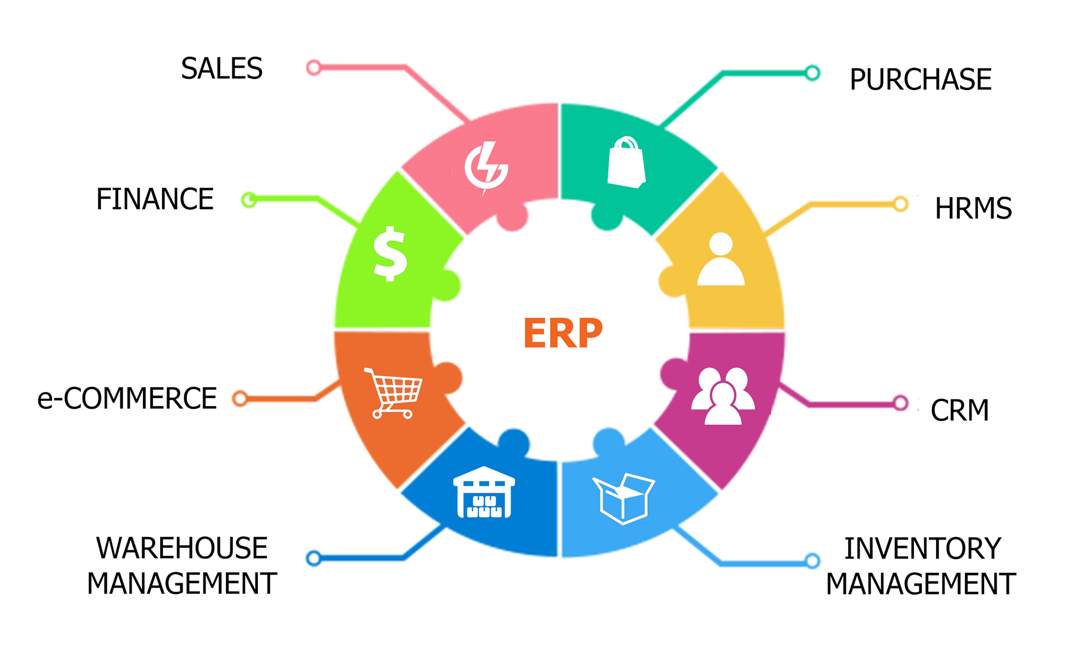
المبيعات
المشتريات
الاالحسابات المالية
الاالموارد البشرية
التجارة الإلكترونية
خدمة العملاء
إدارة المستودع
إدارة المخزون

Slide 6
Benefits of Implementing an Enterprise System
1. Reduce Costs
Reduce administrative and operational costs through automated processes.
2. Streamlined Business Processes
Data is available in a centralized location with complete visibility across all functionalities.

Slide 7
Benefits of Implementing an enterprise System
3. Improved Financial Consolidation
Without Enterprise system, many businesses are forced to use different programs in different departments. An Enterprise system eliminates the data silos that arise from disparate systems.
4. Supply Chain Optimization
Enterprise System allows for real-time visibility of your supply chain and other processes making it easier for decision makers to get a wider view of their supply chain, reduce planning cycles and be on top of your production scheduling.

Slide 8
Benefits of Implementing an Enterprise System
5. Respond to Market Conditions
Enterprise System provides real-time data analysis and reporting to assist the business to rapidly react to changing market requirements.
6. Traceability
Allocation and detection of inventory and stock is critical in highly regulated industries. Enterprise system benefits you in tracing stock, defects and hazards down to the level of individual parts and ingredients.

Slide 9
Benefits of Implementing an Enterprise System
7. Digitally Transform with Mobility
As your business grows, your enterprise system will grow and adapt to cater for your changing needs.
8.Improve Satisfaction with Cloud Enterprise system
Implementing an cloud for Enterprise solution enables you to produce the right product at the right time.

