Slide 1
Object-Oriented Programming Paradigms
by
Rehab Ben Abdulla
Rehabbenabdulla@gmail.com

Slide 2
OOP Paradigms
An object-oriented program is structured as community of interacting agents called objects.
Each object has a role to play.
Each object provides a service or performs an action that is used by other members of the community.
A software system is seen as a community of objects that cooperate with each other by passing messages in solving a problem.

Slide 3
Messages and Responsibilities
Action is initiated by the transmission of a message to an agent (an object) responsible for the actions.
If the receiver accepts the message, it accepts responsibility to carry out the indicated action.

Slide 4
OOP Paradigms
Programming with Abstract Data Types.
ADTs specify/describe behaviors.
Program as a collection of classes that represent the real world interacting objects.

Slide 5
OOP concepts
An object-oriented programming language provides support for the following object oriented concepts:
Encapsulation.
Abstraction.
Inheritance
Polymorphism and Dynamic binding

Slide 6
1- Objects and Classes
Classes and Instances.
class is the type of objects
An object is any thing.
A class consists of a category of things.
In a running program, there may be many instances of an object.
E.g Students in a registration system
Each objects has a stat and behaviour.

Slide 8
1- Objects and Classes
Class is a set of:
Attributes or variables represent the state of the object Methods or functions represent the behaviour of the object. Collectively, the properties and methods defined by a class are called its members.

Slide 9
1- Objects and Classes
Class methods can be:
Constructors
Retrieval and modification of state
Service-providing
Destructor

Slide 10
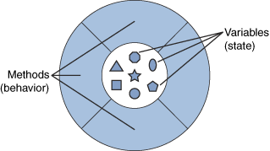
Encapsulation
Object’s variables make up the center, or nucleus, of the object.
Methods surround and hide the object’s nucleus from other objects in the program.
Packaging an object’s variables within the protective custody of its methods is called encapsulation.

Slide 11
Encapsulation
Encapsulation is a mechanism of wrapping the data (variables) and code acting on the data (methods) together as a single unit.
In encapsulation, the variables of a class will be hidden from other classes, and can be accessed only through the methods of their current class. Therefore, it is also known as data hiding.
To achieve encapsulation in Java −
Declare the variables of a class as private.
Provide public setter and getter methods to modify and view the variables values.

Slide 12
Relationship between classes
Object Oriented Programming there are several techniques, classes can use to link with each other:
Association (uses),
Aggregation (has),
Composition (has).

Slide 14
Relationship between classes

Slide 15
Unified Modeling Language (UML) for relations

Slide 16
Association

Slide 17
Aggregation and Composition

Slide 18
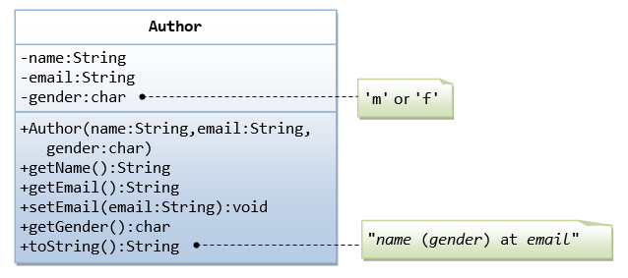
Composition book and author

Slide 19
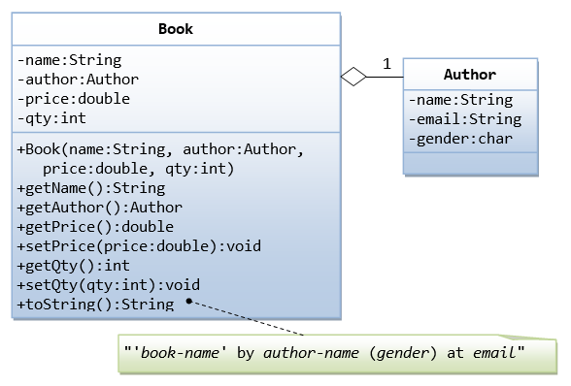
Composition book and author

Slide 20
2- Inheritance
A feature allows developers to define objects in a hierarchy much like a taxonomy chart (like the animal kingdom classification chart).
In OOP, Organizing classes in hierarchy to avoid duplication and reduce redundancy.
Inheritance is a way for code reuse in OOP.
Each level of the hierarchy defines a more specific object than the parent level.
The classes in the lower hierarchy inherit all the members from the higher hierarchies.
Constructors are not class members.
Inheritance is IS-A Relationship.

Slide 21
Generalization, Specialization
By pulling out all the common variables and methods into the superclasses, and leave the specialized variables and methods in the subclasses, redundancy can be greatly reduced or eliminated as these common variables and methods do not need to be repeated in all the subclasses.
Form bottom to top is Generalization.
From top to down is Specialization

Slide 22
example

Slide 23
Types of Inheritance

Slide 24
2- Inheritance
The new classes, known as subclasses (child or derived classes), inherit attributes and behavior of the pre-existing classes, which are referred to as superclasses (parent or ancestor classes).
JAVA dose not support multiple inheritance.
Use interfaces.

Slide 25
Composition vs. Inheritance
There are two ways to reuse existing classes, namely, composition and inheritance.
With composition, you define a new class, which is composed of existing classes.
With inheritance, you derive a new class based on an existing class, with modifications or extensions.

Slide 26
Abstraction
In Object-oriented programming, abstraction is a process of hiding the implementation details from the user, only the functionality will be provided to the user.
In other words, the user will have the information on what the object does instead of how it does it.
Abstraction reduces complexity by hiding irrelevant detail.
Object-oriented programming provides abstraction through composition and inheritance.

Slide 27
Abstraction
For example, a class Car would be made up of an Engine, Gearbox, Steering objects, and many more components. To build the Car class, one does not need to know how the different components work internally, but only how to interface with them, i.e., send messages to them, receive messages from them, and perhaps make the different objects composing the class interact with each other.
To make a new model from your car you just extend it from older model.

Slide 28
Polymorphism
Many forms or many ways.
The object react in different ways.
Overloding and overridig.
The object may has many forms
Substitutability

Slide 29
Polymorphism Substitutability
A subclass inherited all attributes and operations from its superclass.
This means that a subclass object can do whatever its superclass can do.
As a result, we can substitute a subclass instance when a superclass instance is expected,
Using abstract class and interfaces to creat a type (model) of anytype is useful for substitutability.
Inherited object or object that implements the interface, are from its type .

Slide 32
Public void whatIsIt(Shape s)
{
System.out.print(s);
}
Main()
{
Shape s1; // Shape is abstract class
Circle c1= new Circle();
Rectangular r = new Rectangulae()
....
whatIsIt(c1);
whatIsIt(r);
]

Slide 33
3- Polymophism and Dynamic binding
Methods can have the same name but different implementations.
Overloading is ability of a class to have many methods with the same name, different implementations and different arguments list.
Overriding deals with two methods, one in a parent class and one in a child class, have the same name, the child’s method implementation overrides (replaces) the parent’s method implementation.

Slide 34
Overriding

Slide 35
Overriding

Slide 36
3- Polymophism and Dynamic binding

Slide 37
Overloading

Slide 39
OOP Concepts summry
Data Abstraction (specifies behavior)
Encapsulation (controls visibility of names)
Polymorphism (accommodates various implementations)
Inheritance (facilitates code reuse)
Modularity (relates to unit of compilation)

Slide 40
OOP Languages
Concerning the degree of object orientation, following distinction can be made:
Languages called "pure" OO languages, because everything in them is treated consistently as an object, from primitives such as characters and punctuation, all the way up to whole classes, prototypes, blocks, modules, etc. They were designed specifically to facilitate, even enforce, OO methods. Examples: Smalltalk, Eiffel, Ruby, JADE.
Languages designed mainly for OO programming, but with some procedural elements. Examples: C++, C#, Java, Scala, Python.
Languages that are historically procedural languages, but have been extended with some OO features. Examples: VB.NET (derived from VB), Fortran 2003, Perl, COBOL 2002, PHP.

