Slide 1
FUZZY LOGIC
Lecture 4

Slide 2
INTRODUCTION
FL techniques have been used in image-understanding applications such as detection of edges, feature extraction, classification, and clustering.
Fuzzy logic poses the ability to mimic the human mind to effectively employ modes of reasoning that are approximate
rather than exact.
In traditional hard computing, decisions or actions are based on precision, certainty, and vigor. Precision and certainty carry a cost. In soft computing, tolerance and impression are explored in decision making.
Soft computing includes fuzzy logic, neural networks, probabilistic reasoning, and genetic algorithms.

Slide 3
With FL, we can specify mapping rules in terms of words rather than numbers. Computing with the words explores imprecision and tolerance.
Another basic concept in FL is the fuzzy if–then rule. Although rule-based systems have a long history of use in artificial intelligence, what is missing in such systems is machinery for dealing with fuzzy consequents or fuzzy antecedents.
In most applications, an FL solution is a translation of a human solution.

Slide 4
FUZZY SETS AND MEMBERSHIP FUNCTIONS
Zadeh introduced the term fuzzy logic in his seminal work “Fuzzy sets,” which described the mathematics of fuzzy set theory (1965). It was Lukasiewicz who first proposed a systematic alternative to the bivalued logic of Aristotle.
The third value Lukasiewicz proposed can be best translated as “possible,” and he assigned it a numeric value between True and False.
Later he explored four-valued logic and five-valued logic, and then he declared that, in principle, there was nothing to prevent the derivation of infinite-valued logic.

Slide 5
A fuzzy set is an extension of a crisp set. Crisp sets allow only full

Slide 6
For example, if x indicates height, then T(X) may refer to sets such as short, medium, or tall.
A membership function is essentially a curve that defines how each point in the input space is mapped to a membership value (or degree of membership) between 0 and 1.
As an example, consider a fuzzy set tall. Let the universe of discourse be heights from 40 inches to 90 inches.
With a crisp set, all people with height 72 or more inches are considered tall, and all people with height of less than 72 inches are considered not tall.

Slide 8
The corresponding fuzzy set with a smooth membership function is shown in Figure 3.2. The curve defines the transition from not tall and shows the degree of membership for a given height.
We can extend this concept to multiple sets. If we consider a universe of discourse from 40 inches to 90 inches, then, to describe height, we can use three term values such as short, average, and tall.
In practice, the terms short, medium, and tall are not used in the strict sense. Instead, they imply a smooth transition.

Slide 10
LOGICAL OPERATIONS AND IF–THEN RULES
In order to define fuzzy set logical operators, let us

Slide 11
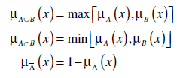
In FL, the truth of any statement is a matter of degree. In order to define FL operators, we have to find the corresponding operators that preserve the results of using AND, OR, and NOT operators.
The answer is min, max, and complement operations. These operators are defined, respectively, as:

Slide 12
The formulas for AND, OR, and NOT operators are useful for proving other mathematical properties about sets; however, min and max are not the only ways to describe the intersection and union of two sets. Zadeh (1965) defined fuzzy union and fuzzy intersection as

Slide 13
FL uses notions from crisp logic. Concepts in crisp logic can be extended to FL by replacing 0 or 1 values with fuzzy membership values.
called the antecedent or premise, while the then part of the rule, “y is B,” is called the consequent or conclusion. Interpreting an if–then rule involves two distinct steps. The first step is to evaluate the antecedent, which involves fuzzifying the input and applying any necessary fuzzy operators. The second step is implication, or applying the result of the antecedent to the consequent, which essentially evaluates the membership function
For most applications, the fuzzy membership function for a given relation is obtained with the minimum or product implication, given, respectively, as follows:

Slide 14
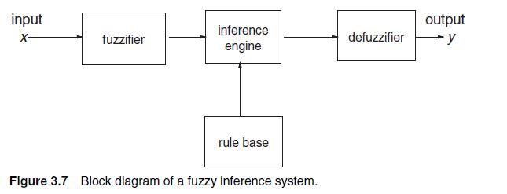
FUZZY INFERENCE SYSTEM
A fuzzy inference system (FIS) essentially defines a nonlinear mapping of the input data vector into a scalar output, using fuzzy rules. The mapping process involves input/output membership functions, FL operators, fuzzy if–then rules, aggregation of output sets, and defuzzification.

Slide 15
The fuzzifier maps input numbers into corresponding fuzzy memberships. This is required in order to activate rules that are in terms of linguistic variables. The fuzzifier takes input values and determines the degree to which they belong to each of the fuzzy sets via membership functions.
The inference engine defines mapping from input fuzzy sets into output fuzzy sets. It determines the degree to which the antecedent is satisfied for each rule. Outputs for all rules are then aggregated.
The defuzzifier maps output fuzzy sets into a crisp number. Given a fuzzy set that encompasses a range of output values, the defuzzifier returns one number, thereby moving from a fuzzy set to a crisp number.

Slide 16
Example: we consider a fuzzy inference system with two inputs (n=2) and one output (m=1) . Let the two inputs represent the number of years of education and the number of years of experience, and let the output of the system be salary. Let x1 indicate the number of years of education, T(X) represent its term set {low, medium, high} and the universe of discourse be[0-15]. Let x2 indicate the number of years of experience, the universe of discourse be[0-30] and the corresponding term set be {low, medium, high}.

Slide 20
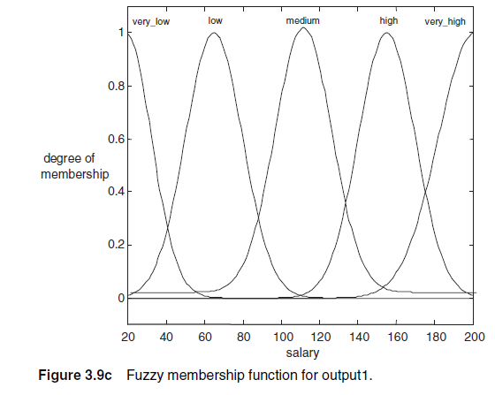

Slide 21
For the given example, the rules are stated as
R1: if education is low and experience is low, then salary is very low
R2: if education is low and experience is medium, then salary is low
R3: if education is low and experience is high, then salary is medium
R4: if education is medium and experience is low, then salary is low
R5: if education is medium and experience is medium, then salary is medium
R6: if education is medium and experience is high, then salary is high
R7: if education is high and experience is low, then salary is medium
R8: if education is high and experience is medium, then salary is high
R9: if education is high and experience is high, then salary is very high

