Slide 1
Artificial Intelligence
AI
Lecture 1

Slide 2
Introduction
The field of artificial intelligence, or AI, attempts to understand intelligent entities. Thus, one reason to study it is to learn more about ourselves.
Another reason to study AI is that these constructed intelligent entities are interesting and useful in their own right.
AI addresses one of the ultimate puzzles. How is it possible for a slow, tiny brain, whether biological or electronic, to perceive, understand, predict, and manipulate a world far larger and more complicated than itself? How do we go about making something with those properties?

Slide 3
These are hard questions, but the researcher in AI has solid evidence that the quest is possible.
AI is one of the newest disciplines. It was formally initiated in 1956, when the name was coined, although at that point work had been under way for about five years.
The study of intelligence is also one of the oldest disciplines. For over 2000 years, philosophers have tried to understand how seeing, learning, remembering, and reasoning could, or should, be done.
AI currently encompasses a huge variety of subfields, from general-purpose areas such as perception and logical reasoning, to specific tasks such as playing chess, proving mathematical theorems, writing poetry, and diagnosing diseases.

Slide 4
WHAT is AI?
Definitions of artificial intelligence according to eight recent textbooks are shown in Figure 1.1.
These definitions vary along two main dimensions. The ones on top are concerned with thought processes and reasoning, whereas the ones on the bottom address behavior.
Also, the definitions on the left measure success in terms of human performance, whereas the ones on the right measure against an ideal concept of intelligence, which we will call rationality. AI system is rational if it does the right thing. This gives us four possible goals to pursue in artificial intelligence, as seen in the caption of Figure 1.1.

Slide 5
WHAT is AI?

Slide 6
Acting humanly: The Turing Test approach
The Turing Test, proposed by Alan Turing (1950), was designed to provide a satisfactory operational definition of intelligence. Turing defined intelligent behavior as the ability to achieve human-level performance in all cognitive tasks, sufficient to fool an interrogator. Roughly speaking, the test he proposed is that the computer should be interrogated by a human via a teletype, and passes the test if the interrogator cannot tell if there is a computer or a human at the other end.
For now, programming a computer to pass the test provides plenty to work on. The computer would need to possess the following capabilities:

Slide 7
Acting humanly: The Turing Test approach
natural language processing to enable it to communicate successfully in English (or some other human language);
knowledge representation to store information provided before or during the interrogation;
automated reasoning to use the stored information to answer questions and to draw new conclusions;
machine learning to adapt to new circumstances and to detect and extrapolate patterns.

Slide 8
Within AI, there has not been a big effort to try to pass the Turing test. The issue of acting like a human comes up primarily when AI programs have to interact with people, as when an expert system explains how it came to its diagnosis, or a natural language processing system has a dialogue with a user.
These programs must behave according to certain normal conventions of human interaction in order to make themselves understood.

Slide 9
Thinking humanly: The cognitive modelling approach
If we are going to say that a given program thinks like a human, we must have some way of determining how humans think. We need to get inside the actual workings of human minds.
There are two ways to do this: through introspection—trying to catch our own thoughts as they go by—or through psychological experiments.
Once we have a sufficiently precise theory of the mind, it becomes possible to express the theory as a computer program. If the program's input/output and timing behavior matches human behavior, that is evidence that some of the program's mechanisms may also be operating in humans.

Slide 10
Thinking rationally: The laws of thought approach
The Greek philosopher Aristotle was one of the first to attempt to codify "right thinking," that is, irrefutable reasoning processes.
His famous syllogisms provided patterns for argument structures that always gave correct conclusions given correct premises. For example, "Socrates is a man; all men are mortal; therefore Socrates is mortal."
These laws of thought were supposed to govern the operation of the mind, and initiated the field of logic.

Slide 11
Thinking rationally: The laws of thought approach
By 1965, programs existed that could, given enough time and memory, take a description of a problem in logical notation and find the solution to the problem, if one exists. (If there is no solution, the program might never stop looking for it.) The so-called logicist tradition within artificial intelligence hopes to build on such programs to create intelligent systems.
There are two main obstacles to this approach. First, it is not easy to take informal
knowledge and state it in the formal terms required by logical notation, particularly when the knowledge is less than 100% certain. Second, there is a big difference between being able to solve a problem "in principle" and doing so in practice.

Slide 12
Acting rationally: The rational agent approach
Acting rationally means acting so as to achieve one's goals, given one's beliefs. An agent is just something that perceives and acts. In this approach, AI is viewed as the study and construction of rational agents.
All the "cognitive skills" needed for the Turing Test are there to allow rational actions. Thus, we need the ability to represent knowledge and reason with it because this enables us to reach good decisions in a wide variety of situations. We need to be able to generate comprehensible sentences in natural language because saying those sentences helps us get by in a complex society.
One important point to keep in mind: we will see before too long that achieving perfect rationality—always doing the right thing—is not possible in complicated environments. The computational demands are just too high.

Slide 13
BRIEF HISTORY OF ARTFICIAL INTELLIGENCE
Can Machines Think?
In the first half of the 20th century, science fiction familiarized the world with the concept of artificially intelligent robots.
Alan Turing, a young British polymath who explored the mathematical possibility of artificial intelligence.
Turing suggested that humans use available information as well as reason in order to solve problems and make decisions, so why can’t machines do the same thing? This was the logical framework of his 1950 paper “Computing Machinery and Intelligence” .

Slide 14
Making the Pursuit Possible
Unfortunately, talk is cheap. What stopped Turing from getting to work right then and there?
First, computers needed to fundamentally change. Before 1949 computers lacked a key prerequisite for intelligence: they couldn’t store commands, only execute them. In other words, computers could be told what to do but couldn’t remember what they did.
Second, computing was extremely expensive. In the early 1950s, the cost of leasing a computer ran up to $200,000 a month. Only prestigious universities and big technology companies could afford to dillydally in these uncharted waters.

Slide 15
The Conference that Started it All
Five years later, the proof of concept was initialized through Allen Newell, Cliff Shaw, and Herbert Simon’s, Logic Theorist.
The Logic Theorist was a program designed to mimic the problem solving skills of a human .
It’s considered by many to be the first artificial intelligence program and was presented at the Dartmouth Summer Research Project on Artificial Intelligence (DSRPAI) hosted by John McCarthy and Marvin Minsky in 1956.
In this historic conference, McCarthy, imagining a great collaborative effort, brought together top researchers from various fields for an open ended discussion on artificial intelligence, the term which he coined at the very event.
The significance of this event cannot be undermined as it catalyzed the next twenty years of AI research.

Slide 16
Roller Coaster of Success and Setbacks
From 1957 to 1974, AI flourished. Computers could store more information and became faster, cheaper, and more accessible.
. Early demonstrations such as Newell and Simon’s General Problem Solver and Joseph Weizenbaum’s ELIZA showed promise toward the goals of problem solving and the interpretation of spoken language respectively.
. Optimism was high and expectations were even higher.
While the basic proof of principle was there, there was still a long way to go before the end goals of natural language processing, abstract thinking, and self-recognition could be achieved.

Slide 17
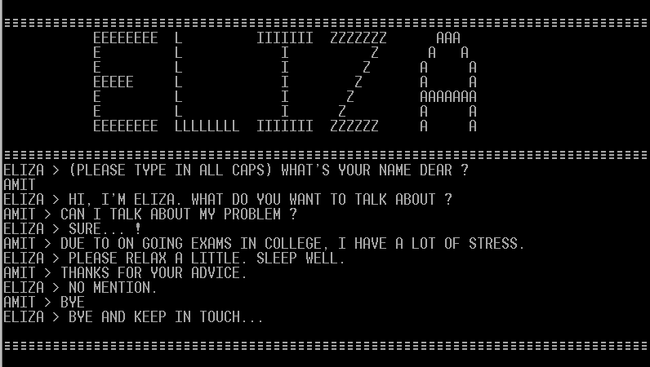

Slide 18
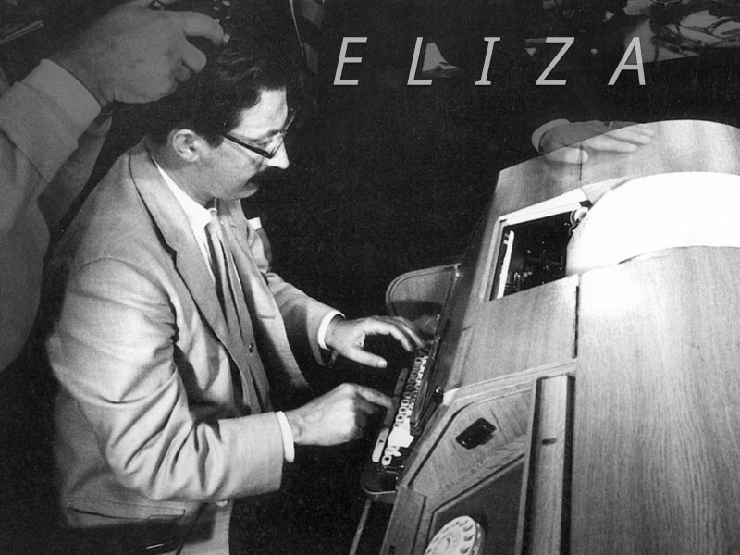

Slide 19
The biggest obstacle was the lack of computational power to do anything substantial.
. Hans Moravec, a doctoral student of McCarthy at the time, stated that “computers were still millions of times too weak to exhibit intelligence.”
In the 1980’s, AI was reignited by two sources: an expansion of the algorithmic toolkit, and a boost of funds.
John Hopfield and David Rumelhart popularized “deep learning” techniques which allowed computers to learn using experience.
On the other hand Edward Feigenbaum introduced expert systems which mimicked the decision making process of a human expert.

Slide 20
The Japanese government heavily funded expert systems and other AI related endeavors as part of their Fifth Generation Computer Project (FGCP).
Unfortunately, most of the ambitious goals were not met.
Ironically, in the absence of government funding and public hype, AI thrived.
In 1997, reigning world chess champion and grand master Gary Kasparov was defeated by IBM’s Deep Blue, a chess playing computer program.
In the same year, speech recognition software, developed by Dragon Systems, was implemented on Windows.
Kismet, a robot developed by Cynthia Breazeal that could recognize and display emotions.

Slide 21
Time Heals all Wounds
The fundamental limit of computer storage that was holding us back 30 years ago was no longer a problem.
The memory and speed of computers doubles every year,
This is precisely how Deep Blue was able to defeat Gary Kasparov in 1997, and how Google’s Alpha Go was able to defeat Chinese Go champion, Ke Jie, in 2017.
we saturate the capabilities of AI to the level of our current computational power (computer storage and processing speed).

Slide 22
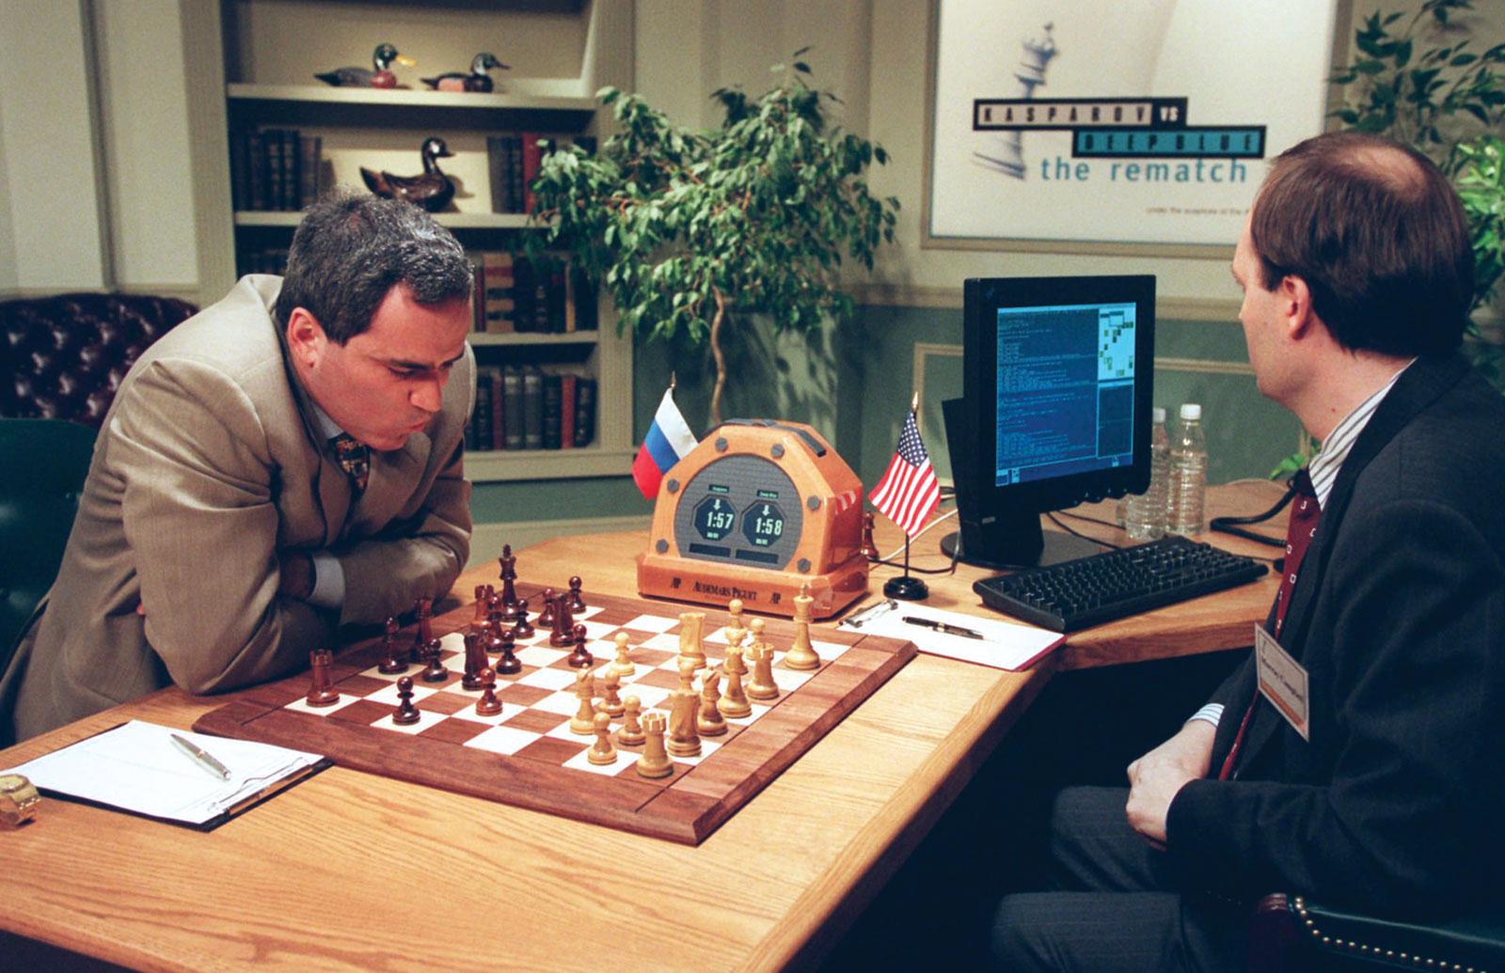

Slide 23
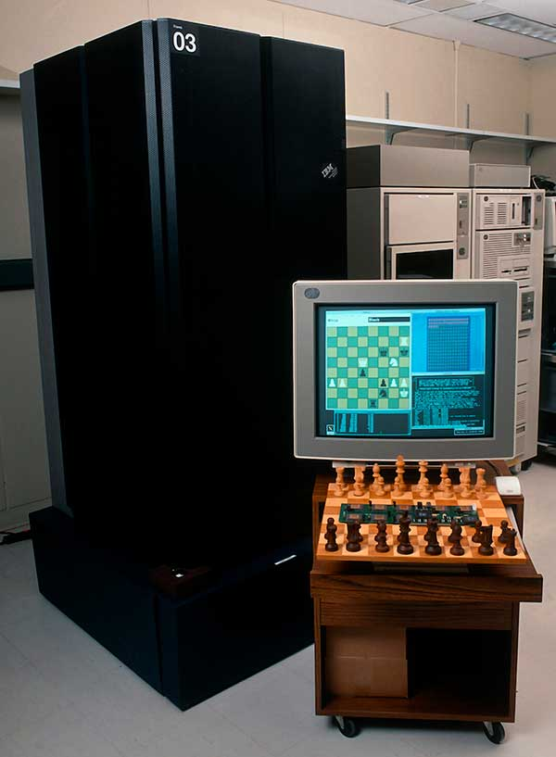

Slide 24
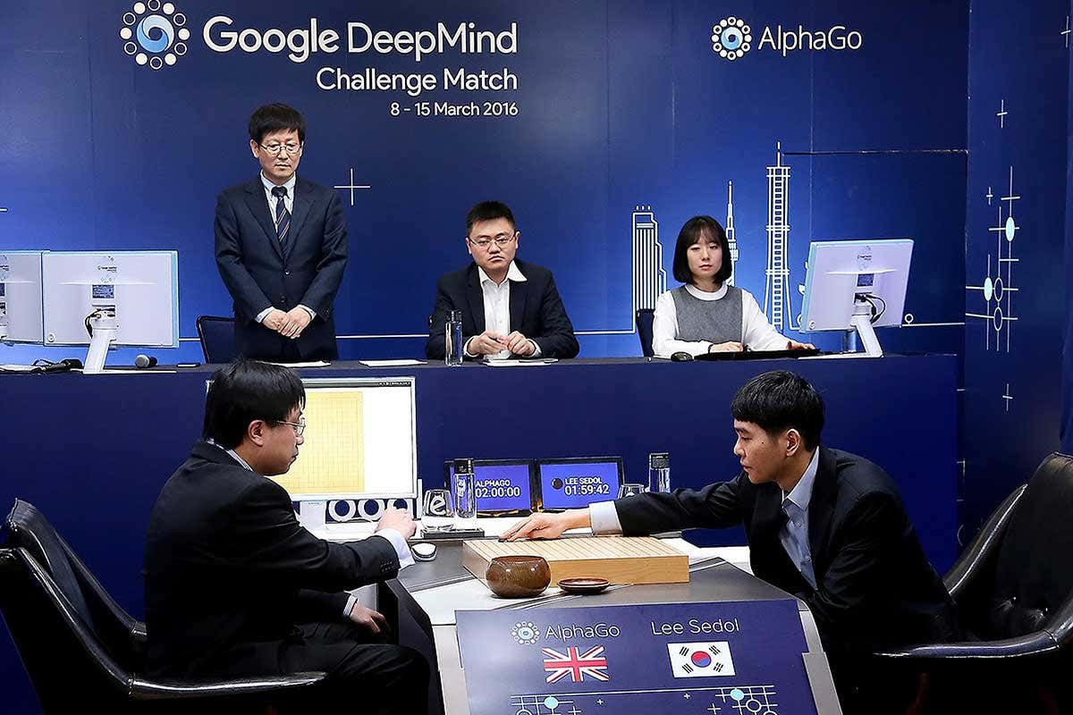

Slide 25
Artificial Intelligence is Everywhere
We now live in the age of “big data” an age in which we have the capacity to collect huge sums of information too cumbersome for a person to process.
Big data and massive computing simply allow artificial intelligence to learn through brute force.

Slide 26
The Future
AI language is looking like the next big thing. In fact, it’s already underway.
We can also expect to see driverless cars on the road in the next twenty years
In the long term, the goal is general intelligence.
The ethical questions would serve as a strong barrier against fruition.

