Slide 1
Digital Video
Lecture 7

Slide 2
Digital Video
Digital video is represented as a sequence of digital images.
Nowadays, it is omnipresent in many types of multimedia applications.
Modern digital video generally uses component video, although RGB signals are first converted into a certain type of color opponent space. The usual color space is YCbCr.

Slide 3
Chroma Subsampling
Chroma subsampling, also known as color subsampling or chrominance subsampling, is a technique used in digital image and video compression to reduce the amount of data required to represent color information accurately while preserving the overall image quality. It is particularly important in applications where storage or transmission bandwidth is limited, such as in digital photography, video streaming, and broadcasting.
In chroma subsampling, color information is sampled at a lower resolution than the luminance (brightness) information. This means that instead of storing full-color information for every pixel, color information is shared across multiple pixels, resulting in reduced data size. The human visual system is typically more sensitive to changes in brightness (luminance) than changes in color (chrominance), so this technique exploits this property to achieve compression without significant perceptible loss in image quality.

Slide 4
The most common chroma subsampling formats are expressed in a notation like "4:2:0“.
This ratio is typically based on four luma values, and takes the form 4:X:Y, where X and Y are the relative number of chroma values for in rows of a conceptual 4x2 pixel block.
Scheme 4:2:0, along with others, is commonly used in JPEG and MPEG.

Slide 5
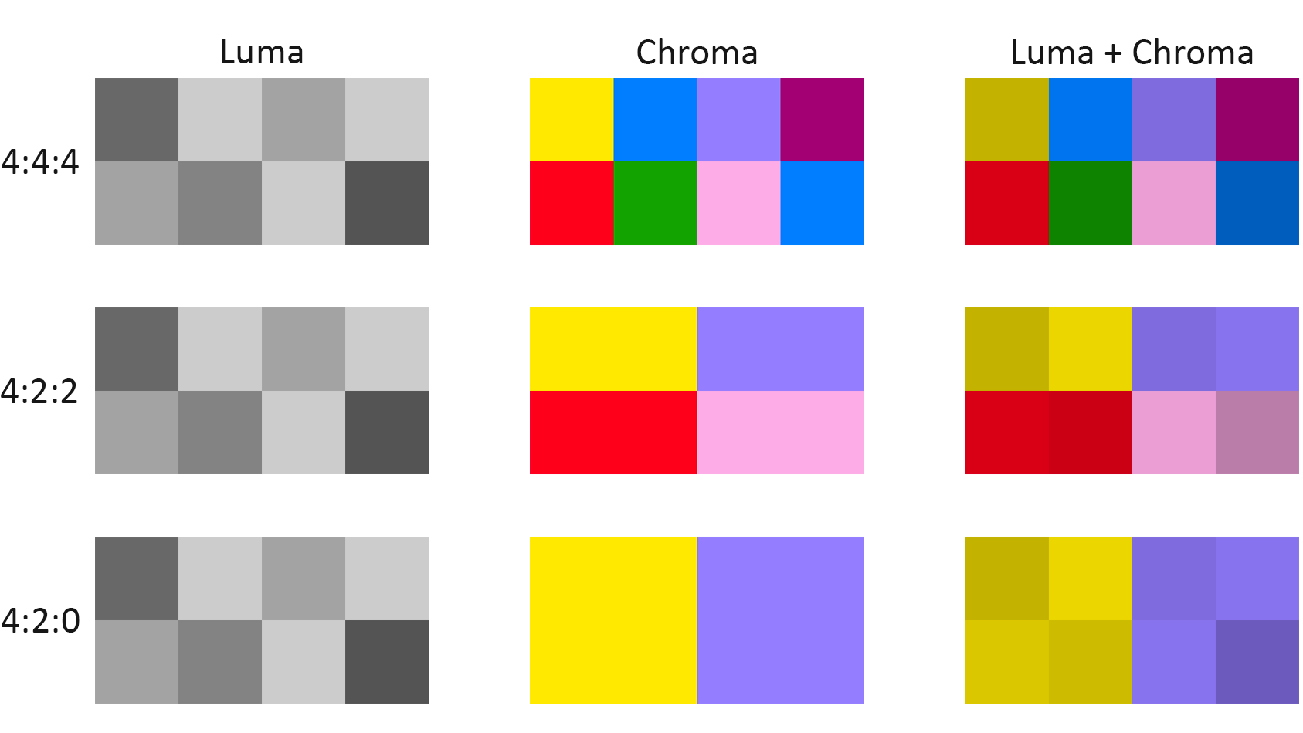

Slide 6
CCIR and ITU-R Standards for Digital Video
The CCIR is the Consultative Committee for International Radio. One of the most important standards it has produced is CCIR-601 for component digital video.
This standard has since become standard ITU-R Rec. 601, an international standard for professional video applications. It is adopted by several digital video formats, including the popular DV video.

Slide 7
The NTSC-compatible version has 525 scan lines, each having 858 pixels (with 720 of them visible, not in the blanking period).
Because the NTSC version uses 4:2:2, each pixel can be represented with 2 bytes (8 bits for Y and 8 bits alternating between Cb and Cr).
The Rec. 601 (NTSC) data rate (including blanking and sync but excluding audio) is thus approximately 216 Mbps (megabits per second).
During blanking, digital video systems may make use of the extra data capacity to carry audio signals, translations into foreign languages, or error-correction information.

Slide 8
Table 5.3 shows some of the digital video specifications, all with an aspect ratio of 4:3. The Rec. 601 standard uses an interlaced scan, so each field has only half as much vertical resolution.
The idea of CIF, is to specify a format for lower bitrate.
CIF uses a progressive (noninterlaced) scan. QCIF stands for Quarter-CIF, and is for even lower bitrate. All the CIF/QCIF resolutions are evenly divisible by 8.

Slide 10
High Definition TV (HDTV)
The main thrust of high-definition TV (HDTV) is not to increase the “definition” in each unit area, but rather to increase the visual field, especially its width.
It has 1,125 scan lines, interlaced (60 fields per second), and a 16:9 aspect ratio. It uses satellite to broadcast.

Slide 11
In general, terrestrial broadcast, satellite broadcast, cable, and broadband networks are all feasible means for transmitting HDTVas well as conventional TV.
Since uncompressed HDTV will easily demand more than 20 MHz bandwidth, which will not fit in the current 6 or 8 MHz channels, various compression techniques are being investigated.
It is also anticipated that high-quality HDTV signals will be transmitted using more than one channel, even after compression.

Slide 12
Ultra-High-Definition TV (UHDTV)
Ultra-High-Definition TV (UHDTV), also known as Ultra HD or UHD, is a new generation of HDTV. Effort toward UHDTV standards was initialized in 2012 and the ATSC (Advanced Television Systems Committee) called for proposals to support the 4K UHDTV (2160P) at 60 fps in 2013.
As of today, UHDTV mainly includes 4KUHDTV: 2160P (3, 840 × 2, 160, progressive scan) and 8K UHDTV: 4320P (7, 680 × 4, 320, progressive scan). The aspect ratio

