Slide 1
Chapter – 3
Layer -2 Protocols

Slide 2
L2 Switch
Switches usually perform these three functions in a LAN:
address learning – switches learn MAC addresses by examining the source MAC address of each received frame.
forward/filter decisions – switches decide whether to forward or filter a frame, based on the destination MAC address.
loop avoidance – switches use Spanning Tree Protocol (STP) to prevent network loops while still permitting redundancy.

Slide 3
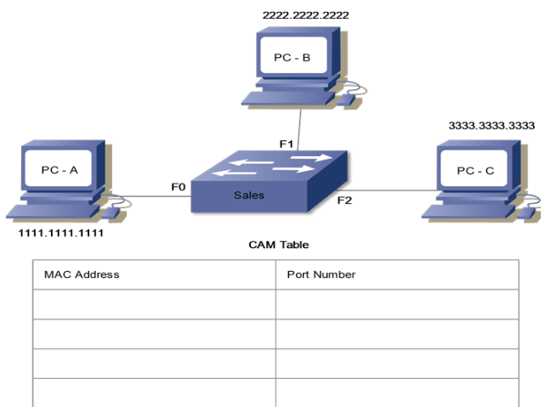
Learning MAC Addresses dynamically
The MAC address learning process is relatively simple. When processing an incoming frame, the switch checks the source MAC address of the frame in the MAC table. If an entry for the source address is not available in the MAC table, it creates a new entry for that source. If an entry is already available, the switch updates the existing entry.
Now suppose, the PC-A sends a frame to the PC-B. Upon receiving this frame on the F0 interface, the switch takes the following actions.
The switch reads both the source and destination MAC addresses of the frame and finds them in the MAC table.
Processing frame based on the destination
If the switch finds an entry for the destination MAC address, it forwards the frame from the port on which the destination address is available. If it does not find an entry for the destination MAC, it floods the frame from all ports except the port on which the frame arrived. Since the MAC table is empty, the switch sends this frame out of every port except the source port (F0).

Slide 4
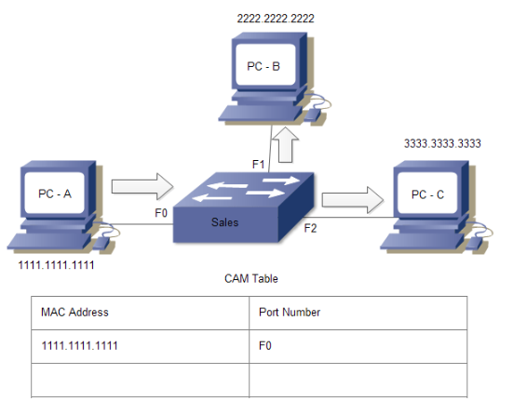
The following image shows how the switch processes the frame sent by the PC-A.
.

Slide 5
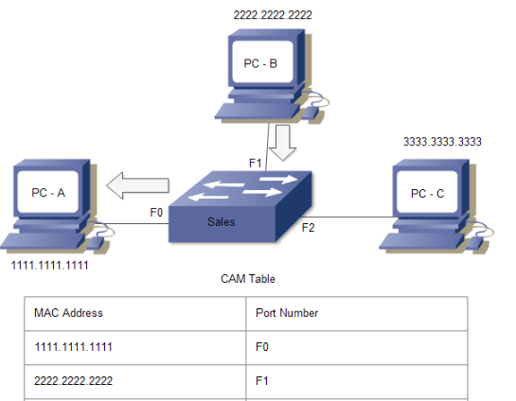
If the PC-B responses back to PC-A and sends a frame back, the switch takes the source MAC address from that frame and place that MAC address in the CAM table as well, associating this address with the interface that received the frame. Since the switch already knows where the PC-A is located, so it doesn’t flood the frame as it did the first time. This time it only sends the frame out from the F0 interface.
The following image shows how the switch processes this frame

Slide 6
ARP (Address Resolution Protocol)
ARP (Address Resolution Protocol) is a network protocol used to find out the hardware (MAC) address of a device from an IP address. It is used when a device wants to communicate with some other device on a local network (for example on an Ethernet network that requires physical addresses to be known before sending packets). The sending device uses ARP to translate IP addresses to MAC addresses. The device sends an ARP request message containing the IP address of the receiving device. All devices on a local network segment see the message, but only the device that has that IP address responds with the ARP reply message containing its MAC address. The sending device now has enough information to send the packet to the receiving device.
ARP request packets are sent to the broadcast addresses (FF:FF:FF:FF:FF:FF for the Ethernet broadcasts and 255.255.255.255 for the IP broadcast).

Slide 7
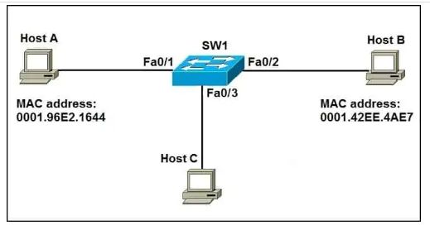
ARP
Let’s say that host A wants to communicate with host B for the first time. Host A knows the IP address of host B, but since this is the first time the two hosts communicate, the hardware (MAC) addresses are not known. Host A uses the ARP process to find out the MAC address of host B. The switch forwards the ARP request out all ports except the port the host A is connected to. Host B receives the ARP request and responds with its MAC address. Host B also learns the MAC address of host A (because host A sent its MAC address in the ARP request). Host C receives the ARP request but doesn’t respond since the IP address listed in the request is not its own.

Slide 8
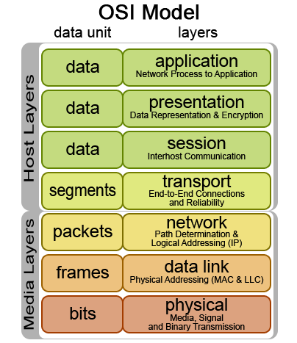
Ethernet
Destination Address (MAC)
Source Address (MAC)
Type
(Data?)
DATA
(IP, etc.)
FCS
(Errors?)
Ethernet
Layer 2 – Data Link Layer
NIC (Source MAC address) to NIC (Destination MAC address) communications in the same network
Source MAC address – Address of the sender’s NIC
Destination MAC address
Unicast: MAC address of destination NIC on the same network
Broadcast: All 1 bits (F’s)

Slide 9
VLAN
VLANs (Virtual LANs) are logical grouping of devices in the same broadcast domain.
Why VLANs:
VLANs increase the number of broadcast domains while decreasing their size.
VLANs reduce security risks
more flexible network designs that group users by department instead of by physical location

Slide 10
Trunking, DTP, VTP, STP and EtherChannel

Slide 11
VLAN Trunking
A VLAN trunk is a point-to-point link that carries more than one VLAN.
Trunks carry the traffic for multiple VLANs across a single physical link (multiplexing).
Usually established between switches to support intra VLAN communication.
A VLAN trunk or trunk ports are not associated to any VLANs.
Switch Ethernet ports can be set to:
Access port: Non-trunking port used to connect to end-devices.
Trunking: Trunking port to carry VLAN information to another switch.
Notes:
The host on the left in VLAN 2 can communicate with the host on the right in VLAN 2 via the trunk link; over the same trunk link, the hosts on VLAN 1 can communicate simultaneously.

Slide 12
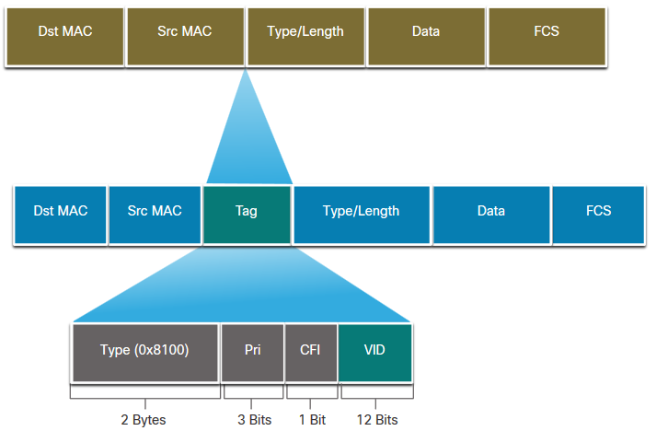
VLAN Trunking with IEEE 802.1Q
802.1Q is a widely supported industry-standard protocol.
Smaller frame overhead than ISL.
The IEEE 802.1Q header is 4 Bytes
When the tag is created the FCS must be recalculated.
When sent to end devices, this tag must be removed and the FCS recalculated back to its original number.
802.1Q VLAN Tag Field | Function
Type | 2-Byte field with hexadecimal 0x8100 This is referred to as Tag Protocol ID (TPID)
User Priority | 3-bit value that supports
Canonical Format Identifier (CFI) | 1-bit value that can support token ring frames on Ethernet
VLAN ID (VID) | 12-bit VLAN identifier that can support up to 4096 VLANs
Notes:
Dest: Destination MAC address (6 bytes)
Src: Source MAC address (6 bytes)
Tag: Inserted 802.1Q tag (4 bytes, detailed here):
EtherType(TPID): Set to 0x8100 to specify that the 802.1Q tag follows.
PRI: 3-bit 802.1p priority field.
CFI: Canonical Format Identifier; is always set to 0 for Ethernet switches and to 1 for Token Ring-type networks.
VLAN ID: 12-bit VLAN field. Of the 4096 possible VLAN IDs, the maximum number of possible VLAN configurations is 4094. A VLAN ID of 0 indicates priority frames, and value 4095 (FFF) is reserved. CFI, PRI, and VLAN ID are represented as Tag Control information (TCI) fields.
Len/Etype: 2-byte field specifying length (802.3) or type (Ethernet II).
Data: Data itself.
FCS: Frame check sequence (4 bytes).

Slide 13
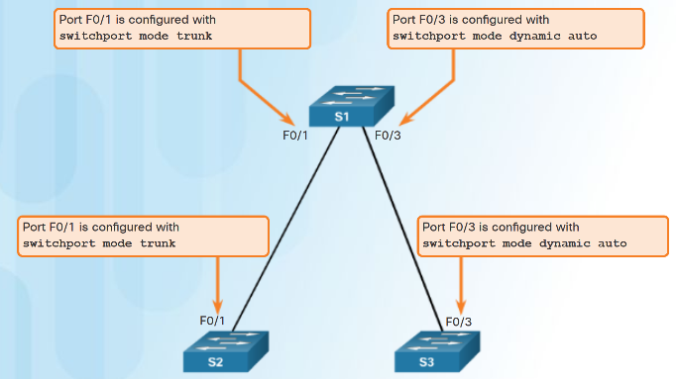
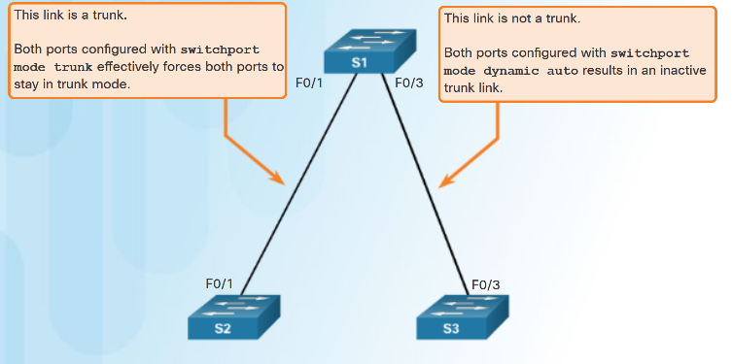
Dynamic Trunking Protocol (DTP)
Trunk negotiation is managed by the Dynamic Trunking Protocol (DTP)
To enable trunking from a Cisco switch to a device that does not support DTP, use the switchport mode trunk and switchport nonegotiate

Slide 14
Dynamic Trunking Protocol (DTP)
Access - Puts the interface into permanent non-trunking mode and negotiates to convert the link into a non-trunk link. The interface becomes a non-trunk interface even if the neighboring interface does not agree to the change.
Trunk - Puts the interface into permanent trunking mode and negotiates to convert the link into a trunk link. The interface becomes a trunk interface even if the neighboring interface does not agree to the change.
Nonegotiate - Puts the interface into permanent trunking mode but prevents the interface from generating DTP frames. You must configure the neighboring interface manually as a trunk interface to establish a trunk link. Use this mode when connecting to a device that does not support DTP.
Dynamic desirable - Makes the interface actively attempt to convert the link to a trunk link. The interface becomes a trunk interface if the neighboring interface is set to trunk, desirable, or auto mode.
Dynamic auto - Makes the interface willing to convert the link to a trunk link. The interface becomes a trunk interface if the neighboring interface is set to trunk or desirable mode. This is the default mode for all Ethernet interfaces in Cisco IOS.
Notes:
All recent Cisco Catalyst switches, except for the Catalyst 2900XL and 3500XL, use a Cisco proprietary point-to-point protocol called Dynamic Trunking Protocol (DTP) on trunk ports to negotiate the trunking state. DTP negotiates the operational mode of directly connected switch ports to a trunk port and selects an appropriate trunking protocol. Nego­tiating trunking is a recommended practice in multilayer switched networks because it avoids network issues resulting from trunking misconfigurations for initial configuration, but best practice is when the network is stable, change to trunk mode.
The default interface trunking mode is dynamic auto.

Slide 15
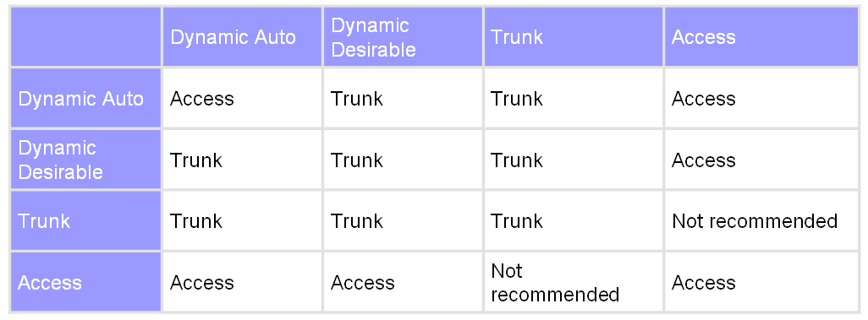
Default
ALS1(config)# interface range fastethernet 0/11 - 12
ALS1(config-if-range)# switchport mode trunk

Slide 16
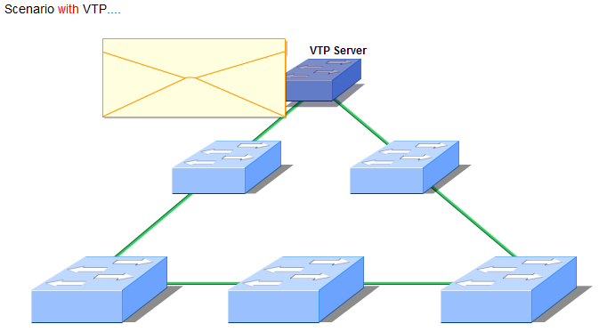
VTP (VLAN Trunking Protocol)
VTP Message
VLAN Trunk Protocol (VTP) reduces administration in a switched network.
VLAN trunking protocol (VTP) allows a network administrator to manage VLANs on a switch configured as a VTP server
VLAN information can be configured on a VTP server, which is then distributed through all switches in the domain.
Do not have to configure on each switch individually.

Slide 17
VTP (VLAN Trunking Protocol) Modes
Server
Can create, modify, and delete VLANs
Configure VTP version and VTP pruning (next week).
Advertise their VLAN configuration to other switches in the same VTP domain
VTP advertisements sent/received over trunk links.
Default mode.
Client
Behave the same way as VTP servers, but you cannot create, change, or delete VLANs on a VTP client.
Transparent
Does not participate in VTP.
Does not advertise its VLAN configuration.
Does not synchronize its VLAN configuration based on received advertisements
Does forward VTP advertisements that they receive out their trunk ports in VTP Version 2.
DLS1(config)# vtp mode ?
client Set the device to client mode.
server Set the device to server mode.
transparent Set the device to transparent mode.
DLS1(config)#

Slide 18
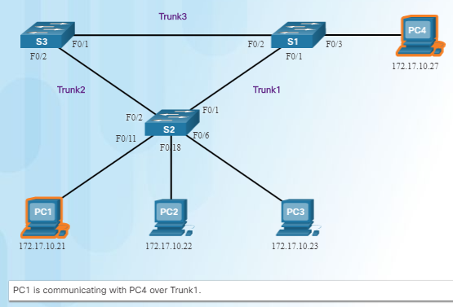
Spanning Tree Protocol Redundancy at OSI Layers 1 and 2
Switched networks commonly have redundant paths and even redundant links between the same two devices.
Redundant paths eliminate a single point of failure in order to improve reliability and availability.
Redundant paths can cause physical and logical Layer 2 loops.
Spanning Tree Protocol (STP) is a Layer 2 protocol that helps especially when there are redundant links.
Layer 2 loop issues
Mac database instability – copies of the same frame being received on different ports.
Broadcast storms – broadcasts are flooded endlessly causing network disruption.
Multiple frame transmission – multiple copies of unicast frames delivered to the same destination.

Slide 19
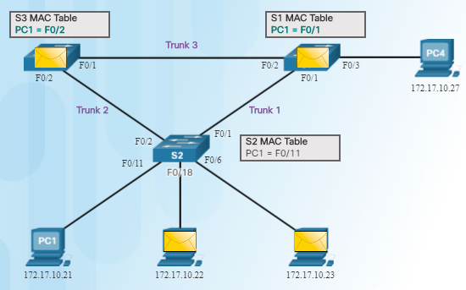
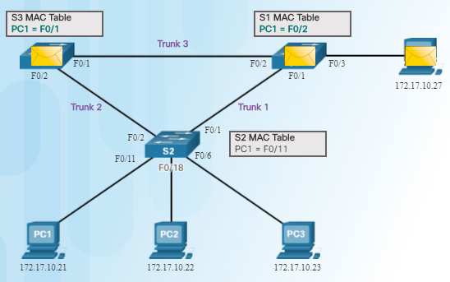
Issues with Layer 1 Redundancy: MAC Database Instability
Ethernet frames do not have a time to live (TTL) field like the Layer 3 IP header has. This means that Ethernet has no mechanism to drop frames that propagate endlessly. This can
result in MAC database instability.
PC1 sends a broadcast frame to S2.
S2 updates the MAC address table for PC1’s MAC address on port 11.
S2 forwards the frame out all ports except the port the frame came in on. S1 and S3 receive the frame on a trunk and update their own MAC address tables that PC1 is reachable through the trunk port.
S1 and S3 send the frame out all ports except the port it came in on.
When S1 sends the frame out port 2 (Trunk 3), S3 updates the MAC address table to reflect that PC1 is now reachable through port 1.
A host caught in a network loop is not accessible to other hosts.
Due to constant changes in the MAC address table, Switches S3 and S1 do not know which port to forward frames.

Slide 20
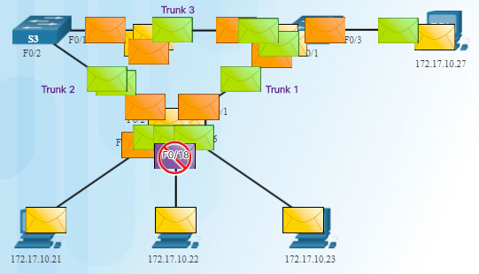
Issues with Layer 1 Redundancy: Broadcast Storms
Broadcast storm – so many broadcast frames in a Layer 2 loop that use all available bandwidth and make the network unreachable for legitimate network traffic.
Causes a denial of service (DoS)
Can develop in seconds and bring the network down

Slide 21
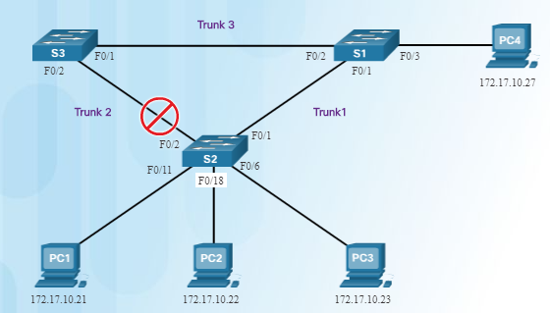
Spanning Tree Algorithm: Introduction
Root bridge
RP
DP
DP
DP
Blocked
RP
Four main steps of STP Process
Elect a root bridge.
Determine the root port (RP) on each non-root bridge switch.
Determine the designated port (DP) for each link between switches.
Elect alternate (blocked) ports.
The Spanning Tree Protocol (STP) creates one logical path through the switch network (all destinations on the network).
Blocks redundant paths that could cause a loop.
STP sends bridge protocol data units (BPDUs) between Layer 2 devices in order to create the one logical path.
A port on S2 is blocked so traffic can only flow one way between any two devices.
When Trunk1 fails, the blocked port on S2 is unblocked and traffic can flow between S2 and S3.

Slide 22
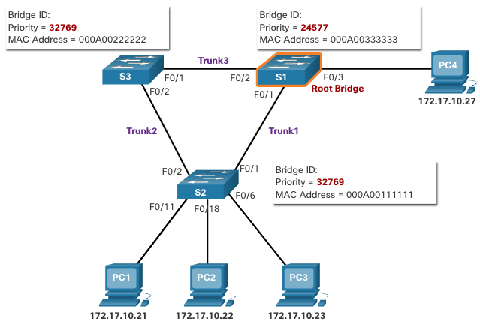
STP Operations 1. Elect the Root Bridge
Supports per-VLAN STP operations
Lowest bridge ID (BID) becomes Root bridge
Originally BID had two fields: bridge priority and MAC address
Bridge priority default is 32,768 (can change)
Lowest MAC address (if bridge priority is not changed) becomes determinant for root bridge.
Notes:
5 – STP Concepts
5.2 – STP Operations
5.2.2 – 1. Elect the Root Bridge

Slide 23
STP Operations 1. Elect the Root Bridge
The STP designates a single switch as the root bridge and uses it as the reference point for all path calculations. Switches exchange BPDUs to build the loop-free topology beginning with selecting the root bridge.
All switches in the broadcast domain participate in the election process. After a switch boots, it begins to send out BPDU frames every two seconds. These BPDU frames contain the BID of the sending switch and the BID of the root bridge, known as the Root ID.
The switch with the lowest BID will become the root bridge. At first, all switches declare themselves as the root bridge with their own BID set as the Root ID. Eventually, the switches learn through the exchange of BPDUs which switch has the lowest BID and will agree on one root bridge.
Notes:
5 – STP Concepts
5.2 – STP Operations
5.2.2 – 1. Elect the Root Bridge

Slide 24
STP Operations Impact of Default BIDs
Because the default BID is 32768, it is possible for two or more switches to have the same priority. In this scenario, where the priorities are the same, the switch with the lowest MAC address will become the root bridge. The administrator should configure the desired root bridge switch with a lower priority.
In the figure, all switches are configured with the same priority of 32769. Here the MAC address becomes the deciding factor as to which switch becomes the root bridge. The switch with the lowest hexadecimal MAC address value is the preferred root bridge. In this example, S2 has the lowest value for its MAC address and is elected as the root bridge for that spanning tree instance.
Note: The priority of all the switches is 32769. The value is based on the 32768 default bridge priority and the extended system ID (VLAN 1 assignment) associated with each switch (32768+1).
Notes:
5 – STP Concepts
5.2 – STP Operations
5.2.3 – Impact of Default BIDs

Slide 25
STP Operations 2. Elect the Root Ports - Determine the Root Path Cost
Root path cost is used to determine the role of the port and whether or not traffic is blocked.
Can be modified with the spanning-tree cost interface command.
Link Speed | STP Cost: IEEE 802.1D-1998 | RSTP Cost: IEEE 802.1w-2004
10 Gbps | 2 | 2,000
1 Gbps | 4 | 20,000
100 Mbps | 19 | 200,000
10 Mbps | 100 | 2,000,000
Notes:
5 – STP Concepts
5.2 – STP Operations
5.2.4 – Determine the Root Path Cost

Slide 26
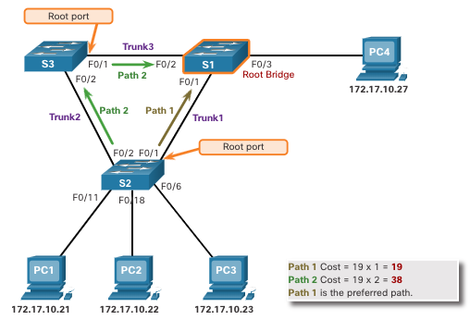
STP Operations 2. Elect the Root Ports
After the root bridge has been determined, the STP algorithm is used to select the root port. Every non-root switch will select one root port. The root port is the port closest to the root bridge in terms of overall cost to the root bridge. This overall cost is known as the internal root path cost.
The internal root path cost is equal to the sum of all the port costs along the path to the root bridge, as shown in the figure. Paths with the lowest cost become preferred, and all other redundant paths are blocked. In the example, the internal root path cost from S2 to the root bridge S1 over path 1 is 19 while the internal root path cost over path 2 is 38. Because path 1 has a lower overall path cost to the root bridge, it is the preferred path and F0/1 becomes the root port on S2.
Notes:
5 – STP Concepts
5.2 – STP Operations
5.2.5 – 2. Elect the Root Ports

Slide 27
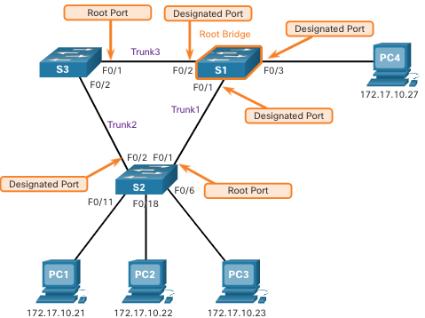
STP Operations 3. Elect Designated Ports
Every segment between two switches will have only one designated port. The designated port is a port on the segment that has the internal root path cost to the root bridge. In other words, the designated port has the best path to receive traffic leading to the root bridge.
What is not a root port or a designated port becomes an alternate or blocked port.
All ports on the root bridge are designated ports.
If one end of a segment is a root port, the other end is a designated port.
All ports attached to end devices are designated ports.
On segments between two switches where neither of the switches is the root bridge, the port on the switch with the least-cost path to the root bridge is a designated port, if the cost is the same the port on the switch with the lowest BID is selected.
Notes:
5 – STP Concepts
5.2 – STP Operations
5.2.6 – Elect Designated Ports

Slide 28
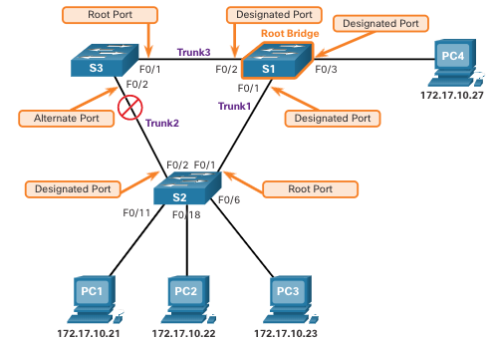
STP Operations 4. Elect Alternate (Blocked) Ports
If a port is not a root port or a designated port, then it becomes an alternate (or backup) port. Alternate ports are in discarding or blocking state to prevent loops. In the figure, the STA has configured port F0/2 on S3 in the alternate role. Port F0/2 on S3 is in the blocking state and will not forward Ethernet frames. All other inter-switch ports are in forwarding state. This is the loop-prevention part of STP.
Notes:
5 – STP Concepts
5.2 – STP Operations
5.2.7 – Elect Alternate (Blocked) Ports

Slide 29
STP Operations Elect a Root Port from Multiple Equal-Cost Paths
When a switch has multiple equal-cost paths to the root bridge, the switch will determine a port using the following criteria:
Lowest sender BID
Lowest sender port priority
Lowest sender port ID
Notes:
5 – STP Concepts
5.2 – STP Operations
5.2.8 – Elect a Root Port from Multiple Equal-Cost Paths

Slide 30
STP Operations Elect a Root Port from Multiple Equal-Cost Paths (Cont.)
Lowest Sender Port Priority: This topology has two switches which are connected with two equal-cost paths between them. S1 is the root bridge, so both of its ports are designated ports.
S4 has two ports with equal-cost paths to the root bridge. Because both ports are connected to the same switch, the sender’s BID (S1) is equal. So the first step is a tie.
Next, is the sender’s (S1) port priority. The default port priority is 128, so both ports on S1 have the same port priority. This is also a tie. However, if either port on S1 was configured with a lower port priority, S4 would put its adjacent port in forwarding state. The other port on S4 would be a blocking state.
Notes:
5 – STP Concepts
5.2 – STP Operations
5.2.8 – Elect a Root Port from Multiple Equal-Cost Paths (Cont.)

Slide 31
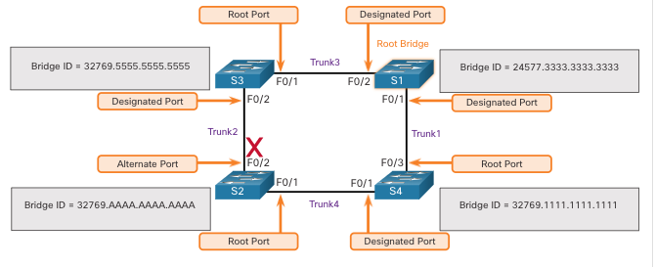
STP Operations Elect a Root Port from Multiple Equal-Cost Paths (Cont.)
Lowest Sender BID: This topology has four switches with switch S1 as the root bridge. Port F0/1 on switch S3 and port F0/3 on switch S4 have been selected as root ports because they have the root path cost to the root bridge for their respective switches. S2 has two ports, F0/1 and F0/2 with equal cost paths to the root bridge. The bridge IDs of S3 and S4, will be used to break the tie. This is known as the sender’s BID. S3 has a BID of 32769.5555.5555.5555 and S4 has a BID of 32769.1111.1111.1111. Because S4 has a lower BID, the F0/1 port of S2, which is the port connected to S4, will be the root port.
Notes:
5 – STP Concepts
5.2 – STP Operations
5.2.8 – Elect a Root Port from Multiple Equal-Cost Paths (Cont.)

Slide 32
STP Operations Elect a Root Port from Multiple Equal-Cost Paths (Cont.)
Lowest Sender Port ID: The last tie-breaker is the lowest sender’s port ID. Switch S4 has received BPDUs from port F0/1 and port F0/2 on S1. The decision is based on the sender’s port ID, not the receiver’s port ID. Because the port ID of F0/1 on S1 is lower than port F0/2, the port F0/6 on switch S4 will be the root port. This is the port on S4 that is connected to the F0/1 port on S1.
Port F0/5 on S4 will become an alternate port and placed in the blocking state.
Notes:
5 – STP Concepts
5.2 – STP Operations
5.2.8 – Elect a Root Port from Multiple Equal-Cost Paths (Cont.)

Slide 33
STP decisions are based on 4 condition
Lowest root Bridge ID
Lowest Root Path Cost to Root Bridge
Lowest Sender Bridge ID
Lowest Sender Port ID

Slide 34
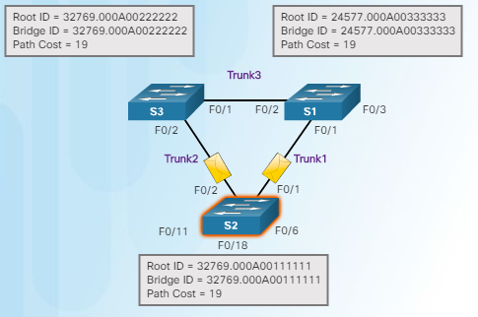
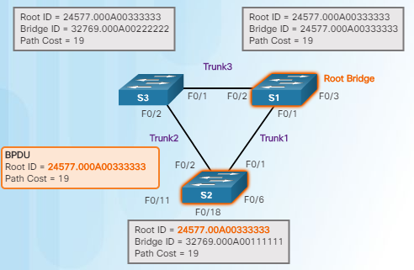
STP Operation 802.1D BPDU Propagation and Process
When a switch is powered on, it assumes it is the root bridge until BPDUs are sent and STP calculations are performed. S2 sends out BPDUs.
S3 compares its root ID with the BPDU from S2. S2 is lower so S3 updates its root ID.
S1 receives the same information from S2 and because S1 has a lower BID, it ignores the information from S2.
S3 sends BPDUs out all ports indicating that S2 is root bridge.
S2 compares the info from S3 so S2 still thinks it is root bridge.
S1 gets the same information from S3 (that S2 is root bridge), but because S1 has a lower BID, the switch ignores the information in the BPDU
S1 now sends out BPDUs out all ports. The BPDU contains information designated S1 as root bridge.
S3 compares the info from S1 so S3 now sees that the BID from S1 is lower than its stored root bridge information which is currently showing that S2 is root bridge. S3 changes the root ID to the information received from S1.
S2 compares the info from S1 so S2 now sees the BID from S1 is lower than its own BID. S2 now updates its own information showing S1 as root bridge.

Slide 35
802.1D STP Port Types
The 802.1D STP standard defines the following three port types:
Port Types | Description
Root port (RP) | A network port that connects to the root bridge or an upstream switch in the spanning-tree topology. There should be only one root port per VLAN on a switch.
Designated port (DP) | A network port that receives and forwards BPDU frames to other switches. Designated ports provide connectivity to downstream devices and switches. There should be only one active designated port on a link.
Blocking port | A network that is not forwarding traffic because of STP calculations.

Slide 36
IEEE 802.1D STP Port States
 | Port States | Description
No Limits | Disabled | The port is in an administratively off position (that is, shut down).
20 Second | Blocking | The switch port is enabled, but the port is not forwarding any traffic.
15 Second | Listening | The switch port has transitioned from a blocking state and can now send or receive only BPDUs.
15 Second | Learning | The switch port can modify the MAC address table. The switch still does not forward any other network traffic besides BPDUs.
No Limits | Forwarding | The switch port can forward all network traffic and can update the MAC address table as expected.
 | Broken | The switch has detected a problem on a port that can have major effects. The port discards packets as long as the problem continues to exist.

Slide 37
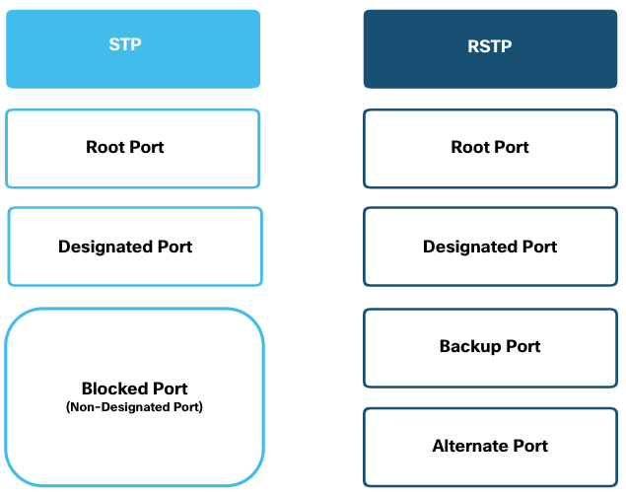
Evolution of STP RSTP Port States and Port Roles
Root ports and designated ports are the same for both STP and RSTP. However, there are two RSTP port roles that correspond to the blocking state of STP. In STP, a blocked port is defined as not being the designated or root port. RSTP has two port roles for this purpose.
Alternate port – (RSTP only) backup port for the designated port when the other side is not a root port.
Backup port – (RSTP only) backup port for the root port.
There are only three port states in RSTP that correspond to the three possible operational states in STP. The 802.1D disabled, blocking, and listening states are merged into a unique 802.1w discarding state.
Notes:
5 – STP Concepts
5.3 – Evolution of STP
5.3.3 – RSTP Port States and Port Roles

Slide 38
Types of Spanning Tree Protocols
STP Type | Description
802.1D | 1998 - Original STP standard
CST | One spanning-tree instance
PVST+ | Cisco update to 802.1D; each VLAN has its own spanning-tree instance
802.1D | 2004 – Updated bridging and STP standard
802.1w (RSTP) | Improves convergence by adding new roles to ports and enhancing BPDU exchange
Rapid PVST+ | Cisco enhancement of RSTP using PVST+
802.1s (MSTP) | Multiple VLANs can have the same spanning-tree instance

Slide 39
Varieties of Spanning Tree Protocols Characteristics of Spanning Tree Protocols
STP Type | Standard | Resources Needed | Convergence | Tree Calculation
STP | 802.1D | Low | Slow | All VLANs
PVST+ | Cisco | High | Slow | Per VLAN
RSTP | 802.1w | Medium | Fast | All VLANs
Rapid PVST+ | Cisco | Very high | Fast | Per VLAN
MSTP | 802.1s | Medium or high | Fast | Per instance

Slide 40
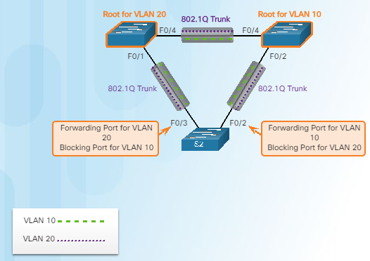
Overview of PVST+
Original 802.1D defines a common spanning tree
One spanning tree instance for the switched network
(no matter how many VLANs)
No load sharing
One uplink must block for all VLANs
Low CPU utilization because only one instance of STP is used/calculated
Cisco PVST+ - each VLAN has its own spanning tree instance
One port can be blocking for one VLAN and forwarding for another VLAN
Can load balance
Can stress the CPU if a large number of VLANs are used

Slide 41
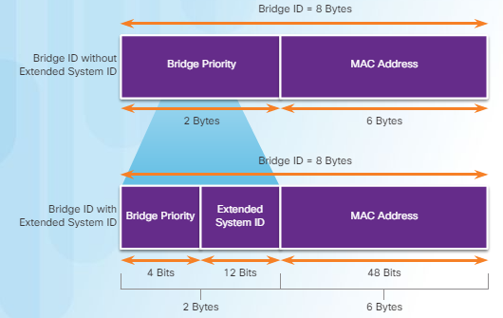
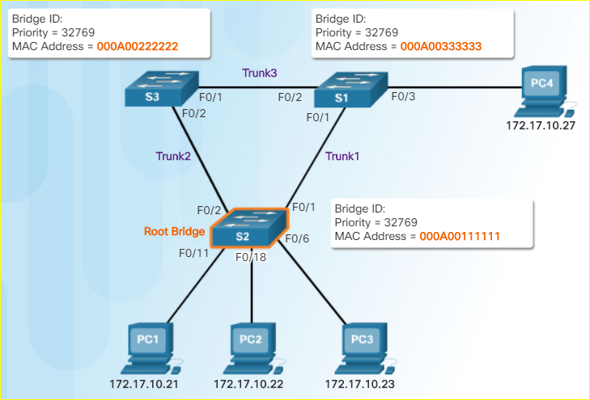
Extended System ID and PVST+ Operation
Remember - lowest BID becomes root
If priorities are all set to the default, lowest MAC address is the determining factor in lowest BID.
The priority value can be modified to influence root bridge elections.
The extended system ID field ensures each switch has a unique BID for each VLAN.
The VLAN number is added to the priority value.
Example – VLAN 2 priority is 32770 (default value of 32768 plus the VLAN number of 2 equals 32770)
Can modify the priority number to influence the root bridge decision process
Reasons to select a particular switch as root bridge
Switch is positioned such that most traffic patterns flow toward this particular switch
Switch has more processing power (better CPU)
Switch is easier to access and manage remotely

Slide 42
Port States and PVST+ Operation
Port State
Operation allowed | Blocking | Listening | Learning | Forwarding | Disabled
Can receive/process BPDUs | Yes | Yes | Yes | Yes | No
Can forward data frames received on an interface | No | No | No | Yes | No
Can forward data frames switched from another interface | No | No | No | Yes | No
Can learn MAC addresses | No | No | Yes | Yes | No

Slide 43
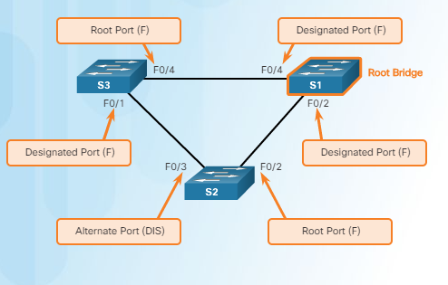
Varieties of Spanning Tree Protocols Overview of Rapid PVST+
Rapid PVST+ speeds up STP recalculations and converges quicker
Cisco version of RSTP
Two new port types
Alternate port (DIS)
Backup port
Independent instance of RSTP runs for each VLAN
Cisco features such as UplinkFast and BackboneFast are not compatible with switches that run RSTP

Slide 44
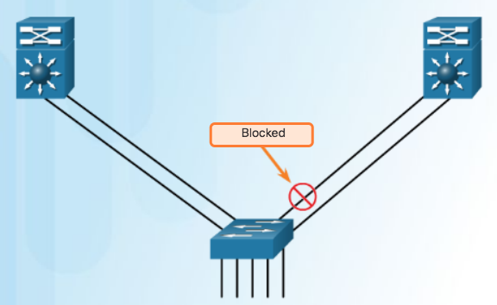
EtherChannel Introduction to Link Aggregation
It is possible to combine the number of physical links between switches to increase the overall speed of switch-to-switch communication.
STP will block redundant links to prevent routing loops.
Redundant Links with STP (by default blocked)
Advantages of EtherChannel
Most configuration tasks can be done on the EtherChannel interface instead of on each individual port.
EtherChannel relies on existing switch ports.
Load balancing takes place between links that are part of the same EtherChannel.
EtherChannel creates an aggregation that is seen as one logical link.
EtherChannel provides redundancy because the overall link is seen as one logical connection.

Slide 45
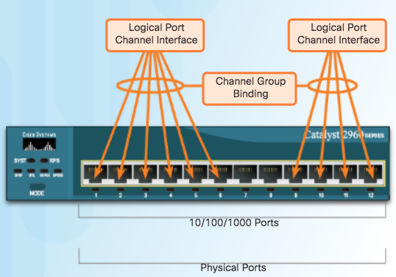
Implementation Restrictions
EtherChannel groups multiple physical ports into one or more logical EtherChannel links.
Link aggregation helps reduce traffic bottlenecks by allowing up to 8 switch ports to be bound together for data communications.
EtherChannel Restrictions
Interface types cannot be mixed. (Fast Ethernet + Gigabit Ethernet cannot be grouped.)
Provides full-duplex bandwidth up to 800 Mbps (Fast EtherChannel) or 8 Gbps (Gigabit EtherChannel)
Cisco IOS Switch can support 6 EtherChannels.
Created between two switches or a server and switch.
If one side is configured as trunk, the other side must be a trunk within same native VLAN.
Each EtherChannel has a logical port channel interface and changes to a channel affects its physical interfaces.

Slide 46
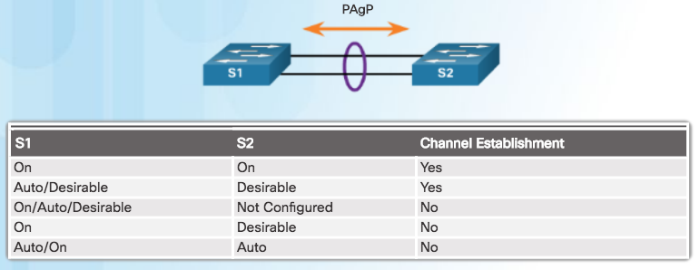
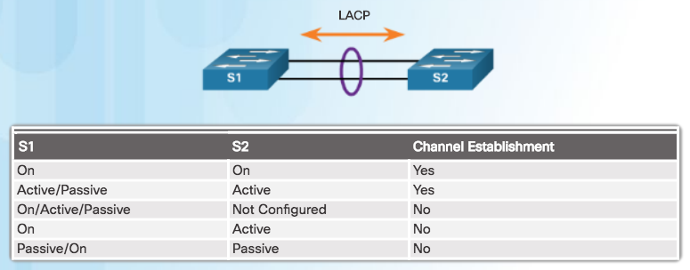
EtherChannel Operation Port Aggregation Protocol and Link Aggregation Control Protocol
EtherChannels can be formed by using PAgP or LACP protocol
PAgP (“Pag-P”) Cisco-proprietary protocol
LACP multivendor environment

Slide 47
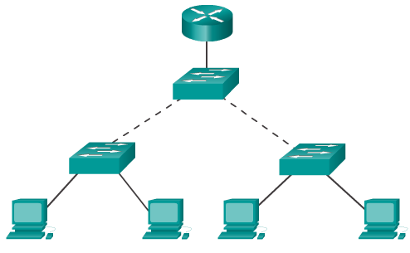
Configure L-2 Port Security
Port security allows an administrator to limit the number of MAC addresses learned on a port.
If this is exceeded, a switch action can be configured.
Configure each access port to accept 1 MAC address only or a small group of MAC addresses.
Frames from any other MAC addresses are not forwarded.
By default, the port will shut down if the wrong device connects.
It has to be brought up again manually.

Slide 48
Configuring Port Security
Use the switchport port-security interface command to enable port security on a port.
It is used to:
Set a maximum number of MAC addresses.
Define violation actions.
MAC address(es) can be learned dynamically, entered manually, or learned and retained dynamically.
Set the aging time for dynamic and static secure address entries.
To verify port security status: show port-security
Switch(config-if)#
switchport port-security [max value] [violation {protect | restrict | shutdown}] [mac-address mac-address [sticky]] [aging time value]

Slide 49
Port Security: Secure MAC Addresses
The switch supports these types of secure MAC addresses:
Static
Configured using switchport port-security mac-address mac-address
Stored in the address table
Added to running configuration.
Dynamic
These are dynamically configured
Stored only in the address table
Removed when the switch restarts
Sticky
These are dynamically configured
Stored in the address table
Added to the running configuration.
If running-config saved to startup-config, when the switch restarts, the interface does not need to dynamically reconfigure them.
Note: When you enter this command, the interface converts all the dynamic secure MAC addresses, including those that were dynamically learned before sticky learning was enabled, to sticky secure MAC addresses. The interface adds all the sticky secure MAC addresses to the running configuration.
Notes:
The switch supports these types of secure MAC addresses:
Static
Configured using switchport port-security mac-address mac-address
Stored in the address table
Added to running configuration.
Dynamic
These are dynamically configured
Stored only in the address table
Removed when the switch restarts
Sticky
These are dynamically configured
Stored in the address table
Added to the running configuration.
If running-config saved to startup-config, when the switch restarts, the interface does not need to dynamically reconfigure them.
Note: When you enter this command, the interface converts all the dynamic secure MAC addresses, including those that were dynamically learned before sticky learning was enabled, to sticky secure MAC addresses. The interface adds all the sticky secure MAC addresses to the running configuration.

Slide 50
End of Chapter 3

