Slide 1
Chapter (2)
Internet Protocol
(IPV4/V6)

Slide 2
IPV4
The IPv4 addresses are unique
and universal.
An IPv4 address is 32 bits long.
The address space of IPv4 is
2³² or 4,294,967,296.
In classful addressing, the address space is divided into five classes:
A, B, C, D, and E.

Slide 3
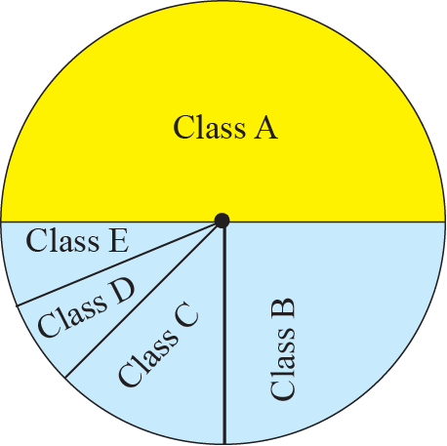
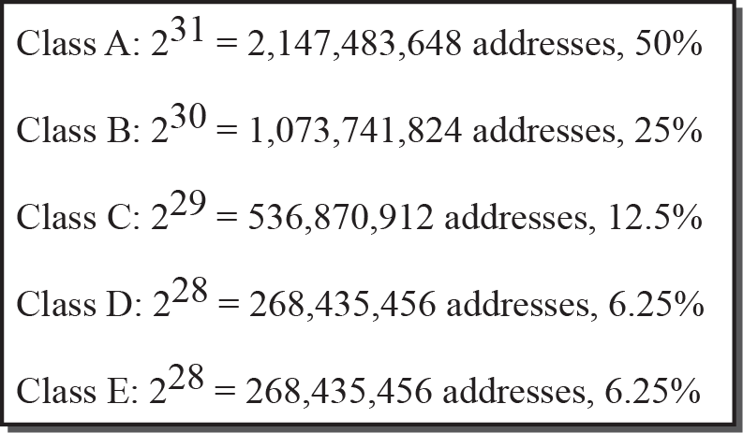
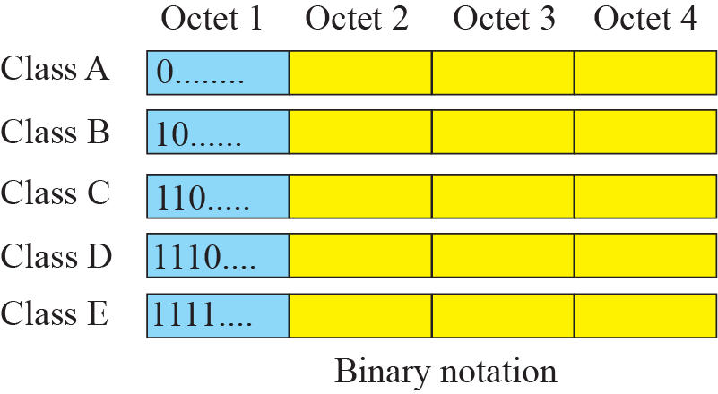
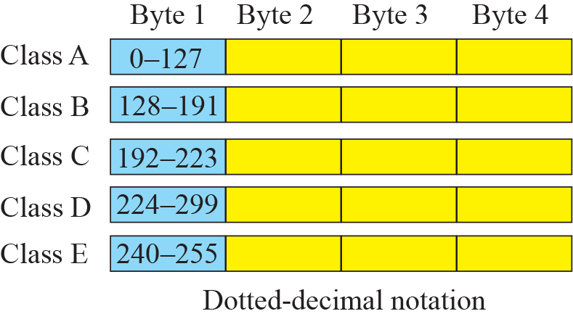
CLASSFUL ADDRESSING
Occupation of address space

Slide 4
Netid and hostid

Slide 5
Private IP Addressing
Private Addressing
10.0.0.0 – 10.255.255.255
172.16.0.0 – 172.31.255.255
192.168.0.0 – 192.168.255.255
Advantage of using IP Private
1.Security. Private network numbers are not advertised to the Internet.
2. Private addressing also helps meet goals for adaptability and flexibility. (Using private addressing makes it easier to change ISPs in the future.
3. Enterprise network can advertise just one network number, or a small block of network numbers, to the Internet

Slide 6
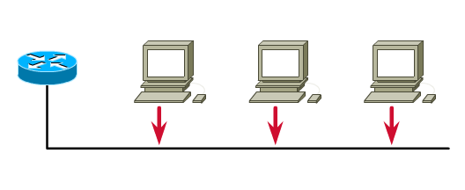
Addressing Hosts
Given the 172.16.0.0 address with the 255.255.0.0 subnet mask:
Network
Network
Host
Host
172
16
0
0
One network address, 65,534 hosts, one broadcast address.
172
16
0
0
1 Network Address
172
16
0
1
65,534 Host Addresses
2¹⁶ - 2
172
16
Etc.
Etc.
172
16
255
254
1 Broadcast Address
172
16
255
255

Slide 7
Subnet Example
Network address 172.16.0.0 with /16 Base Network Mask
Using Subnets: Subnet Mask 255.255.255.0 or /24
What is the range of hosts per subnet and the broadcast address for each subnet?
Network
Network
Subnet
Host
172
16
0
Host
Subnets
172
16
1
Host
172
16
2
Host
255 Subnets
2⁸ - 1
172
16
3
Host
172
16
Etc.
Host
172
16
254
Host
Cannot use last subnet as it contains broadcast address
172
16
255
Host

Slide 8
Subnet Example
Network address 172.16.0.0 with /16 Base Network Mask
Using Subnets: Subnet Mask 255.255.255.0 or /24
Network
Network
Subnet
Hosts
Broadcast
172
16
0
1
254
255
172
16
1
1
254
255
172
16
2
1
254
255
172
16
3
1
254
255
172
16
Etc.
1
254
255
172
16
254
1
254
255
Each subnet has 254 hosts, 2⁸ – 2
172
16
255
Host

Slide 9
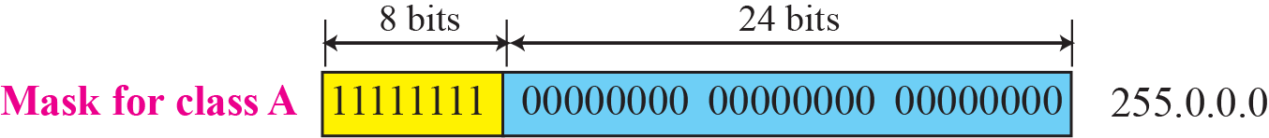
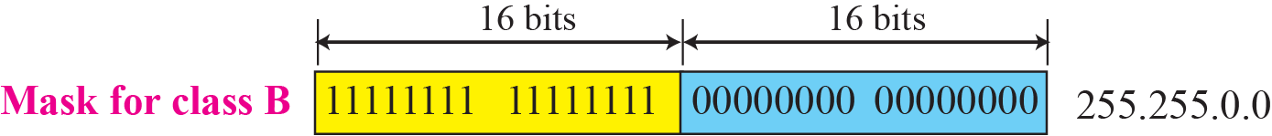
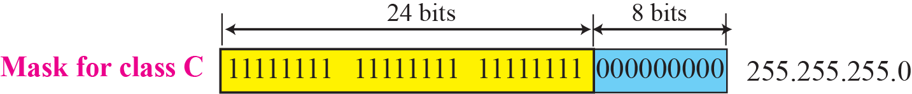
In classless addressing, the prefix defines the network and the suffix defines the host.

Slide 10
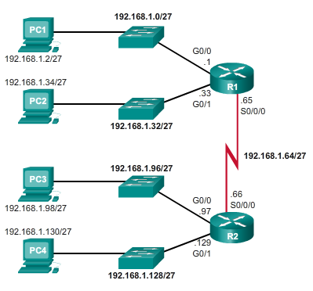
Configuring Subnets in an IPv4 Network
192.168.1.0 /24 We need 3bits for our Network
For example, to configure R1:
  G0/0: 192.168.1.0 /27
  G0/1: 192.168.1.32 /27
  S0/0/0: 192.168.1.64 /27
To configure R2:
  G0/0: 192.168.1.96 /27
  G0/1: 192.168.1.128 /27
  S0/0/0: 192.168.1.64 /27

Slide 11
Variable-Length Subnet Masks (VLSM)
In 1987, RFC 1009 specified how a subnetted network could use more than one subnet mask.
VLSM = Subnetting a Subnet
“If you know how to subnet, you can do VLSM!”

Slide 12
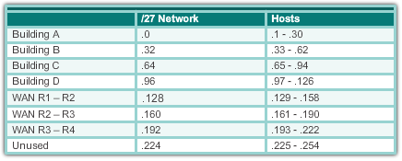
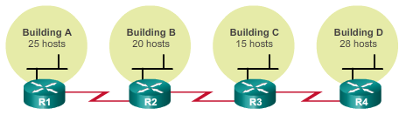
Same Size Subnets = Wasted Addresses
To meet the host requirement of the largest LAN we could borrow 3 bits (/27) to create 8 subnets of 30 hosts each.
  But it also wastes addresses on the point-to-point links and limits future growth by reducing the total number of subnets available.
Solution:
  “Subnet a subnet” using Variable Length Subnet Mask (VLSM).
Point-to-point link
Point-to-point link
Point-to-point link

Slide 13
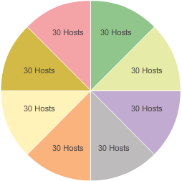
VLSM Example
The four LANs in our previous example can be accommodated using a /27 subnet mask.
This would create subnets with increments of 32, therefore:
  Building A: 192.168.20.0 /27
  Building B: 192.168.20.32 /27
  Building C: 192.168.20.64 /27
  Building D: 192.168.20.96 /27
This leaves four /27 subnets.
Building A
192.168.20.0/27
.224 - 255
.0 - .31
.32 - .63
Building B
192.168.20.32/27
.192 - 223
.160 - 191
.64 - 95
Building C
192.168.20.64/27
.128 - 159
.96 - .127
Building D
192.168.20.96/27

Slide 14
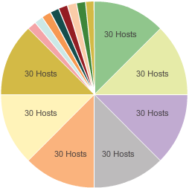
VLSM Example
The WAN interfaces of the routers are assigned the IP addresses and mask for the /30 subnets (2 hosts).
In this example, the last subnet is subnetted into /30 subnets to accommodate WAN interfaces:
  R1 to R2: 192.168.20.224 /30
  R2 to R3: 192.168.20.228 /30
  R3 to R4: 192.168.20.232 /30
This leaves 3 /27 and five /30 subnets.
Building A
192.168.20.0/27
Building B
192.168.20.32/27
Building C
192.168.20.64/27
Building D
192.168.20.96/27

Slide 15
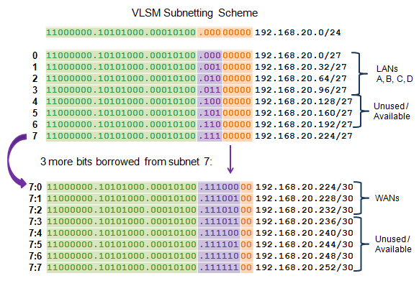
Basic VLSM

Slide 16
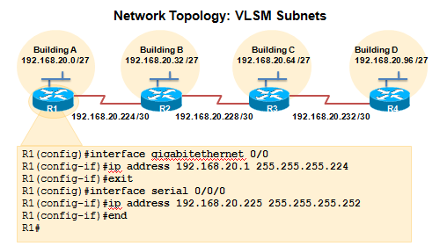
VLSM in Practice
Using VLSM subnets, the LAN and WAN segments in example below can be addressed with minimum waste.
Each LANs will be assigned a subnet with /27 mask.
Each WAN link will be assigned a subnet with /30 mask.

Slide 17
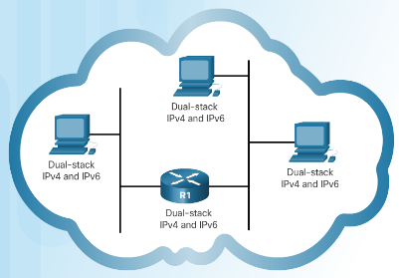
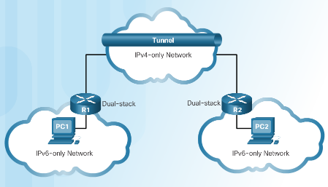
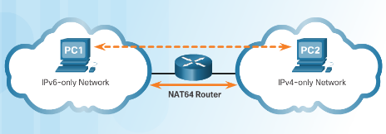
IPv4 and IPv6 Coexistence
Migration from IPv4 to IPv6 Techniques
Dual stack - Devices run both IPv4 and IPv6 protocol stacks simultaneously.
Tunneling - The IPv6 packet is encapsulated inside an IPv4 packet.
Translation - Network Address Translation 64 (NAT64) allows IPv6-enabled devices to communicate with IPv4 devices.
Notes:
7.2 – IPv6 Network Addresses
7.2.1– IPv4 Issues
7.2.1.2 – IPv4 and IPv6 Coexistence

Slide 18
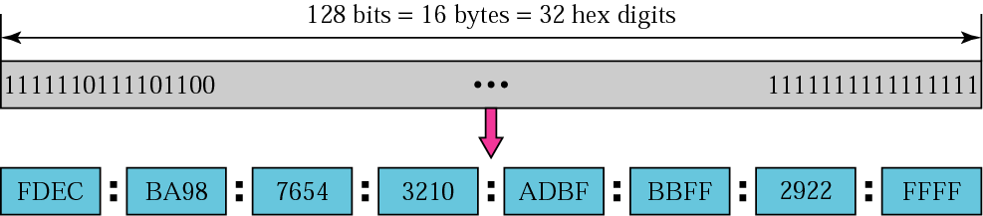
IPv6 address
128 bits in length and written as a string of hexadecimal values
In IPv6, 4 bits represents a single hexadecimal digit, 32 hexadecimal value = IPv6 address
Hextet used to refer to a segment of 16 bits or four hexadecimals
Can be written in either lowercase or uppercase

Slide 19
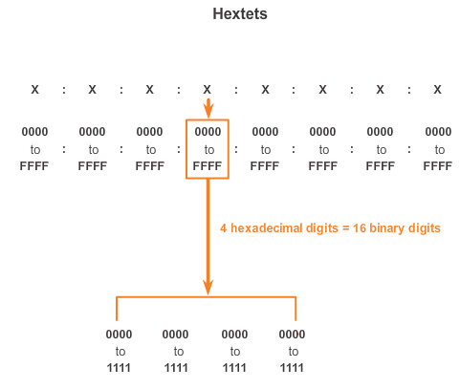
IPv6 Address Representation (cont.)
Notes:
8.2.2.2 IPv6 Address Representation (cont.)

Slide 20

Rule 1- Omitting Leading 0s
The first rule to help reduce the notation of IPv6 addresses is any leading 0s (zeros) in any 16-bit section or hextet can be omitted.
01AB can be represented as 1AB.
09F0 can be represented as 9F0.
0A00 can be represented as A00.
00AB can be represented as AB.
Notes:
8.2.2.3 Rule 1 – Omitting Leading 0s

Slide 21
Rule 2 - Omitting All 0 Segments
A double colon (::) can replace any single, contiguous string of one or more 16-bit segments (hextets) consisting of all 0’s.
Double colon (::) can only be used once within an address otherwise the address will be ambiguous.
Known as the compressed format.
Incorrect address - 2001:0DB8::ABCD::1234.
Notes:
8.2.2.4 Rule 2 – Omitting All 0 Segments

Slide 22
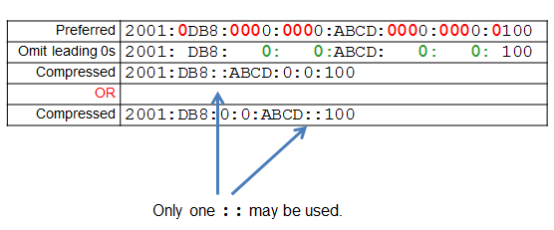
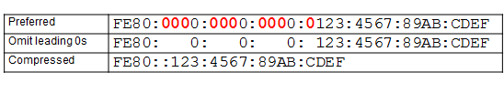
Rule 2 - Omitting All 0 Segments (cont.)
Example #1
Example #2
Notes:
8.2.2.4 Rule 2 – Omitting All 0 Segments (cont.)

Slide 23
IPv4 & IPv6 Header Comparison
IPv4 Header
IPv6 Header
Version | IHL | Type of Service | Total Length
Identification |  |  | Flags | Fragment Offset
Time to Live |  | Protocol | Header Checksum
Source Address
Destination Address
Options |  |  |  |  | Padding
Version | Traffic Class | Flow Label
Payload Length |  |  | Next Header | Hop Limit
Source Address
Destination Address
- field’s name kept from IPv4 to IPv6
- fields not kept in IPv6
- Name & position changed in IPv6
- New field in IPv6
Legend
Notes:
The length of the IPv6 header increases to 40 bytes (from 20 bytes) and contains two 16-byte addresses (source and destination), preceded by 8 bytes of control information,

Slide 24
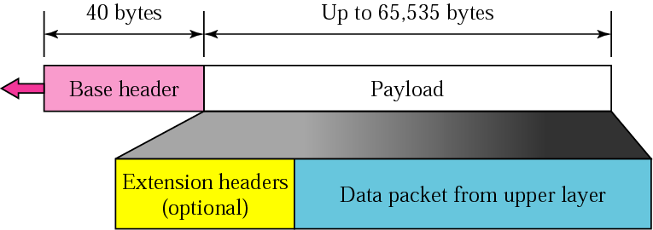
IPv6 datagram

Slide 25
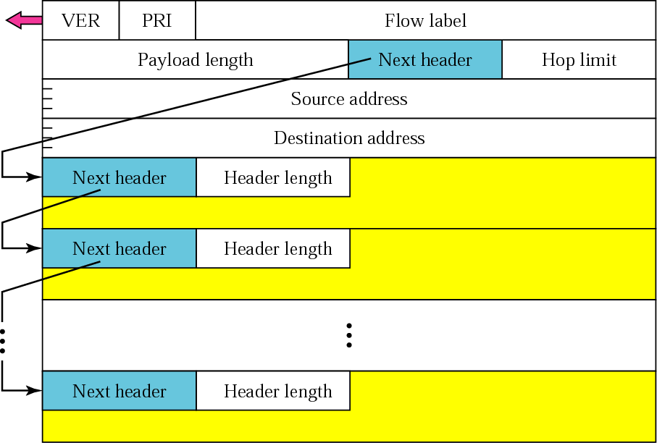
Extension header format

Slide 26
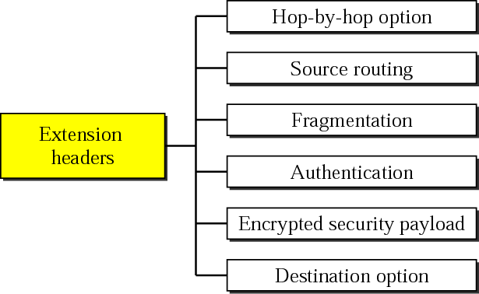
Extension header types

Slide 27
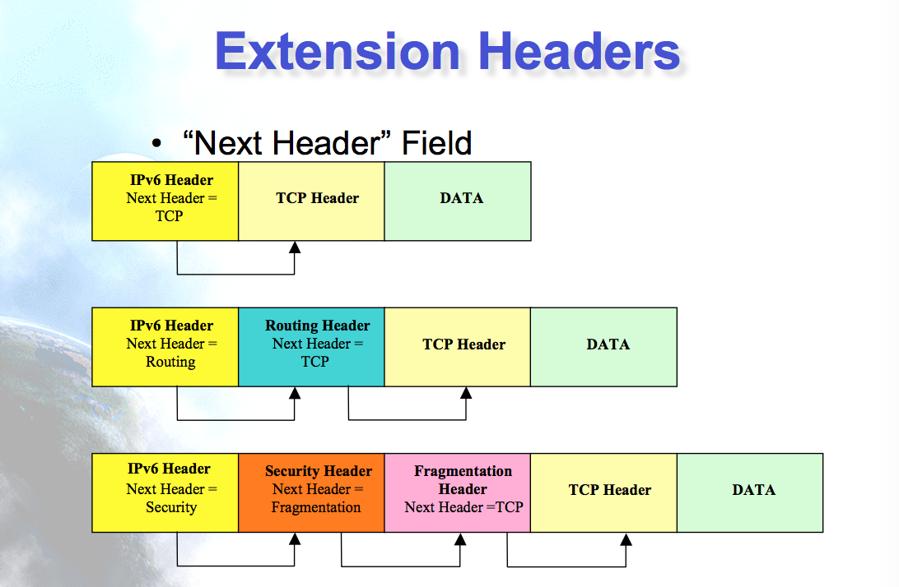

Slide 28
IPv6 Address Types
  Three types of IPv6 addresses:
  Unicast- Single source IPv6 address. A packet sent to unicast address is delivered to the interface identified by that address.
  Multicast - An IPv6 multicast address is used to send a single IPv6 packet to multiple destinations.
  Anycast - An IPv6 anycast address is any IPv6 unicast address that can be assigned to multiple devices. Any packet sent to anycast address will be delivered to only one member interface (mostly nearest host possible). Most used on mobile IPv6 and DNS Discovery
Note: IPv6 does not have broadcast addresses.
Notes:
Unicast
Address of a single interface
Delivery to single interface
Multicast
Address of a set of interfaces
Delivery to all interfaces in the set
Anycast
Address of a set of interfaces
Delivery to a single interface in the set
No more broadcast addresses

Slide 29
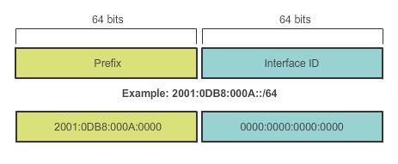
IPv6 Prefix Length
IPv6 does not use the dotted-decimal subnet mask notation
Prefix length indicates the network portion of an IPv6 address using the following format:
  IPv6 address/prefix length
  Prefix length can range from 0 to 128
  Typical prefix length is /64
Notes:
8.2.3.2 IPv6 Prefix Length

Slide 30
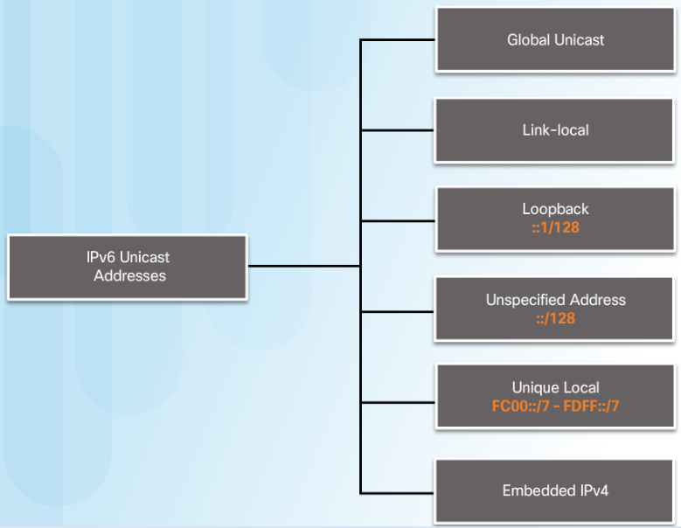
Types of IPv6 Addresses
IPv6 Unicast Addresses
  Global Unicast - These are globally unique, Internet routable addresses.
  Link-local - used to communicate with other devices on the same local link. Confined to a single link.
  Loopback- Used by a host to send a packet to itself and cannot be assigned to a physical interface.
  Unique Local - used for local addressing within a site or between a limited number of sites. IPv4 private addresses
Notes:
Loopback
Used by a host to send a packet to itself and cannot be assigned to a physical interface. On IPv4 we use 127.0.0.1
0:0:0:0:0:0:0:1 or ::1
Ping an IPv6 loopback address to test the configuration of TCP/IP on the local host.
All-0s except for the last bit, represented as ::1/128 or just ::1.
Unspecified Address
All-0’s address represented as ::/128 or just ::
0:0:0:0:0:0:0:0 or :: equivalent of IPv4 0.0.0.0 default route
Cannot be assigned to an interface and is only used as a source address.
An unspecified address is used as a source address when the device does not yet have a permanent IPv6 address or when the source of the packet is irrelevant to the destination.
Unique Local
Similar to private addresses for IPv4.
Non routable privately assigned addresses
Used for local addressing within a site or between a limited number of sites.
In the range of FC00::/7 to FDFF::/7.

Slide 31
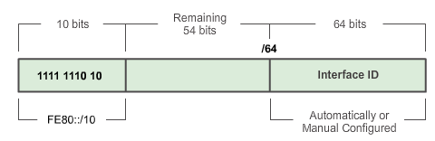
IPv6 Link-Local Unicast Addresses
Every IPv6-enabled network interface is REQUIRED to have a link-local address
Non routable, Router do not forward packets with-link local addresses.
Enables a device to communicate with other IPv6-enabled devices on the same link and only on that link (subnet)
FE80::/10 range, first 10 bits are 1111 1110 10xx xxxx
1111 1110 1000 0000 (FE80) - 1111 1110 1011 1111 (FEBF)
Notes:
Not routable
All nodes are assigned one of theses addresses
Start with FE80

Slide 32
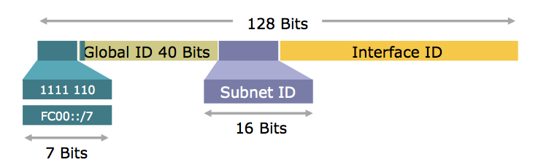
Unique- Local
Unique Local
  Similar to private addresses for IPv4.
  Non routable privately assigned addresses
  Used for local addressing within a site or between a limited number of sites.
  Local devices such as printer, telephone, etc
  Start with either FC or FD in the first two numbers.
  In the range of FC00::/7 to FDFF::/7.

Slide 33
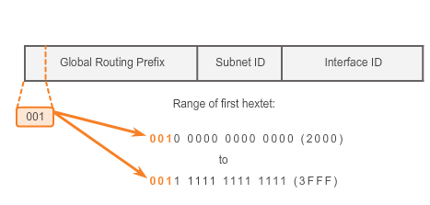
Structure of an IPv6 Global Unicast Address
IPv6 global unicast addresses are globally unique and routable on the IPv6 Internet
Currently, only global unicast addresses with the first three bits of 001 or 2000::/3 are being assigned

Slide 34
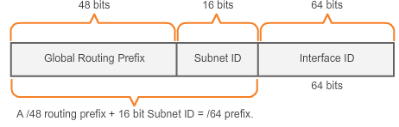
Structure of an IPv6 Global Unicast Address (cont.)
A global unicast address has three parts: Global Routing Prefix, Subnet ID, and Interface ID.
Global Routing Prefix is the prefix or network portion of the address assigned by the provider, such as an ISP, to a customer or site, currently, RIR’s assign a /48 global routing prefix to customers.
2001:0DB8:ACAD::/48 has a prefix that indicates that the first 48 bits (2001:0DB8:ACAD) is the prefix or network portion.
Notes:
8.2.4.1 Structure of an IPv6 Global Unicast Address (cont.)

Slide 35
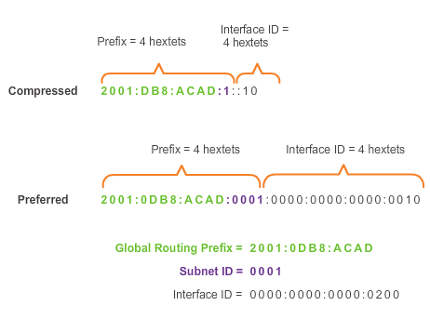
Structure of an IPv6 Global Unicast Address (cont.)
Subnet ID is used by an organization to identify subnets within its site
Interface ID
  Equivalent to the host portion of an IPv4 address.
  Used because a single host may have multiple interfaces, each having one or more IPv6 addresses.
Notes:
8.2.4.1 Structure of an IPv6 Global Unicast Address

Slide 36
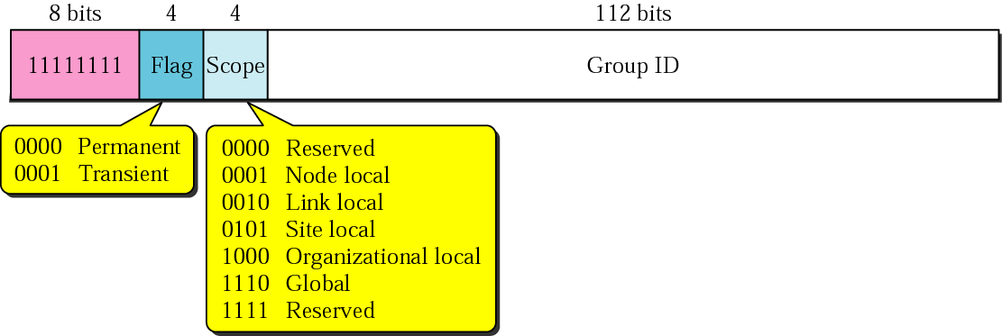
Multicast address
IP multicast address has a prefix FF00::/8
A multicast address is a logical identifier for a group of host in a computer network

Slide 37
IPv6 Multicast Addresses
Assigned IPv6 Multicast Addresses (cont.)
Two common IPv6 assigned multicast groups include:
  FF02::1 All-nodes multicast group –
    All IPv6-enabled devices join
    Same effect as an IPv4 broadcast address
  FF02::2 All-routers multicast group
    All IPv6 routers join
    A router becomes a member of this group when it is enabled as an IPv6 router with the ipv6 unicast-routing global configuration mode command.
    A packet sent to this group is received and processed by all IPv6 routers on the link or network.
Notes:
8.2.5.1 Assigned IPv6 Multicast Addresses (cont.)

Slide 38
Advantages of IPv6 over IPv4 (1)
Feature | IPv4 | IPv6
Source and destination address | 32 bits | 128 bits
IPSec | Optional | required
Payload ID for QoS in the header | No identification | Using Flow label field
Fragmentation | Both router and the sending hosts | Only supported at the sending hosts
Header checksum | included | Not included
Resolve IP address to a link layer address | broadcast ARP request | Multicast Neighbor Solicitation message

Slide 39
Advantages of IPv6 over IPv4 (2)
Feature | IPv4 | IPv6
Determine the address of the best default gateway | ICMP Router Discovery(optional) | ICMPv6 Router Solicitation and Router Advertisement (required)
Send traffic to all nodes on a subnet | Broadcast | Link-local scope all-nodes multicast address
Configure address | Manually or DHCP | Autoconfiguration
Manage local subnet group membership | (IGMP) | Multicast Listener Discovery (MLD)

