Slide 1
Chapter – 1
Introduction to Network Protocols

Slide 2
Rules of Communications
Establishing Rules
Communication begins with a message, or information, that must be sent from a source to a destination.
Protocol: Rules that govern communications.
Protocol suite: A group of inter-related protocols
Example: TCP/IP

Slide 3
Tasks involved in sending a letter

Slide 4
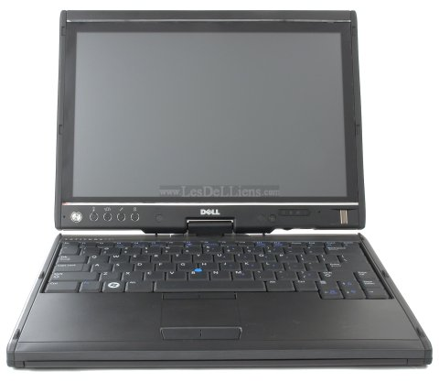
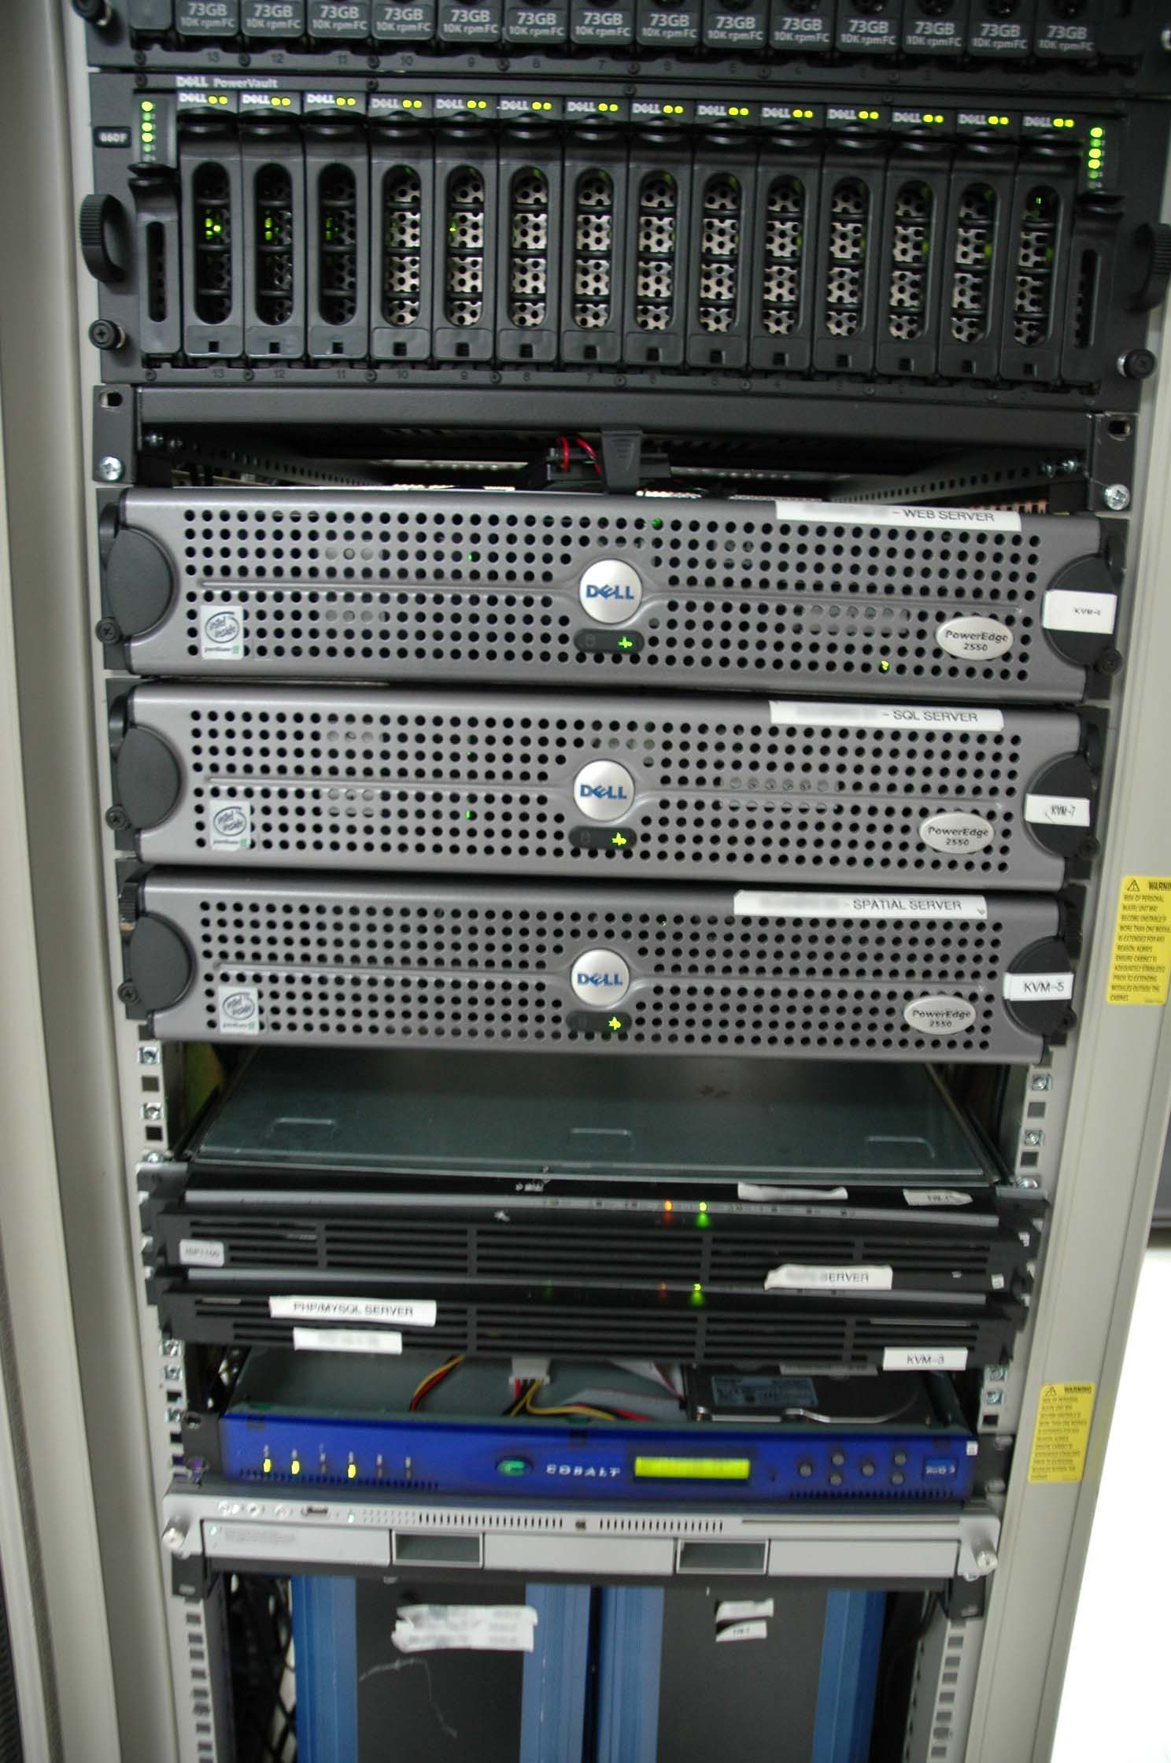
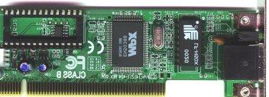
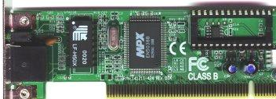
Rules of Communications
Message Encoding

Slide 5
Rules of Communication
Message Timing
People use timing to determine when to speak, how fast/slow to talk, and how long to wait for a response.
Access Method
Determines when someone is able to send a message.
If two people talk at the same time, a collision occurs.
Hosts on a network need an access method to know when to begin sending messages.
Flow Control
How much information can be sent.
Hosts use flow control to negotiate how much data can be sent/received.
Response Timeout
Hosts on the network also have rules that specify how long to wait for responses and what action to take if a response timeout occurs.

Slide 6
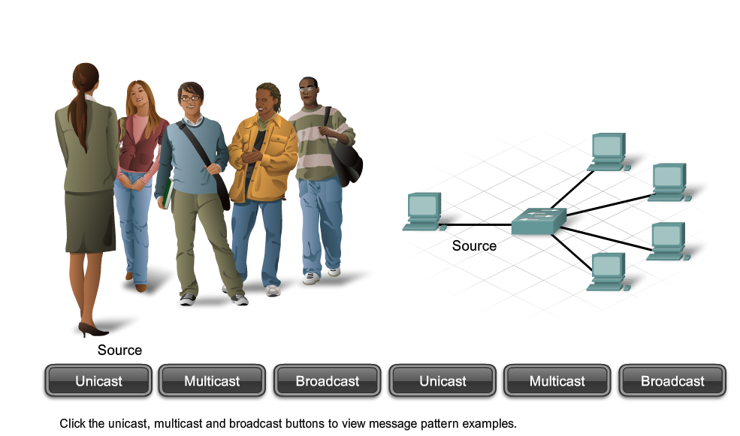
Message Delivery Options
Unicast: One to One
Multicast: One to many
Broadcast: One to everyone

Slide 7
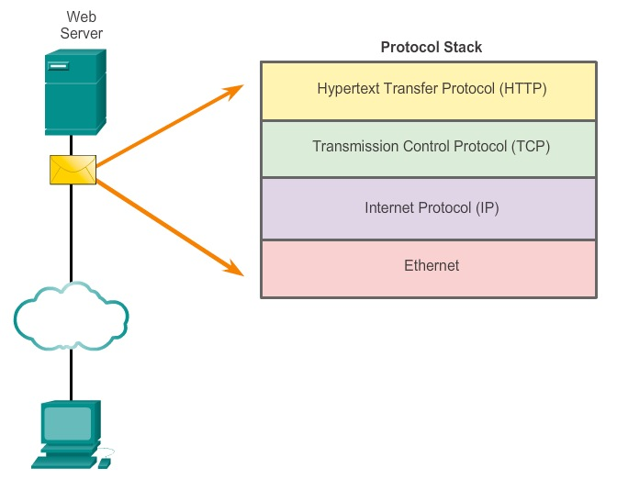
Interaction of Protocols
Application Protocol - Hypertext Transfer Protocol (HTTP) is a protocol that governs the way a web server and a web client interact.
Transport Protocol - Transmission Control Protocol (TCP) is the transport protocol that manages the individual conversations between web servers and web clients.
Internet Protocol - IP is responsible for assigning the appropriate addresses, and delivering them across the best path to the destination host.
Network Access Protocols - Network access protocols describe two primary functions, communication over a data link and the physical transmission of data on the network media.

Slide 8
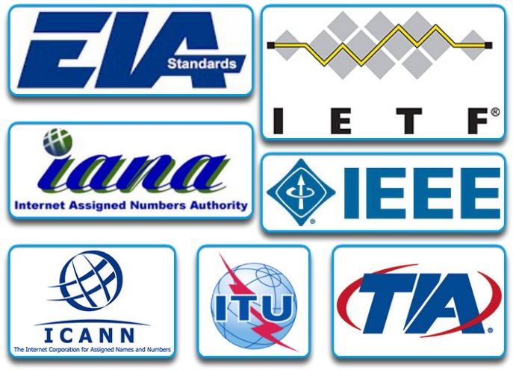
Standards Organizations
Open standards encourage competition and innovation.
Guarantee that no single company’s product can monopolize the market, or have an unfair advantage over its competition.
Standards organizations include:
The Internet Society (ISOC)
The Internet Architecture Board (IAB)
The Internet Engineering Task Force (IETF)
The Institute of Electrical and Electronics Engineers (IEEE)
The International Organization for Standardization (ISO)

Slide 9
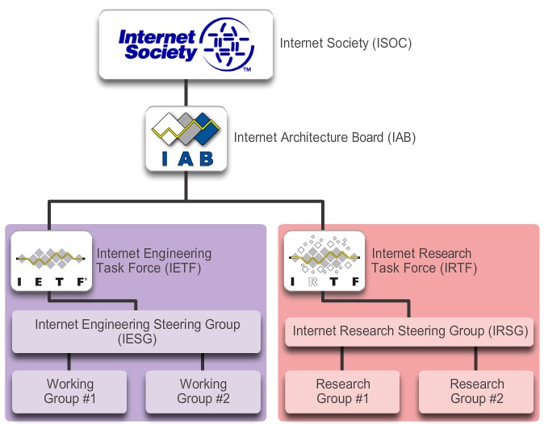
ISOC
The Internet Society (ISOC)
ISOC facilitates the open development of standards and protocols for the technical infrastructure of the Internet, including the oversight of the Internet Architecture Board (IAB).

Slide 10
IAB
The Internet Architecture Board (IAB)
Responsible for overall management and development of Internet standards.
Oversight of the architecture for protocols and procedures used by the Internet.
13 members, including the chair of the Internet Engineering Task Force (IETF).
IAB members serve as individuals and not representatives of any company, agency, or other organization.

Slide 11
IETF
Internet Engineering Task Force (IETF)
Mission is to develop, update, and maintain Internet and TCP/IP technologies.
One of the key responsibilities is to produce Request for Comments (RFC) documents
Memorandum describing protocols, processes, and technologies for the Internet.
The IETF consists of working groups (WGs), the primary mechanism for developing IETF specifications and guidelines.

Slide 12
IRTF
Internet Research Task Force (IRTF)
Focused on long-term research related to Internet and TCP/IP
IETF focuses on shorter-term issues of creating standards
IRTF consists of research groups for long-term development efforts. Including: Anti-Spam Research Group (ASRG), Crypto Forum Research Group (CFRG), Peer-to-Peer Research Group (P2PRG), and Router Research Group (RRG).

Slide 13
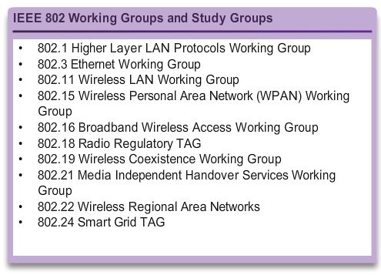
IEEE
Institute of Electrical and Electronics Engineers
A professional organization for those in the electrical engineering and electronics fields who are dedicated to advancing technological innovation and creating standards.
IEEE 802.3 and IEEE 802.11 standards are significant IEEE standards in computer networking.

Slide 14
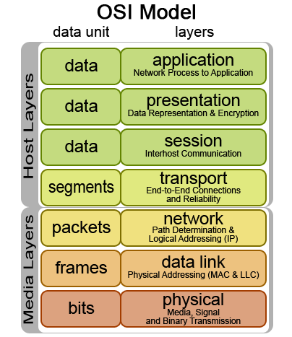
Purpose of ISO
ISO, the International Organization for Standardization
World’s largest developer of international standards for a wide variety of products and services.
ISO is not an acronym but based on the Greek word ISOS, meaning equal.
ISO is best known for its Open Systems Interconnection (OSI) reference model.
ISO published the OSI reference model in 1984 to develop a layered framework for networking protocols.

Slide 15
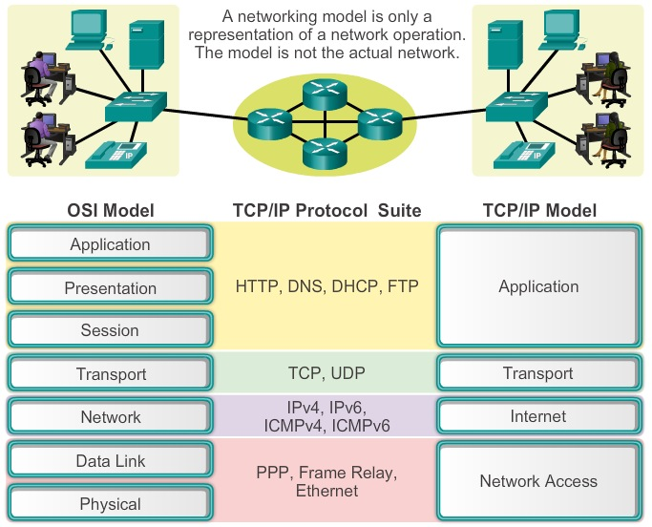
Benefits of a Layered Model
Assists in protocol design, because protocols that operate at a specific and a defined interface to the layers above and below.
Fosters competition
Prevents technology or capability changes in one layer from affecting other layers above and below.
Provides a common language to describe networking functions and capabilities.

Slide 16
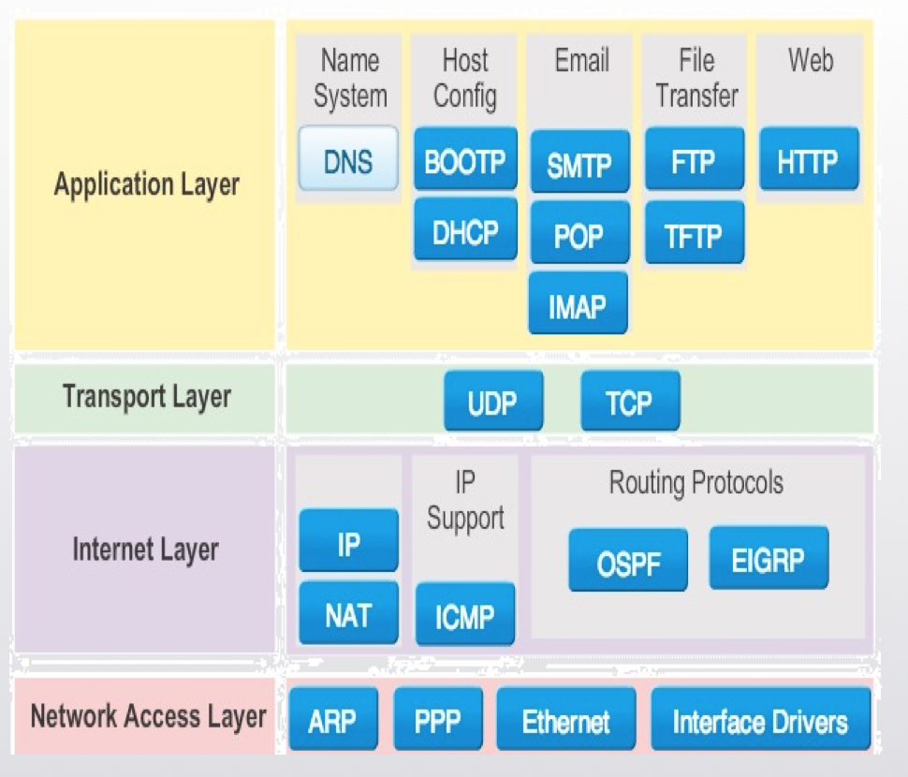
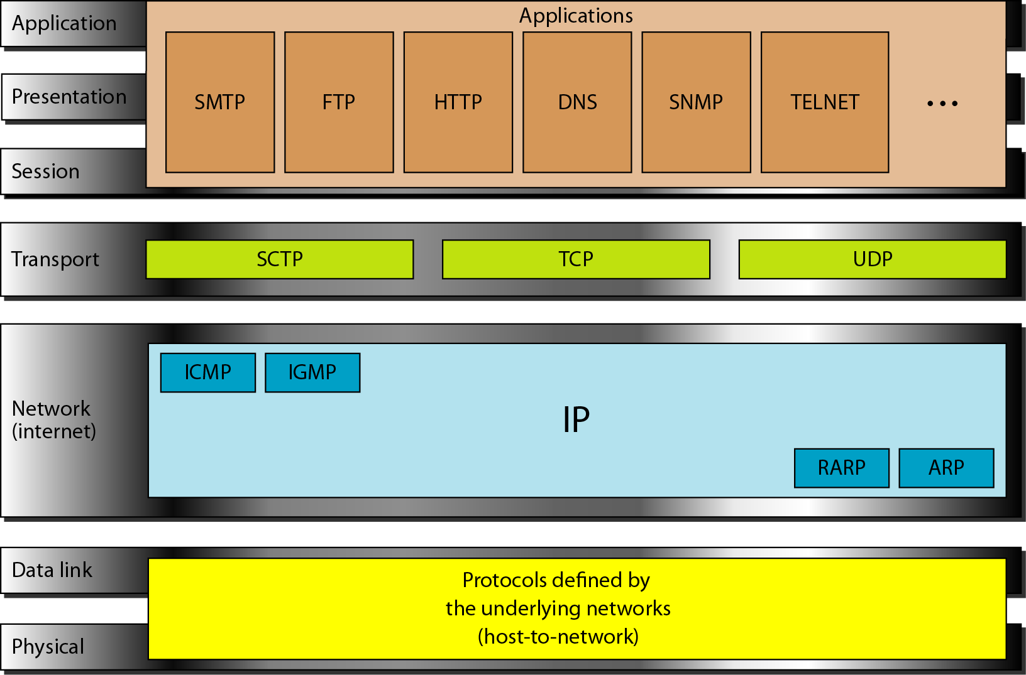
TCP/IP and OSI model

Slide 17
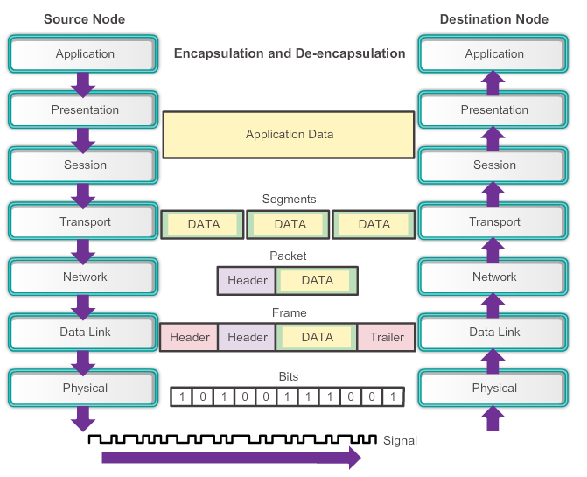
An exchange using the OSI model

Slide 18
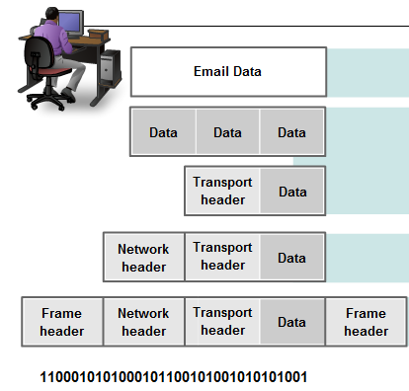
The Communication Process - Encapsulation
Data Link Header
IP Header
TCP Header
HTTP Header
Data
Data Link Trailer
College of IT
Server
HTTP Data
Encapsulation – Process of adding control information as it passes down through the layered model.

Slide 19
The Communication Process - Decapsulation
Data Link Header
IP Header
TCP Header
HTTP Header
Data
Data Link Trailer
College of IT
Decapsulation – Process of removing control information as it passes upwards through the layered model.
Client
HTTP Data

Slide 20
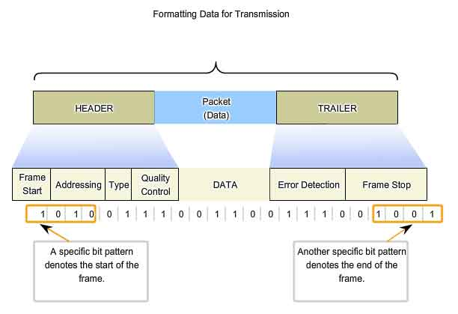
Data Link Layer Layer 2 Frame Structure
The data link layer prepares a packet for transport across the local media by encapsulating it with a header and a trailer to create a frame.
Data Link frame header fields may include:
Start Frame field - Indicates the beginning of the frame
Source and Destination address fields - Indicates the source and destination nodes on the media
Priority/Quality of Service field - Indicates a particular type of communication service for processing
Type field - Indicates the upper layer service contained in the frame
Logical connection control field - Used to establish a logical connection between nodes
Physical link control field - Used to establish the media link
Flow control field - Used to start and stop traffic over the media
Congestion control field - Indicates congestion in the media
Notes:
The data link layer is responsible for moving frames from one hop (node) to the next

Slide 21
Accessing Local Resources : Network Address
Network Address
Contains information required to deliver the IP packet from the source device to the destination device.
Has two parts, the network prefix and the host part.
An IP packet contains two IP addresses:
Source IP address - The IP address of the sending device.
Destination IP address - The IP address of the receiving device. The destination IP address is used by routers to forward a packet to its destination.
Notes:
The network layer is responsible for the delivery of individual packets from the source host to the destination host.

Slide 22
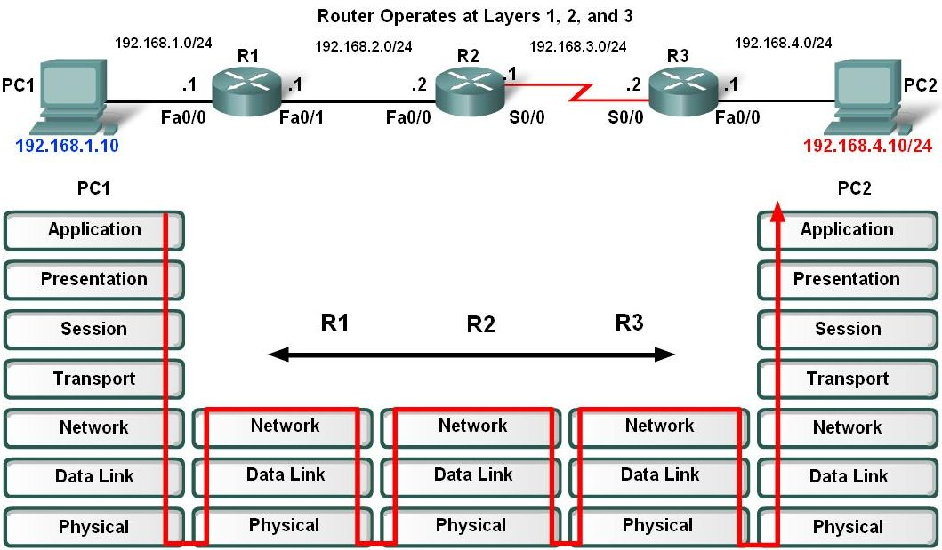
Network Address

Slide 23
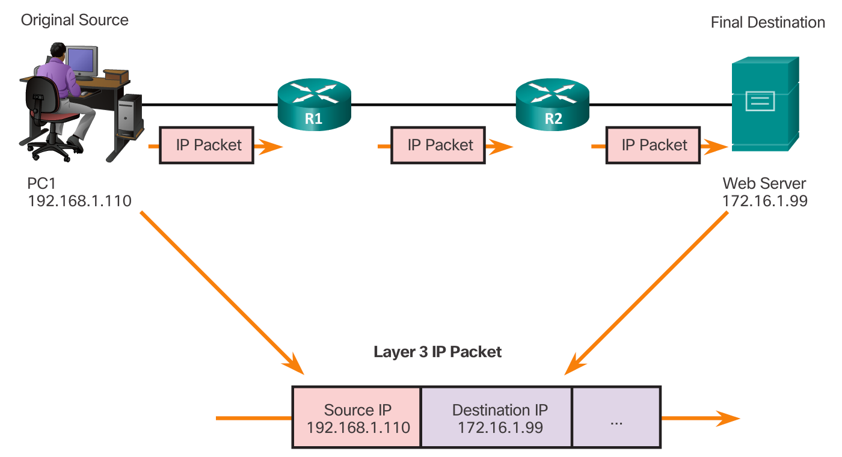
Layer 3 Addresses

Slide 24
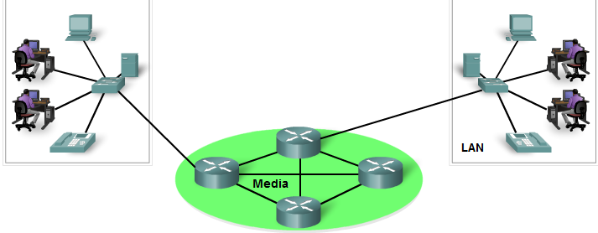
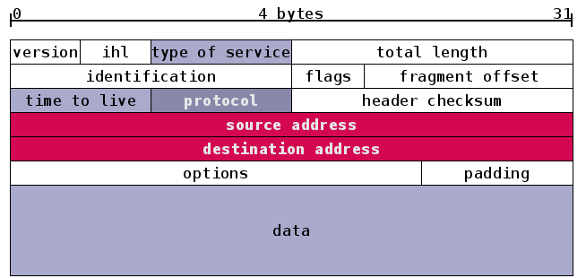
Layer 3 Addresses
209.67.102.55
107.16.4.21
Frame Header
IP Header
TCP Header
HTTP Header
Frame Trailer
Data
209.67.102.55
107.16.4.21

Slide 25
Accessing Local Resources Data Link Address
Data Link Address
Different role.
The purpose of the data link address is to deliver the data link frame from one network interface to another network interface on the same network.
IP packet encapsulated in a data link frame so it can be transmitted over the physical medium, the actual network.
Ethernet LANs and wireless LANs are two examples of networks

Slide 26
Accessing Local Resources
Data Link Address
The source and destination data link addresses are added:
Source data link address - The physical address of the device that is sending the packet.
Initially this is the NIC that is the source of the IP packet.
Destination data link address - The physical address of the network interface of either:
Next hop router or
Network interface of the destination device

Slide 27
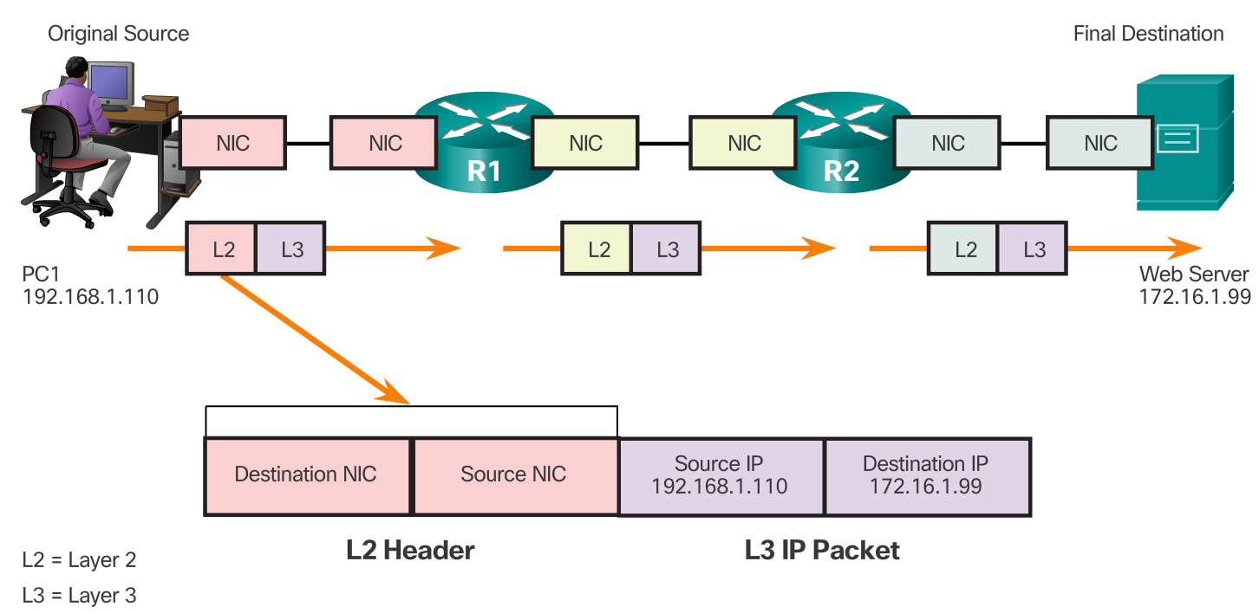
Layer 2 Addresses

Slide 28
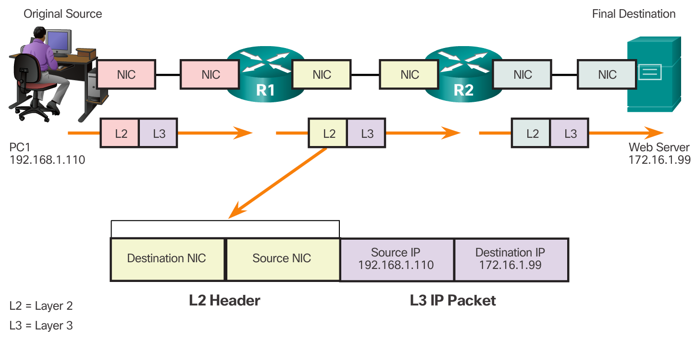
Layer 2 Addresses

Slide 29
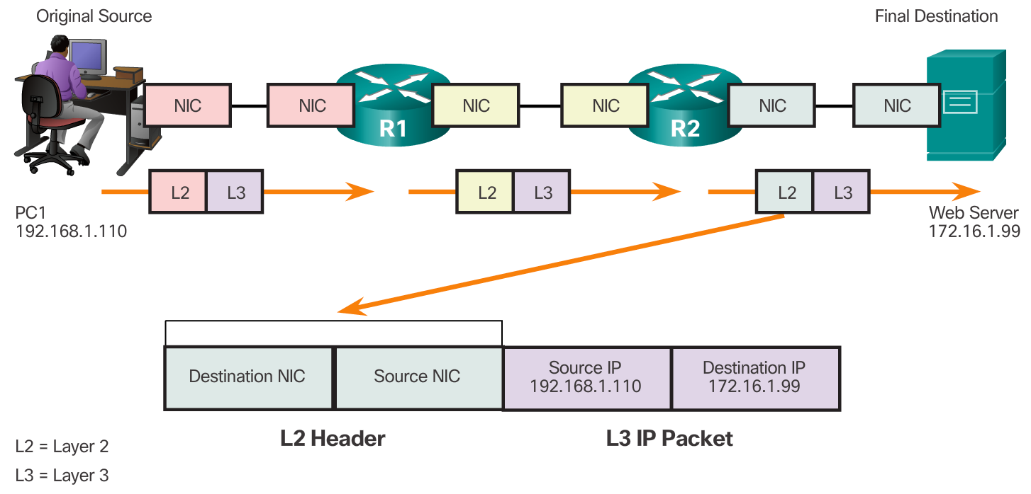
Layer 2 Addresses

Slide 30
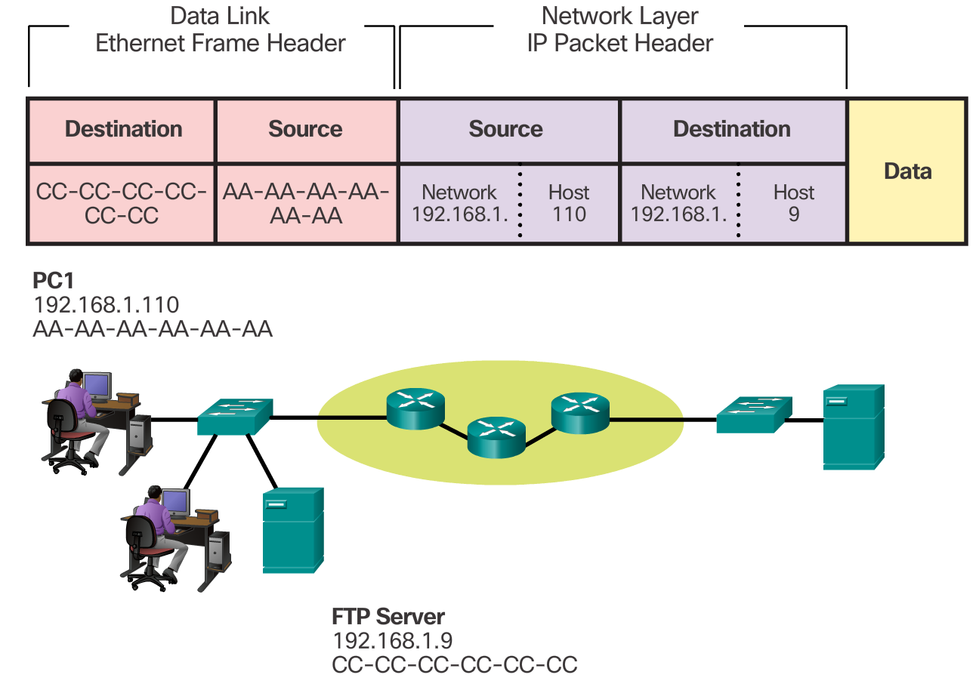
Communicating with Devices on the Same Network

Slide 31
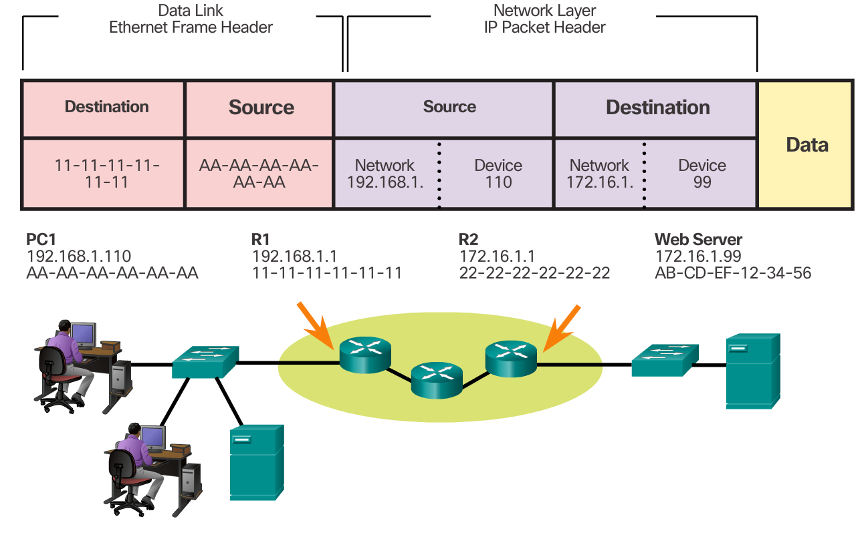
Communicating with Devices on a Different Network

Slide 32
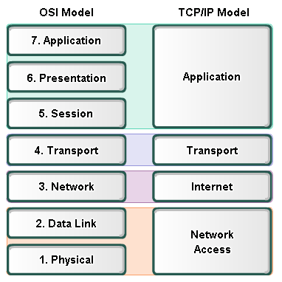
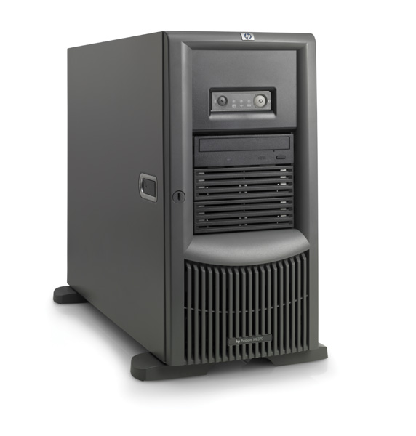
Role of the Transport Layer
TCP UDP
The Transport Layer is responsible for establishing a temporary communication session between two applications and delivering data between them.
It regulates the flow of information from source to destination, reliably and accurately.

Slide 33
Role of the Transport Layer
What two protocols are at the Transport Layer?
TCP
UDP
IP is a best-effort delivery service. What does that mean?
No guarantees
Best-effort service
“Unreliable service”
TCP/UDP is responsible for extending IP’s delivery service between two end systems.
Notes:
TCP provides reliable delivery on top of unreliable IP
In addition to supporting the basic functions of data segmentation and reassembly, TCP also provides:
Reliable delivery
Error checking
Flow control
Congestion control
Ordered delivery
Connection establishment

Slide 34
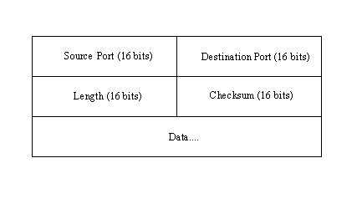
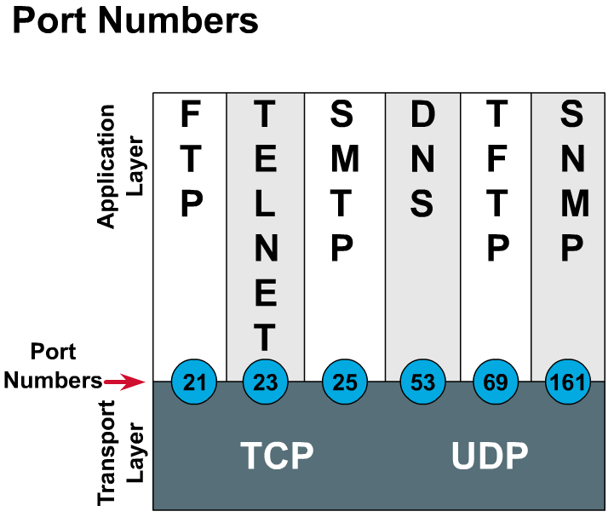
UDP Header
TCP Header
HTTP is Port 80
The transport layer assigns each application an identifier called a port number.
The transport layer uses ports to identify the application or service.
Both TCP and UDP use ports (or sockets) numbers to pass information to the upper layers.

Slide 35
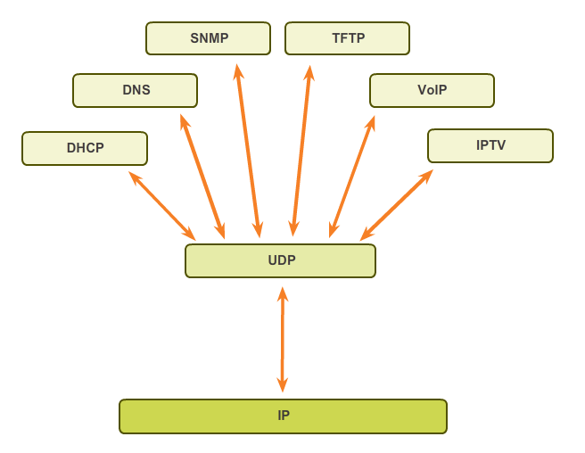
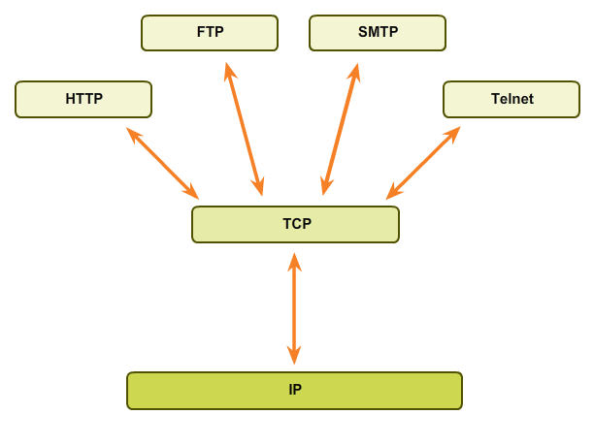
TCP
TCP/UDP Applications
UDP

Slide 36
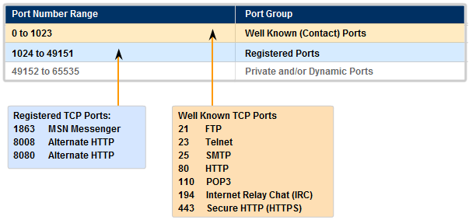
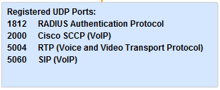
Registered Ports
Well Known Ports (Numbers 0 to 1023)
Reserved for common services and applications
Well Known or Registered Port Number
Registered Ports (Numbers 1024 to 49151)
Assigned to user processes or applications.
Non-common applications.

Slide 37
Private/Dynamic Port Number
Well Known or Registered Port Number
Well Known or Registered Port Number
Private/Dynamic Port Number
Dynamic or Private Ports (Numbers 49152 to 65535)
Also known as Ephemeral Ports
Usually assigned dynamically to client applications when initiating a connection.
Client: TCP source port
Server: TCP destination port
May also include the range of Registered Ports (Numbers 1024 to 49151)

Slide 38
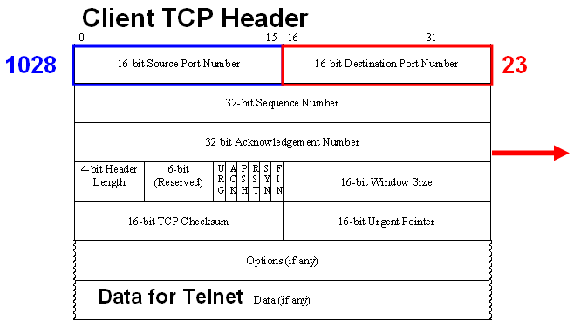
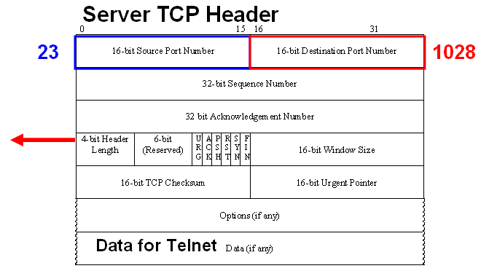
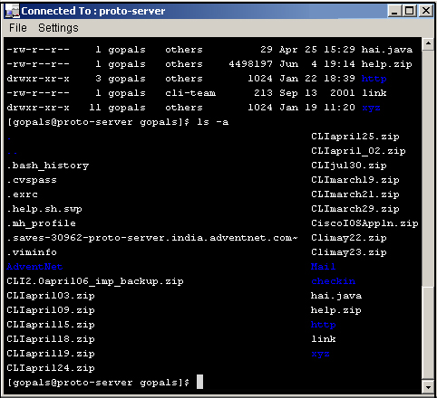
Client
Server
Notice the difference in how source and destination port numbers are used with clients and servers:
Client (initiating Telnet service):
Destination Port = 23 (telnet)
Source Port = 1028 (dynamically assigned)
Server (responding to Telnet service):
Destination Port = 1028 (source port of client)
Source Port = 23 (telnet)

Slide 39
Socket Port Number Example
192.168.1.101
Destination Port
Source Port
198.133.219.25
49888
80
A client socket might look like this, representing the source IP address and source port number:
192.168.1.101:49888
The socket on a web server might be, representing the destination IP address and destination port number:
192.133.219.25:80
Together, these two sockets combine to form a socket pair:
192.168.1.101:49888, 192.133.219.25:80
www.cisco.com

Slide 40
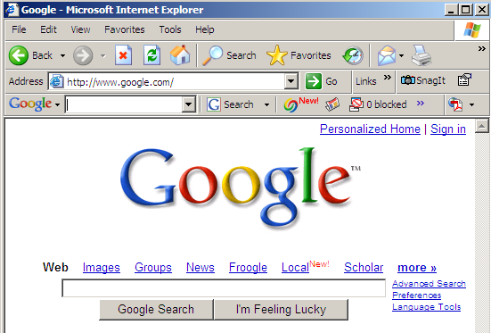
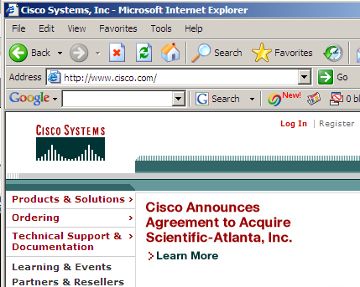
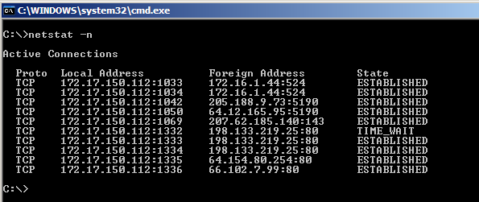
TCP or UDP
Source IP
Destination IP
Connection State
Source Port
Destination Port
www.google.com
www.cisco.com
netstat –n
Note: When downloading a web document and its objects it is common that there will be several TCP sessions created.

Slide 41
Transport Layer Port Numbers
Hypertext Transfer Protocol (HTTP) - TCP Port 80
HTTP Secure (HTTPs) - TCP Port 443
Simple Mail Transfer Protocol (SMTP) - TCP Port 25
Post Office Protocol (POP) - TCP Port 110
Telnet - TCP Port 23
File Transfer Protocol (FTP) - TCP Ports 20 & 21
Trivial FTP (TFTP) - UDP 69
Domain Name System (DNS) - TCP/UDP Port 53
Dynamic Host Configuration Protocol - UDP Port 67 & 68
http://en.wikipedia.org/wiki/List_of_TCP_and_UDP_port_numbers

Slide 42
TCP/IP Application Layer Protocols
Application Layer
Transport Layer
Internet Layer
Network Access Layer
FTP
HTTP
SMTP
Telnet
TFTP
SNMP
DHCP
DNS
20 & 21
80
25
23
69
161
67 & 68
53
TCP
UDP
IP
LAN / WAN

Slide 43
End of Chapter 1

