Slide 1
JavaScript Document Object Model (DOM)

Slide 2
Document Model Object (DOM)
The Document Object Model (DOM) is a programming interface for HTML documents. It provides a structured representation of the document and it defines a way that the structure can be accessed from programs so that they can change the document structure, style and content.

Slide 3
DOM
The document Object Model (DOM) represents a web page in tree structure.
DOM is a tree of objects each represents a single HTML element or a single literal String on the web page.
Every node in the DOM has a relationship to its surrounding nodes.

Slide 4
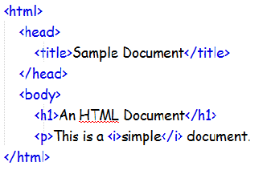
DOM Tree
The DOM views the HTML document as a tree-structure.
All nodes can be accessed through the tree. Their contents can be modified or deleted, and new elements can be created.
Basic HTML structure to illustrate a DOM tree

Slide 5
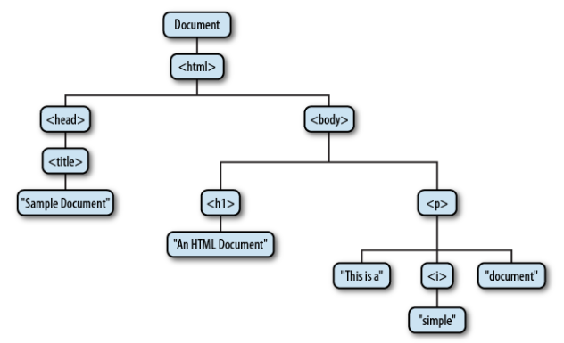
The tree representation of an HTML document

Slide 6
DOM Tree (cont)
The DOM is made up of items called nodes , which can have parents, children, and siblings and this determines its position in the tree.
Parent
A parent node is anything that contains other nodes.
Child
Children are positioned inside parent nodes.
Sibling
It is the nodes that are on the same level .

Slide 7
DOM nodes
The type of nodes in the DOM can be classified to :
Nodes that represent HTML elements are called element nodes
The text inside HTML elements are called text nodes
Every HTML attribute is attribute node.

Slide 8
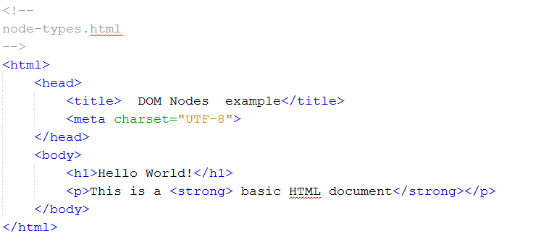
Node Types Example

Slide 9
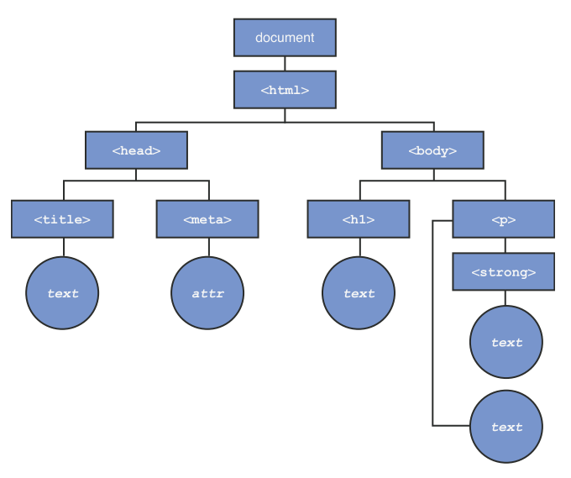
A graphical representation of the Document Object Model

Slide 10
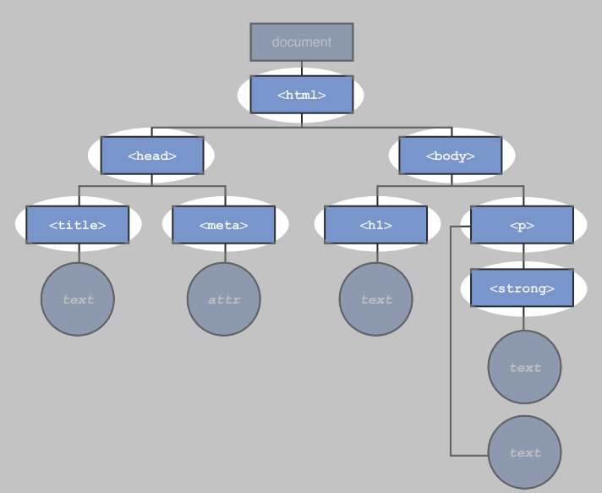
Element Nodes

Slide 11
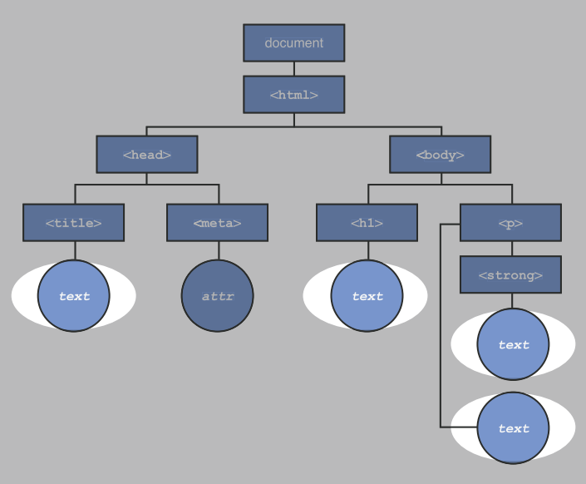
Text Nodes

Slide 12
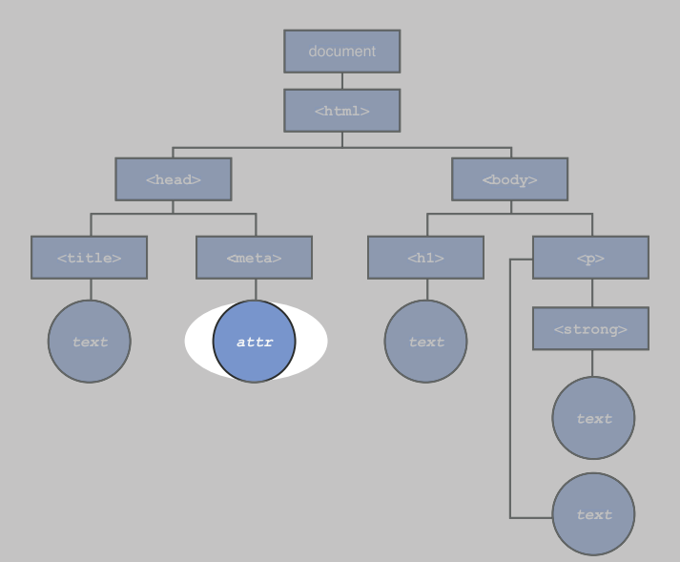
Attribute Nodes

Slide 13
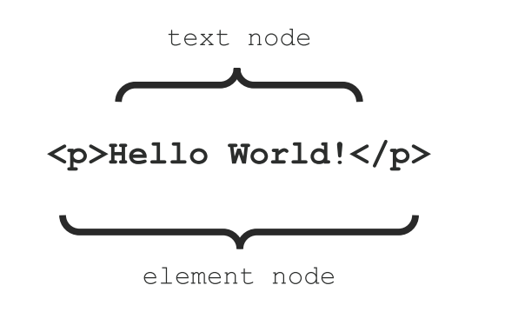
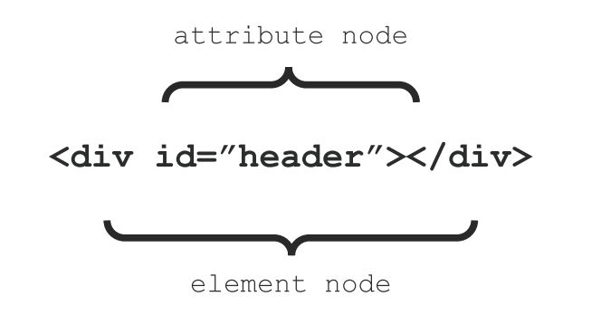
The difference between an element node and a text node
The position of an attribute node in relation to an element node

Slide 14
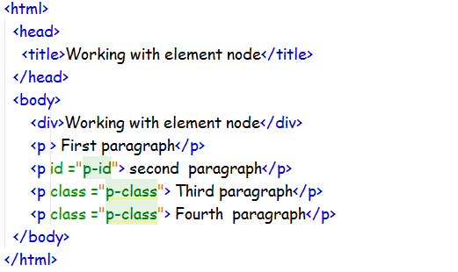
Selecting Element Node
Every element node in the DOM tree can be selected using different methods.
Example-2

Slide 15
Selecting Element Node
Every element node in the DOM tree can be reached using different methods.
Selecting by ID
Selecting by Class
Selecting by Name

Slide 16
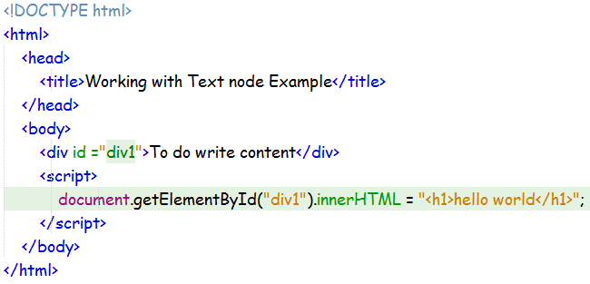
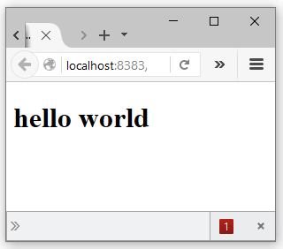
Working with Text node
The method innerHTML is used to get and change the content of HTML node.

Slide 17
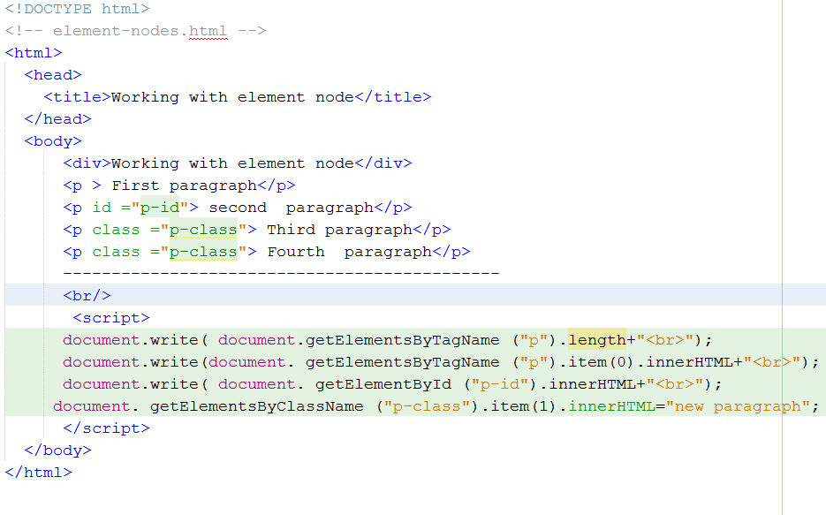
Example-4

Slide 18
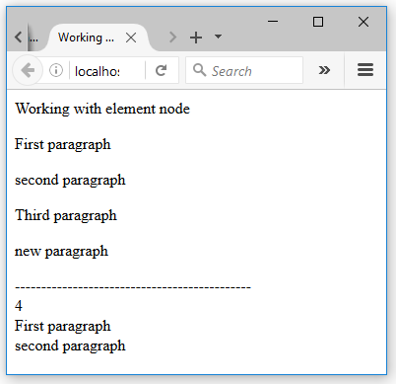

Slide 19
Changing Text node appearance
Changing the CSS properties with the style property of the text node.
Changing the class attribute value of the text node.

Slide 20
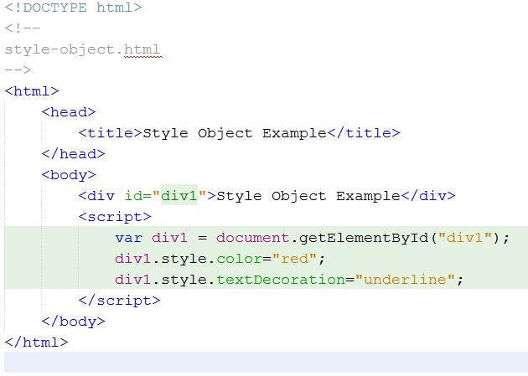
Using Style Property

Slide 21
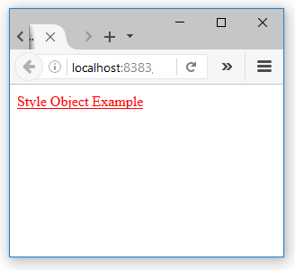

Slide 22
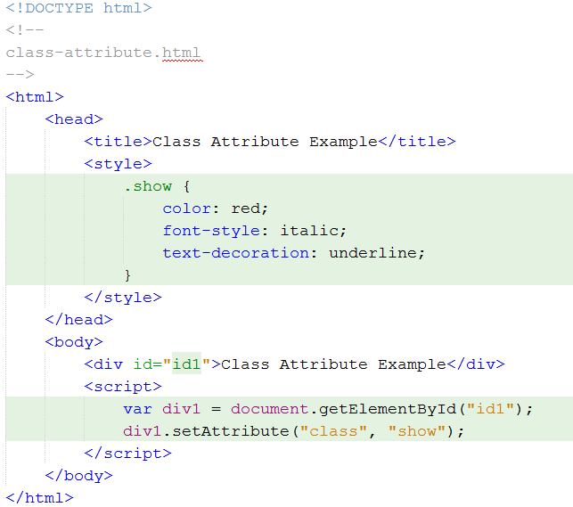
Changing the class attribute

Slide 23
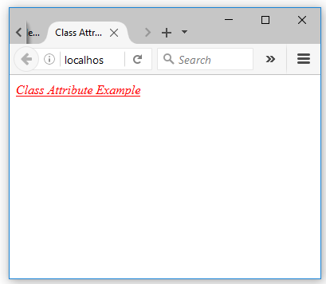

Slide 24
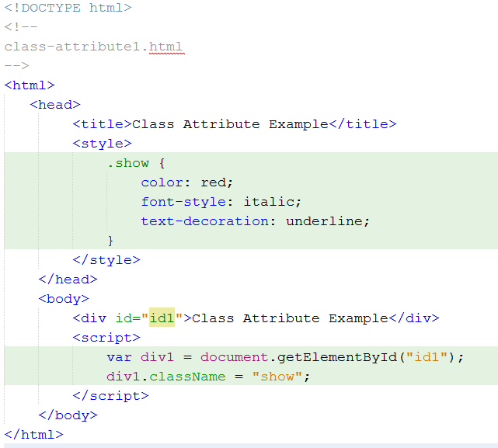
Changing the class attribute

Slide 26
Working with Attributes
The DOM defines set of methods for getting and setting the values of HTML attributes. Those methods are :
getAttribute()
setAttribute()
removeAttribute()
hasAttribute()

Slide 27
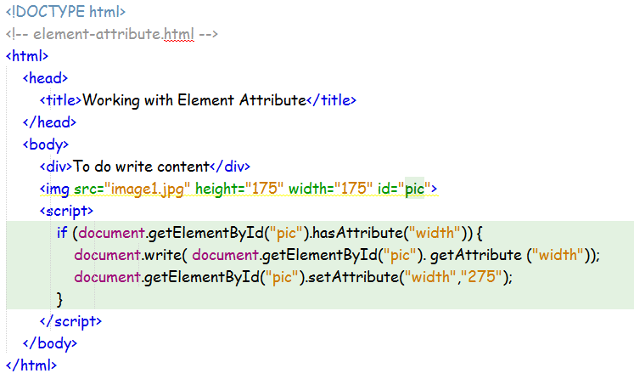
Example-8

Slide 28
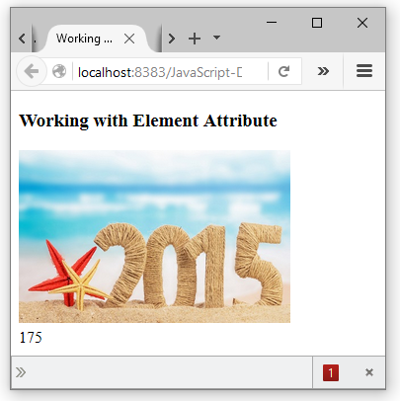

Slide 29
HTML Navigation (Tree Node Traverse)
The node tree can be navigated using the node relationship.
With DOM, all nodes in the node tree can be accessed by JavaScript.
New nodes can be created, and all nodes can be modified or deleted.
There are two special properties that allow access to the full document:
document.body - The body of the document
document.documentElement - The full document

Slide 30
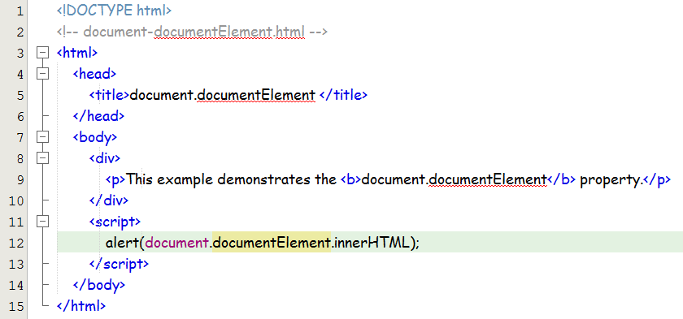
Example-9

Slide 31
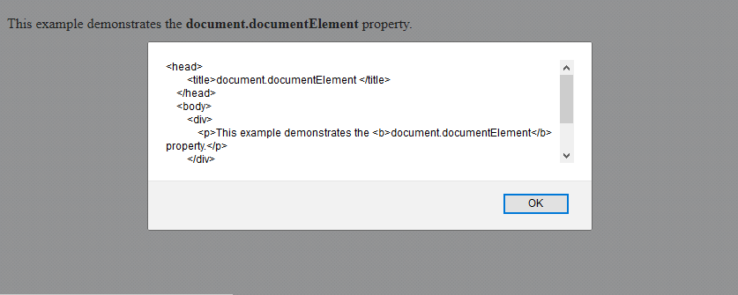

Slide 32
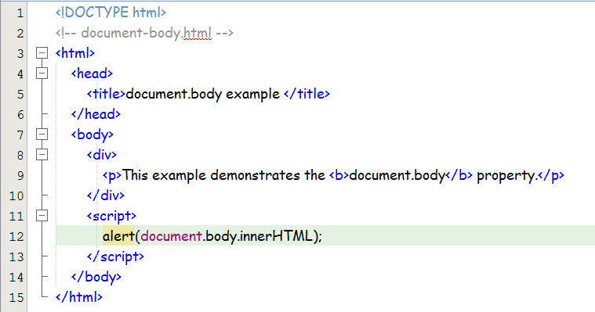
Example-10

Slide 33
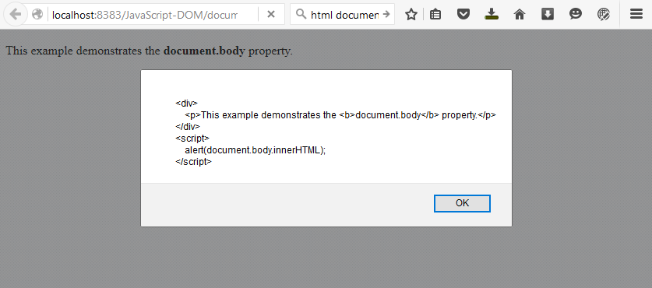

Slide 34
Node Relationships
The nodes in the node tree have a hierarchical relationship to each other.
The terms parent, child, and sibling are used to describe the relationships.
The top node is called the root .
Every node has exactly one parent, except the root (which has no parent)
A node can have a number of children
Siblings are nodes with the same parent

Slide 35
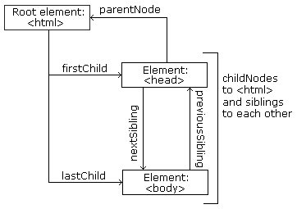
Navigating Between Nodes
The documents can be traversed as trees of Element objects using these methods:
parentNode
previousSibling
nextSibling
firstChild
lastChild

Slide 36
nodeName Property
The nodeName property specifies the name of a node.
nodeName is read-only
nodeName of an element node is the same as the tag name
nodeName of an attribute node is the attribute name
nodeName of a text node is always #text
nodeName of the document node is always #document

Slide 37
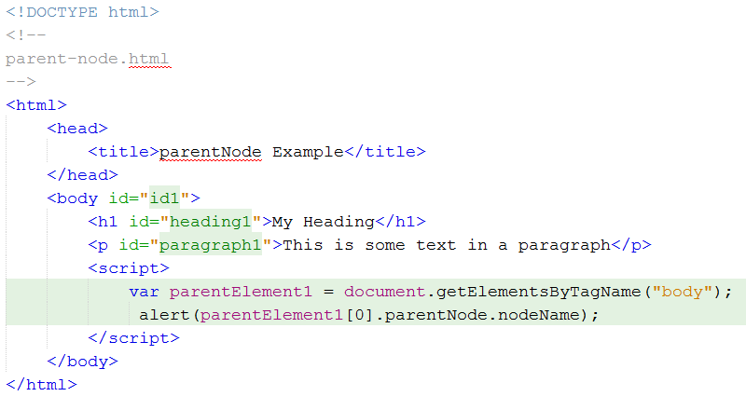
Example-11

Slide 38
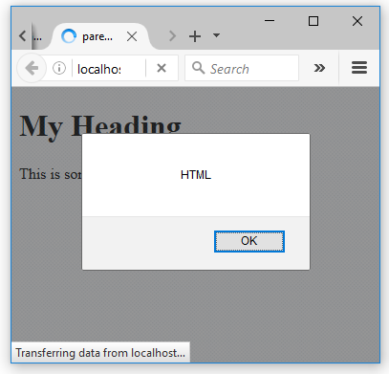

Slide 39
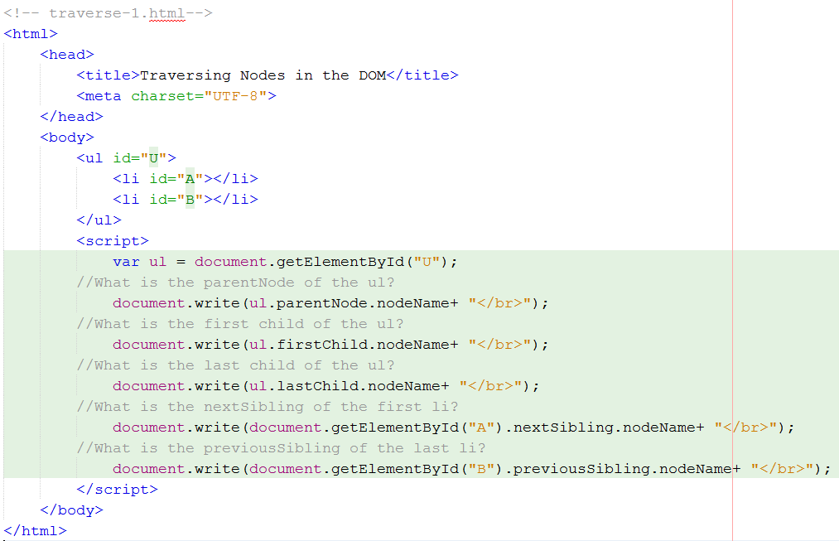
Example-12

Slide 40
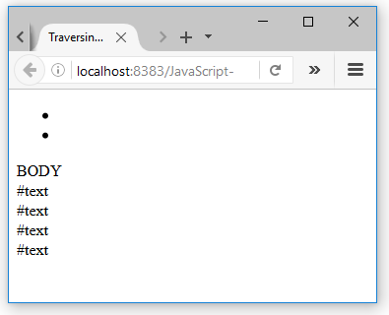

Slide 41
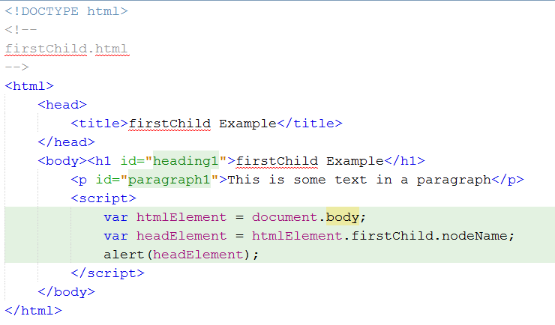
Example-9

Slide 42
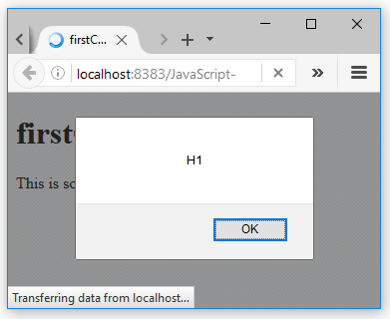

Slide 43
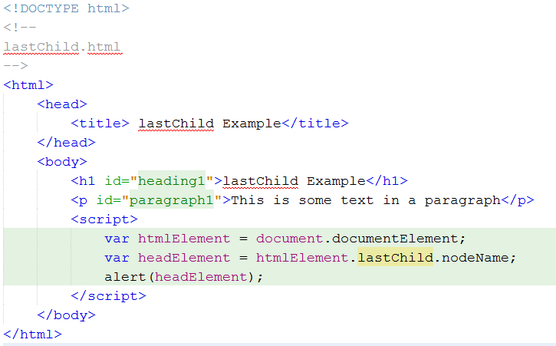
Example-10

Slide 44
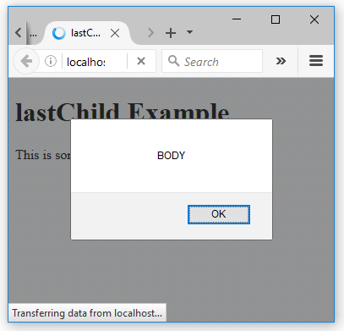

Slide 45
ELEMENT TRAVERSAL
The following set of methods are used to return the element nodes only.
childElementCount - Returns the number of child elements.
firstElementChild - Points to the ﬁ rst child that is an element
lastElementChild - Points to the last child that is an element.
previousElementSibling - Points to the previous sibling that is an element.
nextElementSibling - Points to the next sibling that is an element

Slide 46
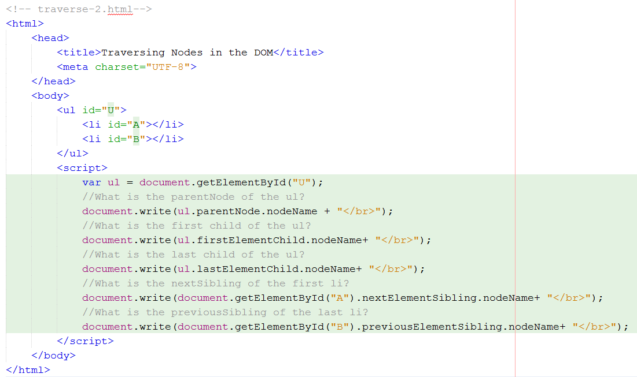
Example-11

Slide 47
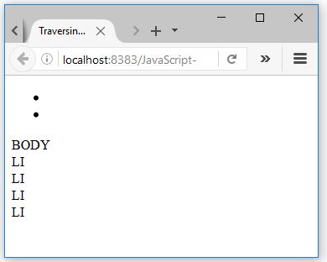

Slide 48
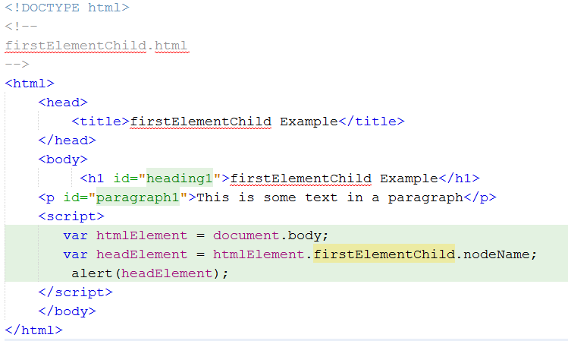
Example-12

Slide 49
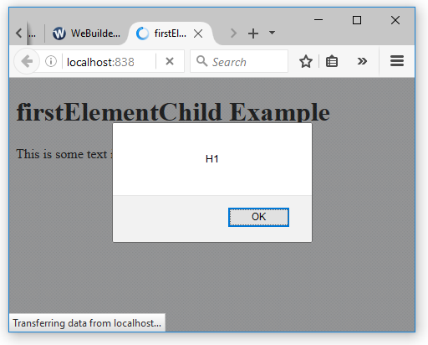

Slide 50
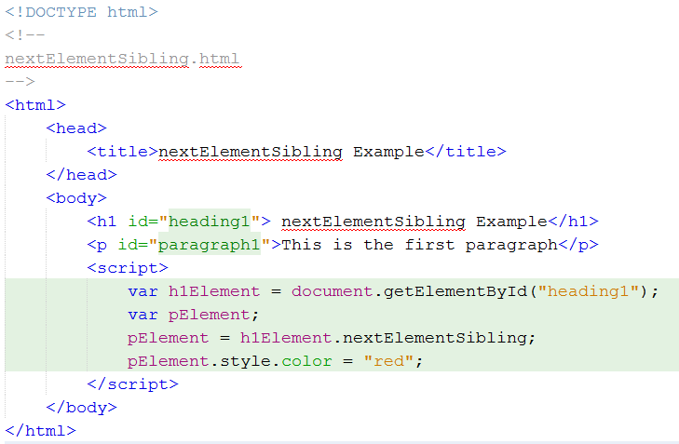
Example-13

Slide 51
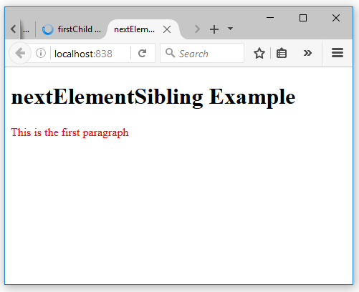

Slide 52
Creating New HTML Elements (Nodes)
To add a new element to the DOM,
First create the element node.
Second append it to an existing element.
The appendChild() method appended the new element as the last child of the parent.
The insertBefore() method appended the new element before a selected node.

Slide 53
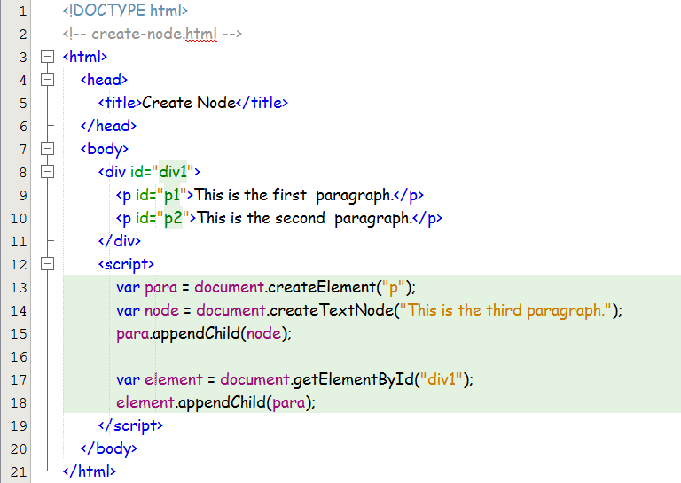
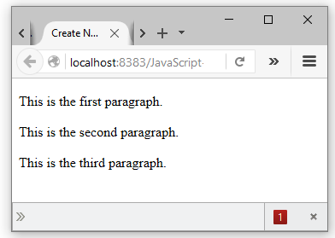
Example-14

Slide 54
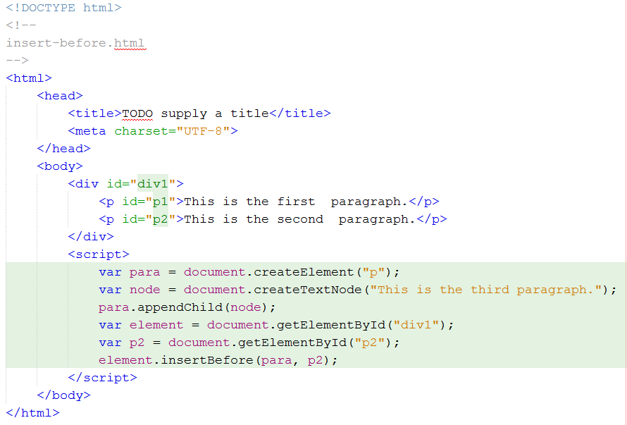
Example-15

Slide 55
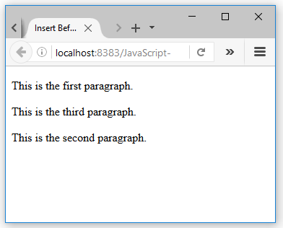

Slide 56
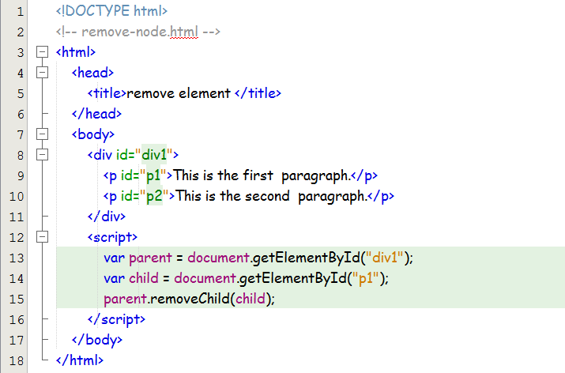
Removing Existing HTML Elements
To remove an HTML element, you must know the parent of the element:

Slide 57
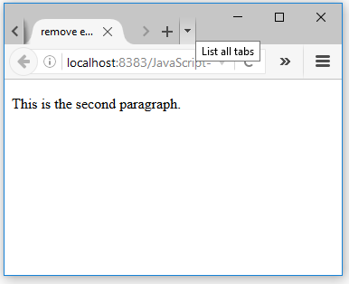

Slide 58
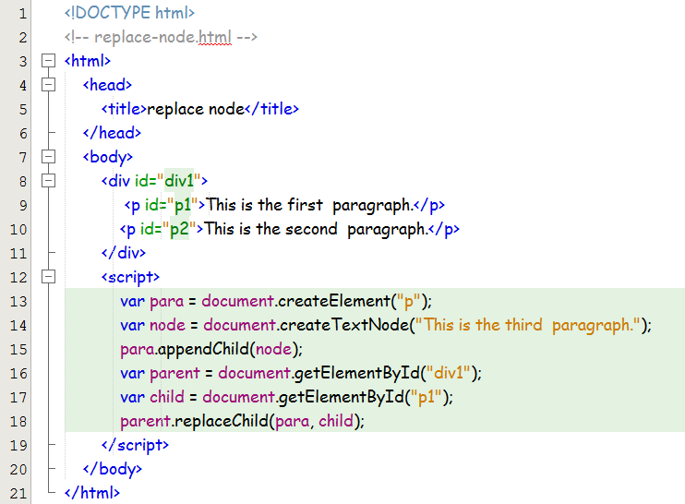
Replacing HTML Elements
The replaceChild() method is used to replace an element to the DOM

Slide 59
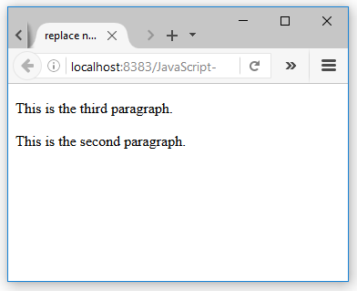

Slide 60
Thanks!

