Slide 1
Lect 4
Radio propagation characteristic

Slide 2
Doppler Effect
When a transmitter or receiver is moving, the frequency of the received signal changes, i.e. İt is different than the frequency of transmission. This is called Doppler Effect. The change in frequency is called Doppler Shift.
It depends on :-
•The relative velocity of the receiver with respect to transmitter
•The frequency (or wavelenth) of transmission
•The direction of traveling with respect to the direction of the arriving signal.

Slide 3
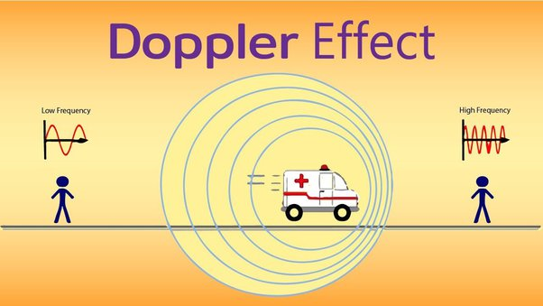
Doppler Shift – Transmitter is moving

Slide 4
Doppler Effect
The Doppler shift is positive
If the mobile is moving toward the direction of arrival of the wave
The Doppler shift is negative
If the mobile is moving away from the direction of arrival of the wave.
mph * 1.609344 = km ph

Slide 6
Fading
Fading: rapid fluctuations of received signal strength over short time intervals and/or travel distances.
Fading signals occur due to reflections from ground & surrounding buildings (clutter) as well as scattered signals from trees, people, towers, etc.
often LOS path is not available so the first multipath signal arrival is probably the desired signal (the one which traveled the shortest distance).
Caused by interference from multiple copies of Tx signal arriving @ Rx in slightly different times.
Multipath signals have randomly distributed amplitudes, phases, & direction of arrival.

Slide 7
Three most important effects:
Rapid changes in signal strengths over small travel distances or short time periods.
Changes in the frequency of signals.
Multiple signals arriving a different times.

Slide 9
Small-scale fading
As the mobile moves over small distances (about 7 cm at 1 GHz), the instantaneous received signal will fluctuate rapidly giving rise to small-scale fading
The reason is that the signal is the sum of many contributors coming from different directions.
In small scale fading, the received signal power may change, when the receiver is only moved a fraction of the wavelength.

Slide 10
large-scale propagation models
As the mobile moves away from the transmitter over larger distances, the local average received signal will gradually decrease. This is called large-scale path loss.
The models that predict the mean signal strength for an arbitrary-receiver (Arbitrary: based on chance rather than being planned or based on reason: arbitrary decision-making) transmitter (T-R) separation distance are called large-scale propagation models
Useful for estimating the coverage area of transmitters

Slide 11
Radio Propagation Models

Slide 14
Large scale propagation model
Free-Space Propagation Model
Used to predict the received signal strength when transmitter and receiver have clear, unobstructed LOS path between them.
The received power decays as a function of T-R separation distance raised to some power.

Slide 15
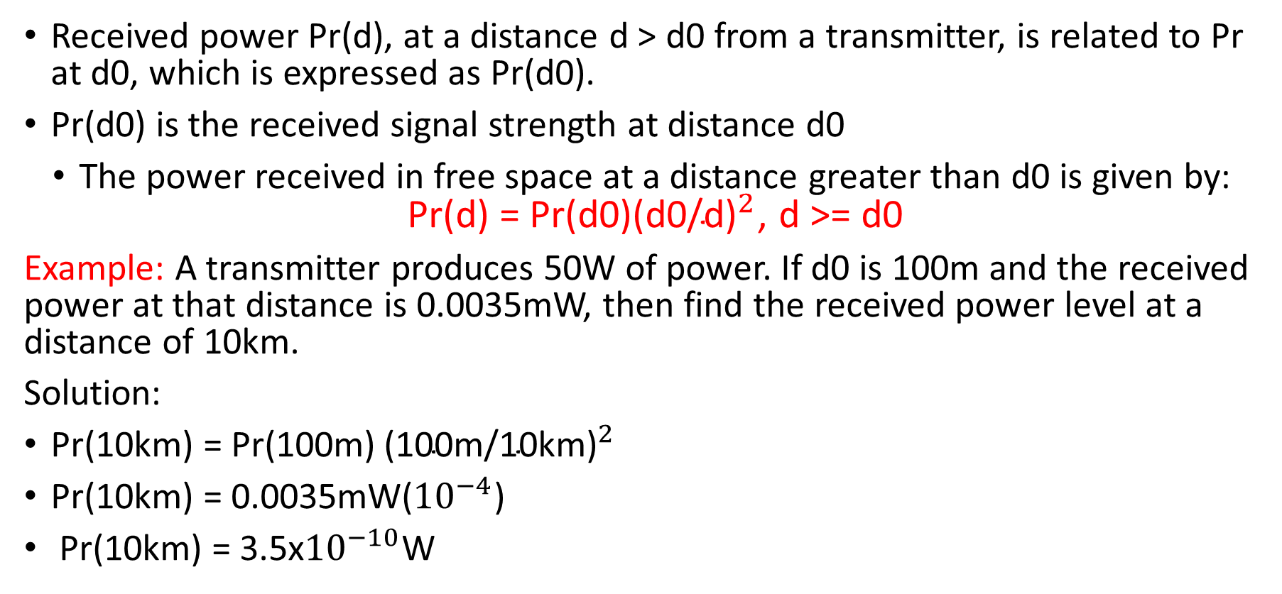
Received power Pr(d), at a distance d > d0 from a transmitter, is related to Pr at d0, which is expressed as Pr(d0).
Pr(d0) is the received signal strength at distance d0
The power received in free space at a distance greater than d0 is given by: Pr(d) = Pr(d0${\text{)(}\text{d}\text{0}\text{/}\text{d}\text{)}}^{2}$, d >= d0
Example: A transmitter produces 50W of power. If d0 is 100m and the received power at that distance is 0.0035mW, then find the received power level at a distance of 10km.
Solution:
Pr(10km) = Pr(100m)${\text{(}\text{100}\text{m}\text{/}\text{10}\text{km}\text{)}}^{2}$
Pr(10km) = 0.0035mW(${10}^{−4}$)
Pr(10km) = 3.5x${10}^{−10}$W

