Slide 1
Lecture 3
Spreading & FDMA&TDMA and CDMA

Slide 2
In Multiplexing combines signals from several sources to achieve bandwidth efficiency; the available bandwidth of a link is divided between the sources.
In spread spectrum (SS), we combine signals from different sources to fit into a larger bandwidth, but our goals are to prevent eavesdropping and jamming. To achieve these goals, spread spectrum techniques add redundancy.
Spread spectrum is designed to be used in wireless applications (LANs and WANs)
SPREAD SPECTRUM

Slide 3
Cont..
A signal that occupies a bandwidth of B, is spread out to occupy a bandwidth of B_{ss}
All signals are spread to occupy the same bandwidth B_{ss}
Signals are spread with different codes so that they can be separated at the receivers.
Signals can be spread in the frequency domain or in the time domain.

Slide 4
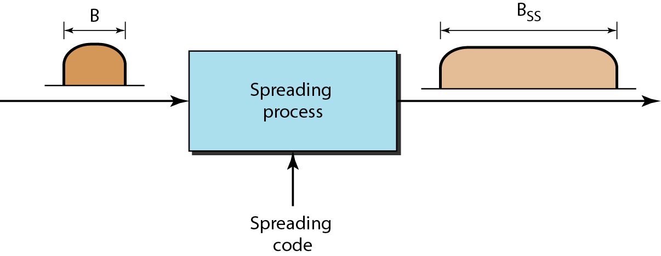
Figure 1 Spread spectrum

Slide 5
Frequency hopping spread spectrum (FHSS)
The frequency hopping spread spectrum (FHSS) technique uses M different carrier frequencies that are modulated by the source signal. At one moment, the signal modulates one carrier frequency; at the next moment, the signal modulates another carrier frequency. Although the modulation is done using one carrier frequency at a time, M frequencies are used in the long run. The bandwidth occupied by a source after spreading is BpHSS »B.

Slide 6
Suppose we have decided to have eight hopping frequencies. In this case, M is 8 and k is 3. The pseudorandom
code generator will create eight different 3-bit patterns.
These are mapped to eight different frequencies in the frequency table. As shown in figure 3.

Slide 7
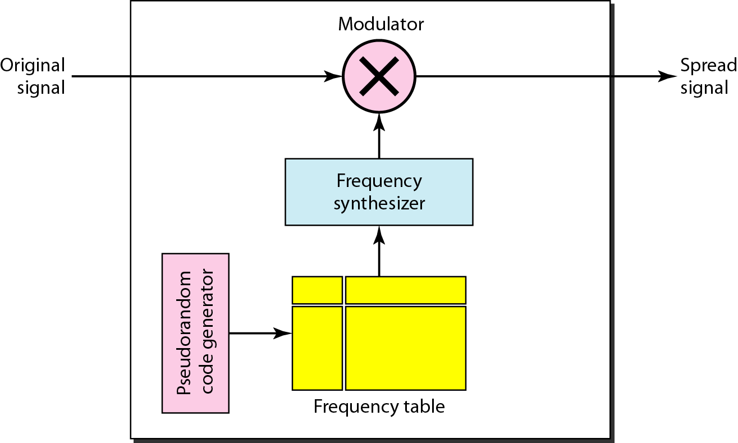
Figure 2 Frequency hopping spread spectrum (FHSS)

Slide 8
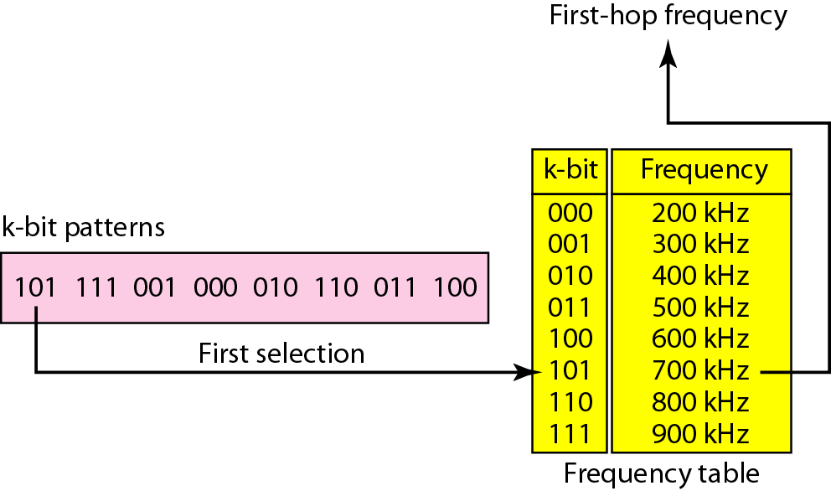
Figure 3 Frequency selection in FHSS

Slide 9
Bandwidth Sharing
If the number of hopping frequencies is M, we can multiplex M channels into one by using the same Bss bandwidth. This is possible because a station uses just one frequency in each hopping period; M - 1 other frequencies can be used by other M - 1 stations.
Figure 4 shows an example of four channels using FDM and four channels using FHSS,In FDM, each station has fixed frequency; while in FHSS, each station uses changes frequency hop to other frequency hop.

Slide 10
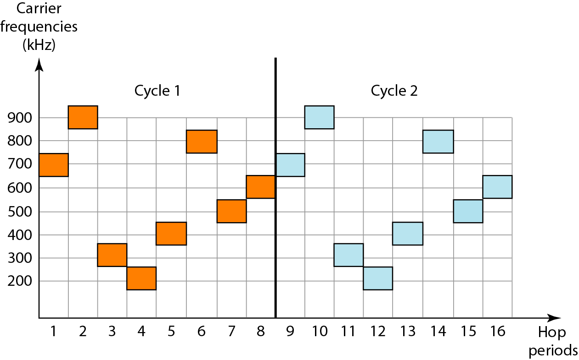
Figure 4 FHSS cycles

Slide 11
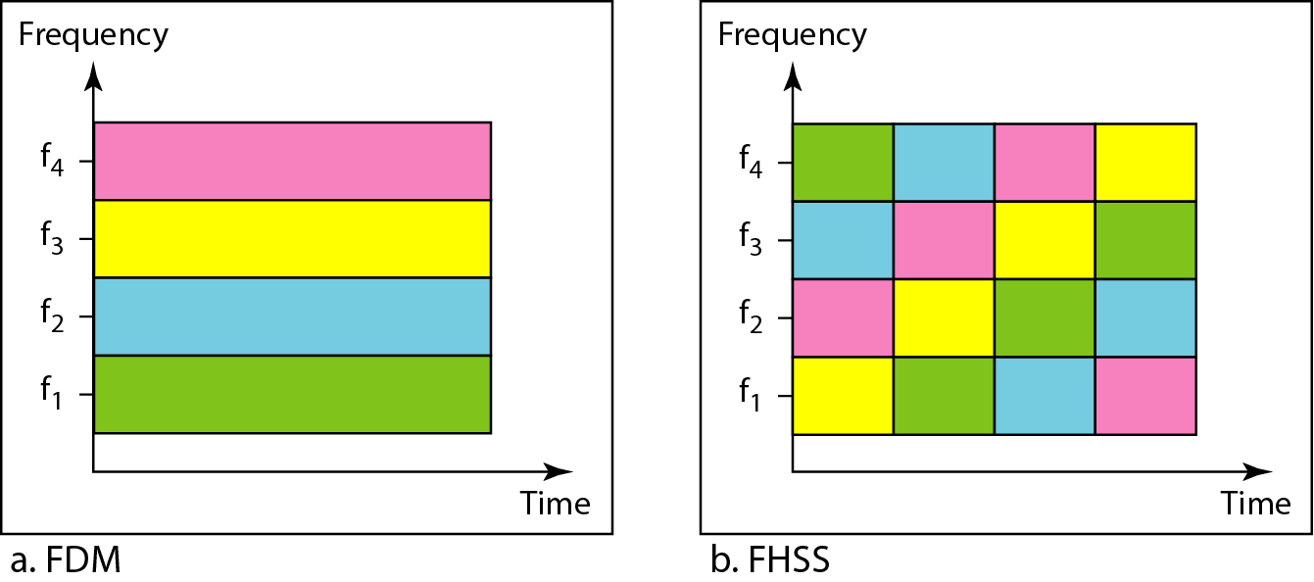
Figure 5 Bandwidth sharing

Slide 12
Direct Sequence Spread Spectrum
The direct sequence spread spectrum (DSSS) technique also expands the bandwidth of the original signal, but the process is different. In DSSS, we replace each data bit with n bits using a spreading code. In other words, each bit is assigned a code of n bits, called chips, where the chip rate is n times that of the data bit

Slide 13
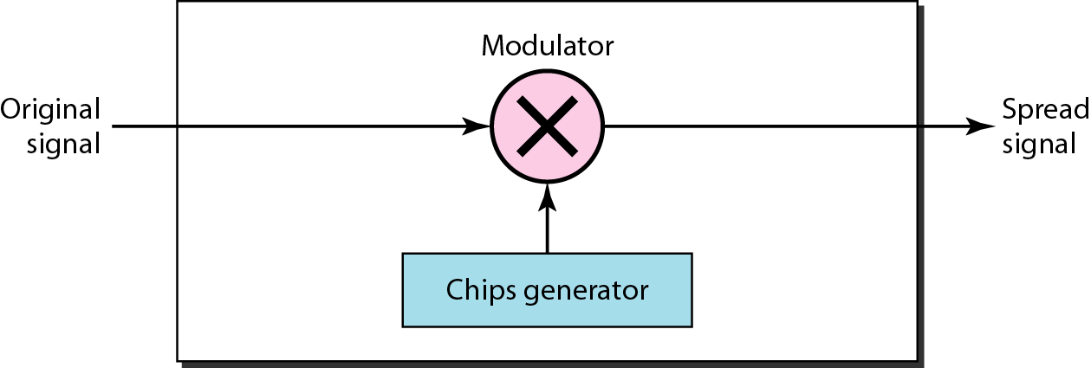
Figure6 DSSS

Slide 14
Cont..
The direct sequence spread spectrum (DSSS) technique also expands the bandwidth of the original signal, but the process is different.
In figure 7 , we replace each data bit with 11 bits using a spreading code.
In other words, each bit is assigned a code of 11 bits, called chips, where the chip rate is 11 times that of the data bit.

Slide 15
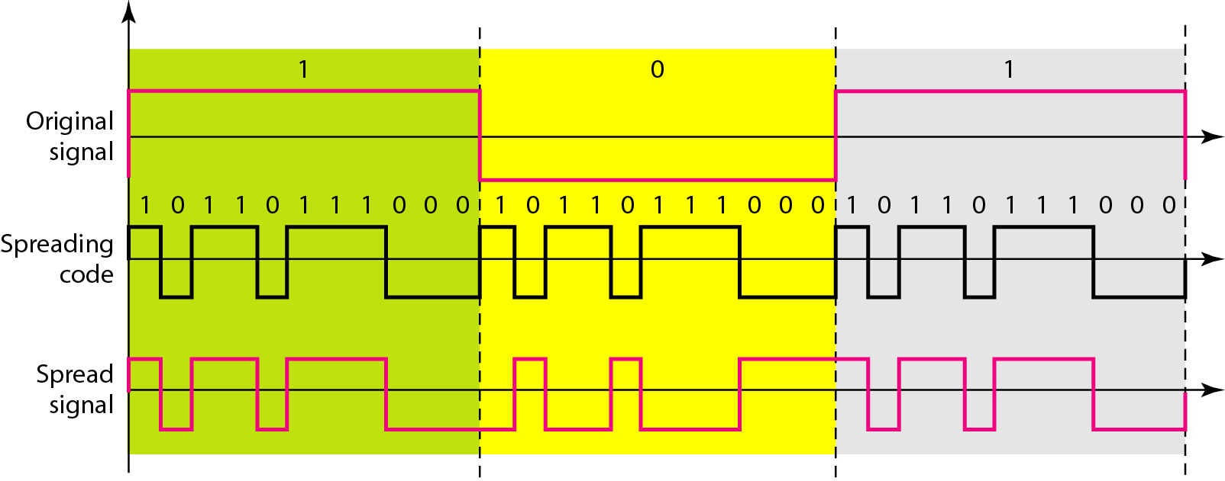
Figure 7 DSSS example

Slide 16
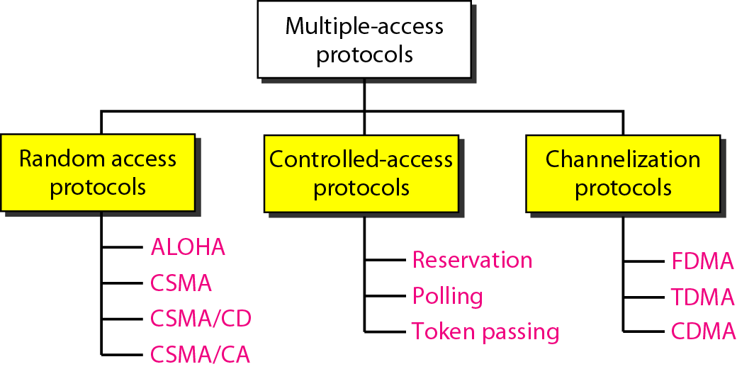
Taxonomy of multiple-access protocols

Slide 17
3 CHANNELIZATION
Channelization is a multiple-access method in which the available bandwidth of a link is shared in time, frequency, or through code, between different stations. In this section, we discuss three channelization protocols: FDMA, TDMA, and CDMA.

Slide 18
FDMA Frequency-Division Multiple Access (FDMA)
In frequency-division multiple access (FDMA), the available bandwidth is divided into frequency bands. Each station is allocated a band to send its data.
To prevent station interferences, the allocated bands are separated from one another by small guard bands.

Slide 19
cont..
Advantages:
no dynamic coordination
necessary
works also for analog signals
Disadvantages:
waste of bandwidth
if the traffic is
distributed unevenly
inflexible
guard spaces
t

Slide 20
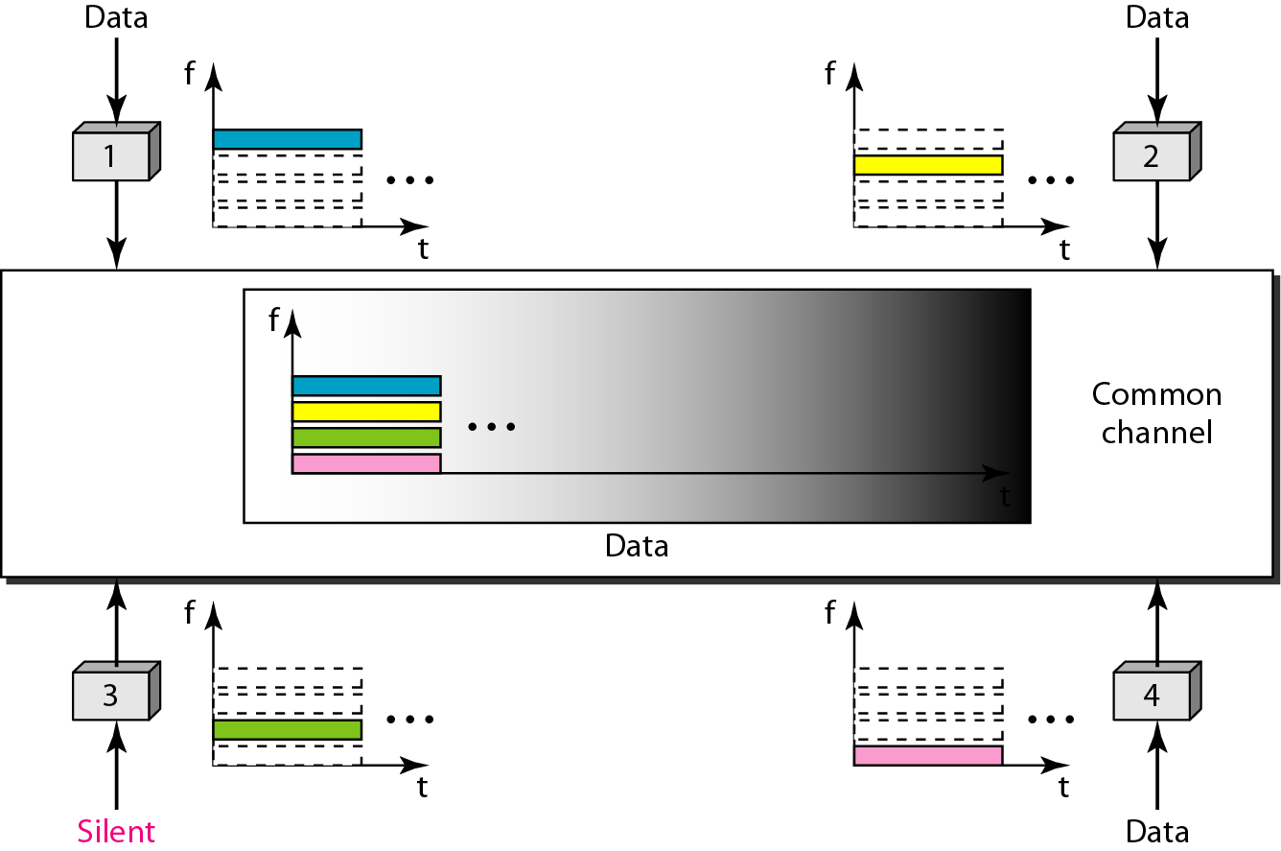
Figure 3.1 Frequency-division multiple access (FDMA)

Slide 21
Time-Division Multiple Access (TDMA)
In time-division multiple access (TDMA), the stations share the bandwidth of the channel in time. Each station is allocated a time slot during which it can send data.
Each station transmits its data in is assigned time slot.
The main problem with TDMA lies in achieving synchronization between the different stations.
Each station needs to know the beginning of its slot and the location of its slot. This may be difficult because of propagation delays introduced in the system if the stations are spread over a large area. To compensate for the delays, we can insert guard

Slide 22
Cont..
Advantage:
No interference from simultaneous transmission.
Share a single carrier frequency with multiple users.
No frequency guard band required.
Flexible bit rate.
Disadvantage
Slot allocation is to be complex in TDMA.

Slide 23
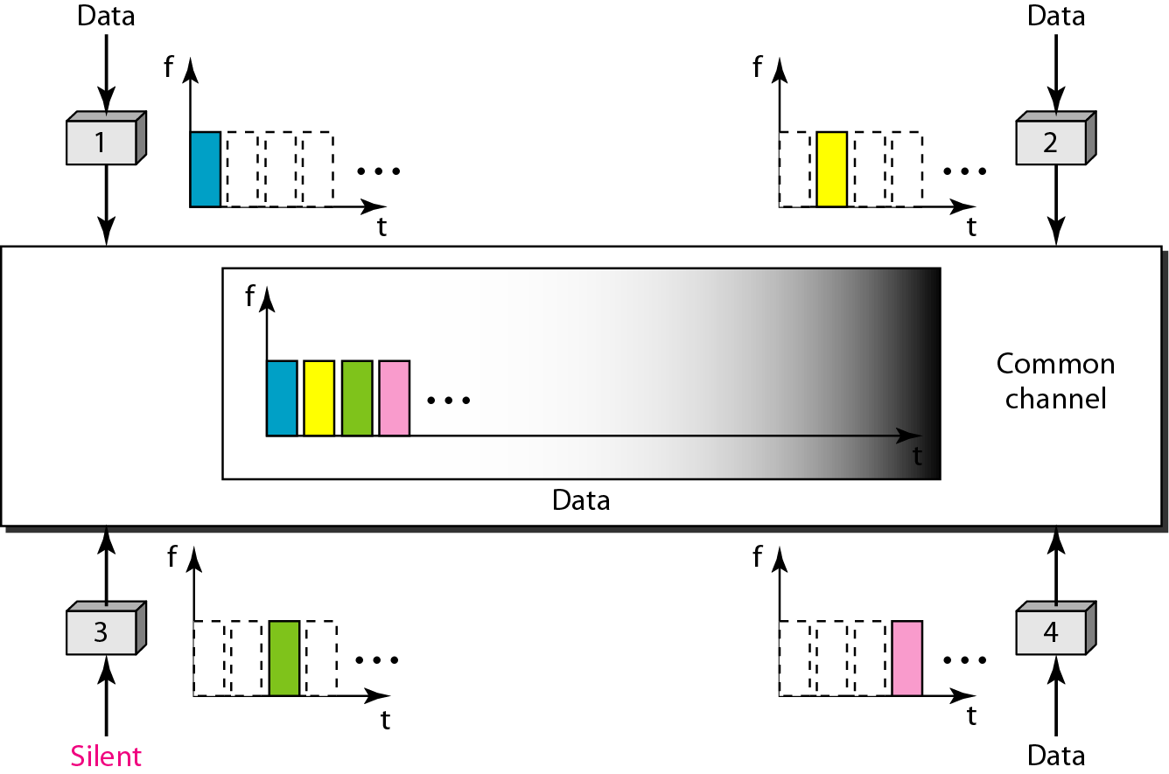
Figure 3.2 Time-division multiple access (TDMA)

Slide 24
In TDMA, the bandwidth is just one channel that is timeshared between different stations.

Slide 25
CDMA (Code-Division Multiple Access)
CDMA differs from FDMA because only one channel occupies the entire bandwidth of the link. It differs from TDMA because all stations can send data simultaneously; there is no timesharing.

Slide 26
Code multiplex
Each channel has a unique code
All channels use the same spectrum
at the same time
Advantages:
  bandwidth efficient
  no coordination and synchronization necessary
  good protection against interference and tapping
Disadvantages:
  lower user data rates
  more complex signal regeneration

Slide 27

Note
In CDMA, one channel carries all transmissions simultaneously.

Slide 28
Figure 3.3 Data representation in CDMA

Slide 29
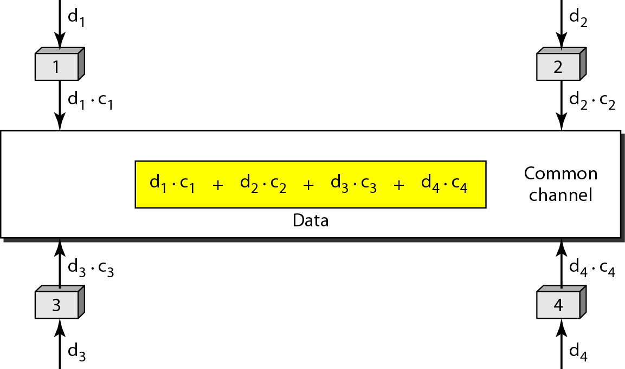
Figure 3.3 Simple idea of communication with code

Slide 30
Figure 3.2 Chip sequences

Slide 31
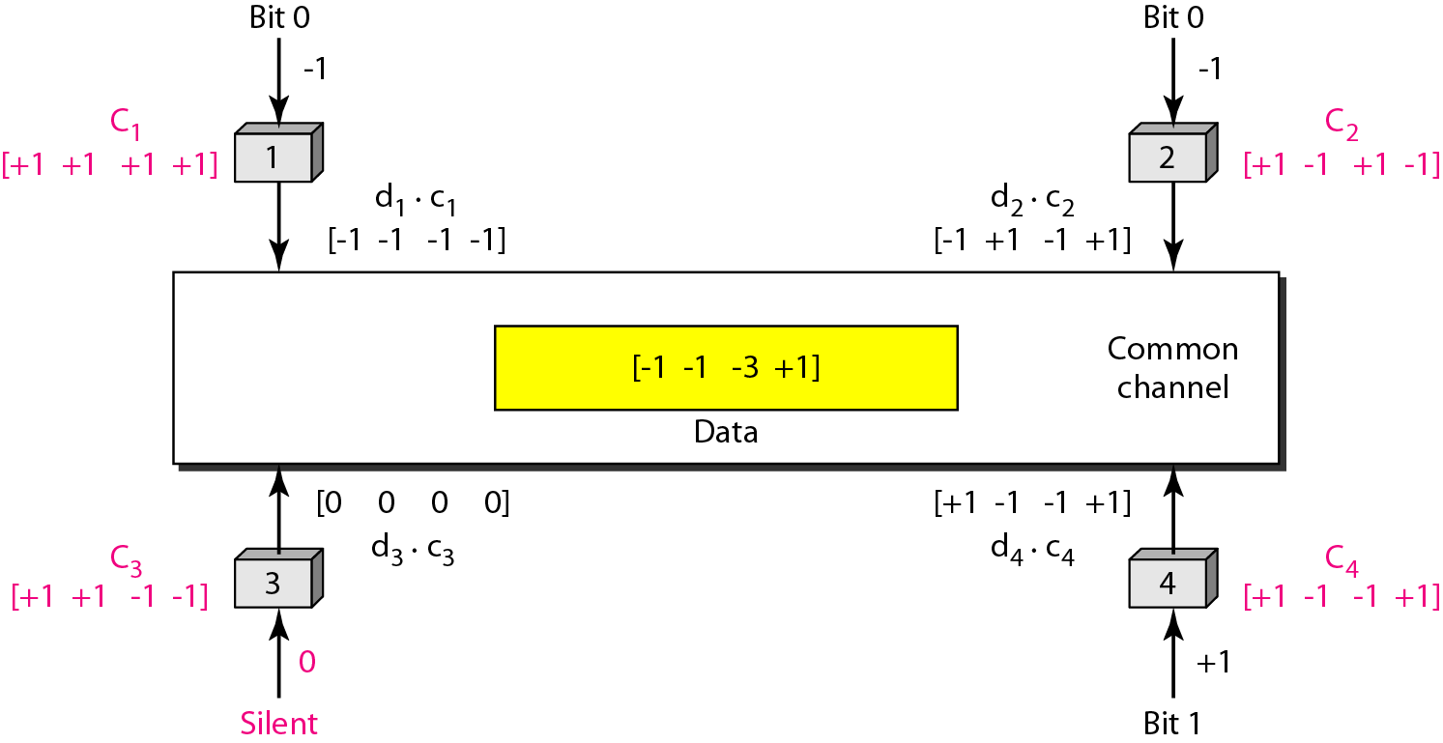
Figure 3.4 Sharing channel in CDMA

Slide 32
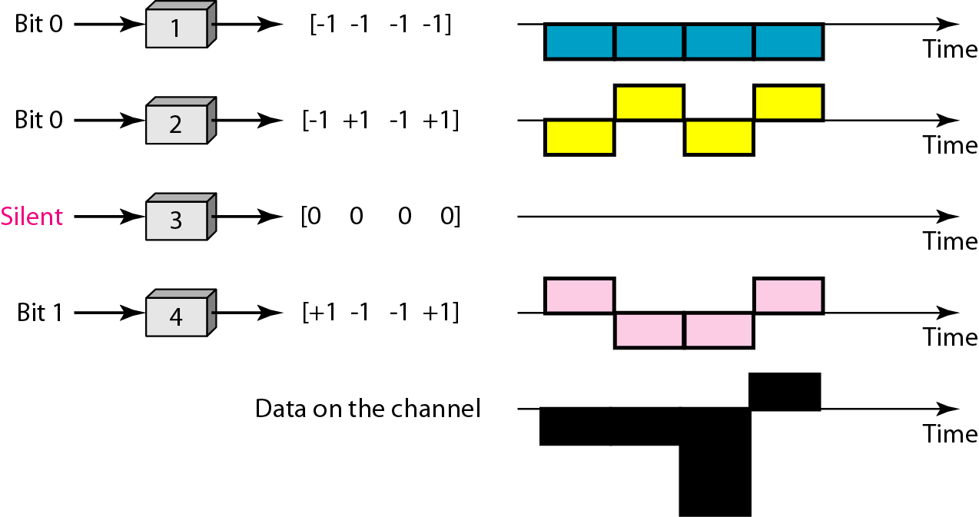
Figure 3.5 Digital signal created by four stations in CDMA

Slide 33
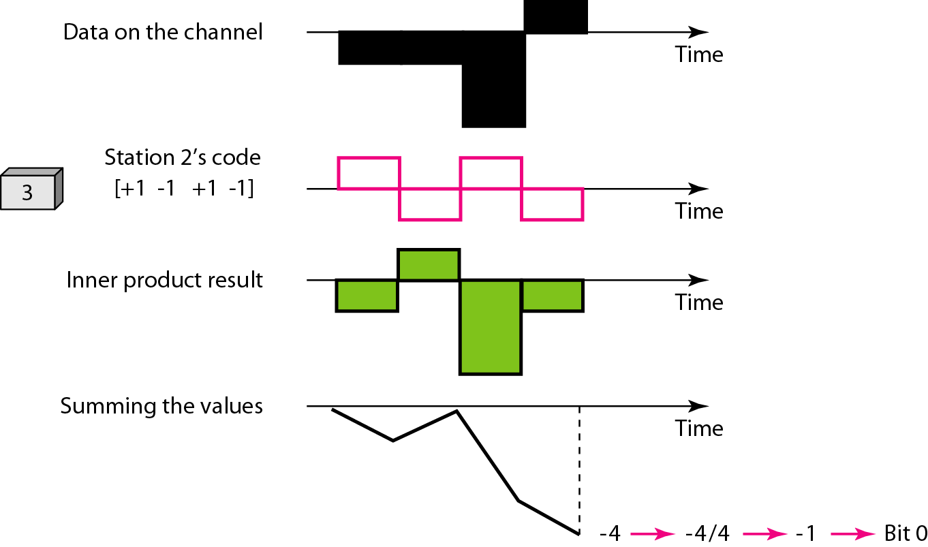
Figure 3.6 Decoding of the composite signal for one in CDMA

Slide 34
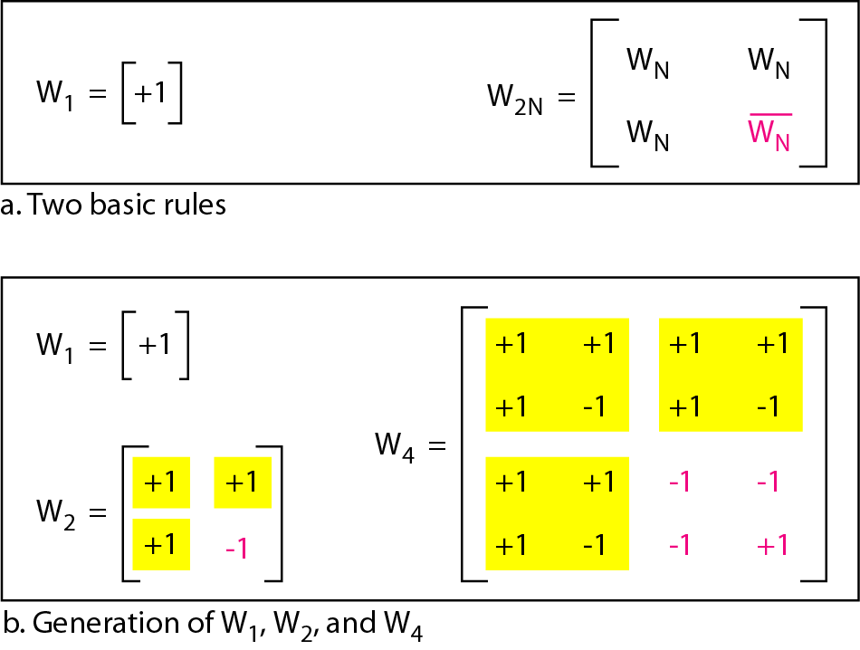
Figure 3.7 General rule and examples of creating Walsh tables

Slide 35
Note
The number of sequences in a Walsh table needs to be N = 2^{m}.

Slide 36
Example 3.8
Find the chips for a network with
a. Two stations b. Four stations
Solution
We can use the rows of W2 and W4 in Figure 12.29:
a. For a two-station network, we have
[+1 +1] and [+1 −1].
b. For a four-station network we have
[+1 +1 +1 +1], [+1 −1 +1 −1],
[+1 +1 −1 −1], and [+1 −1 −1 +1].

Slide 37
Example 3.9
What is the number of sequences if we have 90 stations in our network?
Solution
The number of sequences needs to be 2^{m}. We need to choose m = 7 and N = 2⁷ or 128. We can then use 90
of the sequences as the chips.

Slide 38
Example 3.10
Prove that a receiving station can get the data sent by a specific sender if it multiplies the entire data on the channel by the sender’s chip code and then divides it by the number of stations.
Solution
Let us prove this for the first station, using our previous four-station example. We can say that the data on the channel
D = (d1 ⋅ c1 + d2 ⋅ c2 + d3 ⋅ c3 + d4 ⋅ c4).
The receiver which wants to get the data sent by station 1 multiplies these data by c1.

Slide 39
Example 3.11 (continued)
When we divide the result by N, we get d1 .

