Slide 1
Lecture 2
Radio propagation characteristic

Slide 2
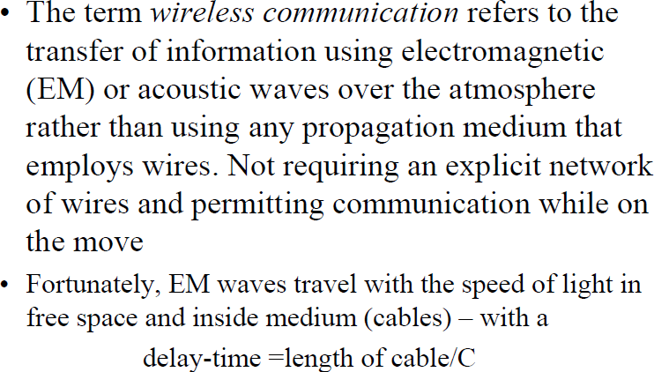

Radio propagation characteristic
2

Slide 3
Understanding Radio Frequency
Radio frequency (RF) waves are used in a wide range of communications, including radio, television, cordless phones, WLANs, and satellite communications. RF is around everyone and everything, and comes in many forms. RF energy is emitted from the numerous devices like antenna that use it for various types of communications.
Figure 2.1 shows some of the many ways RF is used,

Slide 4
Figure 2.1. Radio frequency is used in many different devices to provide wireless
communications

Slide 5
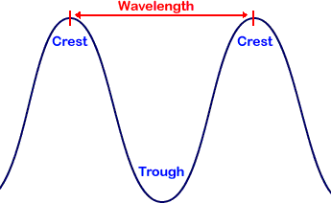
RF consists of high-frequency alternating current (AC) signals passing over a copper cable connected to an antenna.
This antenna will then transform the received signal into radio waves that propagate through the air.
The most basic AC signal is a sine wave, which is the result of an electrical current varying uniformly in voltage over a period of time. This sine wave cycle will repeat a specific number of times (cycles) over a period of one second. The number of cycles per second will result in different frequencies, measured in Hertz.
The distance between two consecutive maxima is called the wavelength, designated by λ. In vacuum, all electromagnetic waves travel at the speed of light: c = 3x10⁸ m/sec.
In copper or fiber the speed slows down to about 2/3 of this value.
Relation between f,λ, c: C= λf

Slide 6
Successful radio transmissions consist of a minimum of two components, a transmitter and receiver (see Figure 3.1).
Figure 2.2 RF transmitter and receiver. In a WLAN, the transmitter and receiver could
be an access point and client device, respectively.

Slide 7
Signals
physical representation of data
function of time and location
signal parameters: parameters representing the value of data
classification
  continuous time/discrete time
  continuous values/discrete values
  analog signal = continuous time and continuous values
  digital signal = discrete time and discrete values
signal parameters of periodic signals:
period T, frequency f=1/T, amplitude A, phase shift ϕ
  sine wave as special periodic signal for a carrier:
  s(t) = A_{t} sin(2 π f_{t} t + ϕ_{t})

Slide 8
Signals
Different representations of signals
  amplitude (amplitude domain)
  frequency spectrum (frequency domain)
  phase state diagram (amplitude M and phase ϕ in polar coordinates)
Composed signals transferred into frequency domain using Fourier transformation
Digital signals need
  infinite frequencies for perfect transmission
  modulation with a carrier frequency for transmission.
A [V]
A [V]
Q = M sin ϕ
t[s]
ϕ
I= M cos ϕ
ϕ
f [Hz]

Slide 9
Frequencies for communication
twisted pair
coax cable
optical transmission
1 Mm
300 Hz
10 km
30 kHz
100 m
3 MHz
1 m
300 MHz
10 mm
30 GHz
100 μm
3 THz
1 μm
300 THz
VLF
LF
MF
HF
VHF
UHF
SHF
EHF
infrared
visible light
UV
VLF = Very Low Frequency UHF = Ultra High Frequency
LF = Low Frequency SHF = Super High Frequency
MF = Medium Frequency EHF = Extra High Frequency
HF = High Frequency UV = Ultraviolet Light
VHF = Very High Frequency
Frequency and wave length:
λ = c/f
wave length λ, speed of light c ≅ 3x10⁸m/s, frequency f

Slide 10
Wireless LANs use frequencies from UHF to SHF spectrum
  some systems planned up to EHF
  limitations due to absorption by water and oxygen molecules (resonance frequencies)
    weather dependent fading, signal loss caused by heavy rainfall etc.

Slide 11
WIRELESS PROPAGATION
A signal radiated from an antenna travels along one of three routes:
Ground wave.
Sky wave.
Line of sight (LOS).

Slide 12
Figure 2.2 Propagation methods

Slide 13
Ground propagation
In ground propagation, radio waves travel through the lowest portion of the atmosphere, hugging the earth.
Radio waves (up to 2 MHz) emanate in all directions from the transmitting antenna and follow the curvature of the planet.
Distance depends on the amount of power in the signal: The greater the power, the greater the distance.
Radio waves with low and medium frequencies are employing , which can pass obstacles.
Omnidirectional antenna is used, where in signals send out in all directions.

Slide 14
sky propagation
In sky propagation, higher-frequency radio waves (2Mhz to 30Mhz) radiate upward into the ionosphere (the layer of atmosphere where particles exist as ions) where they are reflected back to earth.
The ionoshere are: part of the earth's atmosphere, from about 60 kilometers to about 1,000 kilometres above the surface, in which there are many ions.
The waves that reach ionosphere are refracted and sent back to earth.
This type of transmission allows for greater distances with lower output power.
Omnidirectional antenna is used.

Slide 15
Figure 2.3 Omnidirectional antenna

Slide 16
line-of-sight propagation
Very high-frequency signals are transmitted in straight lines directly from antenna to antenna.
Directional antennas are used.
LOS: Line-of-Sight Communication.
At very higher frequencies, radio waves have difficulty passing via obstacles.

Slide 17
Radio Frequency Channels
RF is divided into bands. These bands can be further separated into
channels .
A channel is a smaller allocation of a RF band.

Slide 18
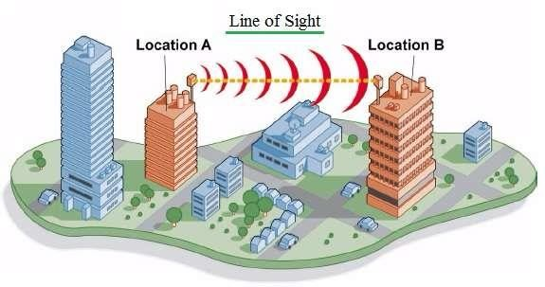
Radio propagation characteristic
Radio Wave Basics: Propagation
LOS-Line of Sight Channel
LOS stands for Line of Sight and NLOS stands for Non Line of Sight.
LOS communication is possible when there is no obstruction between transmitter and receiver. Due to less attenuation in the LOS communication, it offers good signal strength and higher amount of throughput compare to NLOS counterpart.
Examples of LOS wireless link:
Microwave point to point communication
point to point connection between BS and SS.

Slide 19
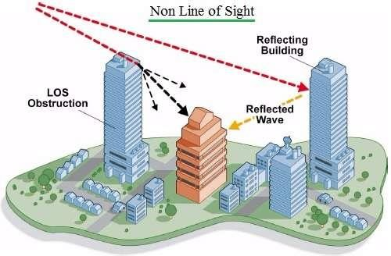
Radio propagation characteristic
Radio Wave Basics: Propagation
NLOS-Non Line of Sight Channel
NLOS communication is possible even when there is obstruction between transmitter and receiver. The signal arrives to the receiver after going through many obstructions in between. On the path, signal goes through attenuations as well as reflection, as well as diffraction.
Due to NLOS, multiple copies of signals arrive at different times with different amplitudes.
This problem is avoided with the use of (Orthogonal frequency-division multiplexing (OFDM)) and Orthogonal frequency-division multiple access (OFDMA) techniques.
Examples of NLOS wireless link:
WiMAX
WLAN

Slide 20
Propagation Models
We are interested in propagation characteristics and models for waves between few MHz to a few GHz.
Modeling radio channel is important for:
•Determining the coverage area of a transmitter
- Determine the transmitter power requirement
- Determine the battery lifetime.
•Finding modulation schemes to improve the channel quality
- Determine the maximum channel capacity
•Transmission path between sender and receiver could be
Line-of-Sight (LOS)
Obstructed by buildings, mountains and foliage
•Even speed of motion effects the fading characteristics of the channel

Slide 21
Signal propagation
Propagation in free space always like light (straight line)
Receiving power proportional to 1/d²
(d = distance between sender and receiver)
Receiving power additionally influenced by
fading (frequency dependent)
shadowing
reflection at large obstacles
refraction depending on the density of a medium
scattering at small obstacles
diffraction at edges
shadowing
reflection
refraction
scattering
diffraction

Slide 22
Radio Propagation Mechanisms
The physical mechanisms that govern radio propagation are complex and diverse, but generally attributed to the following factors: Reflection, Absorption, Diffraction and Scattering.
Reflection:-
Reflection causes the signal to bounce back on itself. The signal can interfere with itself in the air and affect the receiver’s ability to discriminate between the signal and noise in the environment.
Reflection is caused by metal surfaces such as metal doors. Implementing a Wireless LAN (WLAN) across a parking lot can be tricky because of metal cars that come and go.

Slide 23
Occurs when waves impinges upon an obstruction that is much larger in size compared to the wavelength of the signal.

Slide 24
Radio Propagation Mechanisms
Absorption:-
Some of the electromagnetic energy of the signal can be absorbed by the material in objects through which it passes, resulting in a reduced signal level. Water has significant absorption properties, and objects such as trees or thick wooden structures can have a high water content.
Implementing a WLAN in a coffee shop can be tricky if there are large canisters of liquid coffee.
Coffee-shop WLAN users have also noticed that people coming and going can affect the signal level.

Slide 25
Refraction.
When an RF signal passes from a medium with one density into a medium with another density, the signal can be bent, much like light passing through a prism.
The signal changes direction and may interfere with the non-refracted signal.
It can take a different path and encounter other, unexpected obstructions, and arrive at recipients damaged or later than expected. As an example, a water tank not only introduces absorption, but the difference in density between the atmosphere and the water can bend the RF signal.

Slide 26
Diffraction
Diffraction, which is similar to refraction, results when a region through which the RF signal can pass easily is adjacent to a region in which reflective obstructions exist.
Like refraction, the RF signal is bent around the edge of the diffractive region and can then interfere with that part of the RF signal that is not bent.
Diffraction is the bending of waves around obstacles, or the spreading of waves by passing them through an aperture, or opening.

Slide 27
Scattering
Scattering occurs when light bounces off an object in a variety of directions. The amount of scattering that takes place depends on the wavelength of the wave and the size and structure of the object.
They are produced by small objects, rough surfaces and other irregularities on the channel causes the transmitter energy to be radiated in many directions Lamp posts and street signs may cause scattering.

Slide 28
As a mobile moves through a coverage area, these mechanisms have an impact on the instantaneous received signal strength.
If a mobile does have a clear line of sight path to the base-station, then the diffraction and scattering will not dominate the propagation.
If a mobile is at a street level without LOS, then diffraction and scattering will probably dominate the propagation.

Slide 29
Signal propagation ranges
Transmission range
  communication possible
  low error rate
Detection range
  detection of the signal
  possible
  no communication
  possible , because of high error rate.
Interference range
  signal may not be
  detected
  signal adds to the
  background noise
sender
transmission
detection
distance
interference

Slide 30
Multipath propagation
Signal can take many different paths between sender and receiver due to reflection, scattering, diffraction
Time dispersion: signal is dispersed over time
➔ interference with “neighbor” symbols, Inter Symbol Interference (ISI)
The signal reaches a receiver directly and phase shifted
➔ distorted signal depending on the phases of the different parts
multipath
pulses
LOS pulses
signal at sender
signal at receiver

Slide 31
Effects of mobility
Channel characteristics change over time and location
  signal paths change
  different delay variations of different signal parts
  different phases of signal parts
➔ quick changes in the power received (short term fading)
Additional changes in
  distance to sender
  obstacles further away
➔ slow changes in the average power
received (long term fading)
long term
fading
power
t
short term fading

Slide 32
Signals take multiple physical paths between transmitter and receiver can cause errors and affect the quality of communications (constructive and destructive interference, and phase shifting of the signal.)

Slide 34
Signal Multipath Propagation
The effects of multipath include constructive and destructive interference, and phase shifting of the signal. In digital radio communications (such as GSM) multipath can cause errors and affect the quality of communications.
Multiple signal interfere with each other at the receiver either in constructive or deconstructive way.

Slide 35
Radio propagation characteristic
Decibel (dB)
What is dB (decibel):
A logarithmic unit that is used to describe a ratio between the input and output levels. Let say we have two values P1 and P2. The difference (ratio) between them can be expressed in dB and is computed as follows: 10 log (P1/P2) dB
For power differences, dBW is used to denote a power level with respect to 1W as the reference power level.
Example: transmit power P1 = 100W and the received power P2 = 1 W Tx power is 100 times of received power.
The difference is 10log(100/1W) = 20dBW.
For power differences, dBm is used to denote a power level with respect to 1mW as the
reference power level.
Example: Tx power = 100W, Received power = 1mW Tx power is 100,000 times of received power Difference is 10log(100/1mW) = 50dBm

Slide 36

Example
Suppose a signal travels through a transmission medium and its power is reduced to one-half. This means that P2 is (1/2)P1. In this case, the attenuation (loss of power) can be calculated as
A loss of 3 dB (–3 dB) is equivalent to losing one-half the power.

Slide 37
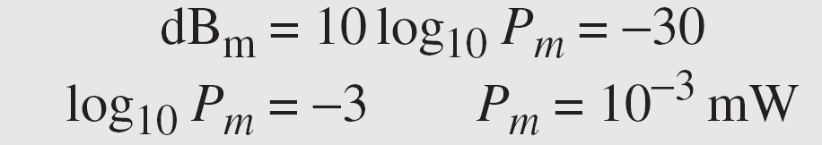
Example
Sometimes the decibel is used to measure signal power in milliwatts. In this case, it is referred to as dB_{m} and is calculated as dB_{m} = 10 log10 P_{m} , where P_{m} is the power in milliwatts. Calculate the power of a signal with dB_{m} = −30.
Solution
We can calculate the power in the signal as

Slide 38
Signal to Noise Ratio (SNR)
To measure the quality of a system the SNR is often used. It indicates the strength of the signal w.r.t the noise power in the system.
It is the ratio between two powers.
It is usually given in dB and referred to as SNR_{dB.}

Slide 39
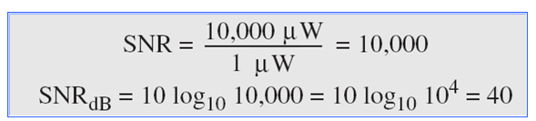
Example
The power of a signal is 10 mW and the power of the noise is 1 μW; what are the values of SNR and SNR_{dB} ?
Solution
The values of SNR and SNRdB can be calculated as follows:

Slide 40
Example
The values of SNR and SNRdB for a noiseless channel are
We can never achieve this ratio in real life; it is an ideal.

Slide 41
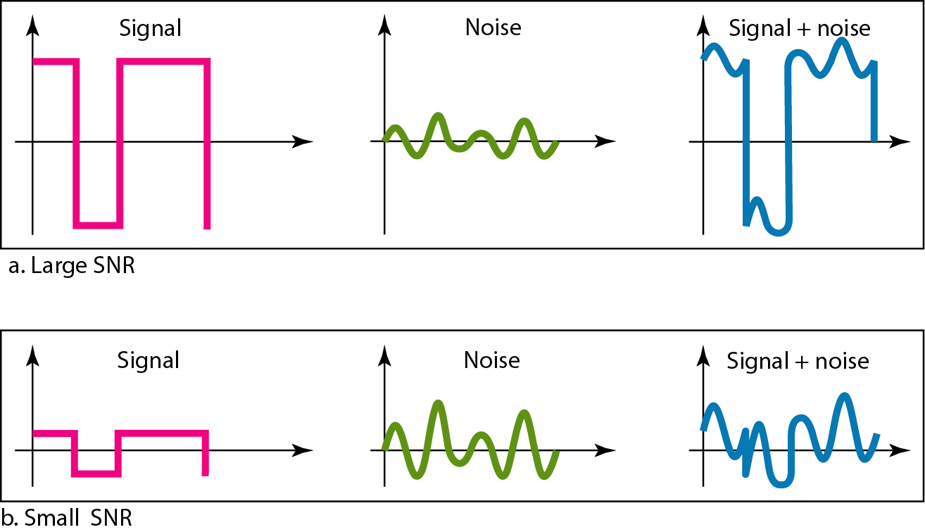
Figure Two cases of SNR: a high SNR and a low SNR

Slide 42
Bit Error Rate
The bit error rate (BER) is the number of bit errors per unit of time.
The bit error ratio (also BER) is the number of bit errors divided by the total number of transferred bits during a studied time interval.
As an example, assume this transmitted bit sequence:
1 1 0 0 0 1 0 1 1
and the following received bit sequence:
0 1 0 1 0 1 0 0 1
In this case, the number of bit errors (the underlined bits) is 3.
The BER is 3 incorrect bits divided by 9 transferred bits, resulting in a BER of 0.333 or 33.3%.

Slide 43
Cont ..
10⁻¹
10⁻²
SNR decreases, BER increase and vise versa.
10⁻³
BER
10⁻⁴
10⁻⁵
10⁻⁶
10⁻⁷
10
20
30
40
SNR(dB)
Modulation techniques
QAM256 (8 Mbps)
QAM16 (4 Mbps)
BPSK (1 Mbps)
operating point

