Slide 1
JavaScript (Event Handling)

Slide 2
Events
Events are the actions that occur as a result of browser activities or user interactions with the web pages.
An HTML web page has finished loading
Such as the user performs an action
mouse click
enters data

Slide 3
Event Handlers
When an event occurs, a code is executed in response to a specific event is called “event handler”.
Event handler names are quite similar to the name of events they handle.
E.g the event handler for the “click” event is “onClick”.
<HTMLtag eventhandler=“JavaScript Code”>

Slide 5
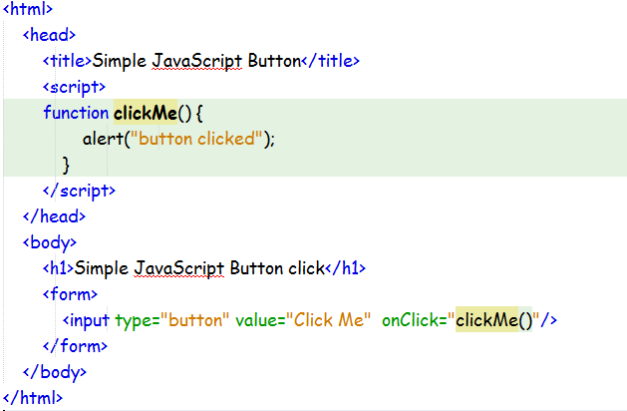
Onclick Example

Slide 6
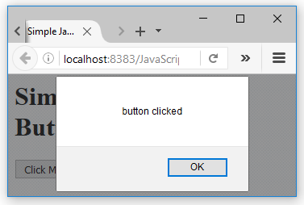

Slide 7
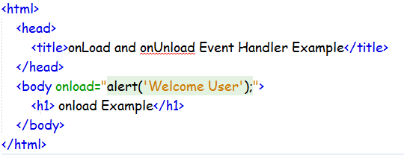
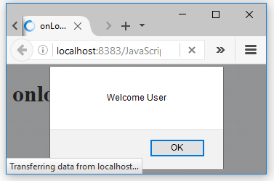
Onload Example

Slide 8
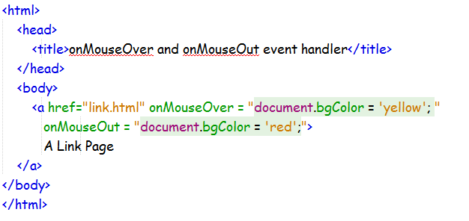
onMouseOver and onMouseOut

Slide 9
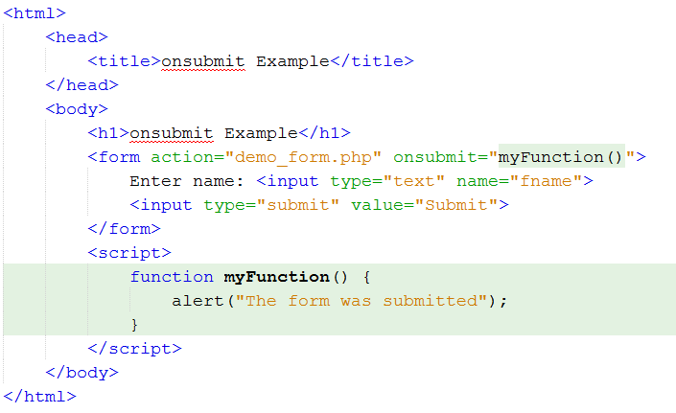
Onsubmit Example

Slide 10
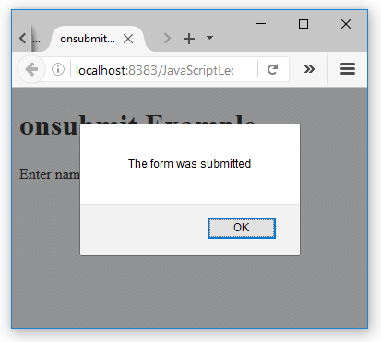

Slide 11
Mouse Events
The following tables show the events and their event handlers:
Event | Fires When
onclick | mouse button is clicked
ondblclick | mouse button is double-clicked
onmousedown | mouse button is pressed down
onmouseup | mouse button is released
onmousemove | mouse moves
onmouseover | mouse enters an element
onmouseout | mouse leaves an element

Slide 12
Keyboard Events
Event | Fires When The User
onkeypress | presses then releases a key
onkeydown | pushes down a key
onkeyup | releases a key

Slide 13
Selection and Focus Events
Event | Fires When
onselect | text selection begins (inside either <input type="text"> or <textarea>)
onchange | when a text input is changed and the element loses focus, or new choice is made in a select element
onfocus | form element gains focus
onblur | form element loses focus

Slide 14
Other Events

Slide 15
The following Link conations the HTML events.
List of HTML Events

