Slide 1
JavaScript (Array, Function, and Objects)

Slide 2
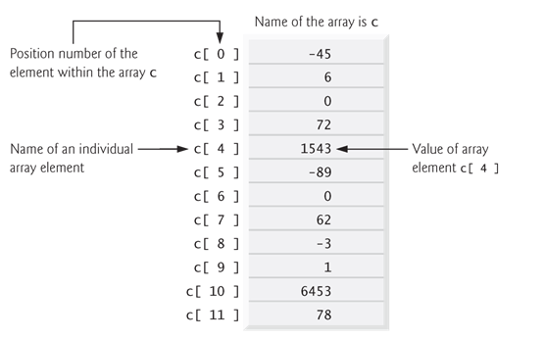
Arrays
An array is an ordered collection of values. Each value is called an element, and each element has a numeric position in the array, known as its index..
JavaScript arrays are dynamic entities that can change size after they are created.
Example1. Array with 12 Elements

Slide 3
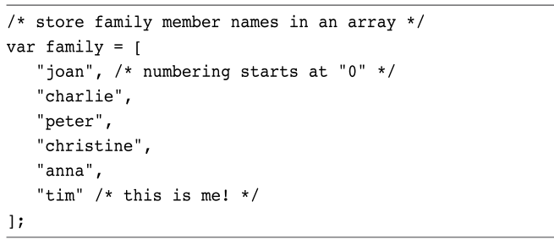
Example:

Slide 4
Decalring an Arrays
Using the new keyword.
var myList = new Array( );
Using the shortcut [ ].
var myList = [ ];

Slide 5
Examle-1
Var studentNames = new Array[ ];
studentNames[0] = “Ahmad”;
studentNames[1] = “Ali”;
studentNames[2] = “Salma”;
Var studentNames = [ ];
studentNames[0] = “Ahmad”;
studentNames[1] = “Ali”;
studentNames[2] = “Salma”;
Var studentNames = [“Ahmad”, ”Ali”, ”Salma”];

Slide 6
Examle-2
The following example uses an array to print student names
<!DOCTYPE html>
<!--. array.html-->
<html>
<head>
<title>Using Arrays</title>
<meta charset="UTF-8">
<meta name="viewport" content="width=device-width, initial-scale=1.0">
</head>
<body>
<div> <h1>Student List </h1> </div>
<script>
var names = ["Ahmad","Ali","Salma"];
n = names.length;
for ( var i = 0; i < n ; ++i ){
document.write(names[i] +"<br>");
}
</script>
</body>
</html>
array.html

Slide 7
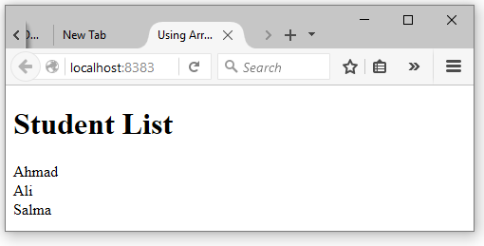

Slide 8
Array Methods

Slide 9
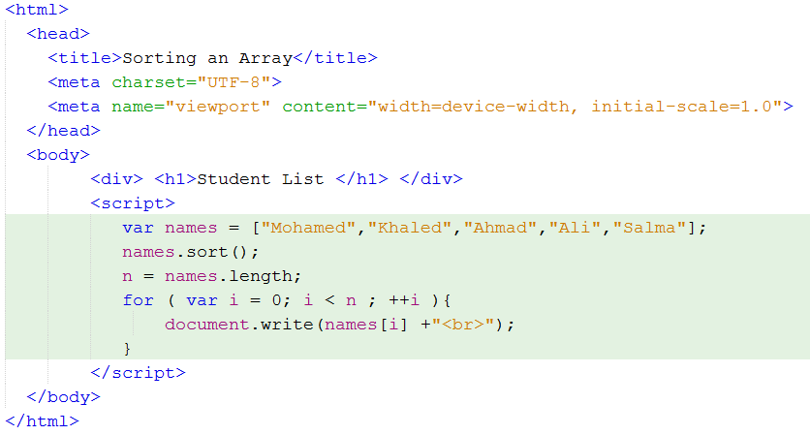
Sort()
JavaScript includes a sort method for arrays, which returns an alphabetically sorted version of the array.
Examle-2
The following example sorts an array and print it.

Slide 10
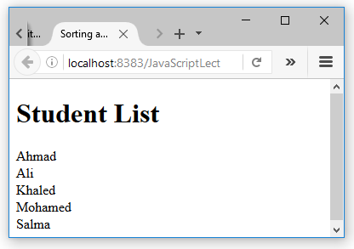

Slide 11
reverse()
The Array.reverse() method reverses the order of the elements of an array and returns the reversed array.
var a = [1,2,3];
a.reverse(); // a is now [3,2,1]
concat()
The Array.concat() method creates and returns a new array that contains the elements of the original array on which concat() was invoked, followed by each of the arguments to concat().
var a = [1,2,3];
a.concat(4, 5) // Returns [1,2,3,4,5]

Slide 12
slice()
The slice() method returns a slice, or subarray, of the specified array. Its two arguments specify the start and end of the slice to be returned.
var a = [1,2,3,4,5];
a.slice(0,3); // Returns [1,2,3]
join()
The Array.join() method converts all the elements of an array to strings and concatenates them, returning the resulting string. You can specify an optional string that separates the elements in the resulting string.
var a = [1, 2, 3]; // Create a new array with these three elements
a.join(); // => "1,2,3"
a.join(" "); // => "1 2 3“
a.join(“-"); // => "1-2-3“

Slide 13
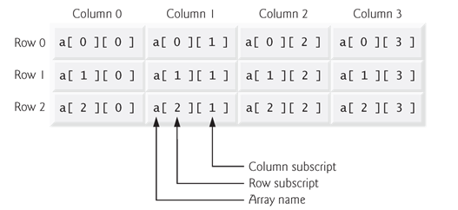
Two-dimensional arrays.
Two dimensional arrays are often used to represent tables of values consisting of information arranged in rows and columns.

Slide 14
Arrays can be initialized in declarations like a one-dimensional array.
var b = [ [ 1, 2 ], [ 3, 4 ] ];
Declaring Array of Array
// Create a two mensional array
var table = new Array(10); // 10 rows of the table
for(var i = 0; i < table.length; i++)
table[i] = new Array(10); // Each row has 10 columns

Slide 15
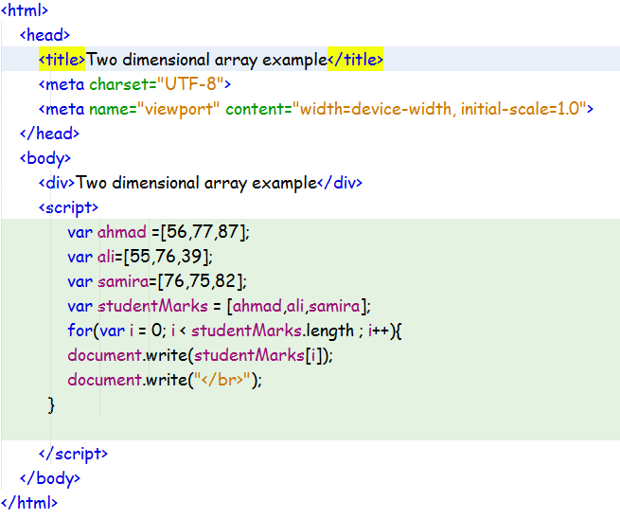
Examle-3

Slide 16
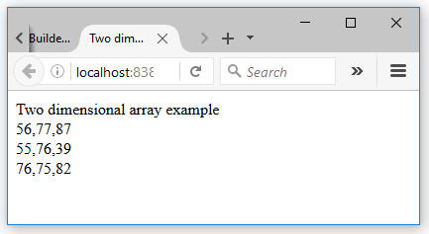

Slide 17
Functions

Slide 18
Functions
A function is a block of JavaScript code that is defined once but may be executed, or invoked, any number of times.
The general syntax for a function is shown here:
function function-name( parameter-list )
{
declarations and statements
}

Slide 19
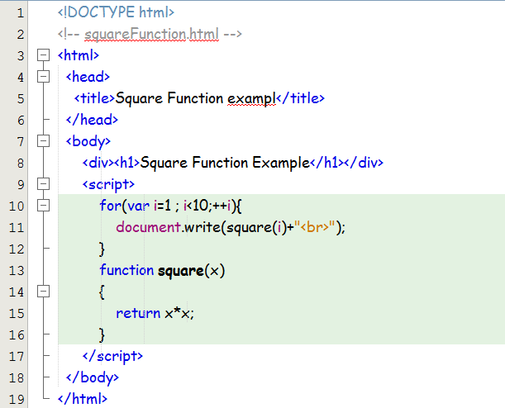
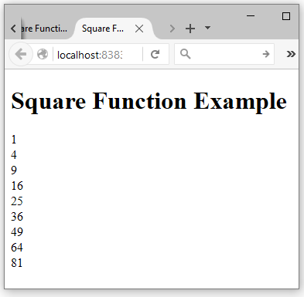
Example-3
This example uses a square function to square the numbers 1-10

Slide 20
Functions As Values
In JavaScript, functions are not only syntax but also values, which means they can be assigned to variables.
function square(x) { return x*x; }
var s = square; // Now s refers to the same function that square does
square(4); // => 16
s(4); // => 16

Slide 21
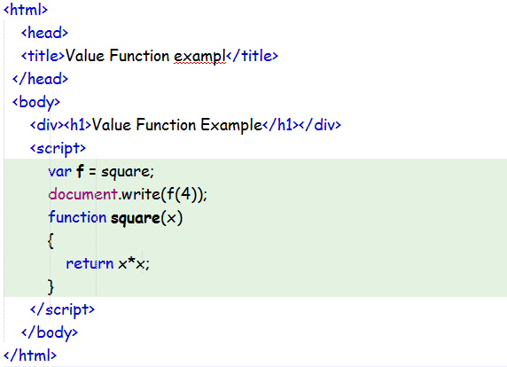
Example-4

Slide 22
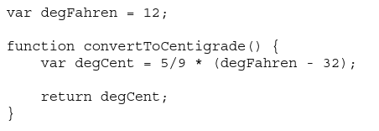
Variables Scope
Global Variable
Variables declared outside of a function are global variables and are visible everywhere in a JavaScript program.
Local Variable
Variables declared inside a function have function scope and are visible only to code that appears inside that function.
Global variable
Local variable

Slide 23
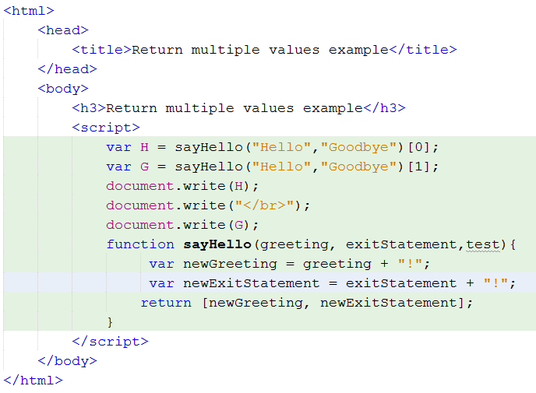
Returning Multiple Data Values with a Function
In JavaScript a function can return multiple values;

Slide 24
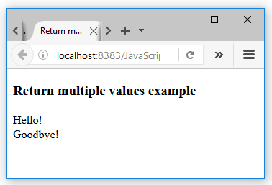

Slide 25
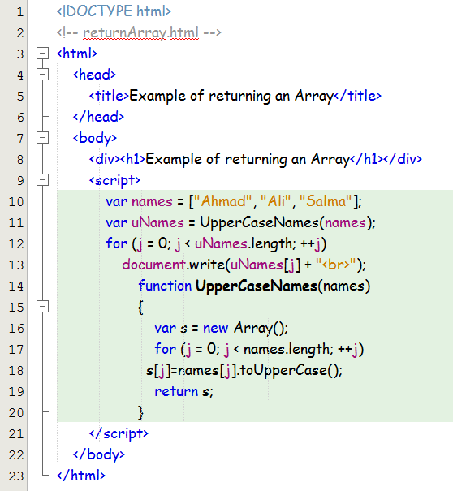
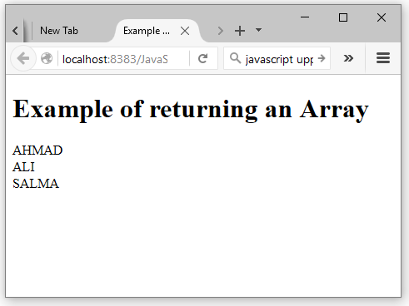
Returning n Array
The following example shows how to return an Array.

Slide 26
JavaScript Objects
Objects are variables can contain many values.
Var car = {type:” Kia”, model:”Picanto”,color:”white”}
var student = {
firstName:"Ali",
lastName:"Salim",
age:20,
eyeColor:"brown" };

Slide 27
Accessing Object Properties
object properties can be accessed in two ways:
objectName.propertyName
car.type
objectName["propertyName"]
car[“type”]

Slide 28
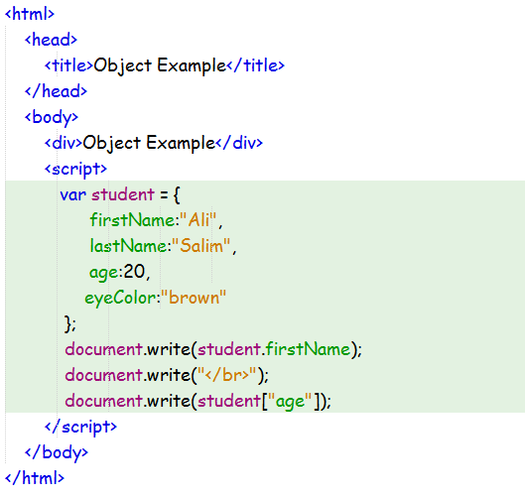
Example

Slide 29
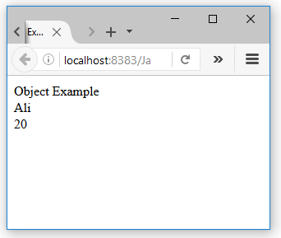

Slide 30
Thanks !

