Slide 1
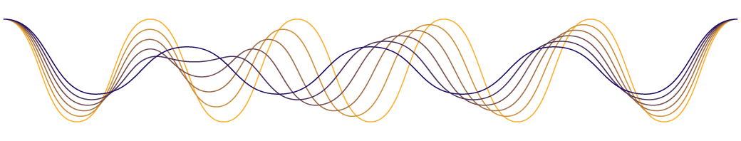
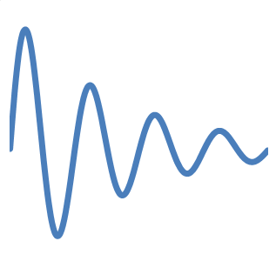
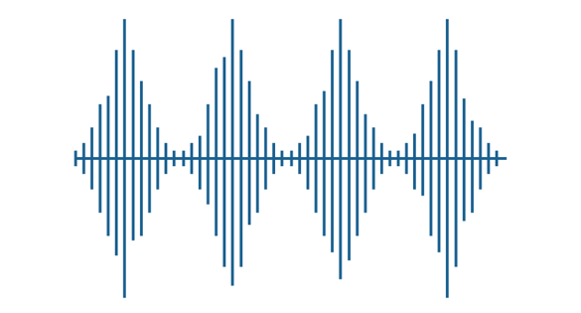
Signal : Channel effect
4-
ITNT323

Slide 2
Overview
  Signals can be either analog or digital. An analog signal has infinitely many levels of intensity over a period of time. As the wave moves from value A to value B, it passes through and includes an infinite number of values along its path. A digital signal, on the other hand, can have only a limited number of defined values. Although each value can be any number, it is often as simple as 1 and 0. So, its electric or electromagnetic representations of data, physically propagates along medium.
  Data are entities that convey meaning.
  Transmission is a communication of data by propagation and processing of signals.
Notes:
Have seen already that analog and digital roughly correspond to continuous and discrete respectively.
Define data as entities that convey meaning, or information.
Signals are electric or electromagnetic representations of data.
Signaling is the physical propagation of the signal along a suitable medium.
Transmission is the communication of data by the propagation and processing of signals.

Slide 3
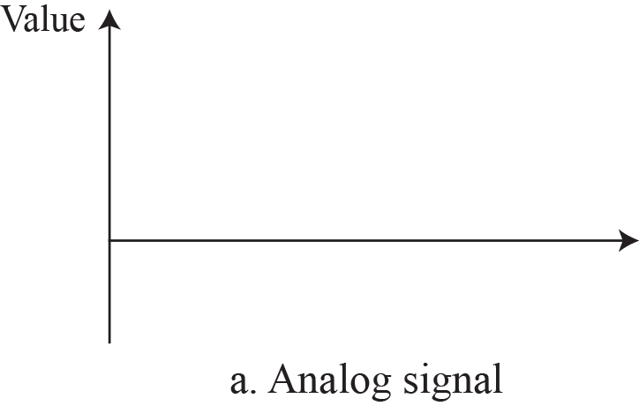
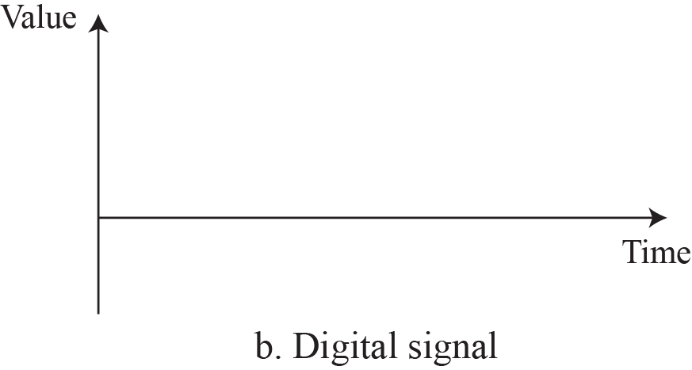
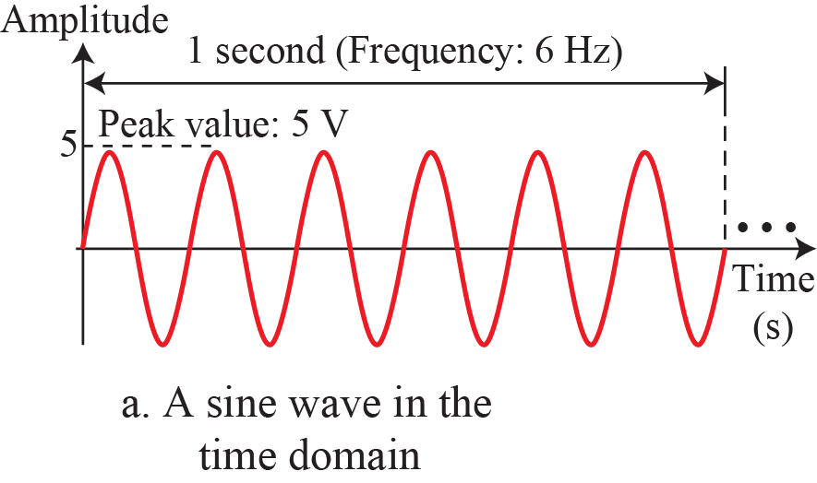
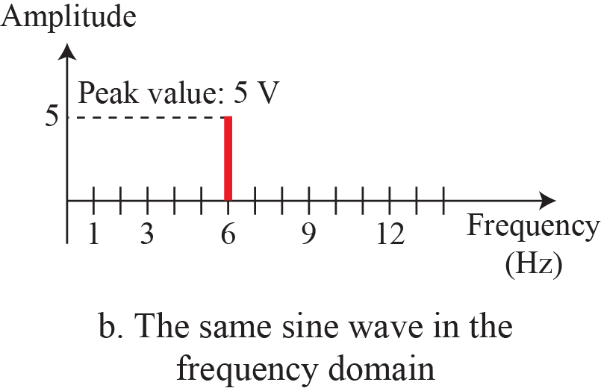
Overview
Notes:
A sine wave is comprehensively defined by its amplitude, frequency, and phase. We have been showing a sine wave by using what is called a time domain plot. The time-domain plot shows changes in signal amplitude with respect to time (it is an amplitude-versus-time plot). Phase is not explicitly shown on a time-domain plot.

Slide 4
Composite Signals
The periodic composite signal is not typical of those found in data communications. The analysis of this signal can give us a good understanding of how to decompose signals. It is very difficult to manually decompose this signal into a series of simple sine waves.
The decomposition of signal define its components from standard sine wave signals, the result of decomposing the signal can be in both the time and frequency domains.

Slide 5
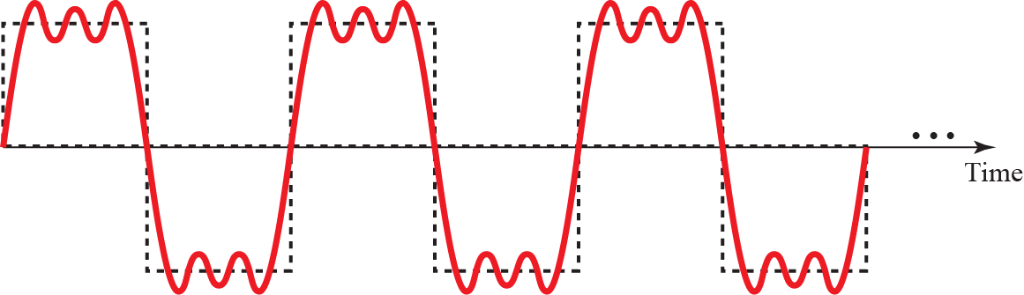
Composite Signals
A composite periodic signal
Decomposition of a composite periodic signal

Slide 6
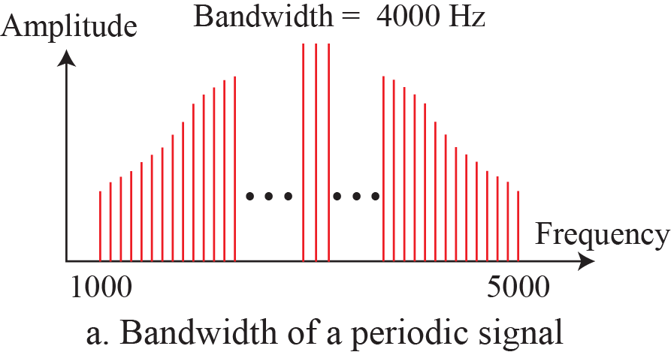
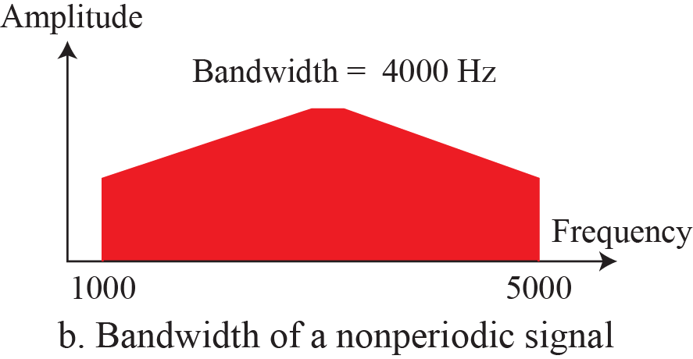
Bandwidth
The range of frequencies contained in a composite signal is its bandwidth. The bandwidth is normally a difference between two numbers. For example, if a composite signal contains frequencies between 1000 and 5000, its bandwidth is 5000 − 1000, or 4000.
The bandwidth of periodic and nonperiodic composite signals

Slide 7

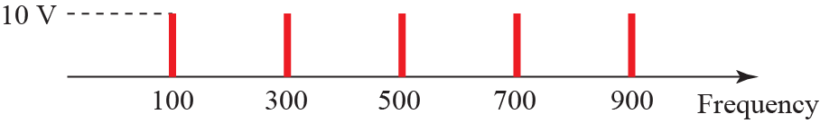

Bandwidth
Example - 1
If a periodic signal is decomposed into five sine waves with frequencies of 100, 300, 500, 700, and 900 Hz, what is its bandwidth? Draw the spectrum, assuming all components have a maximum amplitude of 10 V.
Solution
Let f_{h} be the highest frequency, f_{l} the lowest frequency, and B the bandwidth. Then
The bandwidth for the example

Slide 8
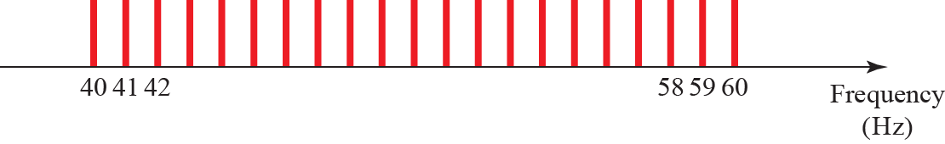
Bandwidth
Example - 2
A periodic signal has a bandwidth of 20 Hz. The highest frequency is 60 Hz. What is the lowest frequency? Draw the spectrum if the signal contains all frequencies of the same amplitude.
Solution
Let f_{h} be the highest frequency, f_{l} the lowest frequency, and B the bandwidth. Then
The spectrum contains all integer frequencies. We show this by a series of spikes.

Slide 9
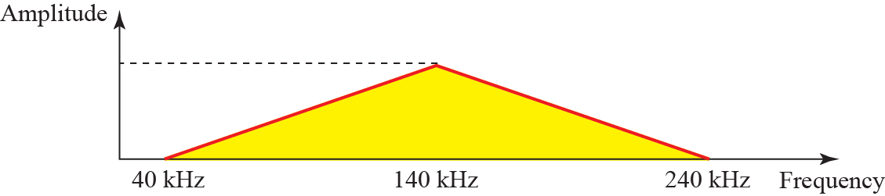
Bandwidth
Example - 3
A nonperiodic composite signal has a bandwidth of 200 kHz, with a middle frequency of 140 kHz and peak amplitude of 20 V. The two extreme frequencies have an amplitude of 0. Draw the frequency domain of the signal.
Solution
The lowest frequency must be at 40 kHz and the highest at 240 kHz. Figure 3.16 shows the frequency domain and the bandwidth.

Slide 10
Bandwidth
Example - 4
An example of a nonperiodic composite signal is the signal propagated by an AM radio station. In the United States, each AM radio station is assigned a 10-kHz bandwidth. The total bandwidth dedicated to AM radio ranges from 530 to 1700 kHz.
Another example of a nonperiodic composite signal is the signal propagated by an FM radio station. In the United States, each FM radio station is assigned a 200-kHz bandwidth. The total bandwidth dedicated to FM radio ranges from 88 to 108 MHz.

Slide 11
Bandwidth
Example - 5
Another example of a nonperiodic composite signal is the signal received by an old-fashioned analog black-and-white TV.
A TV screen is made up of pixels (picture elements) with each pixel being either white or black. The screen is scanned 30 times per second. If we assume a resolution of 525 × 700 (525 vertical lines and 700 horizontal lines), which is a ratio of 3:4, we have 367,500 pixels per screen.
If we scan the screen 30 times per second,
this is 367,500 × 30 = 11,025,000 pixels per second.
The worst-case scenario is alternating black and white pixels.

Slide 12
Bandwidth
In this case, we need to represent one color by the minimum amplitude and the other color by the maximum amplitude. We can send 2 pixels per cycle.
Therefore, we need 11,025,000 / 2 = 5,512,500 cycles per second, or Hz.
The bandwidth needed is 5.5124 MHz. This worst-case scenario has such a low probability of occurrence that the assumption is that we need only 70 percent of this bandwidth, which is 3.85 MHz.
Since audio and synchronization signals are also needed, a 4-MHz bandwidth has been set aside for each black and white TV channel. An analog color TV channel has a 6-MHz bandwidth.

Slide 13
Spectrum & Bandwidth
Spectrum
    range of frequencies contained in signal
Absolute bandwidth
    width of spectrum
Effective bandwidth
    often just bandwidth
    narrow band of frequencies containing most energy
DC Component
    component of zero frequency
Notes:
The spectrum of a signal is the range of frequencies that it contains. For Stallings DCC8e Fig 3.4c, it extends from f to 3f.
The absolute bandwidth of a signal is the width of the spectrum (eg is 2f in Fig 3.4c. Many signals, such as that of Figure 3.5b, have an infinite bandwidth.
Most of the energy in the signal is contained in a relatively narrow band of frequencies known as the effective bandwidth, or just bandwidth.
If a signal includes a component of zero frequency, it is a direct current (dc) or constant component.

Slide 14
Data Rate and Bandwidth
Any transmission system has a limited band of frequencies,
this limits the data rate that can be carried,
square have infinite components and hence bandwidth,
but most energy in first few components,
limited bandwidth increases distortion,
have a direct relationship between data rate & bandwidth.
Notes:
Although a given waveform may contain frequencies over a very broad range, as a practical matter any transmission system (transmitter plus medium plus receiver) will be able to accommodate only a limited band of frequencies. This, in turn, limits the data rate that can be carried on the transmission medium.
A square wave has an infinite number of frequency components and hence an infinite bandwidth. However, the peak amplitude of the kth frequency component, kf, is only 1/k, so most of the energy in this waveform is in the first few frequency components.
In general, any digital waveform will have infinite bandwidth. If we attempt to transmit this waveform as a signal over any medium, the transmission system will limit the bandwidth that can be transmitted. For any given medium, the greater the bandwidth transmitted, the greater the cost. The more limited the bandwidth, the greater the distortion, and the greater the potential for error by the receiver.
There is a direct relationship between data rate and bandwidth: the higher the data rate of a signal, the greater is its required effective bandwidth.

Slide 15
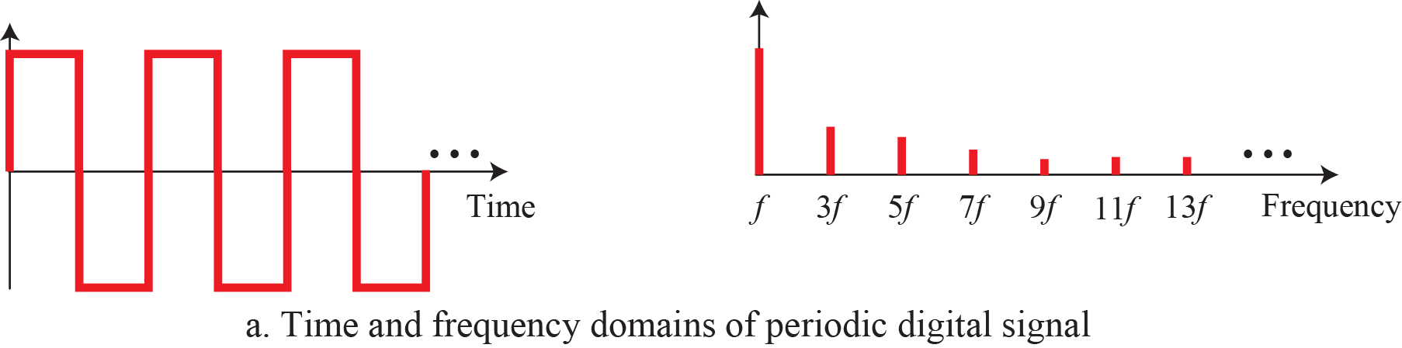
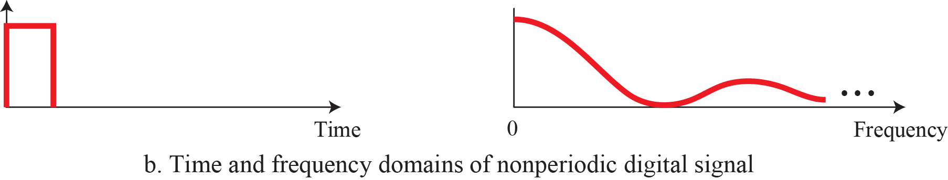
Digital As Composite Analog
Based on Fourier analysis, a digital signal is a composite analog signal. Fourier analysis can be used to decompose a digital signal. If the digital signal is periodic, which is rare in data communications, the decomposed signal has a frequency domain representation with an infinite bandwidth and discrete frequencies. If the digital signal is nonperiodic, the decomposed signal still has an infinite bandwidth, but the frequencies are continuous.
The time and frequency domains of periodic and nonperiodic digital signals

Slide 16
Transmission of Digital Signals
Based on Fourier analysis, a digital signal is a composite analog signal.
We can intuitively come up with this concept when we consider a digital signal. A digital signal, in the time domain, comprises connected vertical and horizontal line segments. A vertical line in the time domain means a frequency of infinity (sudden change in time); a horizontal line in the time domain means a frequency of zero (no change in time). Going from a frequency of zero to a frequency of infinity implies all frequencies in between are part of the domain.

Slide 17
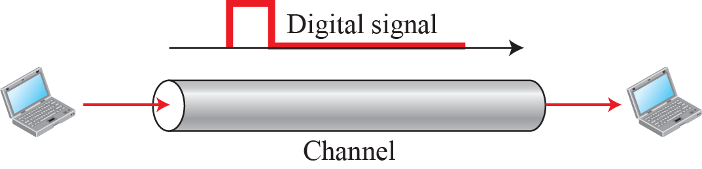
Transmission of Digital Signals : Baseband Transmission
Baseband Transmission
Baseband transmission means sending a digital signal over a channel without changing the digital signal to an analog signal.
Baseband transmission requires that we have a low-pass channel, a channel with a bandwidth that starts from zero. This is the case if we have a dedicated medium with a bandwidth constituting only one channel.
Notes:
For example, the entire bandwidth of a cable connecting two computers is one single channel.
As another example, we may connect several computers to a bus, but not allow more than two stations to communicate at a time. Again we have a low-pass channel, and we can use it for baseband communication.

Slide 18
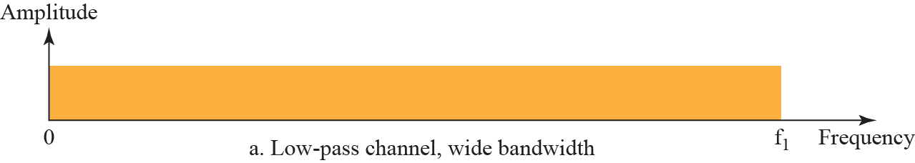
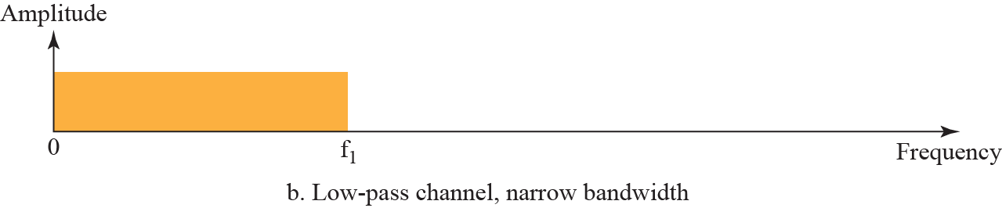
Transmission of Digital Signals : Baseband Transmission
Bandwidth of two low-pass channels
Notes:
Figure shows two low-pass channels: one with a narrow bandwidth
and the other with a wide bandwidth. We need to remember that a low-pass channel
with infinite bandwidth is ideal, but we cannot have such a channel in real life. However,
we can get close.
Baseband transmission of a digital signal that preserves the shape of the digital signal is possible only ifwe have a low-pass channel with an infinite or very wide bandwidth.

Slide 19
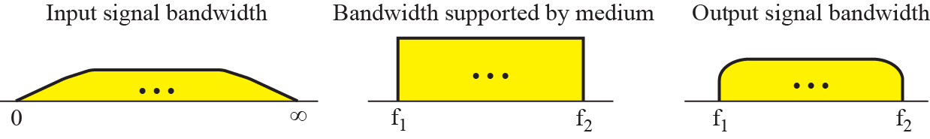
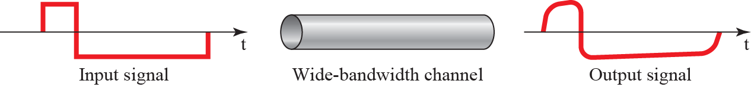
Transmission of Digital Signals : Baseband Transmission
Baseband Transmission:
Case 1: Low-Pass Channel with Wide Bandwidth
Baseband transmission using a dedicated medium
Baseband transmission of a digital signal that preserves the shape of the digital signal is possible only if we have a low-pass channel with an infinite or very wide bandwidth.
Notes:
Case 1: Low-Pass Channel with Wide Bandwidth
If we want to preserve the exact form of a nonperiodic digital signal with vertical segments
vertical and horizontal segments horizontal, we need to send the entire spectrum,
the continuous range of frequencies between zero and infinity. This is possible if we
have a dedicated medium with an infinite bandwidth between the sender and receiver
that preserves the exact amplitude of each component of the composite signal.
Although this may be possible inside a computer (e.g., between CPU and memory), it is
not possible between two devices. Fortunately, the amplitudes of the frequencies at the
border of the bandwidth are so small that they can be ignored. This means that if we
have a medium, such as a coaxial or fiber optic cable, with a very wide bandwidth, two
stations can communicate by using digital signals with very good accuracy, as shown in
Figure 3.21. Note that f1 is close to zero, and f2 is very high.

Slide 20
Transmission of Digital Signals : Baseband Transmission
Example
An example of a dedicated channel where the entire bandwidth of the medium is used as one single channel is a LAN. Almost every wired LAN today uses a dedicated channel for two stations communicating with each other. In a bus topology LAN with multipoint connections, only two stations can communicate with each other at each moment in time (timesharing); the other stations need to refrain from sending data. In a star topology LAN, the entire channel between each station and the hub is used for communication between these two entities.

Slide 21
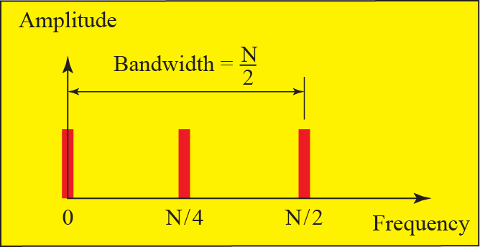
Transmission of Digital Signals : Baseband Transmission
Baseband Transmission:
Case 2: Low-Pass Channel with Limited Bandwidth
A digital signal of bit rate N , the worst case the sequence 01010101 . . . or the sequence 10101010. . . . , need an analog signal of frequency f = N/2 , one harmonic.
Bandwidth = N/2 – 0 = N/2
Rough approximation of a digital signal (part 1)
Notes:
Rough Approximation
Let us assume that we have a digital signal of bit rate N. If we want to send analog signals
to roughly simulate this signal, we need to consider the worst case, a maximum
number of changes in the digital signal. This happens when the signal carries the
sequence 01010101 . . . or the sequence 10101010. . . . To simulate these two cases, we
need an analog signal of frequency f = N/2. Let 1 be the positive peak value and 0 be the
negative peak value. We send 2 bits in each cycle; the frequency of the analog signal is
one-half of the bit rate, or N/2. However, just this one frequency cannot make all patterns;
we need more components. The maximum frequency is N/2.

Slide 22
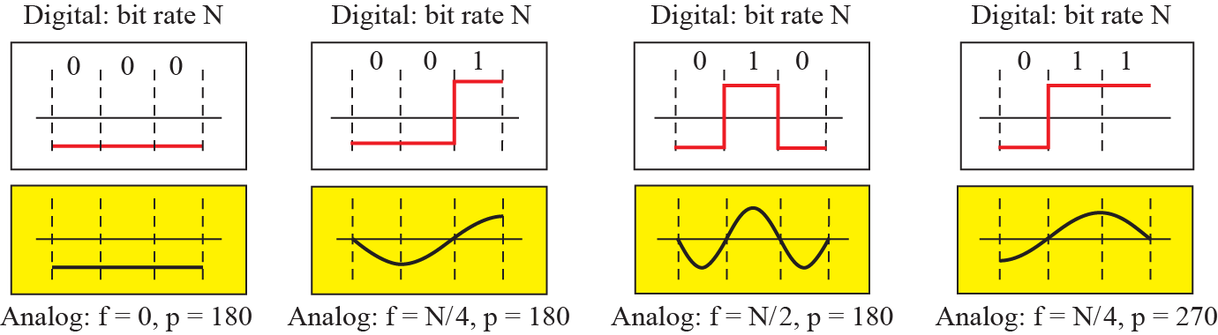
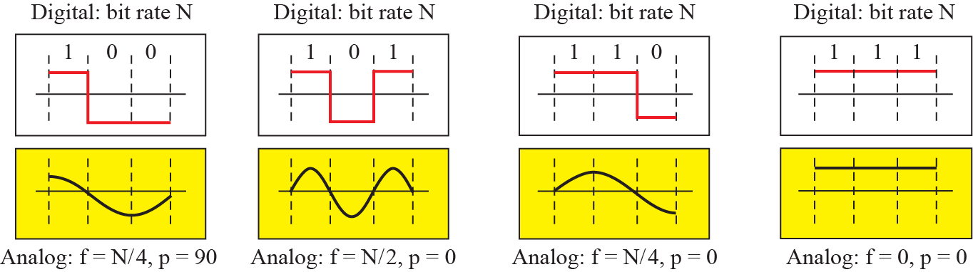
Transmission of Digital Signals : Baseband Transmission
Rough approximation of a digital signal (part 2) , a digital signal with a 3-bit pattern
Notes:
As an example of this concept, let us see how a digital signal with a 3-bit pattern can be simulated by using analog
signals. Figure 3.22 shows the idea. The two similar cases (000 and 111) are simulated
with a signal with frequency f = 0 and a phase of 180° for 000 and a phase of 0° for 111.
The two worst cases (010 and 101) are simulated with an analog signal with frequency f =
N/2 and phases of 180° and 0°. The other four cases can only be simulated with an analog
signal with f = N/4 and phases of 180°, 270°, 90°, and 0°. In other words, we need a channel
that can handle frequencies 0, N/4, and N/2. This rough approximation is referred to
as using the first harmonic (N/2) frequency. The required bandwidth is

Slide 23
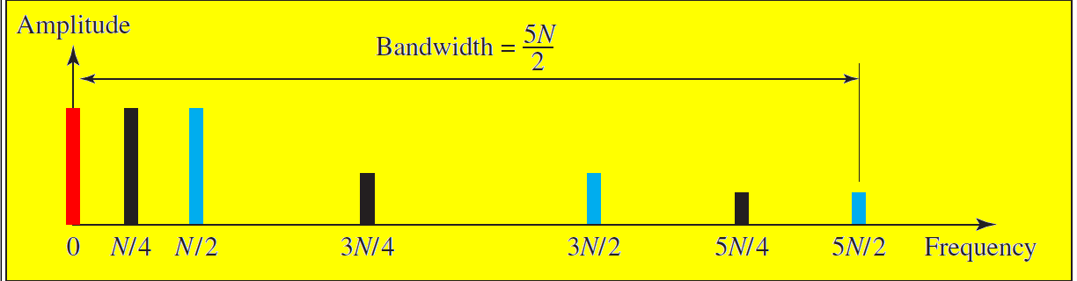
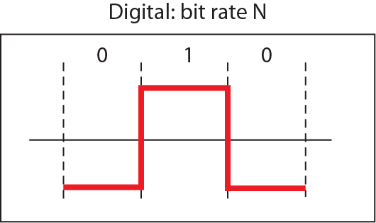
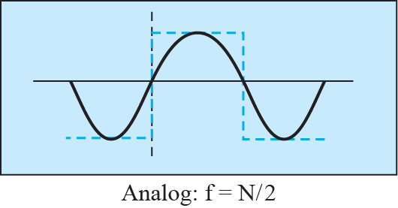
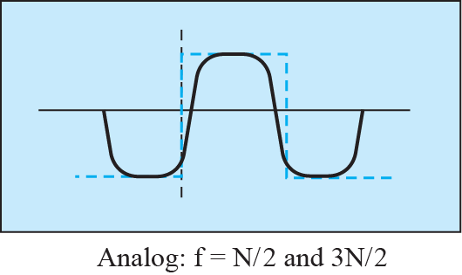
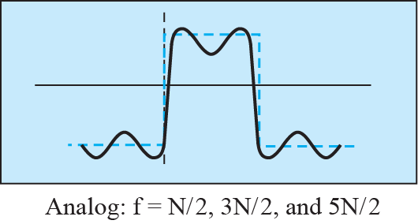
Transmission of Digital Signals : Baseband Transmission
Simulating a digital signal with first three harmonics
Notes:
Better Approximation
To make the shape of the analog signal look more like that of a digital signal, we need
to add more harmonics of the frequencies. We need to increase the bandwidth. We can
increase the bandwidth to 3N/2, 5N/2, 7N/2, and so on. Figure 3.23 shows the effect of
this increase for one of the worst cases, the pattern 010. Note that we have shown only the
highest frequency for each harmonic. We use the first, third, and fifth harmonics. The
required bandwidth is now 5N/2, the difference between the lowest frequency 0 and
the highest frequency 5N/2. As we emphasized before, we need to remember that the
required bandwidth is proportional to the bit rate.

Slide 24
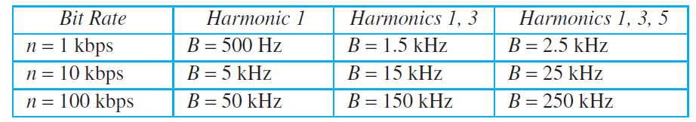
Transmission of Digital Signals : Baseband Transmission
In baseband transmission, the required bandwidth is proportional to the bit rate; if we need to send bits faster, we need more bandwidth.
Bandwidth requirements

Slide 25
Transmission of Digital Signals : Baseband Transmission
Example - 1
What is the required bandwidth of a low-pass channel if we need to send 1 Mbps by using baseband transmission?
Solution
The answer depends on the accuracy desired.
a. The minimum bandwidth, a rough approximation, is B
bit rate /2, or 500 kHz. We need a low-pass channel with
frequencies between 0 and 500 kHz.
b. A better result can be achieved by using the first and the
third harmonics with the required bandwidth B = 3 × 500
kHz = 1.5 MHz.
c. A still better result can be achieved by using the first,
third, and fifth harmonics with B = 5 × 500 kHz = 2.5
MHz.

Slide 26
Transmission of Digital Signals : Baseband Transmission
Example - 2
We have a low-pass channel with bandwidth 100 kHz. What is the maximum bit rate of this channel?.
Solution
The maximum bit rate can be achieved if we use the first harmonic. The bit rate is 2 times the available bandwidth, or 200 kbps.

Slide 27
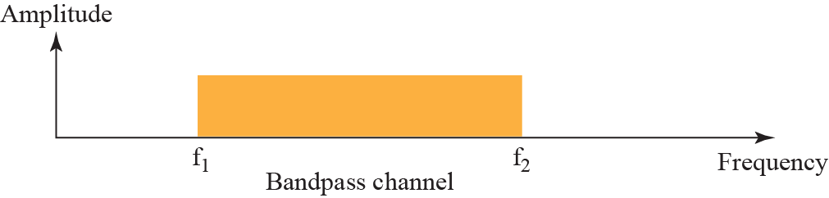
Transmission of Digital Signals : Broadband Transmission
Broadband Transmission (Using Modulation)
Broadband transmission or modulation means changing the digital signal to an analog signal for transmission. Modulation allows us to use a bandpass channel - a channel with a bandwidth that does not start from zero. This type of channel is more available than a low-pass channel.
Bandwidth of a band-pass channel
Notes:
Note that a low-pass channel can be considered a bandpass channel with the lower
frequency starting at zero.

Slide 28
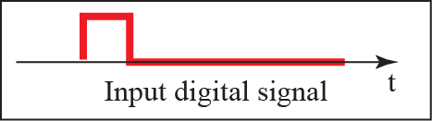
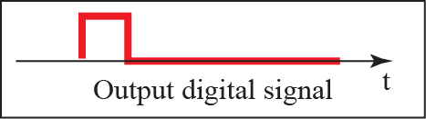
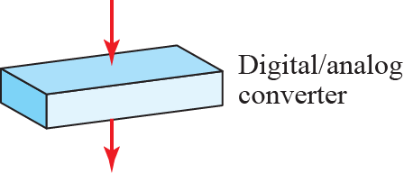
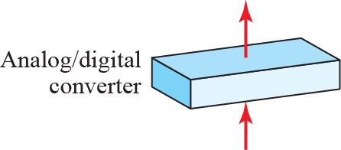
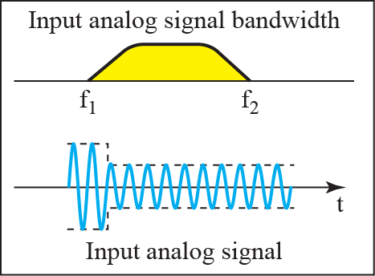
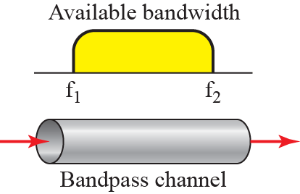
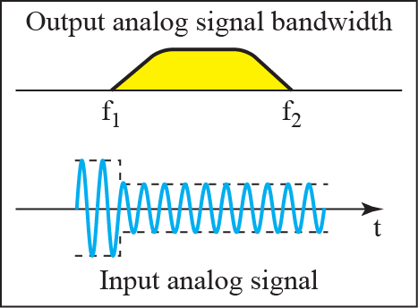
Transmission of Digital Signals : Broadband Transmission
If the available channel is a bandpass channel, we cannot send the digital signal directly to the channel; we need to convert the digital signal to an analog signal before transmission.
Modulation of a digital signal for transmission on band-pass channel
Notes:
Figure shows the modulation of a digital signal. In the figure, a digital signal is
converted to a composite analog signal. We have used a single-frequency analog signal
(called a carrier); the amplitude of the carrier has been changed to look like the digital signal.
The result, however, is not a single-frequency signal; it is a composite signal, as we
will see in Chapter 5. At the receiver, the received analog signal is converted to digital,
and the result is a replica of what has been sent.

Slide 29
Transmission of Digital Signals : Broadband Transmission
Example - 1
An example of broadband transmission using modulation is the sending of computer data through a telephone subscriber line, the line connecting a resident to the central telephone office. These lines, installed many years ago, are designed to carry voice (analog signal) with a limited bandwidth. Although this channel can be used as a low-pass channel, it is normally considered a bandpass channel. One reason is that the bandwidth is so narrow (4 kHz) that if we treat the channel as low-pass and use it for baseband transmission, the maximum bit rate can be only 8 kbps. The solution is to consider the channel a bandpass channel, convert the digital signal from the computer to an analog signal, and send the analog signal.

Slide 30
Transmission of Digital Signals : Broadband Transmission
Example - 2
A second example is the digital cellular telephone. For better reception, digital cellular phones digitize analog voice. Although the bandwidth allocated to a company providing digital cellular phone service is very wide, we still cannot send the digitized signal without conversion. The reason is that we have only a band-pass channel available between caller and callee. For example, if the available bandwidth is W and we allow 1000 couples to talk simultaneously, this means the available channel is W/1000, just part of the entire bandwidth. We need to convert the digitized voice to a composite analog signal before transmission.

Slide 31
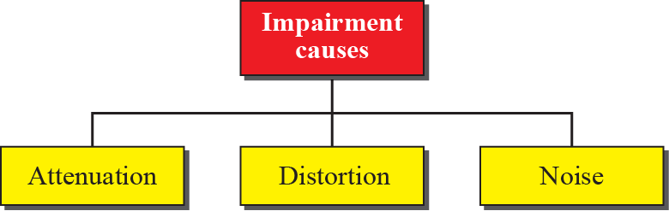
TRANSMISSION IMPAIRMENT
Signals travel through transmission media, which are not perfect. The imperfection causes signal impairment. This means that the signal at the beginning of the medium is not the same as the signal at the end of the medium. What is sent is not what is received. Three causes of impairment are attenuation, distortion, and noise.

Slide 32
Attenuation
Attenuation means a loss of energy. When a signal, simple or composite, travels through a medium, it loses some of its energy in overcoming the resistance of the medium. That is why a wire carrying electric signals gets warm, if not hot, after a while. Some of the electrical energy in the signal is converted to heat. To compensate for this loss, amplifiers are used to amplify the signal. Next figure shows the effect of attenuation and amplification..
Notes:
Attenuation is where the strength of a signal falls off with distance over any transmission medium. For guided media, this is generally exponential and thus is typically expressed as a constant number of decibels per unit distance. For unguided media, attenuation is a more complex function of distance and the makeup of the atmosphere. See Stallings DCC8e Figure 3.11 on previous slide for illustration of attenuation.
Attenuation introduces three considerations for the transmission engineer. First, a received signal must have sufficient strength so that the electronic circuitry in the receiver can detect the signal. Second, the signal must maintain a level sufficiently higher than noise to be received without error. Third, attenuation varies with frequency. The first and second problems are dealt with by attention to signal strength and the use of amplifiers or repeaters. The third problem is particularly noticeable for analog signals. To overcome this problem, techniques are available for equalizing attenuation across a band of frequencies. This is commonly done for voice-grade telephone lines by using loading coils that change the electrical properties of the line; the result is to smooth out attenuation effects. Another approach is to use amplifiers that amplify high frequencies more than lower frequencies.

Slide 33
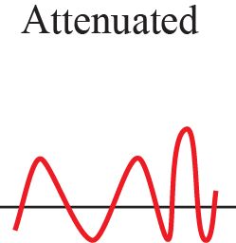
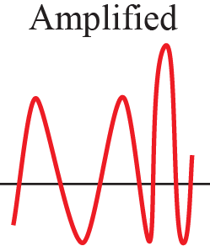
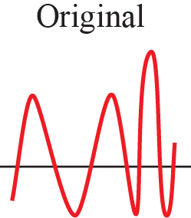
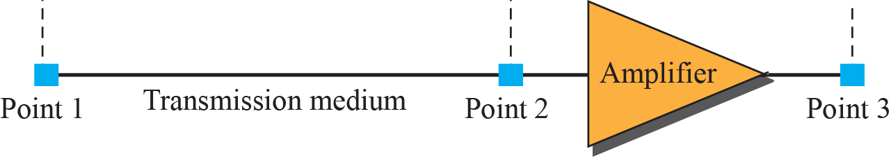
Attenuation
Attenuation and amplification

Slide 34
Attenuation
Example -1
Suppose a signal travels through a transmission medium and its power is reduced to one half. This means that P2 = 0.5 P1. In this case, the attenuation (loss of power) can be calculated as
A loss of 3 dB (−3 dB) is equivalent to losing one-half the power.

Slide 35

Attenuation
Example -2
A signal travels through an amplifier, and its power is increased 10 times. This means that P₂ = 10P₁. In this case, the amplification (gain of power) can be calculated as

Slide 36

Attenuation
Example -3
One reason that engineers use the decibel to measure the changes in the strength of a signal is that decibel numbers can be added (or subtracted) when we are measuring several points (cascading) instead of just two. In next figure a signal travels from point 1 to point 4. The signal is attenuated by the time it reaches point 2. Between points 2 and 3, the signal is amplified. Again, between points 3 and 4, the signal is attenuated. We can find the resultant decibel value for the signal just by adding the decibel measurements between each set of points. In this case, the decibel value can be calculated as

Slide 37
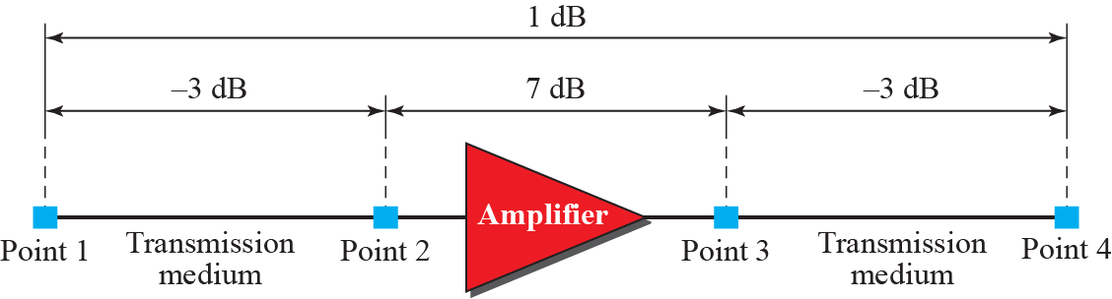
Attenuation
Decibels for Example -3

Slide 38
Attenuation
Example -4
Sometimes the decibel is used to measure signal power in milliwatts. In this case, it is referred to as dB_{m} and is calculated as dB_{m} = 10 log₁₀ P_{m}, where P_{m} is the power in milliwatts. Calculate the power of a signal if its dB_{m} = −30.
Solution
We can calculate the power in the signal as

Slide 39
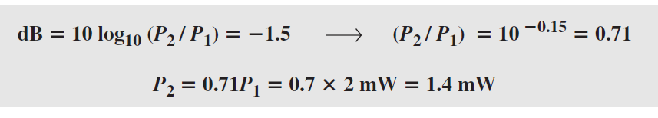
Attenuation
Example -5
The loss in a cable is usually defined in decibels per kilometer (dB/km). If the signal at the beginning of a cable with −0.3 dB/km has a power of 2 mW, what is the power of the signal at 5 km?
Solution
The loss in the cable in decibels is 5 × (−0.3) = −1.5 dB. We can calculate the power as

Slide 40
Distortion
Distortion means that the signal changes its form or shape. Distortion can occur in a composite signal made of different frequencies. Each signal component has its own propagation speed (see the next section) through a medium and, therefore, its own delay in arriving at the final destination. Differences in delay may create a difference in phase if the delay is not exactly the same as the period duration.
Only occurs in guided media,
propagation velocity varies with frequency,
hence various frequency components arrive at different times.
Particularly critical for digital data,
since parts of one bit spill over into others
causing intersymbol interference
Notes:
Delay distortion occurs because the velocity of propagation of a signal through a guided medium varies with frequency. For a bandlimited signal, the velocity tends to be highest near the center frequency and fall off toward the two edges of the band. Thus various frequency components of a signal will arrive at the receiver at different times, resulting in phase shifts between the different frequencies. Delay distortion is particularly critical for digital data, because some of the signal components of one bit position will spill over into other bit positions, causing intersymbol interference. This is a major limitation to maximum bit rate over a transmission channel.

Slide 41
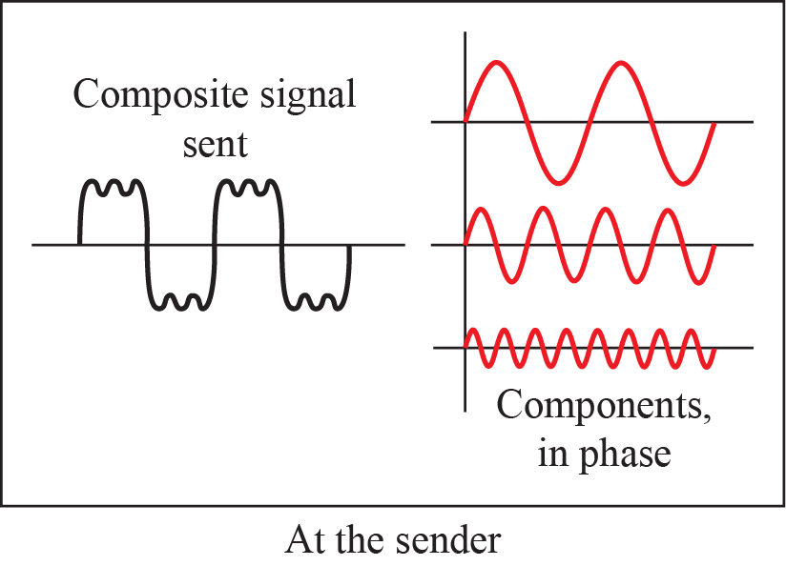
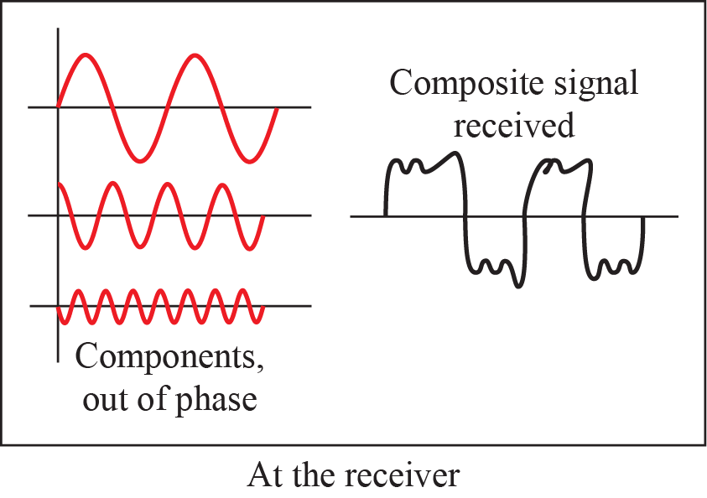
Distortion

Slide 42
Noise
Noise is another cause of impairment. Several types of noise, such as thermal noise, induced noise, crosstalk, and impulse noise, may corrupt the signal.
Thermal noise is the random motion of electrons in a wire, which creates an extra signal not originally sent by the transmitter.
  due to thermal agitation of electrons
  uniformly distributed
  white noise
Notes:
For any data transmission event, the received signal will consist of the transmitted signal, modified by the various distortions imposed by the transmission system, plus additional unwanted signasl, referred to as noise, that are inserted somewhere between transmission and reception. Noise is a major limiting factor in communications system performance. Noise may be divided into four categories.
Thermal noise is due to thermal agitation of electrons. It is present in all electronic devices and transmission media and is a function of temperature. Thermal noise is uniformly distributed across the bandwidths typically used in communications systems and hence is often referred to as white noise. Thermal noise cannot be eliminated and therefore places an upper bound on communications system performance, and. is particularly significant for satellite communication.
When signals at different frequencies share the same transmission medium, the result may be intermodulation noise. The effect of intermodulation noise is to produce signals at a frequency that is the sum or difference of the two original frequencies or multiples of those frequencies, thus possibly interfering with services at these frequencies. It is produced by nonlinearities in the transmitter, receiver, and/or intervening transmission medium.

Slide 43
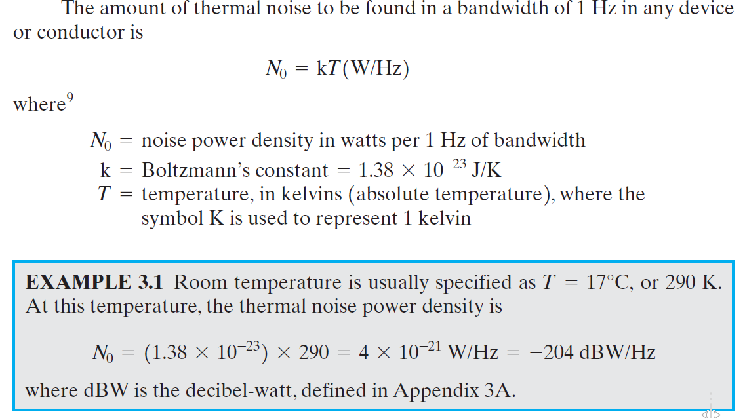
Noise
Thermal noise

Slide 44
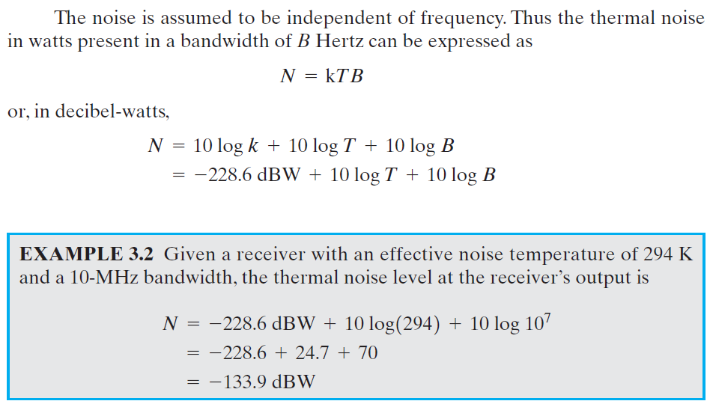
Noise
Thermal noise

Slide 45
Noise
Intermodulation: signals that are the sum and difference of original frequencies sharing a medium
Crosstalk, effect of one wire on the others
  a signal from one line is picked up by another
Induced noise (Impulse) comes from sources such as motors
  irregular pulses or spikes
    eg. external electromagnetic interference
  short duration
  high amplitude
  a minor annoyance for analog signals
  but a major source of error in digital data
    a noise spike could corrupt many bits
Notes:
Crosstalk is an unwanted coupling between signal paths. It can occur by electrical coupling between nearby twisted pairs or, rarely, coax cable lines carrying multiple signals. It can also occur when microwave antennas pick up unwanted signals; although highly directional antennas are used, microwave energy does spread during propagation. Typically, crosstalk is of the same order of magnitude as, or less than, thermal noise.
Impulse noise is noncontinuous, consisting of irregular pulses or noise spikes of short duration and of relatively high amplitude. It is generated from a variety of causes, including external electromagnetic disturbances, such as lightning, and faults and flaws in the communications system. It is generally only a minor annoyance for analog data. However impulse noise is the primary source of error in digital data communication. For example, a sharp spike of energy of 0.01 s duration would not destroy any voice data but would wash out about 560 bits of data being transmitted at 56 kbps.

Slide 46
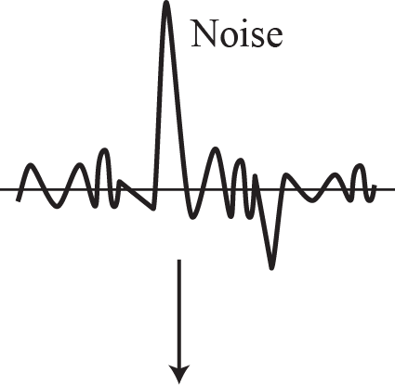
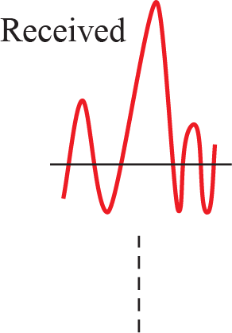

Noise
The effect of noise on a signal

Slide 47

Noise
Signal-to-Noise Ratio (SNR)
To find the theoretical bit rate limit, the is a need to know the ratio of the signal power to the noise power. The signal-to-noise ratio is defined as
We will consider the average signal power and the average noise power because these may change with time.
SNR is actually the ratio of what is wanted (signal) to what is not wanted (noise). A high SNR means the signal is less corrupted by noise; a low SNR means the signal is more corrupted by noise.
Because SNR is the ratio of two powers, it is often described in decibel units, SNR_{dB}, defined as:
SNR_{dB} = 10 log₁₀ SNR
Notes:
The key parameter involved is the signal-to-noise ratio (SNR, or S/N), which is the ratio of the power in a signal to the power contained in the noise that is present at a particular point in the transmission. Typically, this ratio is measured at a receiver, because it is at this point that an attempt is made to process the signal and recover the data. For convenience, this ratio is often reported in decibels. This expresses the amount, in decibels, that the intended signal exceeds the noise level. A high SNR will mean a high-quality signal and a low number of required intermediate repeaters.
The signal-to-noise ratio is important in the transmission of digital data because it sets the upper bound on the achievable data rate.

Slide 48


Noise
Two cases of SNR: a high SNR and a low SNR

Slide 49
Noise
Example
The power of a signal is 10 mW and the power of the noise is 1 μW; what are the values of SNR and SNR_{dB}?
Solution
The values of SNR and SNR_{dB} can be calculated as follows:

Slide 50
Noise
Example
The values of SNR and SNR_{dB} for a noiseless channel are
Solution
The values of SNR and SNRdB for a noiseless channel are
We can never achieve this ratio in real life; it is an ideal.

Slide 51
Further Reading
اساسيات الاتصالات : ص20 – ص25
Data Communications and Networking , Forouzan, 5e , Chapter 3, PP 53-94 .

