Slide 1
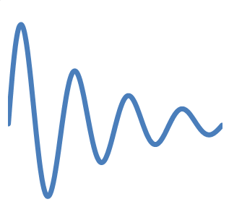
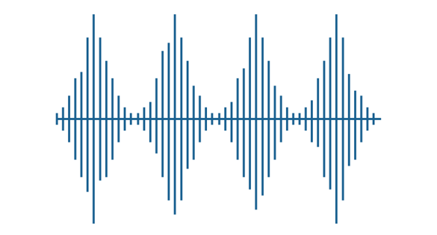
Signal Analysis
3-

Slide 2
Fourier series
Periodic signal : a signal is periodic, with fundamental period T₀, if the following is true for all t: x(t+T₀)=x(t) , this means that the a function of time with period T₀ will have the same value in T₀ seconds. Note that a periodic function with fundamental period T₀ is also periodic with period 2T₀. So the fundamental period is the value of T₀ (greater than zero) that is the smallest possible T₀ for which equation is always true.

Slide 3
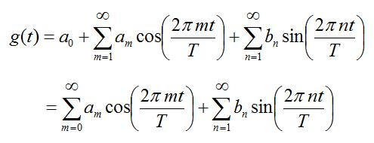
Fourier series
A Fourier Series, with period T₀, is an infinite sum of sinusoidal functions (cosine and sine), each with a frequency that is an integer multiple of 1/T₀ (the inverse of the fundamental period). The Fourier Series also includes a constant, and hence can be written as:
The constants a_{m}, b_{n} are the coefficients of the Fourier Series. These determine the relative weights for each of the sinusoids.
Notes:
For an arbitrary periodic function f(t) - how closely can we approximate this function with simple sinusoids, each with a period some integer multiple of the fundamental period? That is, for a given periodic function f(t), how closely can the function g(t) approximate f(t)?
It turns out that the answer is one of the coolest results in all of Mathematics. And that is, we can approximate f(t) exactly whenever f(t) is continuous and 'smooth'. In real life, all functions are continuous and smooth, so for the practicing engineer or physicist, all periodic functions can be exactly represented by Fourier Series. This is an awesome result.

Slide 4
The Fourier Series breaks down a periodic function into the sum of sinusoidal functions. It is the Fourier Transform for periodic functions, . Each wave in the sum, or harmonic, has a frequency that is an integral multiple of the periodic function’s fundamental frequency.
A Fourier series might have an unlimited number of harmonics
Summing some, but not all, of the harmonics in a function’s Fourier series, yields an approximation to that function.

Slide 5
In terms of Fourier series, an even function has only cosine terms (and possibly a constant term).
In terms of Fourier series, an odd function has only sine terms.
In the context of Fourier series, a function can be decomposed into its even and odd parts.

Slide 6
In terms of Fourier series, an even function has only cosine terms (and possibly a constant term).
In terms of Fourier series, an odd function has only sine terms.
In the context of Fourier series, a function can be decomposed into its even and odd parts.

Slide 7
Fourier series

Slide 8
Fourier Transform
The Fourier Transform decomposes any function into a sum of sinusoidal basis functions. Each of these basis functions is a complex exponential of a different frequency. The Fourier Transform therefore gives us a unique way of viewing any function - as the sum of simple sinusoids.
The Fourier Series showed us how to rewrite any periodic function into a sum of sinusoids. The Fourier Transform is the extension of this idea to non-periodic functions.

Slide 9
Fourier Transform
We have seen that periodic signals can be represented with the Fourier series
Can aperiodic signals be analyzed in terms of frequency components?
Yes, and the Fourier transform provides the tool for this analysis
The major difference w.r.t. the line spectra of periodic signals is that the spectra of aperiodic signals are defined for all real values of the frequency variable not just for a discrete set of values

Slide 10
Example: Fourier Transform of the Rectangular Pulse
Consider the even signal

Slide 11
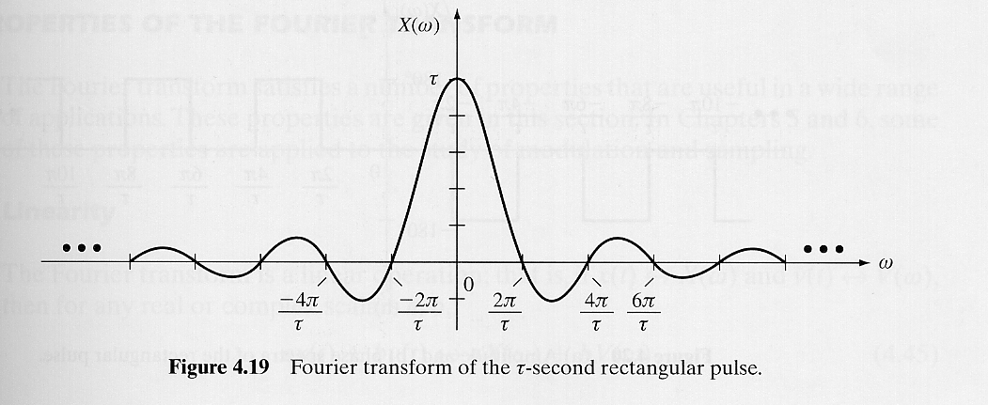
Example: Fourier Transform of the Rectangular Pulse

Slide 12
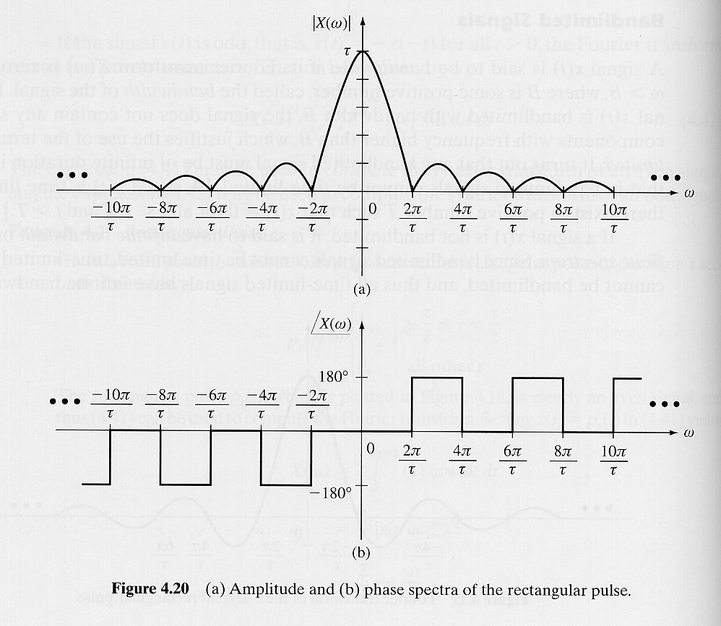
Example: Fourier Transform of the Rectangular Pulse
amplitude spectrum
phase spectrum

Slide 13
Further Reading
اساسيات الاتصالات : ص33 – ص41
اساسيات الاتصالات الرقمية : ص20 – ص27
Comm. System Engineering – Proakis
P21 - P41
Signal & Systems-Oppenhiem-2nd,
Ch4 & Ch5
Signal & Systems (Schaum) ,
P211 – P221

