Slide 1
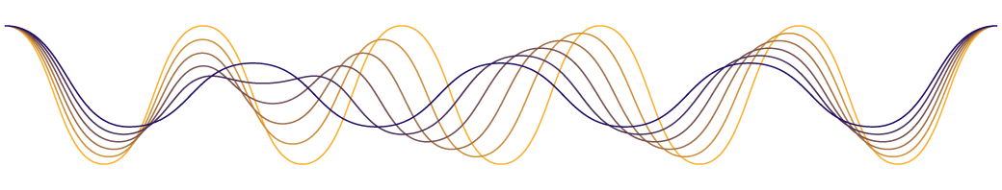
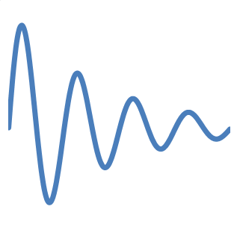
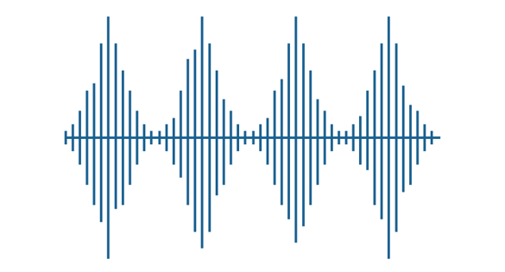
Signal Basics

Slide 2

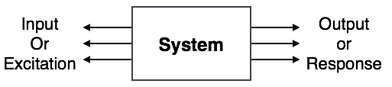
What is System?
System is a device or combination of devices, which can operate on signals and produces corresponding response. Input to a system is called as excitation and output from it is called as response.
For one or more inputs, the system can have one or more outputs.
Example: Communication System

Slide 3
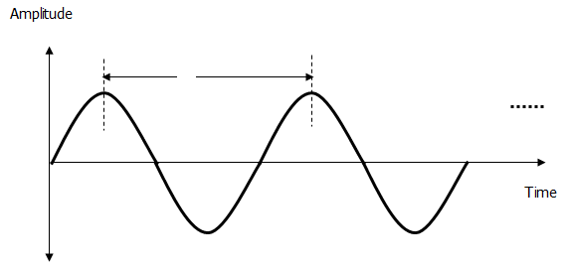
What is Signal?
Signal is a time varying physical phenomenon which is intended to convey information.
OR
Signal is a function of time.
OR
Signal is a function of one or more independent variables, which contain some information.
Example: voice signal, video signal, signals on telephone wires etc.
Note: Noise is also a signal, but the information conveyed by noise is unwanted hence it is considered as undesirable.

Slide 4
Elementry Signals
Unit Step
Unit Impulse
Ramp Signal
Signum Function
Exponential Signal
Complex Exponential Signals
Rectangular Signal
Triangular Signal
Sinusoidal Signal
Sinc Function

Slide 5
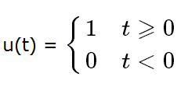
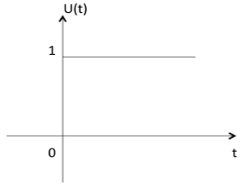
Unit Step signal
Unit step function is denoted by u(t).
It is defined as
  It is used as best test signal.
  Area under unit step function is unity.

Slide 6
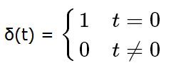
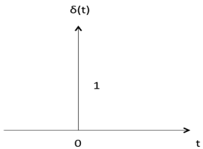
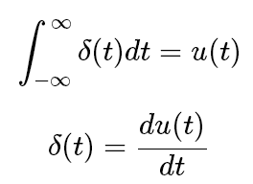
Unit Impulse signal
Impulse function is denoted by δ(t). and it is defined as

Slide 7
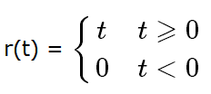
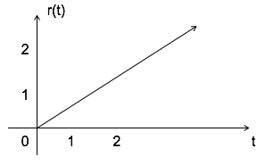
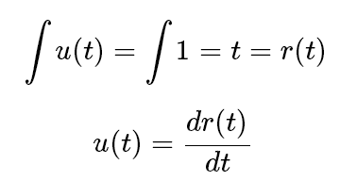
Ramp Signal
Ramp signal is denoted by r(t), and it is defined as
  Area under unit ramp is unity.

Slide 8
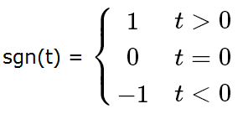
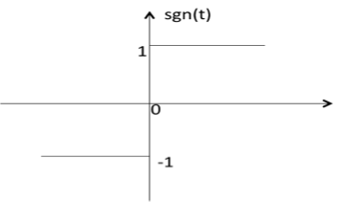
Sign signal
Signum function is denoted as sgn(t). It is defined as

Slide 9
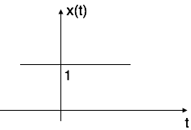
Exponential Signal
Exponential signal is in the form of x(t) = e^{αt}.
The shape of exponential can be defined by α.
Case i: if α = 0 → x(t) = e⁰ = 1

Slide 10
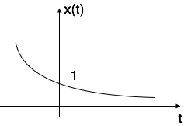
Exponential Signal
Case ii: if α < 0 i.e. -ve then x(t) = e^{−αt}.
The shape is called decaying exponential.

Slide 11
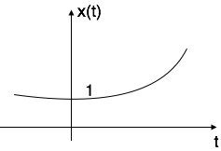
Exponential Signal
Case iii: if α > 0 i.e. +ve then x(t) = e^{αt}.
The shape is called raising exponential.

Slide 12
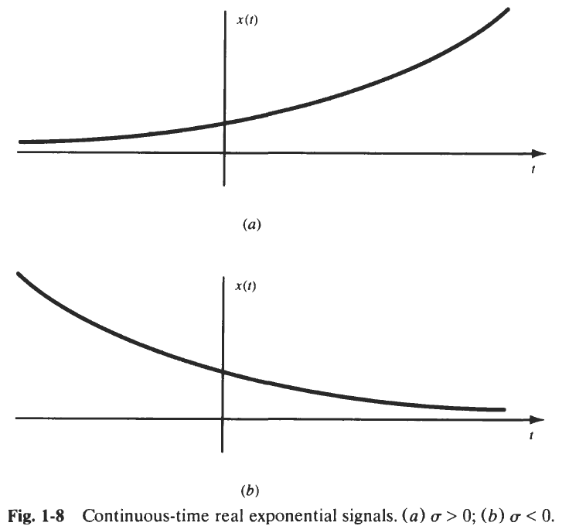
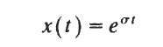
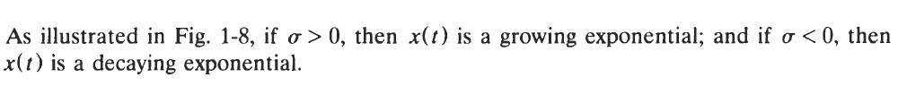
Real Exponential Signals
Real exponential signal is defined as:

Slide 13
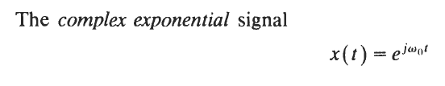
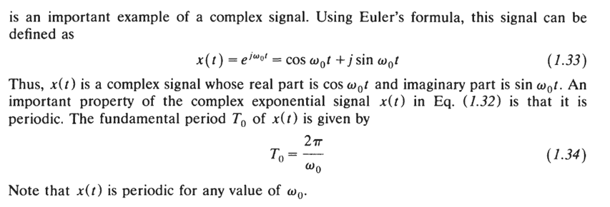
Complex Exponential Signals

Slide 14
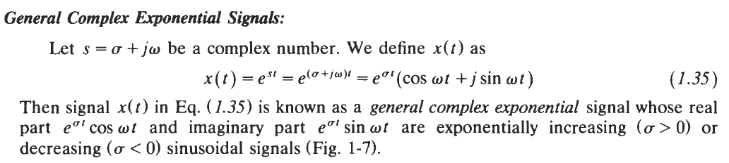
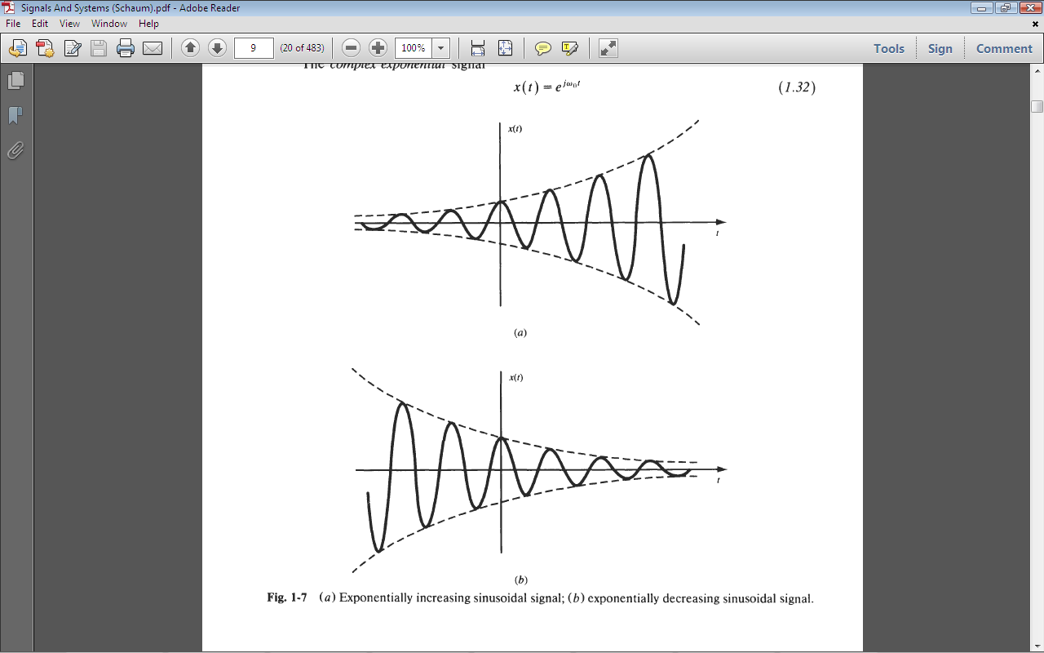
Complex Exponential Signals

Slide 15
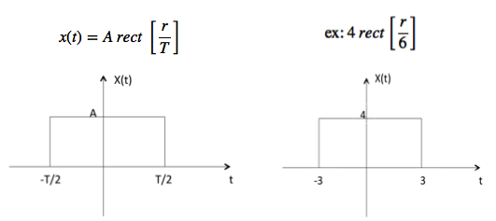
Rectangular Signal
Let it be denoted as x(t) and it is defined as

Slide 16
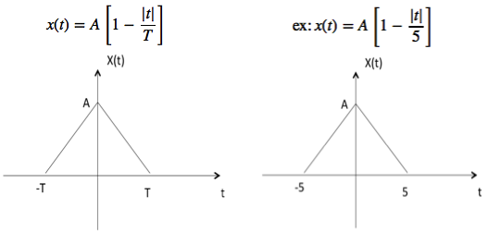
Triangular Signal
Let it be denoted as x(t)

Slide 17
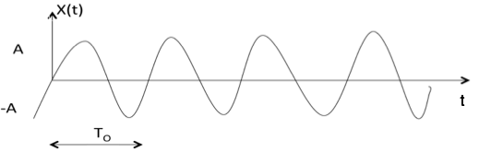
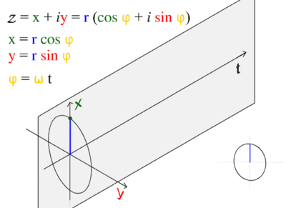
Sinusoidal Signal
Sinusoidal signal is in the form of
x(t) = A cos(w₀±ϕ) , or
= A sin(w₀±ϕ)
Where T₀ = 2π/w₀

Slide 18
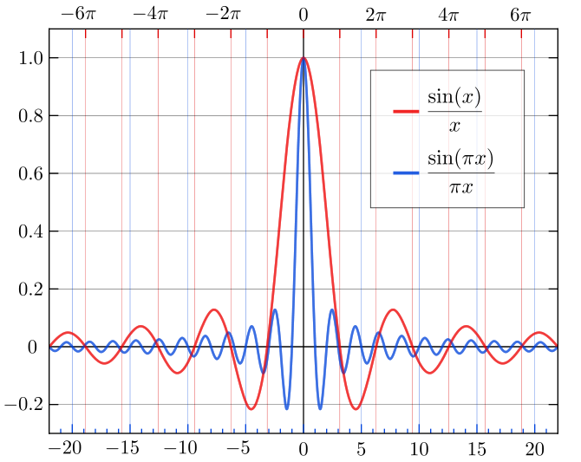
Sinc Function
It is denoted as sinc(t) and it is defined as sinc(t)=sinπt/πt , for t=±1,±2,±3... , the value at t = 0 is defined to be the limiting value
sinc(0) = 1
Notes:
The normalized sinc (blue) and unnormalized sinc function (red) shown on the same scale.
The normalization causes the definite integral of the function over the real numbers to equal 1 (whereas the same integral of the unnormalized sinc function has a value of π). As a further useful property, all of the zeros of the normalized sinc function are integer values of x.

Slide 19
Signals Categories
Signals are classified into the following categories:
Continuous Time and Discrete Time Signals
Deterministic and Non-deterministic Signals
Even and Odd Signals
Periodic and Non-periodic Signals
Energy and Power Signals

Slide 20
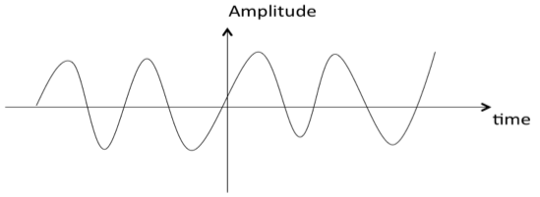
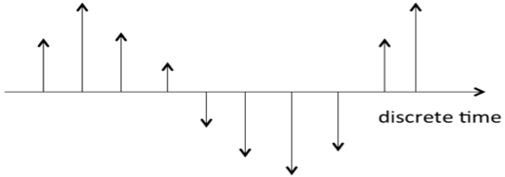
Continuous Time and Discrete Time Signals
A signal is said to be continuous when it is defined for all instants of time.
A signal is said to be discrete when it is defined at only discrete instants of time

Slide 21
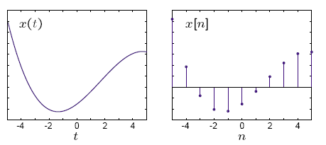
Continuous Time and Discrete Time Signals
CT signals take on real or complex values as a function of an independent variable that ranges over the real numbers and are denoted as x(t).
DT signals take on real or complex values as a function of an independent variable that ranges over the integers and are denoted as x[n].
Note the subtle use of parentheses and square brackets to distinguish between CT and DT signals.

Slide 22
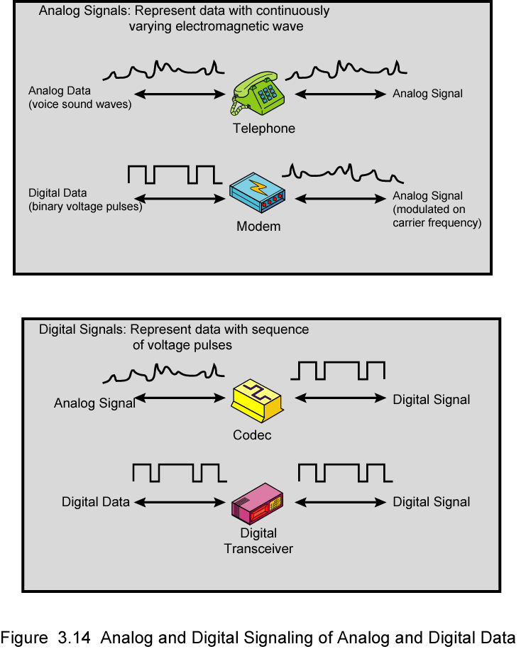
Analog Signals
Notes:
In a communications system, data are propagated from one point to another by means of electromagnetic signals. Both analog and digital signals may be transmitted on suitable transmission media.
An analog signal is a continuously varying electromagnetic wave that may be propagated over a variety of media, depending on spectrum; examples are wire media, such as twisted pair and coaxial cable; fiber optic cable; and unguided media, such as atmosphere or space propagation.
As Stallings DCC8e Figure 3.14 illustrates, analog signals can be used to transmit both analog data represented by an electromagnetic signal occupying the same spectrum, and digital data using a modem (modulator/demodulator) to modulate the digital data on some carrier frequency.
However, analog signal will become weaker (attenuate) after a certain distance. To achieve longer distances, the analog transmission system includes amplifiers that boost the energy in the signal. Unfortunately, the amplifier also boosts the noise components. With amplifiers cascaded to achieve long distances, the signal becomes more and more distorted. For analog data, such as voice, quite a bit of distortion can be tolerated and the data remain intelligible. However, for digital data, cascaded amplifiers will introduce errors.

Slide 23
Digital Signals
Notes:
A digital signal is a sequence of voltage pulses that may be transmitted over a wire medium; eg. a constant positive voltage level may represent binary 0 and a constant negative voltage level may represent binary 1.
As Stallings DCC8e Figure 3.14 also illustrates, digital signals can be used to transmit both analog signals and digital data. Analog data can converted to digital using a codec (coder-decoder), which takes an analog signal that directly represents the voice data and approximates that signal by a bit stream. At the receiving end, the bit stream is used to reconstruct the analog data. Digital data can be directly represented by digital signals.
A digital signal can be transmitted only a limited distance before attenuation, noise, and other impairments endanger the integrity of the data. To achieve greater distances, repeaters are used. A repeater receives the digital signal, recovers the pattern of 1s and 0s, and retransmits a new signal. Thus the attenuation is overcome.

Slide 24
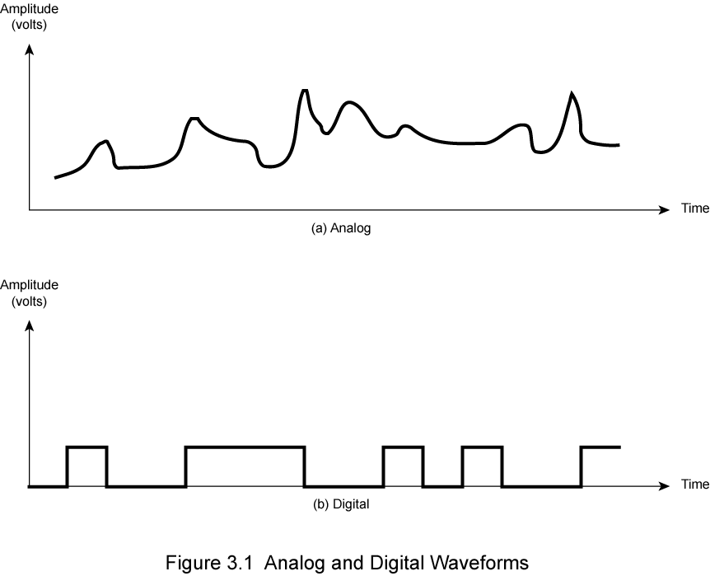
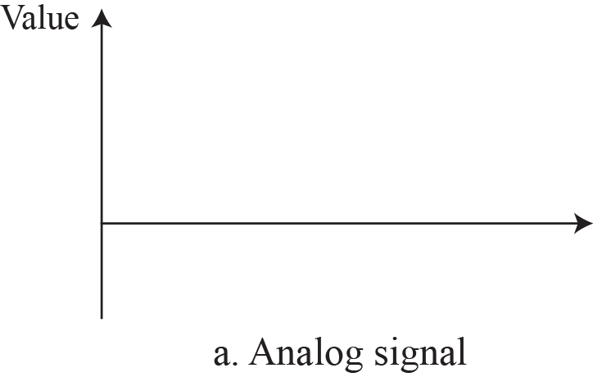
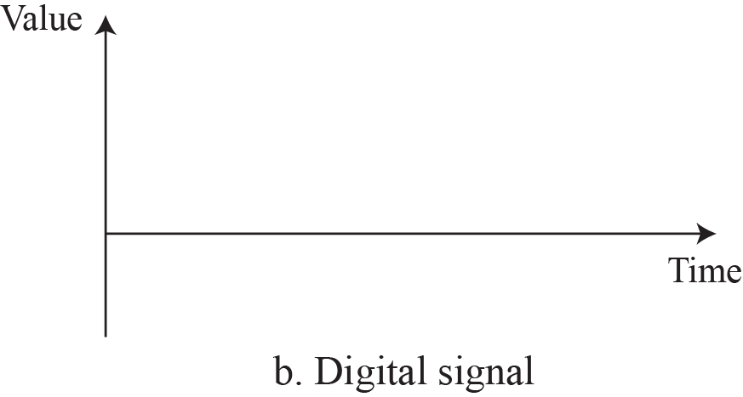
Comparison of analog and digital signals

Slide 25
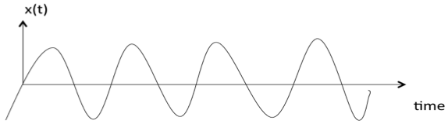
Deterministic and Non-deterministic Signals
A signal is said to be deterministic if there is no uncertainty with respect to its value at any instant of time. Or, signals which can be defined exactly by a mathematical formula are known as deterministic signals.

Slide 26
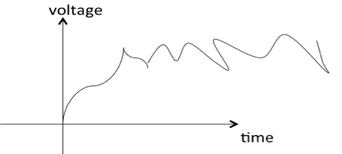
Deterministic and Non-deterministic Signals
A signal is said to be non-deterministic if there is uncertainty with respect to its value at some instant of time. Non-deterministic signals are random in nature hence they are called random signals. Random signals cannot be described by a mathematical equation. They are modelled in probabilistic terms.

Slide 27
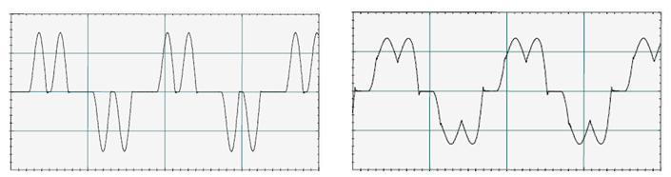
Deterministic and Random Signals
A deterministic waveform can be modeled as a completely specified function of time
  Example:

Slide 28
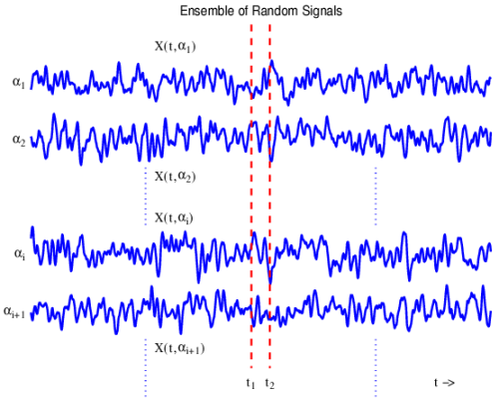
Deterministic and Random Signals
A random waveform ( or stochastic waveform) cannot be completely specified as a function of time and must be modeled probabilistically.
Communication systems deal with random waveforms because we do not know exactly which messages will be transmitted.
This requires the use of probabilistic and statistical concepts.
However if we represent the signal by a "typical" deterministic waveform, we can obtain most of the results we are seeking.

Slide 29
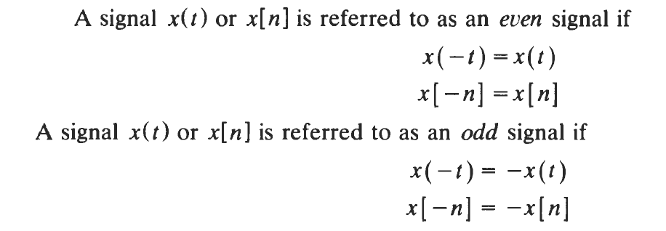
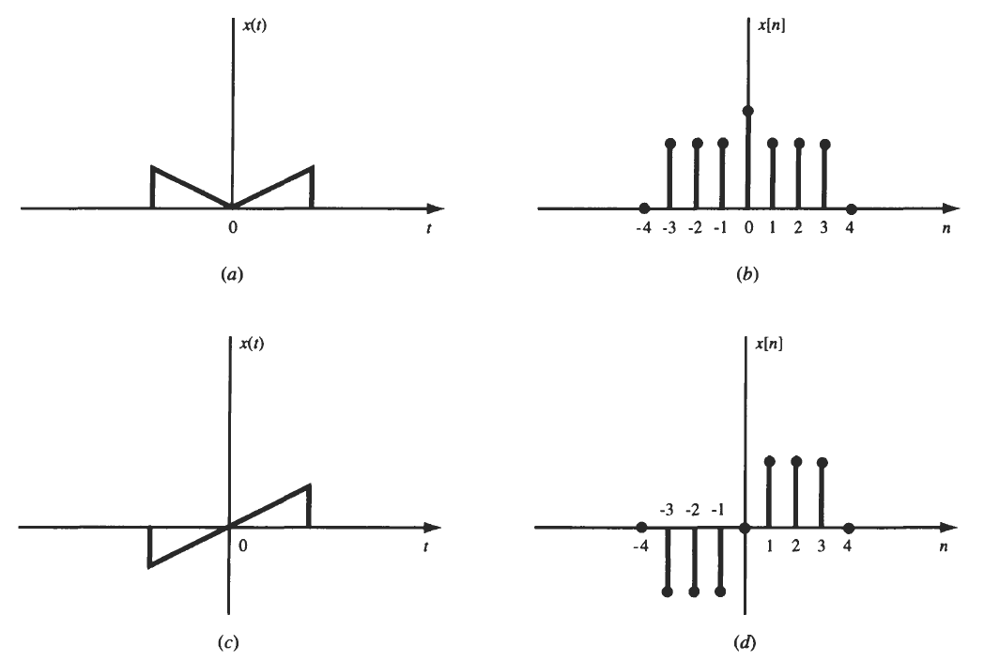
Even & Odd Signals
A signal is said to be even when it satisfies the condition x(t) = x(-t)

Slide 30
Even and Odd Signals
  Example 1: t2, t4… cos t.
    Let x(t) = t2
    x(-t) = (-t)2 = t2 = x(t)
    ∴, t2 is even function
  Example 2: t, t3 ... Sin t.
    Let x(t) = sin t
    x(-t) = sin(-t) = -sin t = -x(t)
    ∴, sin t is odd function.

Slide 31
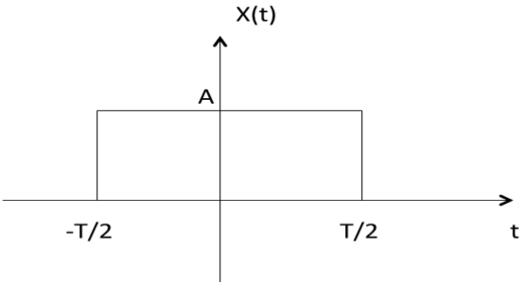
Even and Odd Signals
  Example 3: As shown in the following diagram, rectangle function x(t) = x(-t) so it is also even function

Slide 32
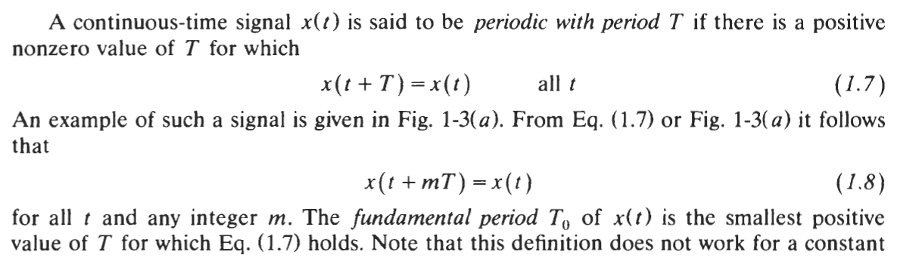
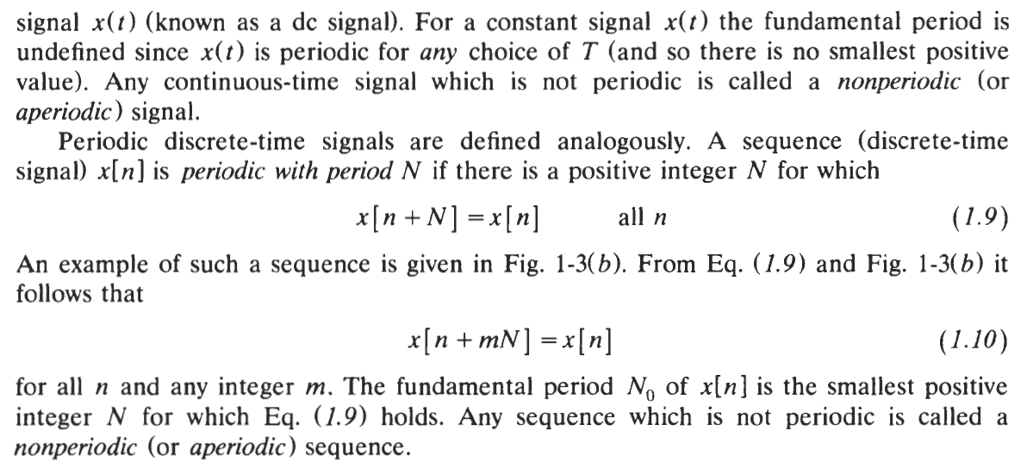
Periodic & Nonperiodic Signals

Slide 33
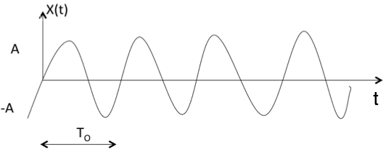
Periodic and Non-periodic Signals
A signal is said to be periodic if it satisfies the condition x(t) = x(t + T) or
x(n) = x(n + N).
Where : T = fundamental time period,1/T = f = fundamental frequency.
The above signal will repeat for every time interval T₀ hence it is periodic with period T₀.

Slide 34
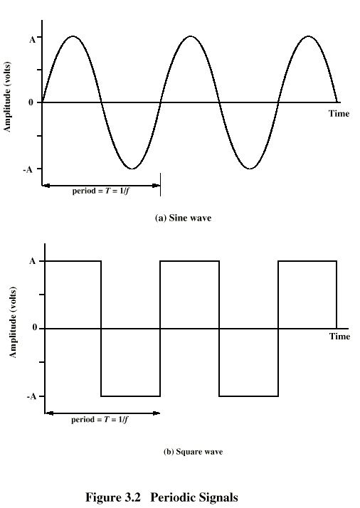
Periodic and Non-periodic Signals
A periodic signal completes a pattern within a measurable time frame, called a period, and repeats that pattern over subsequent identical periods. The completion of one full pattern is called a cycle. A non-periodic signal changes without exhibiting a pattern or cycle that repeats over time. Both analog and digital signals.

Slide 35
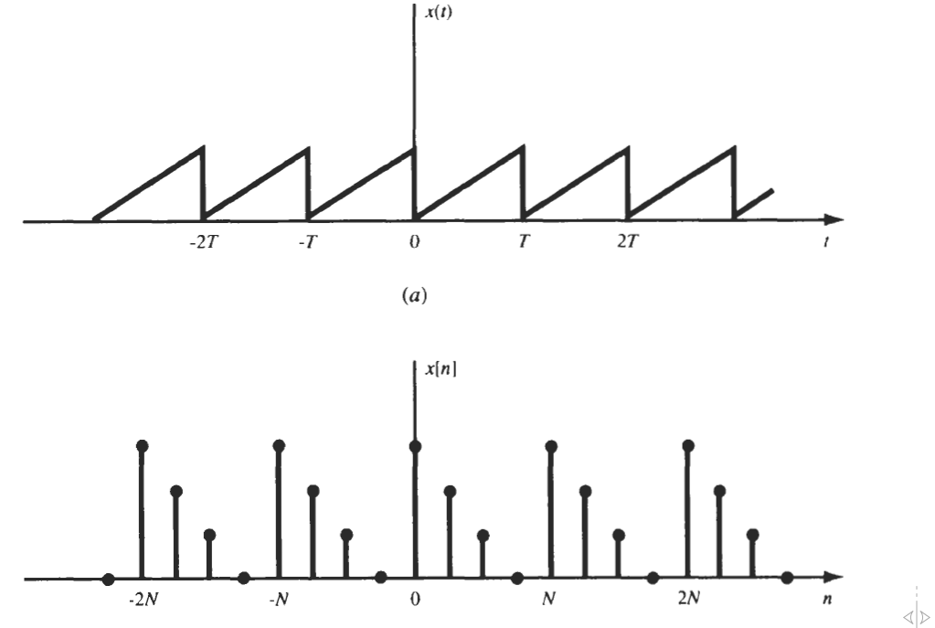
Periodic & Nonperiodic Signals

Slide 36
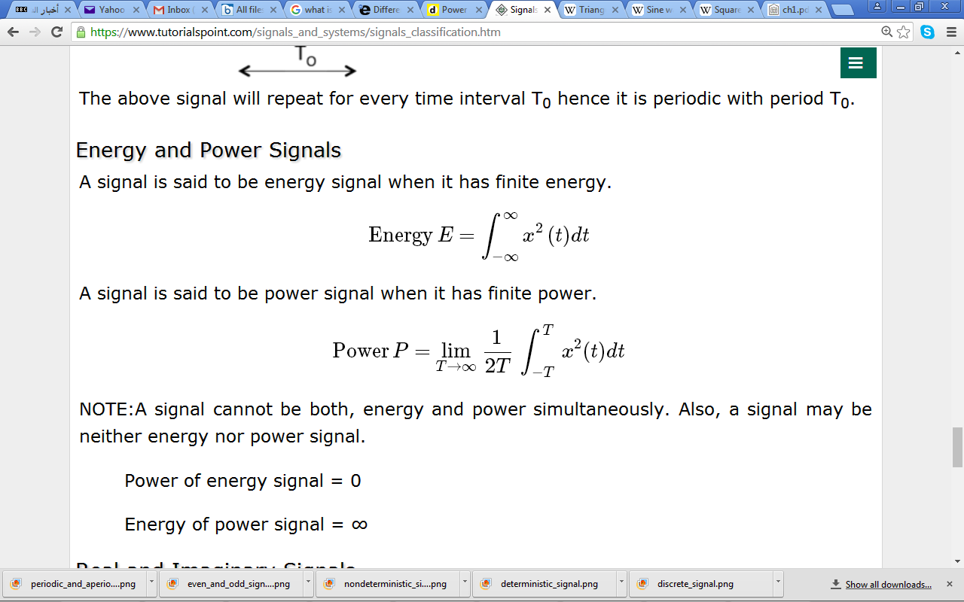
Energy and Power Signals
A signal is said to be energy signal when it has finite energy.
A signal is said to be power signal when it has finite power.
NOTE: A signal cannot be both, energy and power simultaneously. Also, a signal may be neither energy nor power signal.
  Power of energy signal = 0
  Energy of power signal = ∞

Slide 37

Signals Basic Operations
There are two variable parameters in general:
  Amplitude
  Time
The following operation can be performed with amplitude:
Amplitude Scaling
C x(t) is a amplitude scaled version of x(t) whose amplitude is scaled by a factor C.

Slide 38

Signals Basic Operations : Amplitude
Addition
Addition of two signals is nothing but addition of their corresponding amplitudes. This can be best explained by using the following example: as seen from the diagram,
-10 < t < -3 amplitude of
z(t) = x1(t) + x2(t) = 0 + 2 = 2
-3 < t < 3 amplitude of
z(t) = x1(t) + x2(t) = 1 + 2 = 3
3 < t < 10 amplitude of
z(t) = x1(t) + x2(t) = 0 + 2 = 2

Slide 39

Signals Basic Operations : Amplitude
Subtraction
subtraction of two signals is nothing but subtraction of their corresponding amplitudes. This can be best explained by the following example: as seen from the diagram ,
-10 < t < -3 amplitude of
z (t) = x1(t) - x2(t) = 0 - 2 = -2
-3 < t < 3 amplitude of
z (t) = x1(t) - x2(t) = 1 - 2 = -1
3 < t < 10 amplitude of
z (t) = x1(t) + x2(t) = 0 - 2 = -2

Slide 40

Signals Basic Operations : Amplitude
Multiplication
Multiplication of two signals is nothing but multiplication of their corresponding amplitudes. This can be best explained by the following example: as seen from the diagram,
-10 < t < -3 amplitude of
z (t) = x1(t) × x2(t) = 0 ×2 = 0
-3 < t < 3 amplitude of
z (t) = x1(t) × x2(t) = 1 ×2 = 2
3 < t < 10 amplitude of
z (t) = x1(t) × x2(t) = 0 × 2 = 0

Slide 41

Signals Basic Operations : Time
Time Shifting
x(t ± t₀) is time shifted version of the signal x(t).
  x (t + t₀) → negative shift
  x (t - t₀) → positive shift

Slide 42

Signals Basic Operations : Time
Time Scaling
x(At) is time scaled version of the signal x(t). where A is always positive.
  |A| > 1 → Compression of the signal
  |A| < 1 → Expansion of the signal
Note: u(at) = u(t) time scaling is not applicable for unit step function.

Slide 43

Signals Basic Operations : Time
Time Reversal
x(-t) is the time reversal of the signal x(t).

Slide 44
Further Reading
اساسيات الاتصالات : ص33 – ص36
اساسيات الاتصالات الرقمية : ص9 – ص10 ، ص21 – ص37
Ch1-Signal & Systems-Oppenhiem-2nd, P27 – P38
Ch1 – Signal & Systems, P1 – P20
Signal & Systems (Schaum) , P1 – P16

