Slide 1
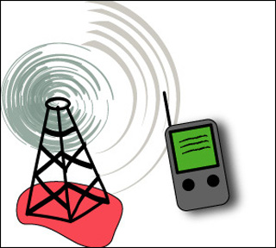

ITNT323
Principles of Communication Systems

Slide 2
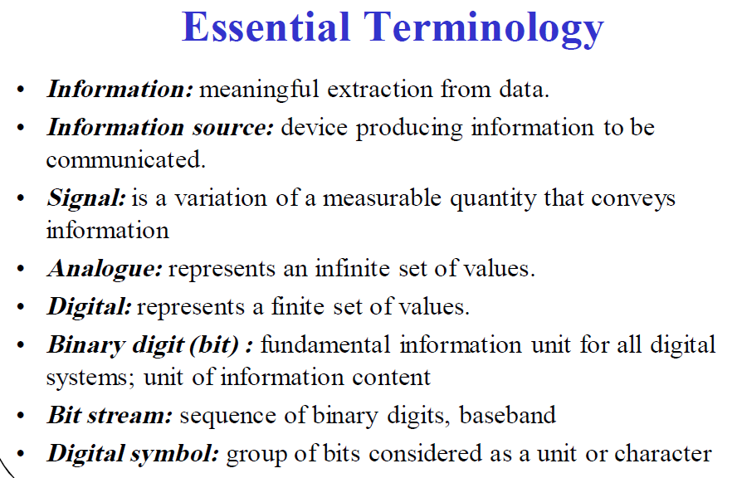

Slide 3
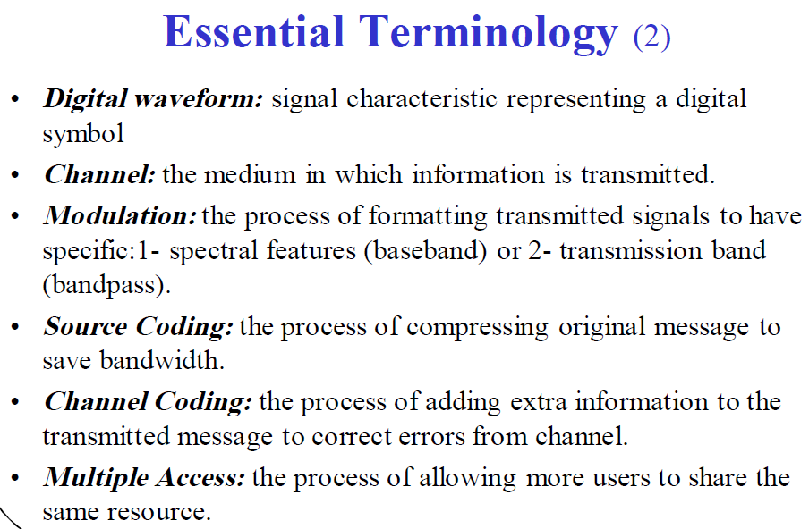

Slide 4
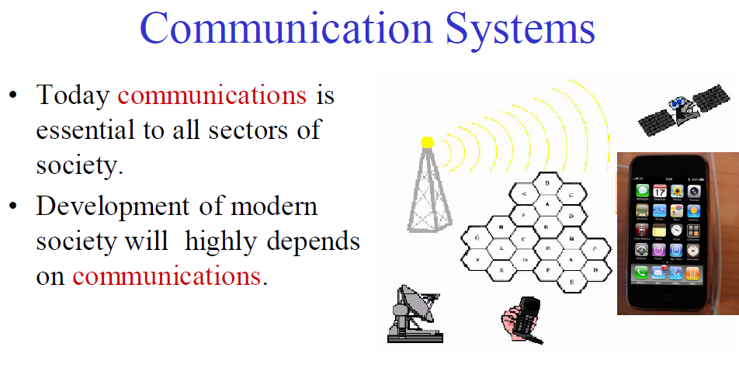

Slide 5
Communication Systems
Basic concepts
    Sources (information inputs)
    voice (audio), text, image/video and data
    Signals
    Analogue signals, Digital signals
    Noises
    Thermal noise, man-made noise, atmospheric noise, etc
    Sinks (information output devices)
    Computer screens, speakers, TV screens, etc

Slide 6
Communication Systems
  Basic components
    Transmitter
      Convert Source (information) to signals
      Send converted signals to the channel (by antenna if applicable)
    Channel
      Wireless: atmosphere (free space)
      Wired: coaxial cables, twisted wires, optical fibre
    Receiver
      Reconvert received signals to original information
      Output the original information
Signal
Processing
Carrier
Circuits
Transmission Medium
Carrier Circuits
Signal
Processing
m(t)
s(t)
r(t)
TRANSMITTER
CHANNEL
RECEIVER

Slide 7
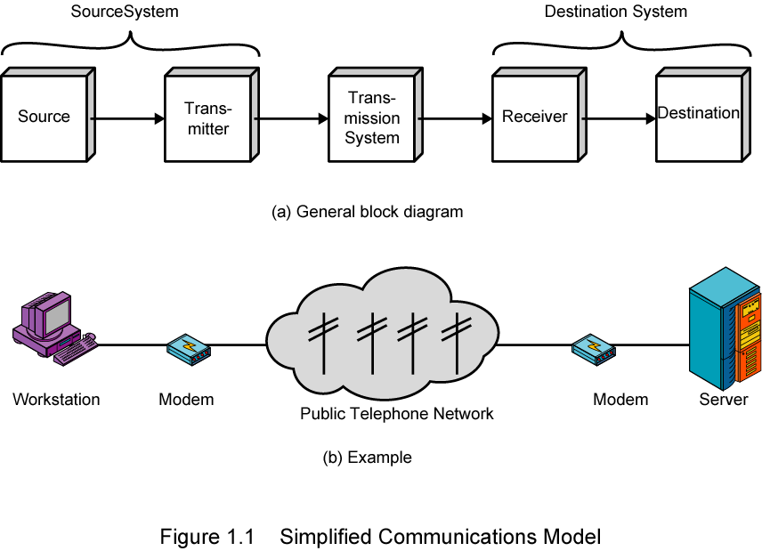
A Communications Model
Source - generates data to be transmitted, examples are telephones and computers
Transmitter - converts data into transmittable signals
Transmission System - carries data from source to destination
Receiver - converts received signal into data
Destination - takes incoming data

Slide 8
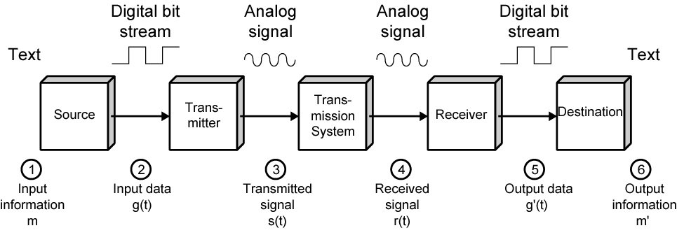
Data Communications Model
user keys in message m comprising bits g buffered in source PC memory
input data is transferred to I/O device (transmitter) as sequence of bits g(t) using voltage shifts
transmitter converts these into a signal s(t) suitable for transmission media being used
whilst transiting media signal may be impaired so received signal r(t) may differ from s(t)
receiver decodes signal recovering g’(t) as estimate of original g(t)
which is buffered in destination PC memory as bits g’ being the received message m’

Slide 9
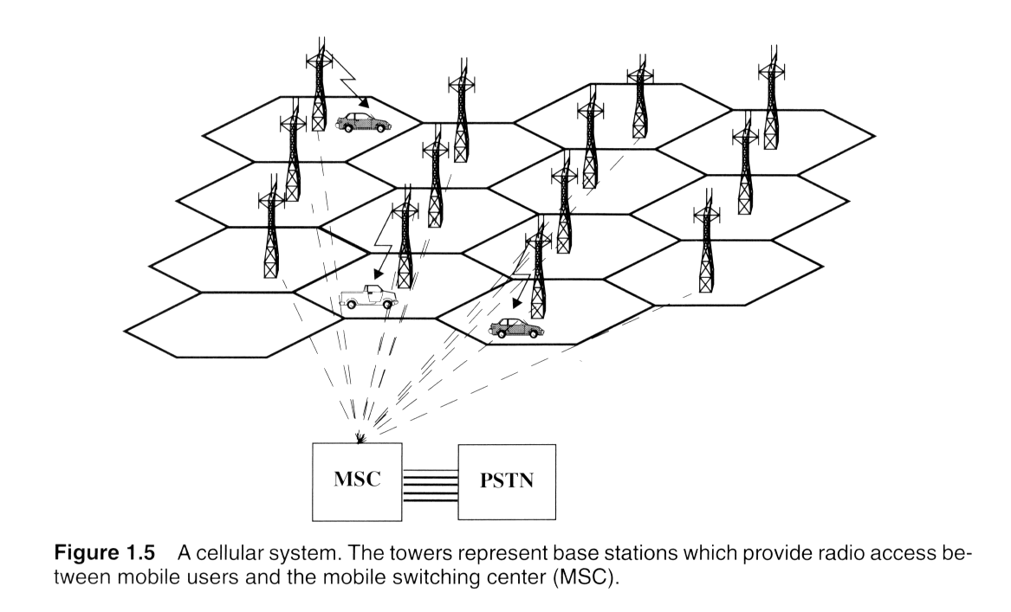
Cellular telephone system
The cellular mobile telephone system consists of:
Mobile Stations (MS), Base Stations (BS) and Mobile Switching Center
(MSC), connected to the Public Switching Telephone Network (PSTN)

Slide 10
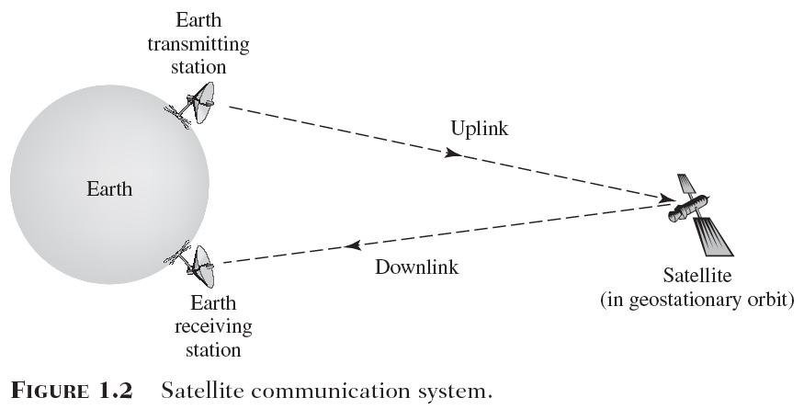
Satellite Communication system
The information-bearing signal is transmitted from the earth terminal to the satellite via the uplink, amplified by the transponder (electronic circuitry on board of the satellite), and then retransmitted from the satellite via the downlink to the other earth terminal

Slide 11
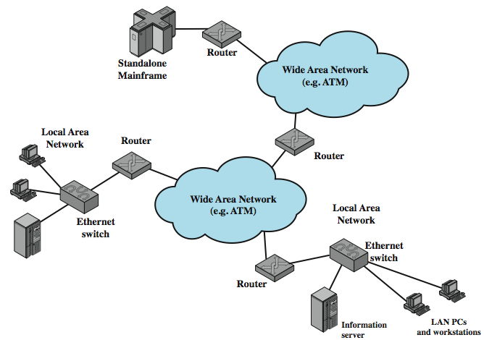
Computer Networks and the Internet
This figure illustrates the key elements that comprise the Internet, whose purpose is to interconnect end systems, called hosts; including PCs, workstations, servers, mainframes, and so on. Most hosts that use the Internet are connected to a network, such as a local area network (LAN) or a wide area network (WAN). These networks are in turn connected by routers.

Slide 12
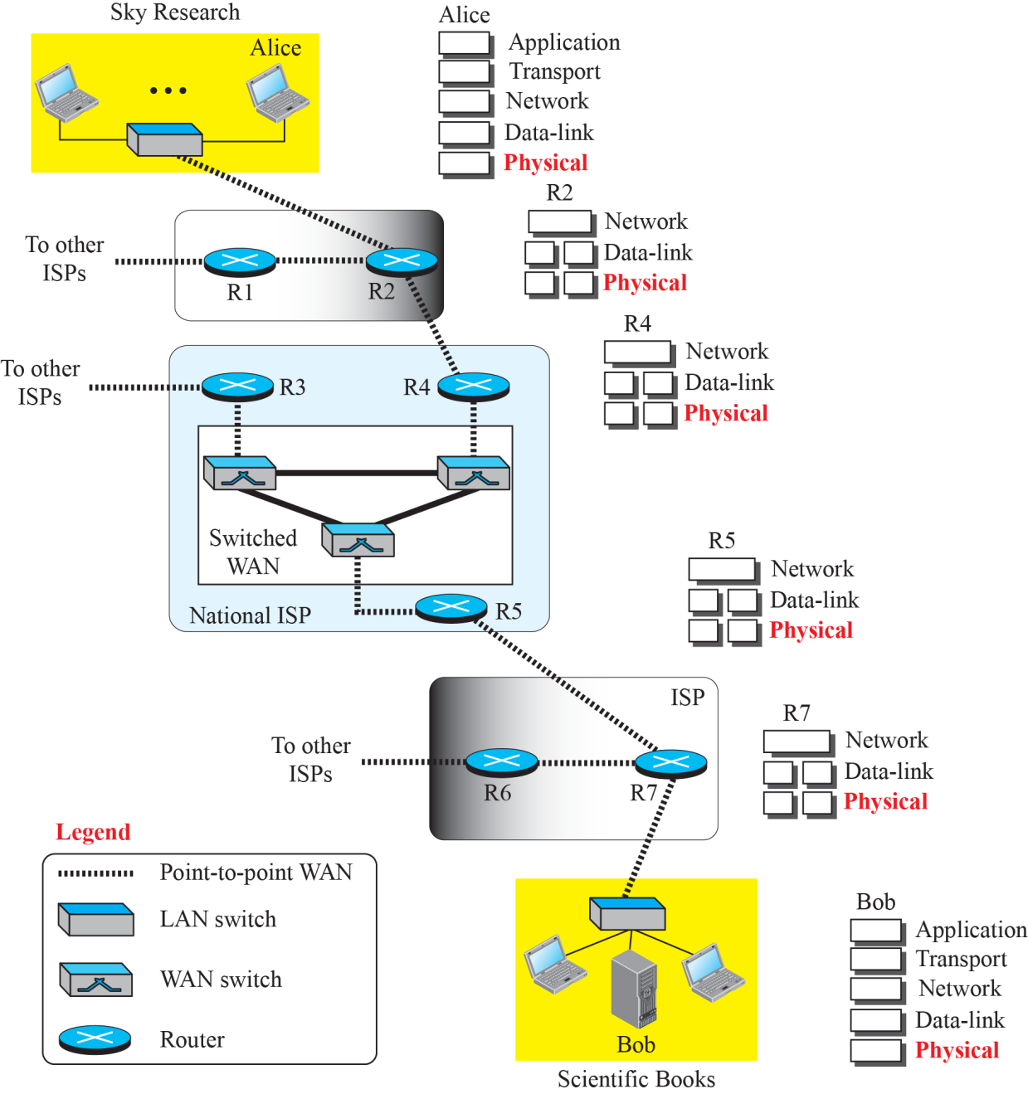
Communication at the physical layer
Figure shows a scenario in which a scientist working in a research company, Sky Research, needs to order a book related to her research from an online bookseller, Scientific Books.

Slide 13
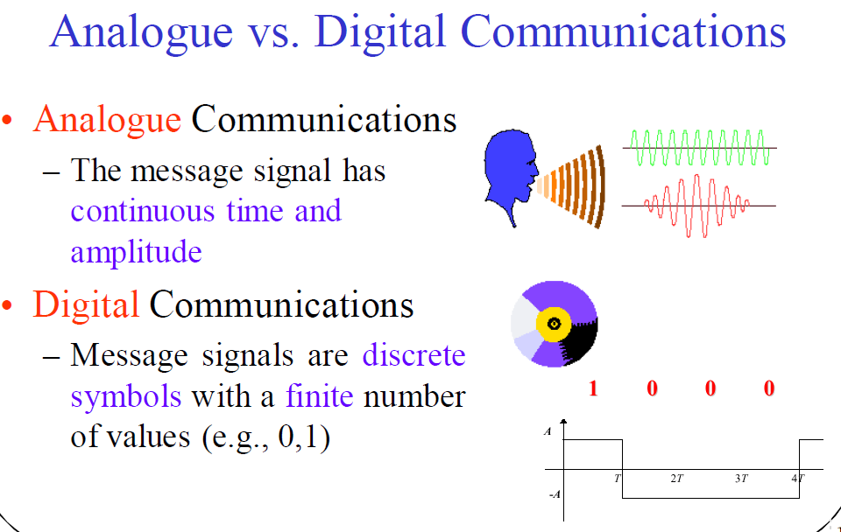

Slide 14
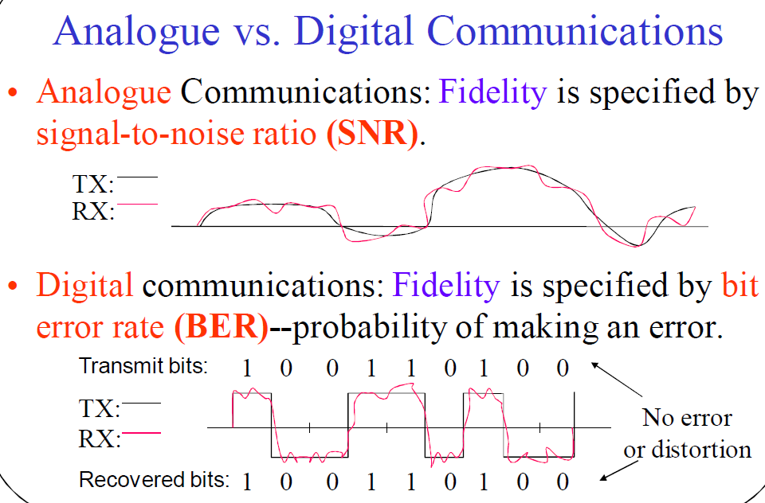

Slide 15
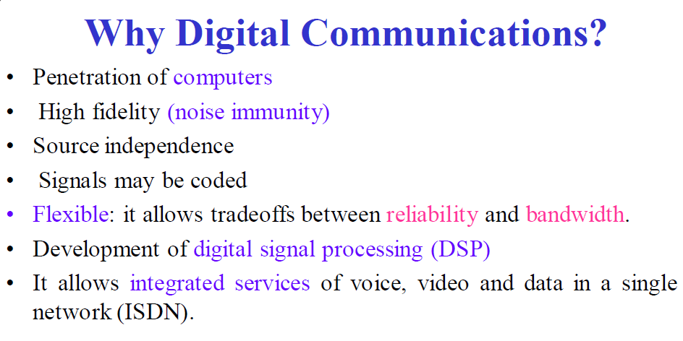

Slide 16
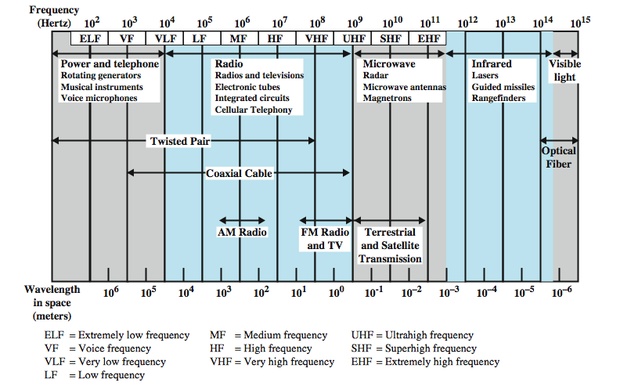
  Frequencies for communication
λ = c/f , wave length λ, speed of light c ≅ 3x10⁸m/s, frequency f

Slide 17
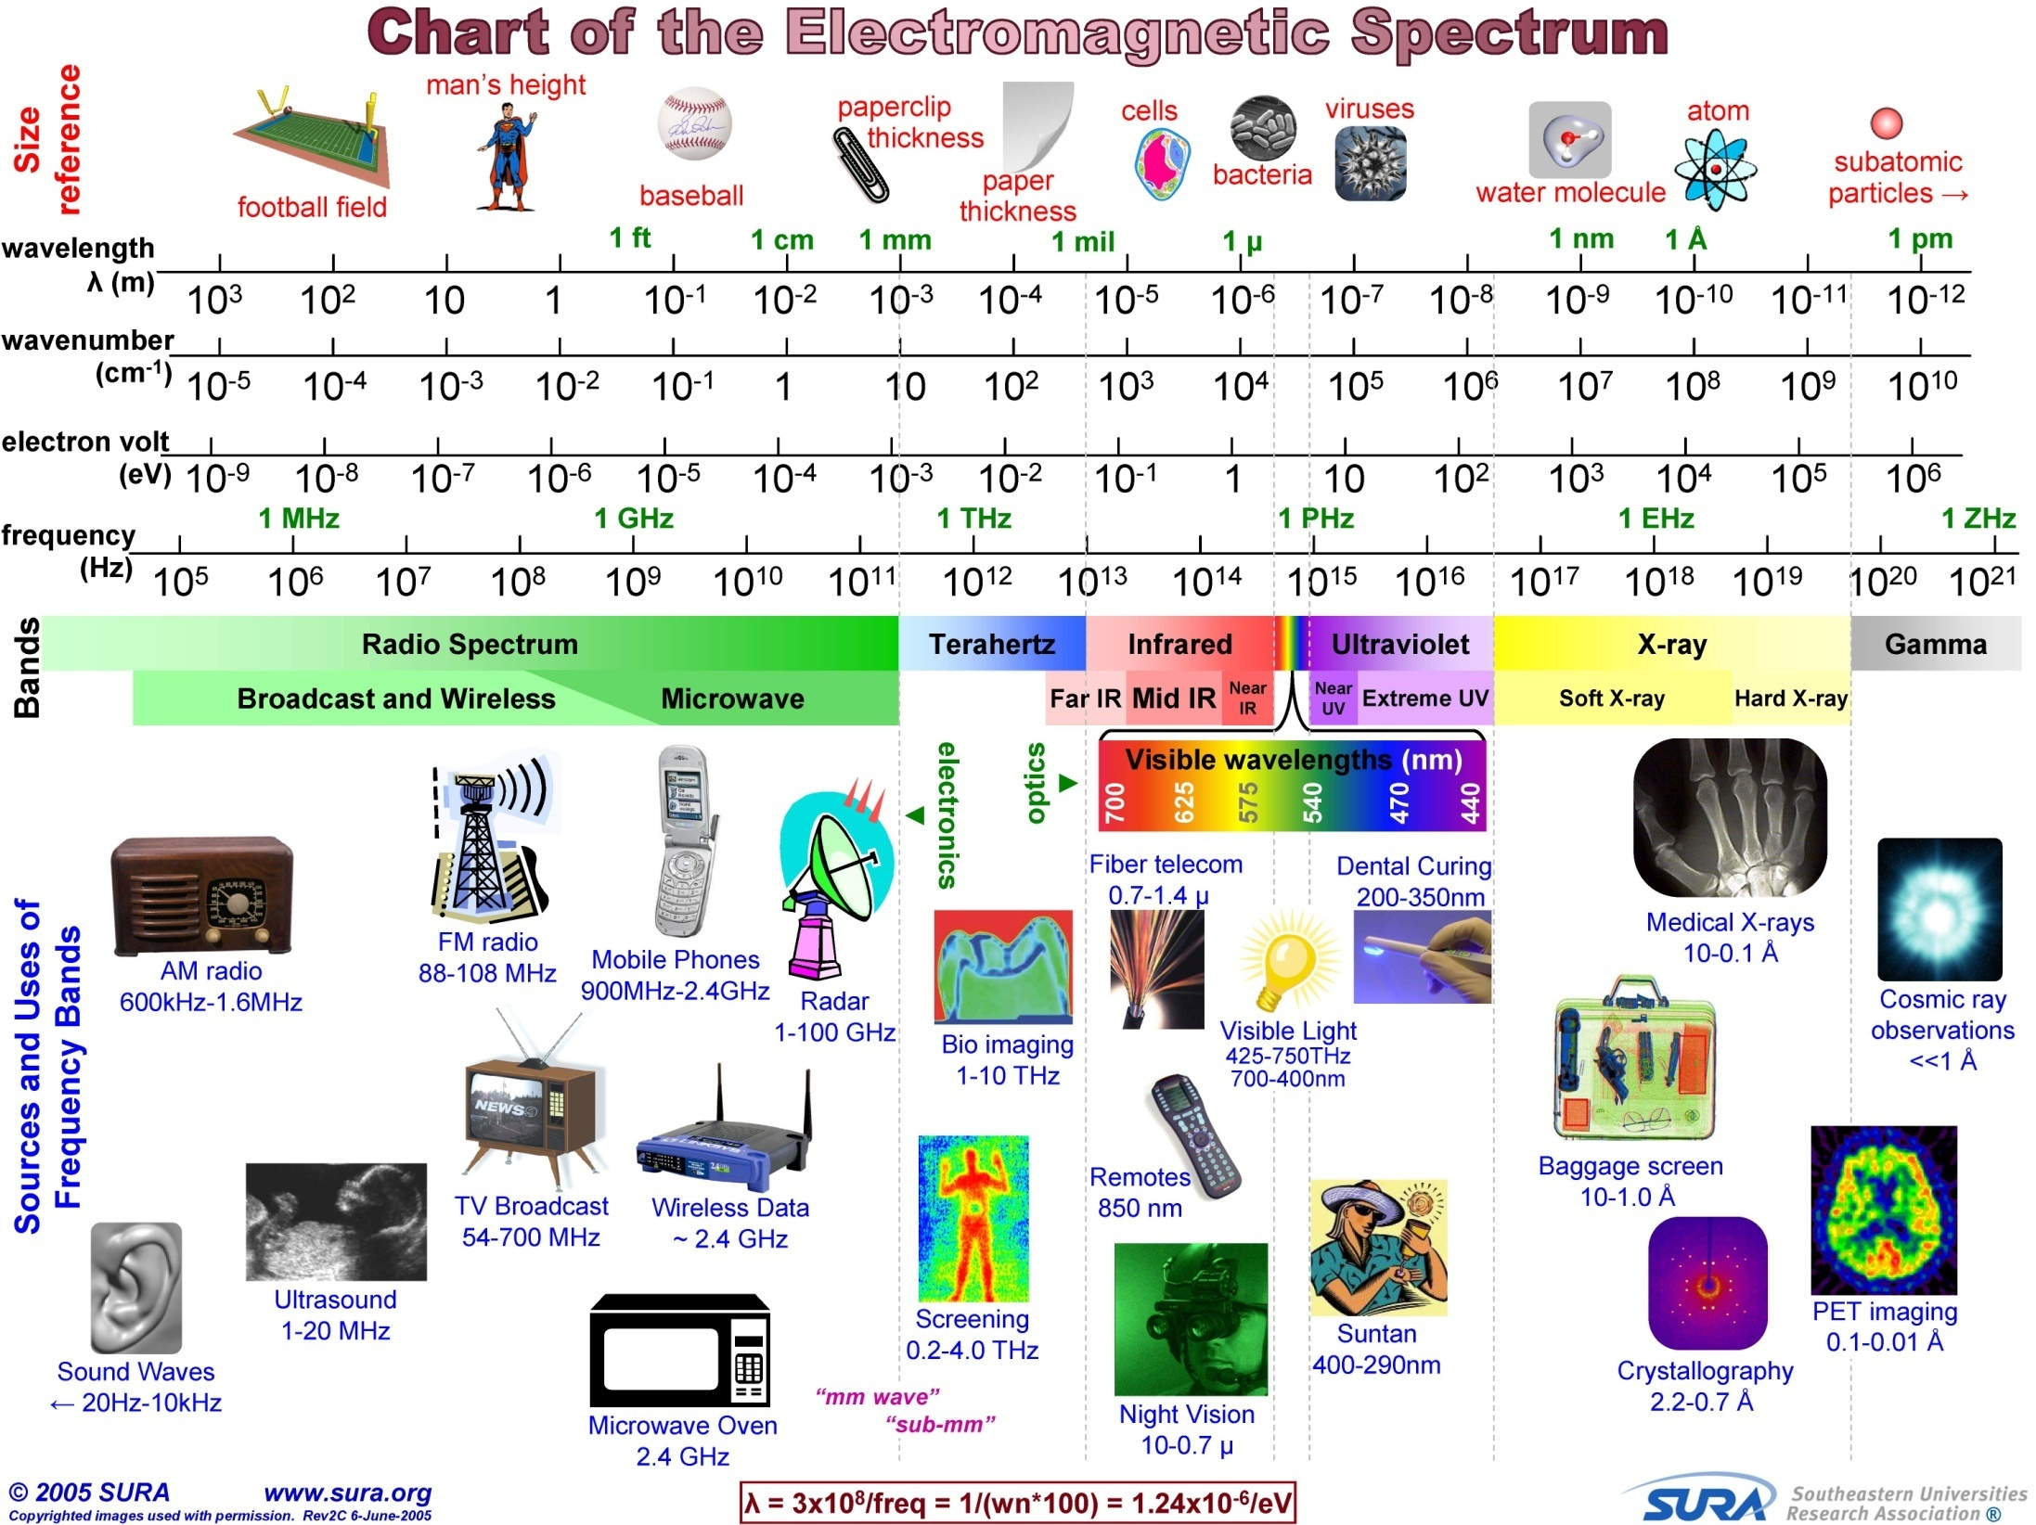

Slide 18
Electromagnetic Spectrum
Band | Frequency range | Propagation characteristics | Typical use
ELF (extremely low frequency) | 30 to 300 Hz | Ground Wave (GW) propagation | Power line frequencies
VF (voice frequency) | 300 to 3000 Hz | GW propagation | Used by the telephone system for analog subscriber lines
VLF (very low frequency) | 3 to 30 kHz | GW propagation | Long-range navigation; submarine communication
LF (low frequency) | 30 to 300 kHz | GW propagation | Long-range navigation; marine communication
MF (medium frequency) | 300 to 3000 kHz | Sky-Wave (SW) ionospheric propagation | AM broadcasting
HF (high frequency) | 3 to 30 MHz | SW ionospheric propagation | international broadcasting, military communication; long- distance aircraft and ship communication

Slide 19
Electromagnetic Spectrum
Band | Frequency range | Propagation characteristics | Typical use
VHF (very high frequency) | 30 to 300 MHz | SW ionospheric and tropospheric propagation; Line-Of-Sight (LOS) Propagation | VHF television; FM broadcast AM aircraft communication; Aircraft navigational aids
UHF (ultra high frequency) | 300 to 3000 MHz | LOS Propagation | UHF television; cellular telephone; radar; microwave links; personal communications systems
SHF (super high frequency) | 3 to 30 GHz | LOS Propagation | Satellite communication; radar; terrestrial microwave links; wireless local loop
EHF (extremely high frequency) | 30 to 300 GHz | LOS Propagation | Experimental; wireless local loop
Infrared | 300 GHz to 400 THz | LOS Propagation | Infrared LANs; consumer electronic applications
Visible light | 400 THz to 900 THz | LOS Propagation | Optical communication

Slide 20
Further reading :-
اساسيات الاتصالات :- مقدمة فى الاتصالات ، ص11-18

